Slide 1
Chapter-5 (Lesson-2)
International Trade Theory

Slide 2
Lesson Learning Objectives
After reading this lesson the students will be able to;
Be familiar with the arguments of those who maintain that government can play a proactive role in promoting national competitive advantage in certain industries.
Understand the important implications that international trade theory holds for business practice.
Notes:
LO2: Summarize the different theories explaining trade flows between nations.

Slide 3
Lesson contents
What is new trade theory?
The implications of new trade theory for nations
Porter’s diamond of competitive advantage?
Does porter’s theory hold?
What are the implications of trade theory for managers?
What is the balance of payments?
Notes:
LO2: Summarize the different theories explaining trade flows between nations.

Slide 4
What Is New Trade Theory?
New trade theory suggests that the ability of firms to gain economies of scale (unit cost reductions associated with a large scale of output) can have important implications for international trade
Countries may specialize in the production and export of particular products because in certain industries, the world market can only support a limited number of firms
new trade theory emerged in the 1980s
Paul Krugman won the Nobel prize for his work in 2008
Notes:
LO2: Summarize the different theories explaining trade flows between nations.

Slide 5
What Is New Trade Theory?
During the 1980s economists such as Nobel Prize winner Paul Krugman developed what has come to be known as the new trade theory, for which Krugman won the Nobel Prize in 2008.
This theory tries to explain why trade is growing fastest between industrial countries
With similar economies of scale and endowments of the factors of production (intra-regional trade)
Trading similar goods (intra-industry trade)
Notes:
LO2: Summarize the different theories explaining trade flows between nations.

Slide 6
What Is New Trade Theory?
New trade theory makes two important points:
First, through its impact on economies of scale, trade can increase the variety of good available to consumers and decrease the average costs of those goods.
Second, in those industries when the output required to attain economies of scale represents a significant proportion of total world demand, the global market may only be able to support a small number of enterprises. Thus, world trade in certain products may be dominated by countries whose firms were first movers in their production.
Notes:
LO2: Summarize the different theories explaining trade flows between nations.

Slide 7
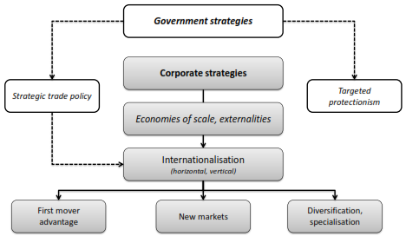
What Is New Trade Theory?
Notes:
LO2: Summarize the different theories explaining trade flows between nations.

Slide 8
The Implications Of New Trade Theory For Nations
Nations may benefit from trade even when they do not differ in resource endowments or technology
a country may dominate in the export of a good simply because it was lucky enough to have one or more firms among the first to produce that good
Governments should consider strategic trade policies that nurture and protect firms and industries where first mover advantages and economies of scale are important.

Slide 9
Porter’s Diamond Of Competitive Advantage?
Michael Porter (1990) tried to explain why a nation achieves international success in a particular industry
Porter identified four attributes that promote or impede the creation of competitive advantage
Factor endowments
Demand conditions
Relating and supporting industries
Firm strategy, structure, and rivalry
Notes:
LO2: Summarize the different theories explaining trade flows between nations.

Slide 10
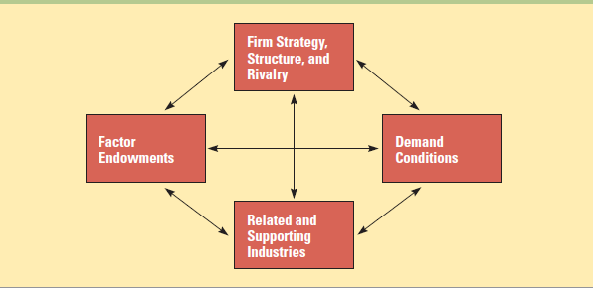
Porter’s Diamond Of Competitive Advantage?
Determinants of National Competitive Advantage: Porter’s Diamond

Slide 11
Does Porter’s Theory Hold?
Government policy can
affect demand through product standards
influence rivalry through regulation and antitrust laws
impact the availability of highly educated workers and advanced transportation infrastructure.
The four attributes, government policy, and chance work as a reinforcing system, complementing each other and in combination creating the conditions appropriate for competitive advantage
So far, Porter’s theory has not been sufficiently tested to know how well it holds up
Notes:
LO4: Explain the arguments of those who maintain that government can play a proactive role in promoting national competitive advantage in certain industries.

Slide 12
What Are The Implications Of Trade Theory For Managers?
Location implications - a firm should disperse its various productive activities to those countries where they can be performed most efficiently
First-mover implications - a first-mover advantage can help a firm dominate global trade in that product
Policy implications - firms should work to encourage governmental policies that support free trade
Notes:
LO5: Understand the important implications that international trade theory holds for business practice.

Slide 13
What Is The Balance Of Payments?
A country’s balance of payments accounts keep track of the payments to and receipts from other countries for a particular time period
The current account records transactions of goods, services, and income, receipts and payments
current account deficit
current account surplus
The capital account records one time changes in the stock of assets
The financial account records transactions that involve the purchase or sale of assets

Slide 14
Any Question?????
Thank you for you nice cooperation

