Slide 1

SE 234: Theory of Computation
SE 234: Lecture 2.1
Fatama Binta Rafiq (FBR)
Lecturer, Department of Software Engineering

Slide 2
Deterministic Finite Automaton (DFA)
In DFA, for each input symbol, one can determine the state to which the machine will move. Hence, it is called Deterministic Automaton. As it has a finite number of states, the machine is called Deterministic Finite Machine or Deterministic Finite Automaton.
Formal Definition of a DFA
A DFA can be represented by a 5-tuple (Q, ∑, δ, q₀, F) where −
Q is a finite set of states.
∑ is a finite set of symbols called the alphabet.
δ is the transition function where δ: Q × ∑ → Q
q₀ is the initial state from where any input is processed (q₀ ∈ Q).
F is a set of final state/states of Q (F ⊆ Q).

Slide 3
Graphical Representation of a DFA
A DFA is represented by digraphs called state diagram.
The vertices represent the states.
The arcs labeled with an input alphabet show the transitions.
The initial state is denoted by an empty single incoming arc.
The final state is indicated by double circles.

Slide 4
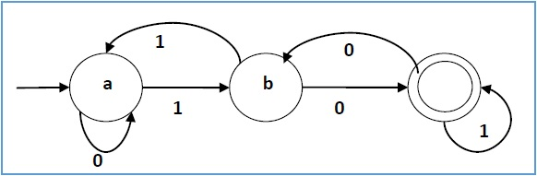
Example:
Let a deterministic finite automaton be →
Q = {a, b, c},
∑ = {0, 1},
q₀ = a,
F = {c}, and
Transition function δ as shown by the following table −
Its graphical representation would be as follows −
Present State | Next State for Input 0 | Next State for Input 1
→ a | a | b
b | c | a
*c | b | c

Slide 5
Non-deterministic Finite Automaton (NFA)
In NDFA, for a particular input symbol, the machine can move to any combination of the states in the machine. In other words, the exact state to which the machine moves cannot be determined. Hence, it is called Non-deterministic Automaton. As it has finite number of states, the machine is called Non-deterministic Finite Machine or Non-deterministic Finite Automaton.
Formal Definition of an NDFA
An NDFA can be represented by a 5-tuple (Q, ∑, δ, q₀, F) where −
Q is a finite set of states.
∑ is a finite set of symbols called the alphabets.
δ is the transition function where δ: Q × ∑ → 2^{Q}
(Here the power set of Q (2^{Q}) has been taken because in case of NDFA, from a state, transition can occur to any combination of Q states)
q₀ is the initial state from where any input is processed (q₀ ∈ Q).
F is a set of final state/states of Q (F ⊆ Q).

Slide 6
Graphical Representation of an NDFA: (same as DFA)
An NDFA is represented by digraphs called state diagram.
The vertices represent the states.
The arcs labeled with an input alphabet show the transitions.
The initial state is denoted by an empty single incoming arc.
The final state is indicated by double circles.

Slide 7
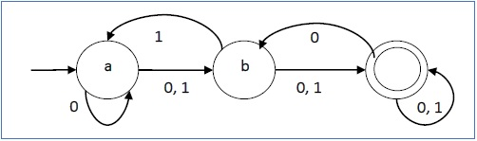
Example:
Let a non-deterministic finite automaton be →
Q = {a, b, c}
∑ = {0, 1}
q₀ = a
F = {c}
The transition function δ as shown below −
Its graphical representation would be as follows −
Present State | Next State for Input 0 | Next State for Input 1
→a | {a, b} | {b}
b | {c} | {a, c}
*c | {b, c} | {c}

Slide 8
DFA vs NDFA
The following table lists the differences between DFA and NDFA.
DFA | NDFA
The transition from a state is to a single particular next state for each input symbol. Hence it is called deterministic. | The transition from a state can be to multiple next states for each input symbol. Hence it is called non-deterministic.
Empty string transitions are not seen in DFA. | NDFA permits empty string transitions.
Backtracking is allowed in DFA | In NDFA, backtracking is not always possible.
Requires more space. | Requires less space.
A string is accepted by a DFA, if it transits to a final state. | A string is accepted by a NDFA, if at least one of all possible transitions ends in a final state.

Slide 9
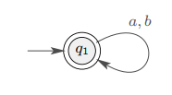
String Acceptance
Upon scanning an entire string, if we can reach at final state the string is called accepted.
Language Acceptance
If all the strings present in the language which are accepted and all the strings not present in the language should be rejected that is called language acceptance.

Slide 10
DFA Computation:
Basic idea how a finite automaton works:
It is presented an input string w over an alphabet Σ; i.e., w ∈ Σ*.
It reads in the symbols of w from left to right, one at a time. After reading the last symbol, it indicates if it accepts or rejects the string.
These machines are useful for string matching, compilers, etc.

Slide 11
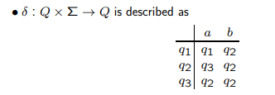
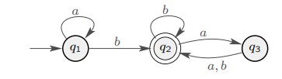
Example:
DFA with alphabet Σ = {a, b}:
• q1, q2, q3 are the states.
• q1 is the start state as it has an arrow coming into it from nowhere.
• q2 is an accept state as it is drawn with a double circle.
Edges tell how to move when in a state and a symbol from Σ is read.
• DFA is fed input string w ∈ Σ∗. After reading last symbol of w, if DFA is in an accept state, then string is accepted otherwise, it is rejected.

Slide 12

Example Cont.
Process the following strings over Σ = {a, b} on above machine:

Slide 13
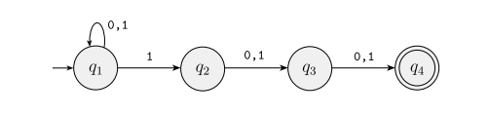
NFA Computation
 | 0 | 1
→q1 | {q1} | {q1, q2}
q2 | {q3} | {q3}
q3 | {q4} | {q4}
*q4 | {} | {}

Slide 14
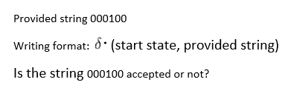
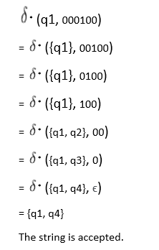

 | 0 | 1
q1 | {q1} | {q1, q2}
q2 | {q3} | {q3}
q3 | {q4} | {q4}
q4 | {} | {}

Slide 15

End of Slides

