Slide 1
SE 234: Theory of Computation Pushdown Automata
SE 234: Lecture 4
Fatama Binta Rafiq (FBR)
Lecturer, Department of Software Engineering

Slide 2
Basic Structure of PDA
A pushdown automaton is a way to implement a context-free grammar in a similar way we design DFA for a regular grammar. A DFA can remember a finite amount of information, but a PDA can remember an infinite amount of information.
Basically a pushdown automaton is −
"Finite state machine" + "a stack"
A pushdown automaton has three components −
an input tape,
a control unit, and
a stack with infinite size.

Slide 3
Cont.
The stack head scans the top symbol of the stack.
A stack does two operations −
Push − a new symbol is added at the top.
Pop − the top symbol is read and removed.
A PDA may or may not read an input symbol, but it has to read the top of the stack in every transition.

Slide 4
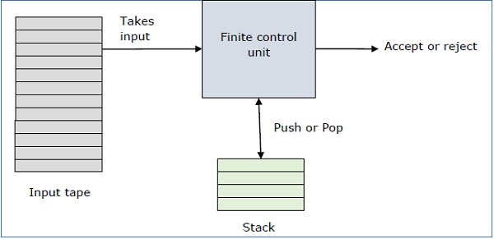

Slide 5
Formal Definition
A PDA can be formally described as a 7-tuple (Q, ∑, S, δ, q₀, I, F) −
Q is the finite number of states
∑ is input alphabet
S is stack symbols
δ is the transition function: Q × (∑ ∪ {ε}) × S × Q × S*
q₀ is the initial state (q₀ ∈ Q)
I is the initial stack top symbol (I ∈ S)
F is a set of accepting states (F ∈ Q)

Slide 6
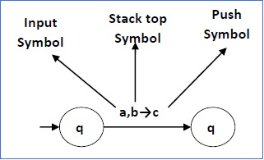
Transition Function
The following diagram shows a transition in a PDA from a state q₁ to state q₂, labeled as a,b → c −
This means at state q₁, if we encounter an input string ‘a’ and top symbol of the stack is ‘b’, then we pop ‘b’, push ‘c’ on top of the stack and move to state q₂.

Slide 7
PDA Construction
Deterministic Push Down Automata for a^n b^n; n>=1
First we have to count number of a's and that number should be equal to number of b's.
That we will achieve by pushing a's in STACK and then we will pop a's whenever "b" comes.
So in the end of the strings if nothing is left in the STACK then we can say that language is accepted in the PDA.

Slide 8
PDA for a^nb^n aabb ab
b, a/ epsilon
Transition Function:
δ(q0, a, Z) = (q0, aZ)
δ(q0, a, a) = (q0, aa)
δ(q0, b, a) = (q1, ε)
δ(q1, b, a) = (q1, ε)
δ(q1, ε, Z) = (qf, Z)

Slide 9
Lets see, how this DPDA is working: We will take one input string: "aabb"
Scan string from left to right
First input is 'a' and follow the rule:
on input 'a' and STACK alphabet Z, push the input 'a' into STACK as : (a,Z/aZ) and state will be q0
Second input is 'a' and so follow the rule:
on input 'a' and STACK alphabet 'a', push the input 'a' into STACK as : (a,a/aa) and state will be q0
Third input is 'b' and so follow the rule:
on input 'b' and STACK alphabet 'a', pop STACK with one 'a' as : (b,a/&epsiloon;) and state will be now q1
Fourth input is 'b' and so follow the rule:
on input 'b' and STACK alphabet 'a' and state is q1, pop STACK with one 'a' as : (b,a/&epsiloon;) and state will be q1
We reached end of the string, so follow the rule:
on input ε and STACK alphabet Z, go to final state(qf) as : (ε, Z/Z)

Slide 10
DPDA for anb2n n ≥ 1
For every two a's push two a's into STACK cause there are two b's for one 'a'
So by pushing two 'a' we can have 'a' for every 'b'.
That we will achieve by pushing two a's and poping a's for every b
And then pushing c's and poping c's for every d's
So in the end of the strings if nothing is left in the STACK then we can say that language is accepted in the PDA.

Slide 11
DPDA for anb2n n ≥ 1
Transition Function:
δ(q0, a, Z) = (q0, aaZ)
δ(q0, a, a) = (q0, aaa)
δ(q0, b, a) = (q1, ε)
δ(q1, b, a) = (q1, ε)
δ(q1, ε, Z) = (qf, Z)

Slide 12
Lets see, how this DPDA is working: We will take one input string: "aabbbb"
Scan string from left to right
First input is 'a' and follow the rule:
on input 'a' and STACK alphabet Z, push the two 'a's into STACK as : (a,Z/aaZ) and state will be q0
Second input is 'a' and so follow the rule:
on input 'a' and STACK alphabet 'a', push the two 'a's into STACK as : (a,a/aaa) and state will be q0
Now the STACK has "aaaa", So:
Third input is 'b' and so follow the rule:
on input 'b' and STACK alphabet 'a', pop one 'a' from STACK as : (b,a/ε) and state will be q1
Fourth input is 'b' and so follow the rule:
on input 'b' and STACK alphabet 'a' and state q1, pop one 'a' from STACK as : (b,a/ε) and state will remain q1
Fifth input is 'b' and so follow the rule:
on input 'b' and STACK alphabet 'a', pop one 'a' from STACK as : (b,a/ε) and state will be q1
Sixth input is 'b' and so follow the rule:
on input 'b' and STACK alphabet 'a' and state q1, pop one 'a' from STACK as : (b,a/ε) and state will remain q1
We reached end of the string, so follow the rule:
on input ε and STACK alphabet Z, go to final state(qf) as : (ε, Z/Z)

Slide 13
DPDA for number of a(w) = number of b(w)
Here approach is little bit different than previous example.
Let either 'a' or 'b' push in STACK. That means if 'a' comes first let it push.
After 'a' if again 'a' comes then let push it.
If 'b' comes first, push it in STACK ('a' did not come yet)
If again 'b' comes then push it in STACK.
Now if 'a' is present in top of STACK and 'b' comes then, pop 'a'
Similarily if 'b' is present in top of STACK and 'a' comes then, pop 'b'
So in the end of the strings if nothing is left in the STACK then we can say that CFL is accepted in the PDA.

Slide 14
DPDA for number of a(w) = number of b(w)
Transition Function:
δ(q0, a, Z) = (q0, aZ)
δ(q0, a, a) = (q0, aa)
δ(q0, b, Z) = (q0, bZ)
δ(q0, b, b) = (q0, bb)
δ(q0, b, a) = (q0, ε)
δ(q0, a, b) = (q0, ε)
δ(q0, ε, Z) = (qf, Z)

Slide 15
DPDA for a^nb^nc^md^m n,m≥1
Just see the given problem in another perspective.
Number of a's are equal to number of b's
And number of c's are equal to number of d's
That we will achieve by pushing a's and poping a's for every b
And then pushing c's and poping c's for every d's
So in the end of the strings if nothing is left in the STACK then we can say that language is accepted in the PDA.

Slide 16
DPDA for anbncmdm n,m≥1
Transition Function:
δ(q0, a, Z) = (q0, aZ)
δ(q0, a, a) = (q0, aa)
δ(q0, b, a) = (q1, ε)
δ(q1, b, a) = (q1, ε)
δ(q1, c, Z) = (q2, cZ)
δ(q2, c, c) = (q2, cc)
δ(q2, d, c) = (q3, ε)
δ(q3, d, c) = (q3, ε)
δ(q1, ε, Z) = (qf, Z)

