Slide 1
Turing Machine
By Fatama Binta Rafiq

Slide 2
Definition
A Turing machine (TM) is an abstract computational model that performs computations by reading and writing to an infinite tape.
It is a mathematical model which consists of an infinite length tape divided into cells on which input is given.

Slide 3

Fundamental Concepts of Working
It consists of a head which reads the input tape. A state register stores the state of the Turing machine.
After reading an input symbol, it is replaced with another symbol, its internal state is changed, and it moves from one cell to the right or left.
If the TM reaches the final state, the input string is accepted, otherwise rejected.

Slide 4
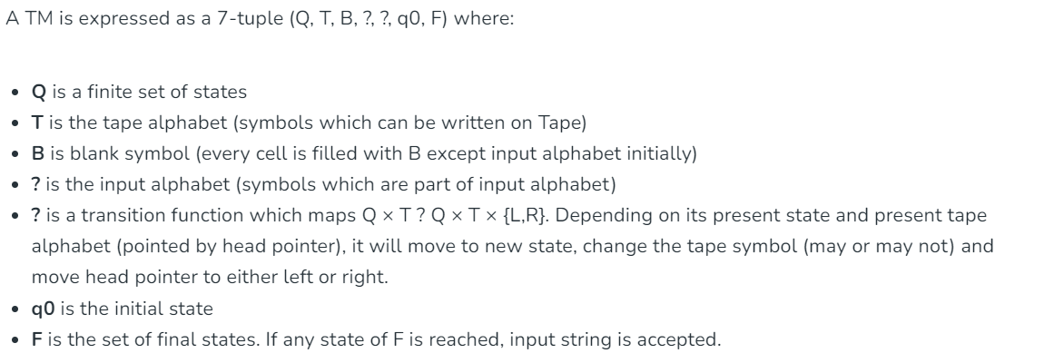
Formal Definition

Slide 5
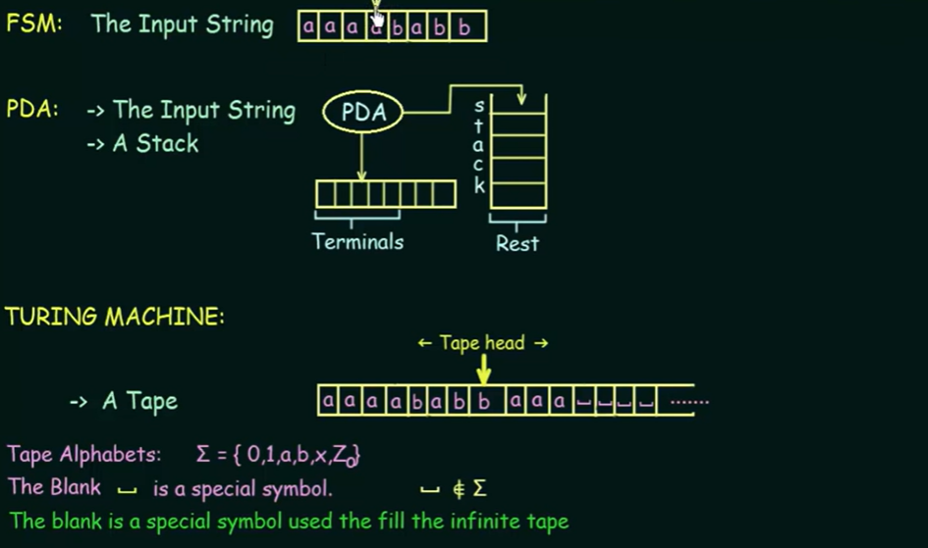

Slide 6
