Slide 1
Importance of raw cotton
a. Raw materials represents about 50-75% of the manufacturing cost of a short-staple yarn. This fact alone is sufficient to indicate the significance of the raw material for the yarn producer.
b. Raw material accounts for about 80% to 90% of the yarn quality.

Slide 2
Some Brand name of cotton
Brand name Country
Pima USA
Arizona USA
SJV USA
Elena CIS
Parvee CIS
Ronda CIS
Brand name Country
Raja CIS
Giza Egypt
Andy Australia
Suvin India
Delta Bangladesh
Barakat Sudan

Slide 3
CIS
Commonwealth of Independent states (CIS) is the international organization or alliance consisting of eleven former soviet republics Armenia, Azerbaijan, Belarus, Georgia, Kazakhstan, Kyrgyzstan, Moldova, Russia, Tajikistan, Ukraine & Uzbekistan.

Slide 4
Cotton fibers characteristics consider for spinning process
1. Length
2. Strength
3. Fineness
4. Maturity
5. Cleanliness
6. Color
7. Elongation

Slide 5
Elongation
It is a very important for spinning. Without this fiber could not be spined. Elongation of cotton 6-10%
Elongation is a measurement of the elastic behavior of the fibers in the bundle. The fibers clamped on the bundle with a 1/8 inch distance between the clamps. The first pair of clamps stationary & the back pair of clamps is pulled away at a constant rate. The distance the fibers extend before they break is recorded & expressed as percent elongation.

Slide 6
Principle of elongation measurement
                Stationery (Fixed)
                1/8 inch
                Moveable (moves a constant rate)
Upper Clamp
Fibre Bundle
Lower Clamp

Slide 7
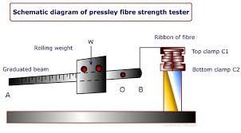

Slide 8
A table describing ranges of actual elongation values in cotton fibers:
Elongation Description
Less than 5.0 Very low
5.0 to 5.8 Low
5.9 to 6.7 Medium
6.8 to 7.6 High
7.7 & higher Very high

Slide 9
Color
Color: The color of cotton is determined by the degree of reflectance (Rd) and yellowness (+b) in the HVI instrument
Reflectance (Rd):
This value expresses the whiteness of the light that is reflected by the cotton fibers.
Yellowness (+b):
This value expresses the Yellowness of the light that is reflected by the cotton fibers.

Slide 10
Importance of color
As the color of cotton deteriorates due to environmental conditions, the probability for reduced processing efficiency is increased. Color deterioration also affects the ability of fibers to absorb & hold dyes & finishes.

Slide 11
Cotton fibre whiteness grading
There are five grading of whiteness (Reflectance-Rd) of cotton fibre
  White
  Light Spotted
  Spotted
  Tinged
  Yellow stained

Slide 12
Cotton fibre yellowness (+b) grading
There are seven (7) grading of yellowness (+b) of cotton fibre –
Grade Symbol
Good Middling GM
Strict Middling SM
Middling M
Strict Low Middling SLM
Low Middling LM
Strict Good ordinary SGO
Good ordinary GO

Slide 13
Cotton color code
HVI (High Volume Instrument) color grades for American Upland cotton examples are 11, 12, 13,21, 22, 23, 31,32 , 33 etc.
Color Code=
e.g. 11, 21, 53 etc.
+b Grade
Rd Grade

Slide 14
Cleanliness & trash content
Generally many types of foreign matter may contain in cotton stock
Vegetable matter
1. Husk portion
2. Seed fragments
3. Stem fragments
4. Leaf fragments
5. Wood fragments
Mineral matter
Soil
Sand
Dust
Other foreign matters
Metal fragments
Cloth fragments
Packing fragments (mostly polymer)

Slide 15
Causes of presence of trashes in cotton
As spinning process is sensitive to impurities so the fiber should be maintained clean as far as possible. The reason for fiber containing such foreign matters are:
Modern high performance plucking system
Hard ginning, cleaning & pre-drying.
Careless handling during transportation & packing.

Slide 16
Problem due to unclean fiber
Metal parts cut the fibers & harmful to spinning machine.
Vegetable matter makes disturbance in drafting.
Vegetable matter jam the carding pin carding machine
Mineral matter decays the rolling parts of machine.

Slide 17
Cotton grading on the basis of trash content
The scale below represents the degree of contamination:
Amount of trash Grade
Up to 1.2% Very clean
1.2% – 2.0% Clean
2.0 % - 4.0 % Medium
4.0 % - 7.0 % Dirty
7.0% - Above Very dirty

Slide 18
Fineness
Fineness is one of the most important fiber characteristics. It determines how many fibers are present in the X-section of a yarn of given thickness.
Micronaire Value of cotton:
The average weight of one inch length of fiber, expressed in micrograms (0.000001g), is called micronaire value of cotton and it is defined by ASTM (American Society for Testing and Materials)

Slide 19
Cotton grading on the basis of fineness
The fineness scale is as follows:
Mic-value Fineness
Up to 3.1 Very fine
3.1 to 3.9 Fine
4.0 to 4.9 Medium
5.0 to 5.9 Slightly Coarse
Above 6 Coarse

Slide 20
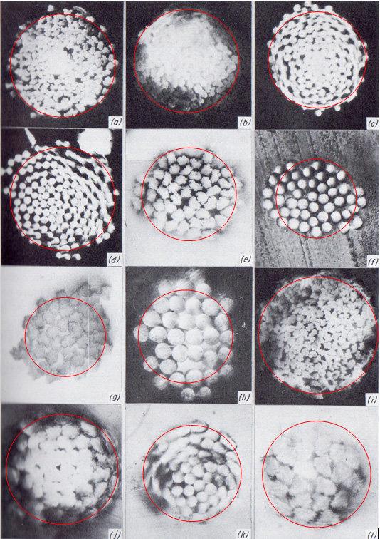
Cross-sectional view of yarn

Slide 21
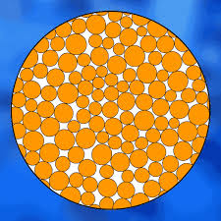
Yarn cross sectional view (ilustrated)

Slide 22
Importance of fibre fineness
Fiber fineness influences primarily:
Spinning limit
Yarn strength
Yarn evenness
Yarn fullness
Drape of the fabric product
Lustre
Handle
Productivity of the process

Slide 23
Fibre length
Different staple length of cotton:
Length class Length (mm)
Short staple (S) <20
Medium staple (M) 20.6-25.4
Medium long staple (ML) 26.2-27.8
Long staple (L) 28.6-33.3
Extra long staple (XL) > 34.9

Slide 24
Importance of fibre length
Fiber length is also one of the most important fiber characteristics. It influences:
Spinning limit
Yarn strength
Yarn evenness
Drape of the fabric product
Lustre of the product
Handle of the product
Productivity

Slide 25
Fibre Strength
The bundle strength is the breaking strength of the cotton fibers in grams per tex. The fineness is calculated from the micronaire value. The fiber beard is broken at a continuous deformation rate (constant rate of extension) & with a 1/8 inch distance between the clams.
Fibre Grading on the basiss of strength
Strength (grams/tex) Description
Less than 21 Very weak
22 to 24 Weak
25 to 27 Medium
28 to 30 Strong
31 & higher Very strong

Slide 26
Fibre Maturity
Fiber maturity means the thickness of cell wall. The more thick the more mature. Unripe fibers have neither adequate strength nor adequate longitudinal stiffness. They therefore lead to:
Loss of yarn strength
Neppiness
A high proportion of short fibers
Varying dye ability &
Processing difficulties mainly at the card

Slide 27
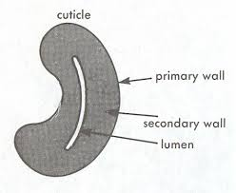
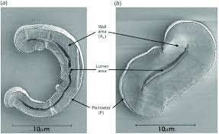
Cross sectional view of fibre

Slide 28
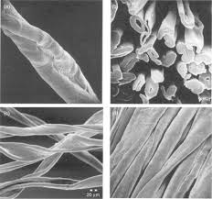
Fibre microscopic view

Slide 29
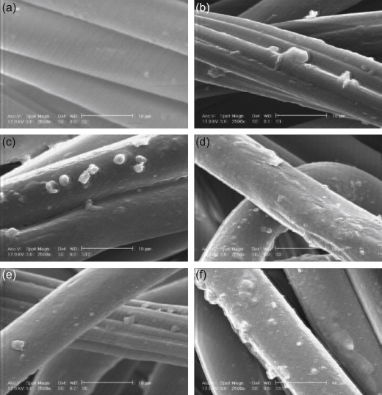
Longitudinal view of mature fibre

Slide 30
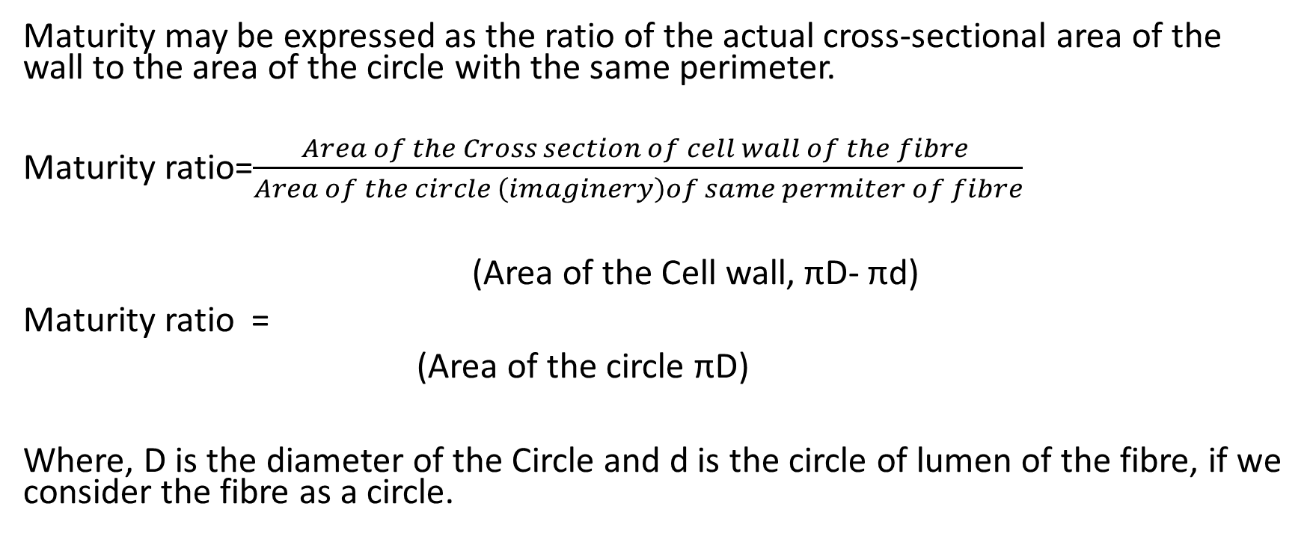
Maturity ratio
Maturity may be expressed as the ratio of the actual cross-sectional area of the wall to the area of the circle with the same perimeter.
Maturity ratio=$\frac{Area of the Cross section of cell wall of the fibre }{Area of the circle \left(imaginery\right)of same permiter of fibre}$
(Area of the Cell wall, πD- πd)
Maturity ratio =
(Area of the circle πD)
Where, D is the diameter of the Circle and d is the circle of lumen of the fibre, if we consider the fibre as a circle.

Slide 31
Fibre Grading on the basis of maturity
Maturity may be expressed as the ratio of the actual cross-sectional area of the wall to the area of the circle with the same perimeter.
Maturity Index Description
Below 0.75 Uncommon
0.75 to 0.85 Immature
0.86 to 0.95 Mature
Above 0.95 Very mature

Slide 32
Bale Management
Bale management refers to the process of inventory control & selection of fiber according to its properties to maintain homogeneous mixing quality for getting consistent production & quality of yarn. For bale management, all bale samples are tested and bale with almost similar category are arranged for homogeneous mixing.
Object of Bale management:
  To get uniform yarn quality (consistent).
  To minimize shade variation of the finished fabric.
  To reduce fabric ‘barre.’

Slide 33
Factors consider for efficient Bale Management system
Origin (Country of origin)
Length & Length uniformity
Fineness
Strength & elongation
SCI (Spinning consistency index)
Maturity
Color
Trash%, etc.

Slide 34
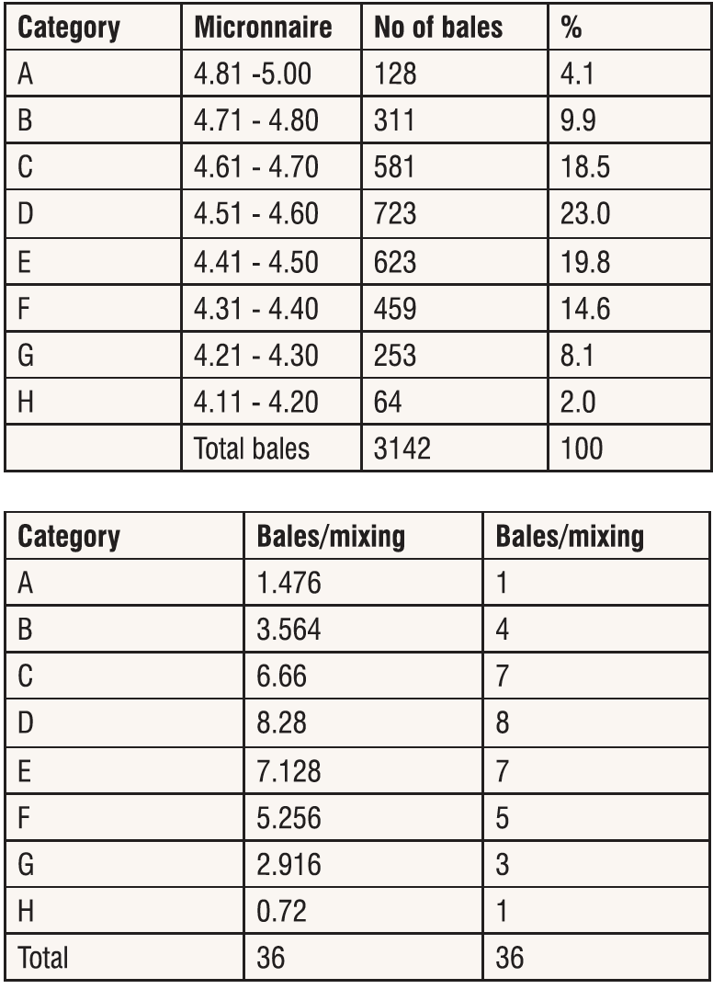
Bale management

Slide 35
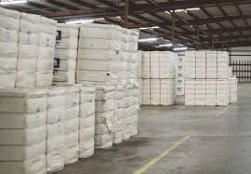
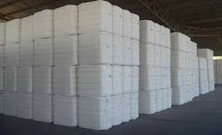
Store of cotton bale

Slide 36
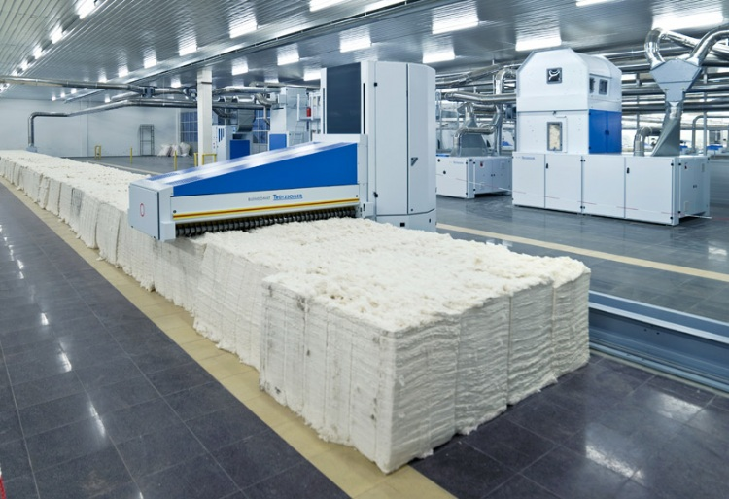
Cotton Bale lay down

Slide 37
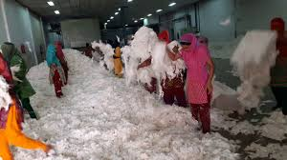
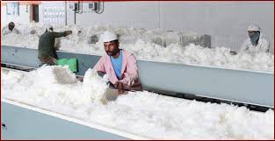
Manual Mixing

Slide 38
Spinning consistency Index (SCI)
Spinning consistency Index is a calculation for predicting the spin ability of the fibers. A multiple regression equation can provide valuable information to anticipate the yarn strength and spinning potential. The regression equation uses most of the individual HVI measurement results to calculate the SCI. This index can be used to simply the category system used in the cotton warehouse. In general, the higher the index, the higher the yarn strength and the better the overall fiber spin ability.
The equation for the SCI value is:
Spinning consistency index (SCI) = -414.67+2.9 x Strength – 9.32 x Micronaire + 49.17 x Length (inch) + 4.74 x Uniformity + 0.65 x Rd + 0.36 x (+b)

