Slide 1
Blow Room
The section in where the supplied compressed fibre bales are turned into a uniform lap of particular length or small fibre tufts by opening cleaning, blending or mixing is called blow room section. It is the first section of spinning.
Objects of blow room:
To open the baled fibers into small tufts which allow foreign matter to be separated from the fibers & prepare the material for easy carding.
To clean the fibers by removing the foreign matter as the waste.
To mix thoroughly the different component fibers of a mixing so as to give a homogeneous blending.
To form a compact & uniform sheet of fibers the lap. or
To feed blended material to the chute feed system.

Slide 2
Basic operations involved in the blow room
Opening by the action of opposite spike
Cleaning by the action of beater
Dust removal by action of air current
Blending or Mixing
Formation of carding lap or even feed of the materials to the card by regulating action.

Slide 3
Deferent types of Opening device
Rollers
Drums
Quilted shaft
Multiple bladed beaters
Spiked lattice
Pluckers
Carding bar or plate
See also Figure and description (book W. Klein opening: Page 11)

Slide 4
Grid
Grids are segment-shaped devices under the opening assemblies and consist of several (or many) individual polygonal bars or blades (i.e. elements with edges) and together these form a trough. The grid encircles at least ¼, at most ¾ and usually 1/3 to ½ of the opening assembly.
The grid has a large influence on the cleaning effect via the section of the bars, the grasping effect of the edges of the polygonal bars; the setting angle of the bars relative to the opening elements; the width of the gaps between the bars; the overall surface area of the grid.

Slide 5
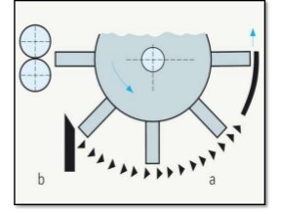
Grid

Slide 6
The elements of the grid
The following elements can be used in the grid:
  Slotted sheets
  Perforated sheet
  Triangular section bars
  Angle bars
  Blades etc.

Slide 7
Elements of Grid
Figure: a
Figure: b
o
o
o
o
o
Figure: c
Figure: d
Figure: e

Slide 8
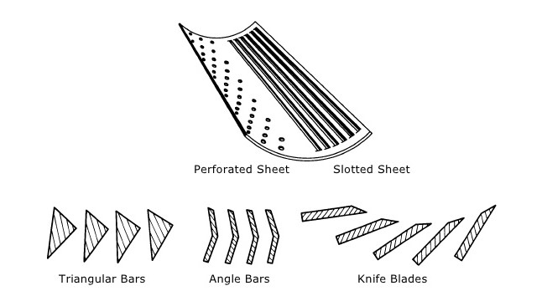
Elements of Grid

Slide 9
Elements of grid
They can be used individually or in combination, but slotted and perforated sheets which were formerly under cards. Modern grids are made up of triangular bars. They are robust, easy to manipulate and give a good cleaning effect.
Blades have been used as grid for a long time, almost always in combination with triangular section bars. Today, grids are made up of knife blades alone, without other elements types.
Angle bars are somewhat less robust and tend to create blockage.

Slide 10
Grid adjustment
The grid can be in one, two or three parts. Correspondingly, it can be adjusted only as a unit or in individual sections. Three basic adjustments are possible:
  Distance of the complete grid to the beater grid;
  Width of the gaps between the bars (a=closed, b=opened)
  Setting angle relative to the beater envelope (c=aggressive, d=glancing)

Slide 11
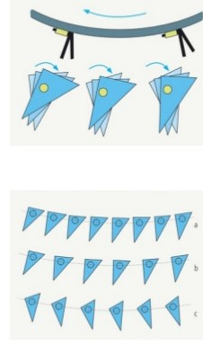
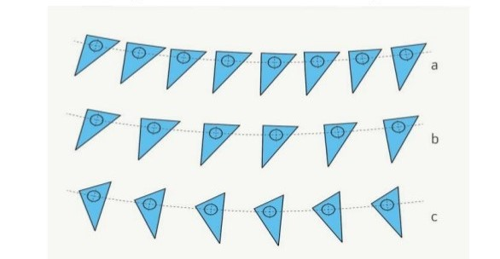
Adjustment of grid

