Slide 1
Basic operations involved in the blow room
Opening by the action of opposite spike
Cleaning by the action of beater
Dust removal by action of air current
Blending or Mixing
Formation of carding lap or even feed of the materials to the card by regulating action.

Slide 2
Opening
Opening is an important operation in spinning system. Opening is needed for carrying out the basic operation of spinning. The raw materials enter the spinning mil is highly pressed form to enable optimum transport and storage conditions. Thus, opening must precede the other basic operations.
Type of opening: Opening can be distinguished in two stages, as follows:
i) Opening to flock- in the blow room.
ii) Opening to fibres: in the card and OE spinning machine.

Slide 3
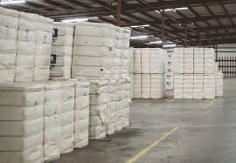
Cotton Bale

Slide 4
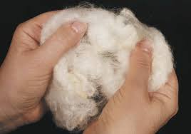
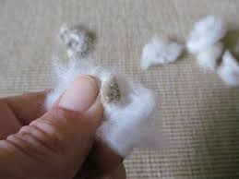

Slide 5
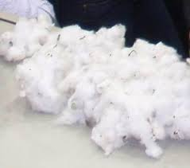
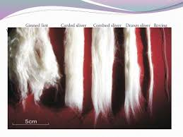
Opening

Slide 6
Opening
Two technological operations are included in opening. These are shown below:
Opening out: In which the volume of the flock is increased but the number of the fibres remains constant, i.e. the specific density of the material is reduced.
Breaking apart: In which two or more flocks are formed from one flock without changing the specific density.
Breaking apart is suffice for cleaning, but opening out is needed for blending and individualization.

Slide 7
Intensity of Opening depends on the following factors
Raw material: Thickness of feed, density of feed, fibre coherence, fibre alignment, size of the flock in the feed.
Machines or devices: Type of feed- loose or clamped; form of feeding device; type of opening device; type of clothing; point density of clothing; arrangement of pin, needles, teeth etc. , on the surface.
Speed: Speed of the device; throughput speed of materials.
Ambient conditions: Humidity, temperature.

Slide 8
Cleaning
Cleaning is an important basic operation. It will become steadily more important. In cleaning, it is necessary to release the adhesion of impurities to the fibres & to give particles an opportunity to separate from the stock. This is achieved mostly by picking of flock out of the feed materials and by rapid acceleration of these flocks over a grid. Dirt dust, foreign matter & neps should be eliminated.
The process of removing dirt, dust, foreign matter, neps and other impurities from the cotton fibre to make fibre free from impurities is called cleaning.

Slide 9
Cleaning points
There are several machines in blow room. Each machine is known as either as opening or as beating point. Beating or cleaning points are classified as major cleaning points and minor cleaning points.
This does not mean that minor cleaning points are not important. In fact they prepare the material readily for the major cleaning points to do a through job i.e. a minor point with its immediately following major point forms one unit.

Slide 10
Major & minor cleaning points
Major & minor cleaning points: Criton opener, porcupine opener, two or three bladed beaters, Krishner beater etc. are the major cleaning point of a conventional blow room line. In case of modern blow room line uniclean, uniflex, CVT1, CVT3 are the major cleaning points.
On the other hand hopper feeder, condenser dust case, pneumatic delivery boxes, scutchers etc. are regarded as minor cleaning points.

Slide 11
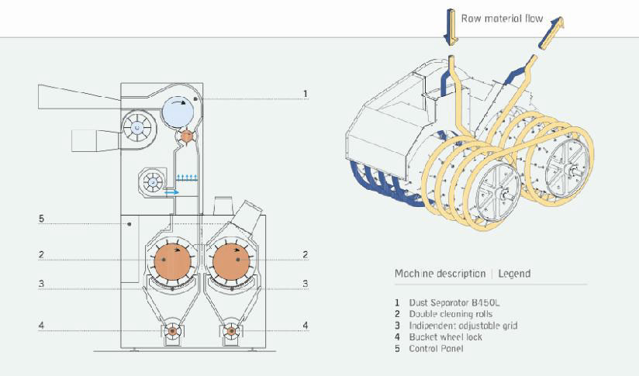
Major cleaning point

Slide 12
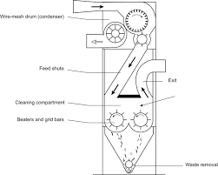
Major cleaning point

Slide 13
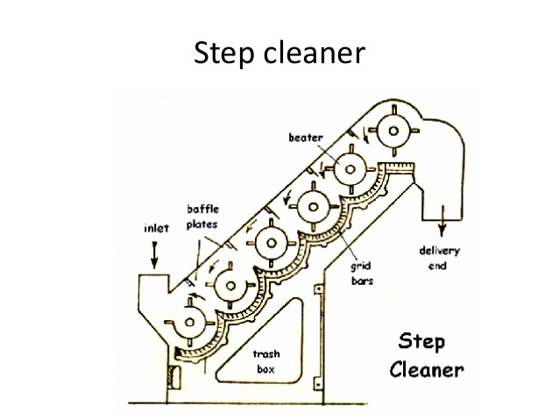
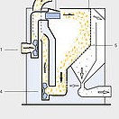
Major cleaning point

Slide 14
Factors influencing opening and cleaning
  The size of dirt particles
  Type of opening device
  Degree of opening device
  Type of feed
  Grid settings
  Surface area of grid
  Air flow rate through the grid
  Condition of pre-opening
  Thickness of the feed materials
  Material through put
  Space between grid bar and beaters.

