Slide 1
Blending
Raw materials used in spinning mill are always inhomogeneous in their characteristics. In part, this is inevitable owing to the different cultivation conditions of natural fibres and different production conditions for synthetic fibres. It is done in order to influence the end product and the process. Blending is performed mainly in order to:
Give the required characteristics to the end product, for example, blending of synthetic fibres with natural fibres produces the desired easy-care character.
Compensate for variations in the characteristics of the raw materials.
Hold down raw material cost
Influence favorably the behavior of the raw material during processing
Achieve effects by varying color, fibre characteristics and so on.

Slide 2
Types of blending
Bale Mixing: before the blow room
Flock blending: within the blow room
Lap blending: using scutchers
Web blending: at ribbon lap machine or blending at drawframe
Sliver blending: at drawframe, the sliver-lap machine, or at the comber
Fibre blending: at card or the OE spinning machine
Roving blending: at the ring spinning machine

Slide 3
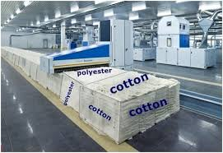
Flock blending in Blendomat

Slide 4
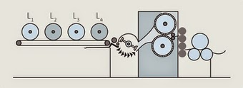
Lap blending

Slide 5
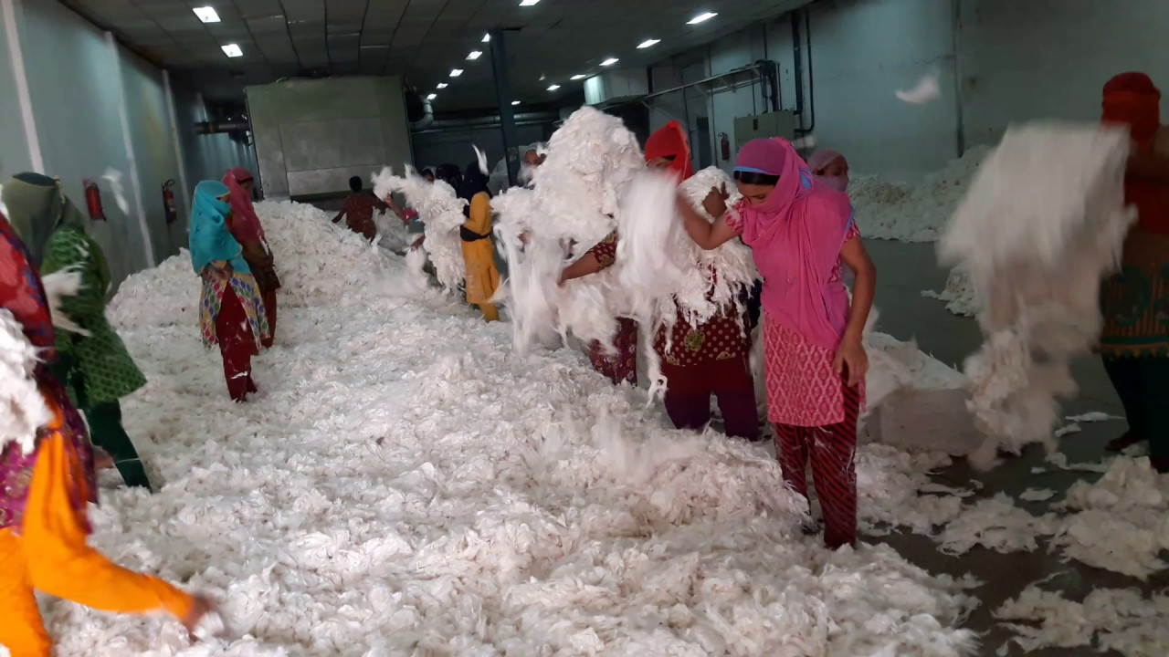
Manual flock blending in blow room

Slide 6
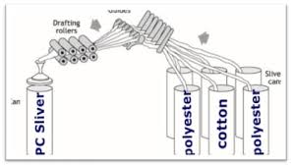
Sliver blending

