Slide 1
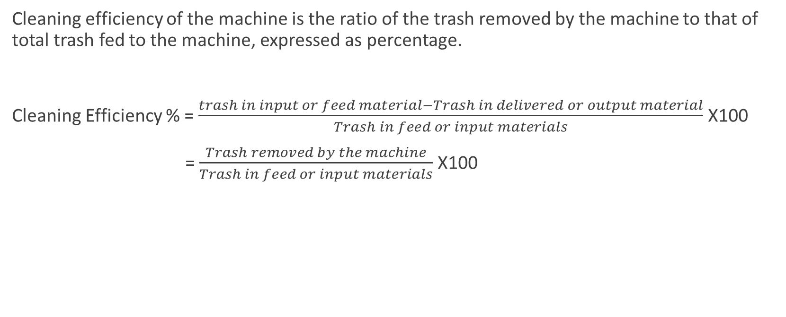
Cleaning efficiency of blow room
Cleaning efficiency of the machine is the ratio of the trash removed by the machine to that of total trash fed to the machine, expressed as percentage.
Cleaning Efficiency % = $\frac{trash in input or feed material−Trash in delivered or output material}{Trash in feed or input materials}$ X100
= $\frac{Trash removed by the machine}{Trash in feed or input materials}$ X100

Slide 2
Cleaning efficiency
                Wastage /impurities
Lap/ Chute mat
Raw cotton
Blow room
Carding
Carded slivers
Wastage/ impurities
Wastage Removed by the Blow room
Wastage Removed by the Carding machine

Slide 3
Calculations
Problem: 1
A cotton of 3% trash is feed to a blow room having 50% cleaning efficiency. If the card sliver contains 0.4% trash. What would be the cleaning efficiency of the card?
Problem 2. A cotton of 6% trash is feed to a blow room. If the card sliver contains 0.4% trash & cleaning efficiency of carding 75%, what would be the cleaning efficiency of the blow room?

Slide 4
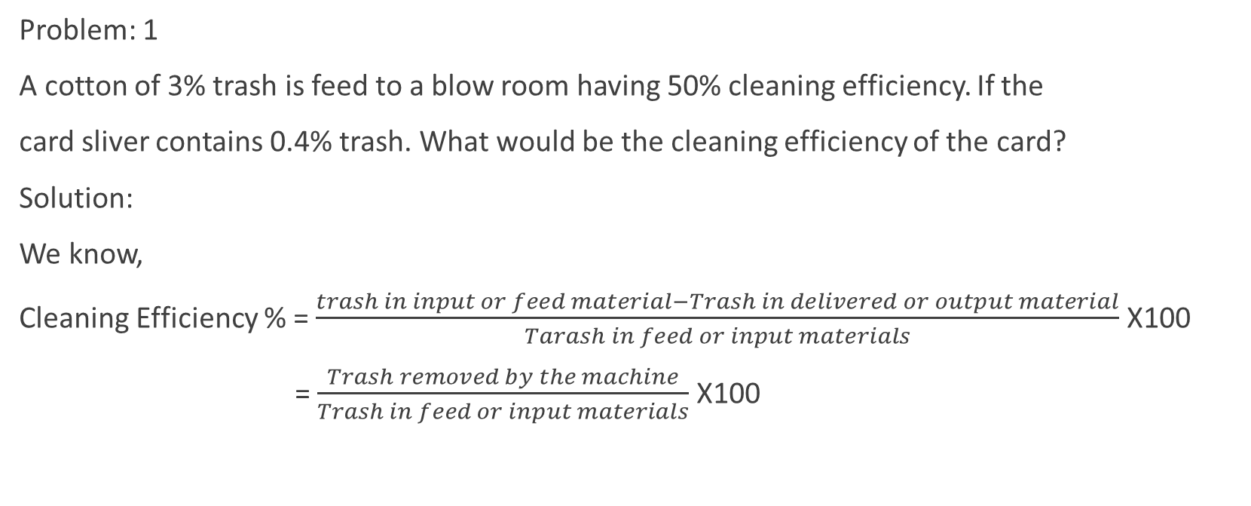
Solution 1
Problem: 1
A cotton of 3% trash is feed to a blow room having 50% cleaning efficiency. If the
card sliver contains 0.4% trash. What would be the cleaning efficiency of the card?
Solution:
We know,
Cleaning Efficiency % = $\frac{trash in input or feed material−Trash in delivered or output material}{Tarash in feed or input materials}$ X100
= $\frac{Trash removed by the machine}{Trash in feed or input materials}$ X100

Slide 5
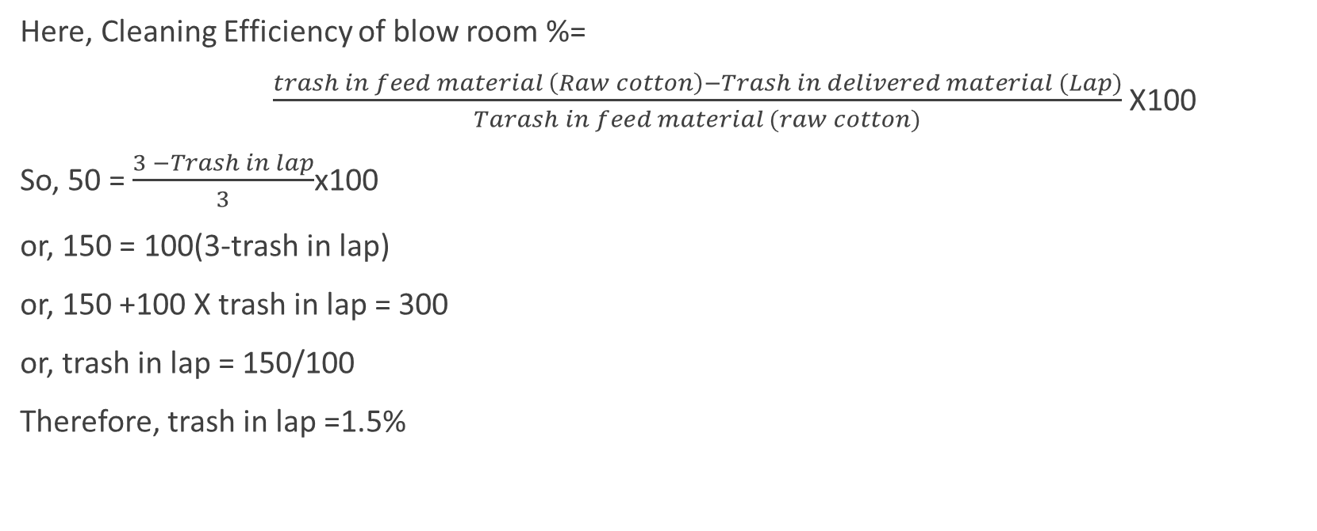
Solution 1
Here, Cleaning Efficiency of blow room %=
$\frac{trash in feed material \left(Raw cotton\right)−Trash in delivered material (Lap)}{Tarash in feed material (raw cotton)}$ X100
So, 50 = $\frac{3 −Trash in lap}{3}$x100
or, 150 = 100(3-trash in lap)
or, 150 +100 X trash in lap = 300
or, trash in lap = 150/100
Therefore, trash in lap =1.5%

Slide 6
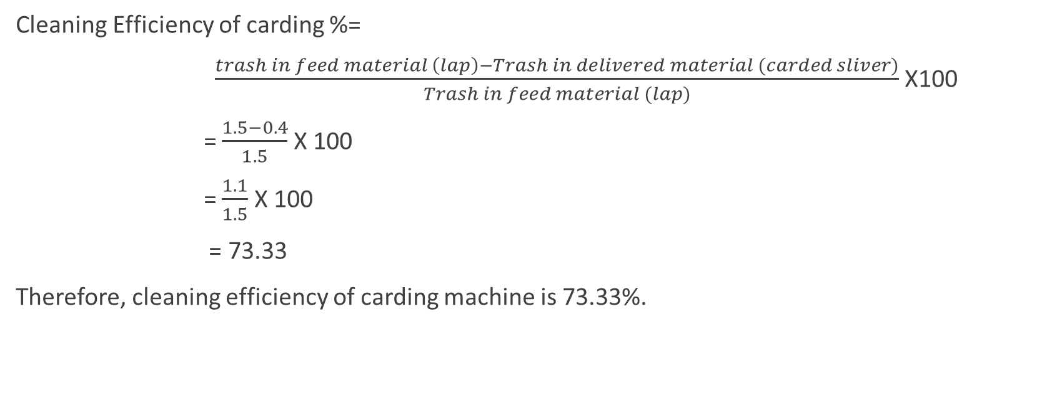
Solution 1
Cleaning Efficiency of carding %=
$\frac{trash in feed material \left(lap\right)−Trash in delivered material (carded sliver)}{Trash in feed material (lap)}$ X100
= $\frac{1.5−0.4}{1.5}$ X 100
= $\frac{1.1}{1.5}$ X 100
= 73.33
Therefore, cleaning efficiency of carding machine is 73.33%.

Slide 7
Rieter Blow room line
Unifloc B 12
Uniclean B11
Unimix B60
Uniflex B70
FFD (Vission Shield, Jossi)
Condenser A21

Slide 8
Trutzschler Blow Room line
Blendomat BO
Precleaner CLP
Multimixer MPM
Fine Cleaner CLC
FFD (SP EP, Securo, Prop, Securomat)
Dustex

Slide 9
Automatic bale opener
Features of automatic bale opener:
Gentle Uniform Opening
Production up to 1500 Kg/hr
Easy operation
Minimal maintenance
Universally applicable

Slide 10
Automatic bale opener:
Up to 3 bale groups at the same time
Up to 180 bales in the lay down
Feeding in up to 3 lines
Processing by lot or continuously bale supply
Process visualization

Slide 11
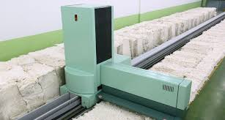
Automatic bale opener:

Slide 12
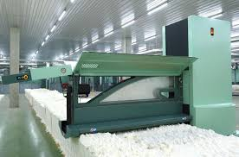
Automatic bale opener

Slide 13
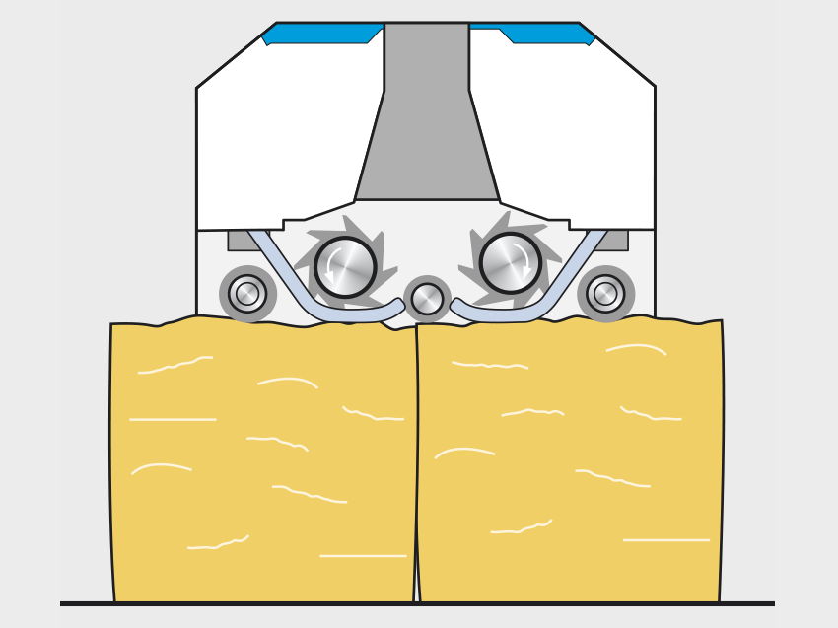
Working Principle of Blendomat/Unifloc( Automatic bale opener)

Slide 14
Parts name of the machine
The machine parts for automatic bale opener:
A) Tower
B) Suction hood
C) Track or rail for machine
D) Take off roller or plucker
E) Control panel
F) Sensors

Slide 15
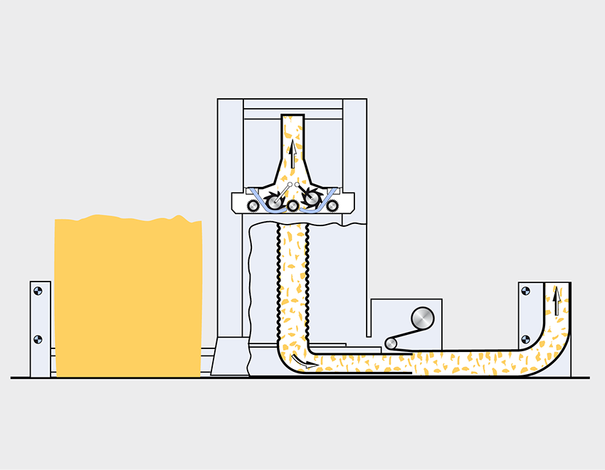

Slide 16
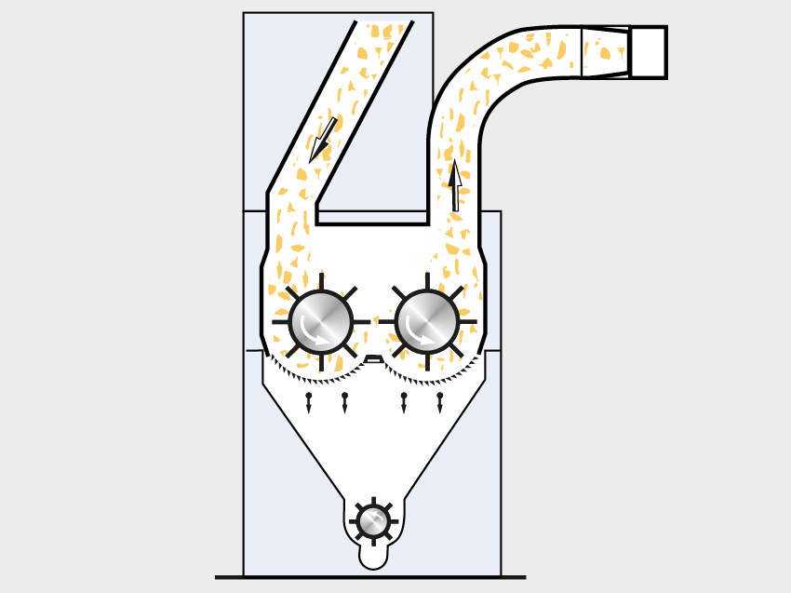
Precleaner/ Uniclean (coarse cleaner)

Slide 17
Parts name of the machine
A) Inlet
B) Cleaning roller or Spiked roller (Beaters)
C) Grids
D) Bucket wheel trap for waste extraction
E) Outlet

Slide 18
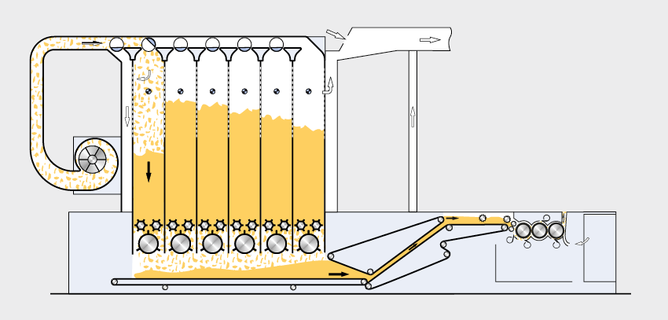
Multimixer/Multiple Mixer/UNimix

Slide 19
Parts name of the machine
Inlet
Feed duct
Mixing Chambers
Closing Flap
Sensors
Perforated wall
Opening roller
Blending roller
Blending Duct
Outlet

Slide 20
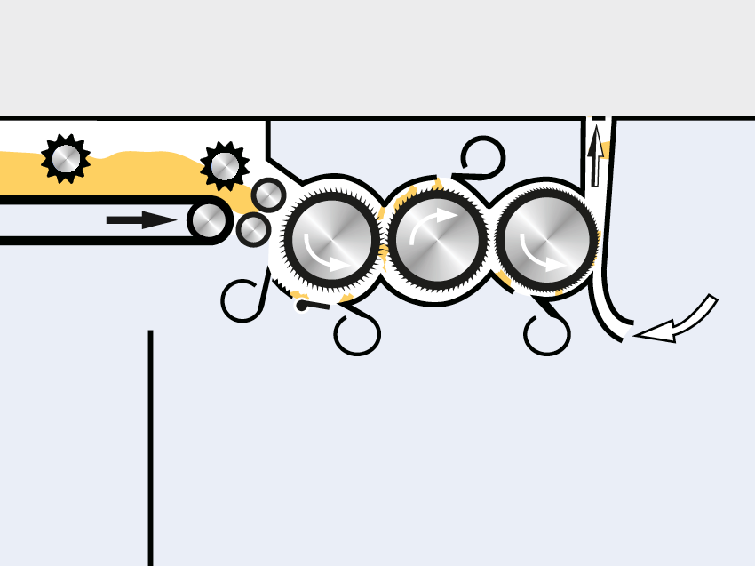
Finecleaner / Uniflex (fine particle cleaner)

Slide 21
Parts name of the machine
A) Coarse saw toothed roller
B) Medium saw toothed roller
C) Fine saw toothed roller
D) Suction hood
E) Deflector blade
F) Mote knife

Slide 22
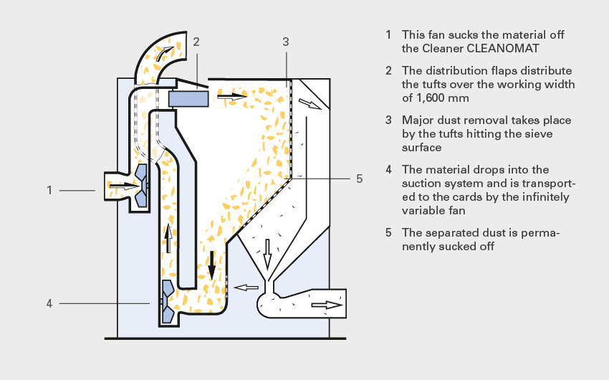
Dedusting Machine

Slide 23
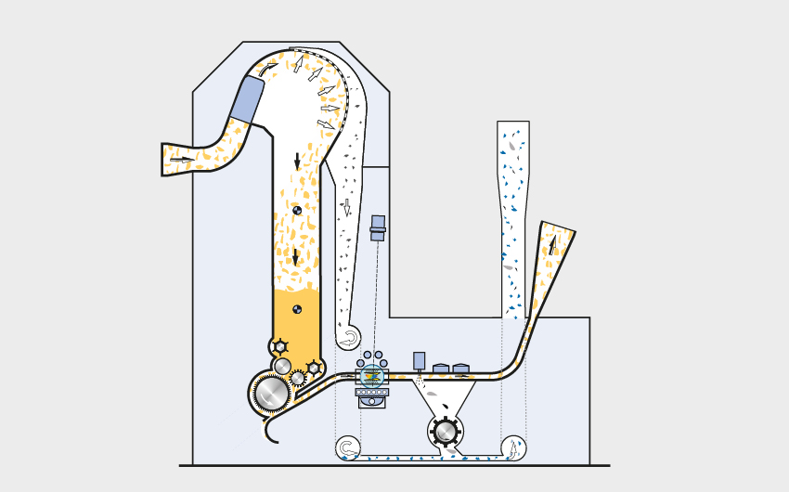
Foreign Metal detector

Slide 24
Foreign Metal detector

