Slide 1
Carding
Carding is defined as the reduction of entangled mass of fibers to filmy web by working them between two closely spaced relatively moving surfaces clothed with sharp points. It is a preliminary process in spun yarn technology just after blow room process.
The proverbs of experts-
a. “The card is the heart of the spinning mill”
b. ‘Well-carded is half-spun’- demonstrate the immense significance of carding for the final result of the spinning operation.

Slide 2
Tasks or objectives of carding machine
1. Opening to the individual fibres.
2. Elimination of remaining impurities and dust.
3. Disentangling of neps.
4. Elimination of short fiber.
5. Fiber orientation or alignment.
6. Producing a uniform continuous strand called sliver.
7. Fibre blending

Slide 3
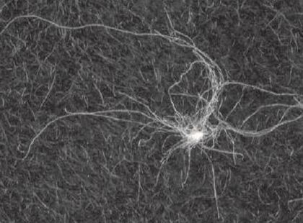
Fibre neps
A nep can be defined as a small knot (or cluster) of entangled fibres consisting either entirely of fibres (i.e. a fibre nep) or of foreign matter (e.g. a seed-coat fragment) entangled with fibres.

Slide 4
Types of Carding machine or Cards
There are three types of carding machine,
A) Revolving flat carding machine
B) Tandem or dual carding machine
C) Super carding machine

Slide 5
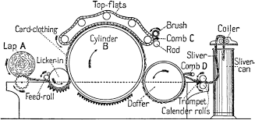
Revolving flat card
Card designed for processing of relatively short fibres (e.g. Cotton, wool etc) have flats circulating on an endless path. So they are referred as revolving flat cards.

Slide 6
Tandem card:
Tandem card consists of two individual cards joined together to make up a unit, in which the doffer of the first cards feeds fiber material to the taker-in of the second card. e.g: Crosrol tandem card.

Slide 7
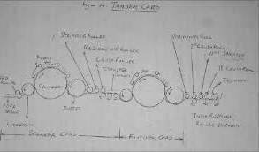
Tandem card

Slide 8
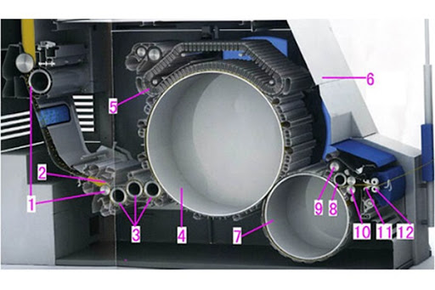
Super card:
Feature:
(a) Two or three taker-in instead of one.
(b) Cylinder speed up to 800 rpm.
(c) Increase of the operating width 1.5 m
(d) Production 300-350 kg/hour

Slide 9
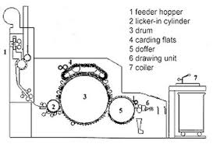
Functional Zone of carding
Generally there are four functional zone of carding:
a) Feeding Zone
b) Cleaning Zone
c) Carding Zone
d) Sliver formation Zone

Slide 10
Card feeding is of two types:
a. Lap Feed (Conventional)
b. Chute feed (Modern)
(i) Single chute feed system
(ii) Double chute feed system

Slide 11
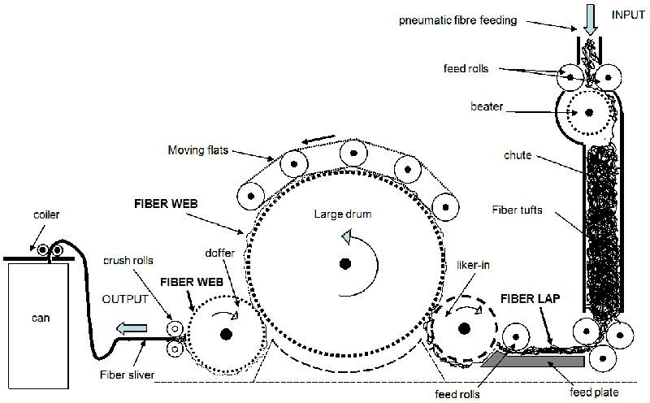
Passage diagram of a modern carding machine

Slide 12
Advantages of lap feed system
1. Linear density of the lap is very good and easier to maintain (uniformity).
2. The whole installation is very flexible.
3. The deviation of card output will be nill as laps can be rejected.
4. Autolevellers are not required, hence investment cost and maintenance cost is less.

Slide 13
Disadvantages of lap feed system
1.Transportation of lap needs more manual efforts (more labour).
2. Lap run out is an additional source of fault, as it should be replaced by a new lap.
3. More good fiber loss during lap change.
4. More load on the taker-in as laps are heavily compressed.

Slide 14
Advantages of Chute feed system
1. High performance of carding due to high degree of openness of feed web.
2. Labor requirement is less due to no lap transportation and lap change in cards.
3. This system eliminates additional burden on the taker-in to open the compressed lap.
4. Elimination of lap waste up to 3%.

Slide 15
Disadvantages of chute feed system:
1. Flock feeding is the only solution for high production cards.
2. Linear density of the web to the card is not as good as lap.
3. Installation is not flexible.
4. Autoleveller is a must, hence investment cost and maintenance cost is more

