Slide 1
Different actions occurred in carding machine
Stripping Action : occur between taker-in and cylinder
Carding Action: occur between cylinder and flat
Doffing Action: occur between cylinder and doffer

Slide 2
Different actions in carding machine

Slide 3
Stripping Action
Stripping action is occurred between taker – in and cylinder. Here wire and speed direction is same.
Definition:
When two close surfaces have same wire direction and their speed direction or relative motion is also same then the action between two surfaces is called Stripping action.
Result by the action of Stripping:
Trash, neps are transferred from cylinder, taker – in and doffer by stripping action/cleaning.

Slide 4
Carding Action:
Carding action is occurred between flat and cylinder. Here wire direction and rotational direction both are opposite.
Definition: If two close surface have opposite wire direction and their speed direction or relative motion also is opposite then the action between two surfaces is known as Carding action.
Result by the action of Carding: a) Maximum individualization of fibre is achieved in this region by opposite spikes. b) Neps, short fibres, dirt and dust are removed. c) The difference of surface speed between cylinder and flat is more, so carding action is maximum occurred.

Slide 5
Doffing Action
Doffing action is a special carding action. The action takes place between cylinder and doffer. Here the wire direction is opposite but speed action is same.
Definition: When two close surfaces wire point are inclined in opposite direction and they rotates in same direction, then the action between two surfaces is called Doffing carding.
Result by the action of Doffing: We get sliver from doffer (sliver formation)

Slide 6
Card clothing
The main segments of carding machine are covered by cloth having metallic wire with sharp edges or points. These are called card clothing. The main carding segments are taker-in, cylinder, doffer and flats.
Types of card clothing:
Flexible card clothing
Semi-rigid card clothing
Metallic card clothing

Slide 7
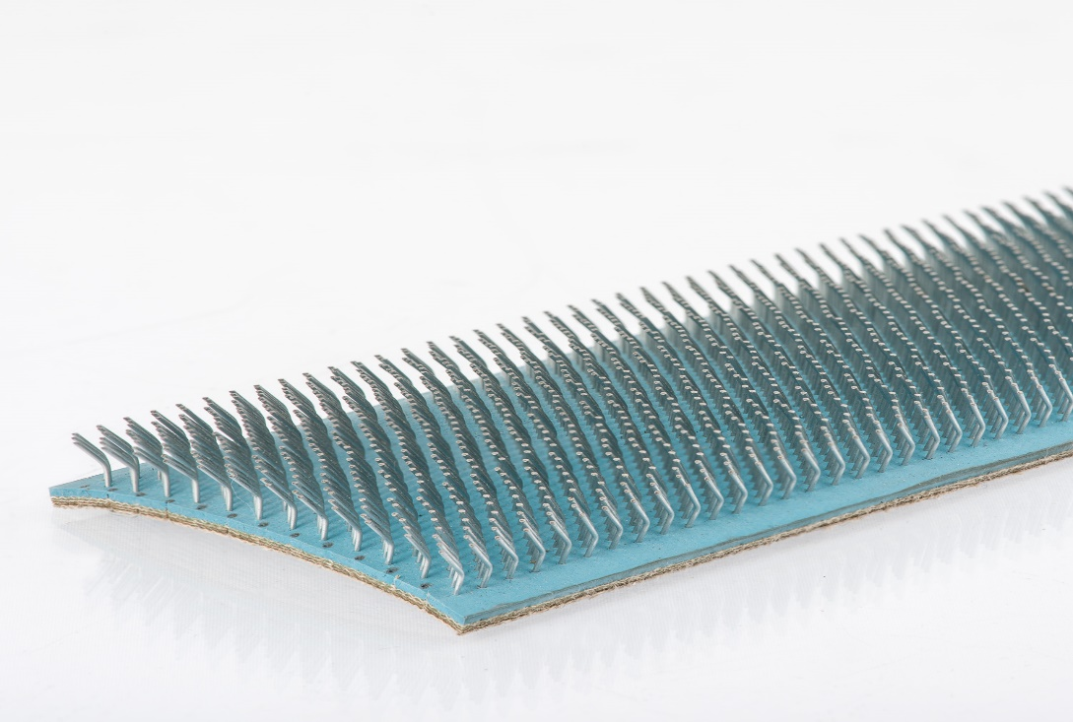
Flexible card clothing
These have hooks of rounds or oval wire set into elastic, multiple – ply cloth backings.
Each hook is bent to a U – shape and is formed with a knee that flexes under bending load and returns to its original position when the load is removed.
In short – staple spinning mills this clothing is now found only in the card flats.

Slide 8
Advantages of flexible card clothing
1. Higher point density, so better carding action. 2. Fibre damage is less due to flexible wire point. 3. Only the damaged part of the clothing is needed to be prepared. 4. Exerts desirable force on cotton causing good carding. 5. Less expensive. 6. Finer yarn count can be prepared.

Slide 9
Flexible card clothing in flat bars

Slide 10
Disadvantages of flexible card clothing
1. Requires textile fabric or rubber as foundation materials 2. The wires can be loosened. 3. Production less, due to stripping. 4. Needs regular grinding
5. Wire & foundation materials may get damage because of they are both flexible. 6. Fibre becomes lose for grinding action. 7. Any carding angle cannot be chosen

Slide 11
Semi- rigid card clothing
Flat or round wires with sharp points are set in backings which are less elastic than those of the flexible clothing. These backings are multiple – ply structures with more plies than the backings of flexible clothing, comprising both cloth and plastics layers.

Slide 12
Semi-rigid card clothing
Advantages: 1. No need of frequent sharping. 2. No need of stripping as well as there is no knee & no dirt & dust is stored.

Slide 13
Metallic card clothing
These are continuous, self supporting wire structures in which teeth are cut at the smallest possible spacing. They do not need any base material. The wire has no knee.

Slide 14
Metallic Card Clothing

Slide 15
Metallic card clothing
Advantage of Metallic Card Clothing
Machine productivity is increased due to elimination of stoppage for Stripping and Grinding.
The frequency of setting is also reduced due to the reduction of frequent grinding.
The formation of neps is less due to better condition of wire.
Regularity of card sliver is improved due to less frequency of stripping.
Disadvantage of Metallic Card Clothing:
Highly skilled fitter are necessary.
Highly power requirement is necessary due to high starting torque.
Highly fly (flying fibres in the air of the mill) generation.

Slide 16
Selection of card clothing depends on the following factors
Type and design of card
Rotation speed of the cylinder
Production rate
Material throughput (output)
Raw material type (natural or man-made fibers)
Fiber characteristics (mainly fineness, length, bulk, trash content)
Overall quality requirements
Price of the clothing
Service offered by the clothing supplier.

Slide 17
Neps Removal Efficiency (NRE%)
The efficiency of carding machine is determine by the NRE% of a carding machine. It means Neps Removal Efficiency% of a carding machine. It is expressed in percentage of the removed amount of neps (entangled mass) by the carding machine. The feed materials (Lap or chute mat) contains more neps. Carding machine opens the neps, so number of neps is reduced in carded sliver. The amount of neps removed by the carding machine is the difference between the amount of neps present in lap or chute mat and carded sliver. Finally the amount of neps removed by the carding machine is expressed in percentage.

Slide 18
Neps Removal Efficiency (NRE%)
Neps Removal Efficiency (NRE)%
= $\frac{Neps in feed material−Neps in delivered material}{Neps in feed material}$ X100%
Or $\frac{Neps in lap or chute matt − Neps in carded sliver}{Neps in lap or chute matt}$ X100%
The NRE% of carding machine varies mill to mill. The standard NRE% lies between 65-70%.

Slide 19
Grinding of the card clothing
The main segments of carding machine are covered by card clothing. These are metal cloth with sharp wire. The wire looses its sharpness due to metal to metal or metal to fibre friction. The efficiency of carding machine reduces if the sharpness of the wire decreases. That’s why it needs re-sharpening. The process of re- sharpening the card clothing wire is called GRINDING.
The purpose of grinding is to maintain the card clothing in sharp condition.
Two types of grinding roller is used for grinding card clothing.
Long roller grinding
Traverse roller grinding

Slide 20
Long roller grinding

Slide 21
Traverse disk roller

Slide 22
Different gauge (Settings) of the carding machine
Different distance of carding machine is measured by “ Gauge leaf.” The unit of measurement is “Thou”.
1 Thou = 1/1000 inch 4 Thou = 0.1mm
There are many points of carding machine where distance needs to change if required. E.g. the distance between cylinder to taker in, cylinder to flats, cylinder to doffer etc.

Slide 23
Gauge leaf

Slide 24
Different gauge (Settings) of the carding machine
Setting Points | Setting or distance (mm) | Setting or distance (Thou)
Taker-in to cylinder | 0.3mm | 12 Thou
Taker-in to mote knife: | 1mm | 40 Thou
Cylinder to doffer | 0.175mm | 7 Thou
Cylinder to flat | 0.3mm, 0.275mm, 0.25mm, 0.225mm, 0.225mm | 12 Thou, 11 Thou, 10 Thou, 9 Thou, 9 Thou
Cylinder to stationary flat (back) | 0.6mm, 0.55mm, 0.5mm | 24 Thou, 22 Thou, 20 Thou
Cylinder to stationary flat (front) | 0.45mm, 0.4mm | 18Thou, 16 Thou
Doffer to detaching roller | 0.15mm | 6 Thou
Cylinder to cylinder under casing | 0.9-1.2mm | 36-48 Thou
Taker-in to taker-in under casing | 0.5mm | 20 Thou
Calendar rollers | 1.6mm | 64 Thou

Slide 25
Recent developments of carding machine
In 1748 Lewis Paul of Birmingham, England invented the hand driven carding machine. This carding machine has been added many values and developed for the requirement of spinners. The most recent developments are given below:
Higher production rate up to 400 kg/hour
Direct feeding system FBK : Chute feed
Feed rate control system: CFD (CORRECTA FEED)
Multiple licker-in system: 3 Licker-in
Precision Flat Setting System PFS
Precision Mote Knife Setting System PMS

Slide 26
Recent developments of carding machine
Aluminum flats without bolted connection
Computer control with Touch Screen
Electronic Flat Measuring System FLATCONTROL TC-FCT
On-line nep counting with NEPCONTROL TC-NCT
Waste quality measuring with WASTECONTROL TC-WCT
Digitally controlled, maintenance-free servodrives
Integrated Carding Grinding system:
IGS Tops
IGS Classic
Magnetic flat bar: MAGNA TOP
Integrated and continuous suction system
Larger can size: 1000X1200 mm
Roller doffing system

