Slide 1
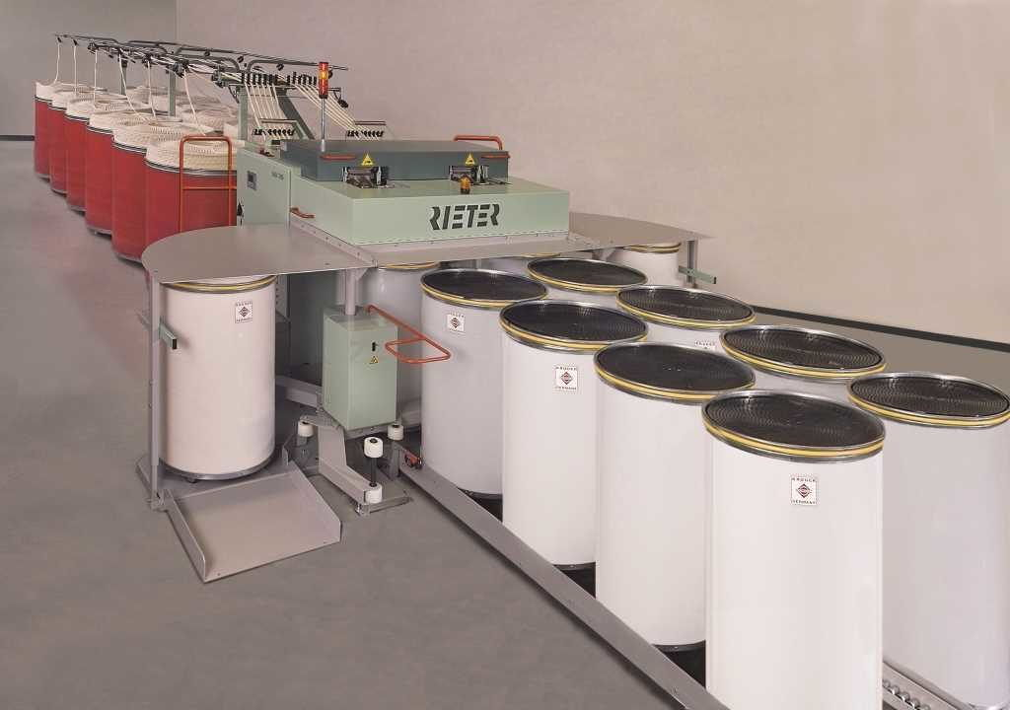
Draw Frame

Slide 2
Draw Frame
Draw frame is a machine for combining and drawing slivers of a textile fiber (as of hemp for rope manufacture or cotton for spinning). Drawing is the operation by which slivers are blended, doubled and leveled. In short staple spinning the term is only applied to the process at a draw frame. It is used just after the carding machine or after the comber machine in ring spinning system.
In drawing slivers are elongated when passing through a group of pair rollers, each pair is moving faster than the previous one.

Slide 3
Objects of Drawing
● To straighten the crimped and hooked fibres in the card sliver.
● To improve the short medium and long term unevenness of the sliver by doubling.
● To produce a more uniform sliver.
● To achieve a fairly through parallelization of the fibre along the sliver axis.
● To reduce the weight/unit length of card sliver.
● To mix the fibre intimately or thoroughly.
● To make the perfect blend of fibre.
● To remove the dirt, dust from carded sliver.

Slide 4
Some important term:
Drafting: It is the process of increasing length per unit weight of sliver. It is mainly due to peripheral speed of the rollers. In other words, drafting is the process of reducing weight per unit length of textile materials (lap, slivers, roving).
Doubling: The process of combining two or more slivers into a single form is called doubling. In draw frame machine generally four to eight slivers are fed to convert into one. The number of slivers fed considered as number of doubling. If six slivers are fed, then number of doubling is six.
Drawing: Drawing is a process where several slivers are converted into one and weight per unit length of materials is reduced by passing them several pairs of rollers.

Slide 5
Tasks of Draw frame
· Equalizing
· Parallelizing
· Blending
· Dust removal
Equalizing: One of the main tasks of draw frame is improving evenness over short, medium and especially long terms variations of slivers. Carded slivers are fed to the draw frame have higher degree of unevenness that cannot be tolerated in practice and slivers from the comber contain such unevenness due to bad piecing. It is obscured by draw frame.

Slide 6
Task of draw frame
Parallelizing: To obtain an optimum value for strength in the yarn characteristics, the fibers must be arranged parallel in the fiber strand. The draw frame has the tasks of creating this parallel arrangement. It fulfills the task drafting process, since every drafting step leads to straightening the fibers.
Blending: In addition to the equalizing effect, doubling also provides a degree of compensation of raw material variation by blending. Their results are exploited in particular way in the production of blended yarns comprising cotton or synthetic blends. At the draw frame metering of the individual components can be carried out very simply be selection of the number of slivers entering the machines.
Dust Removal: Dust is steadily becoming a greater problem both in processing and for the personnel involved. It is therefore important to remove dust to the greatest practical extent at every possible point within the overall process. It is the process of removing dust from the fibre by fibre to fibre of fibre to metal friction during the drawing process.

Slide 7
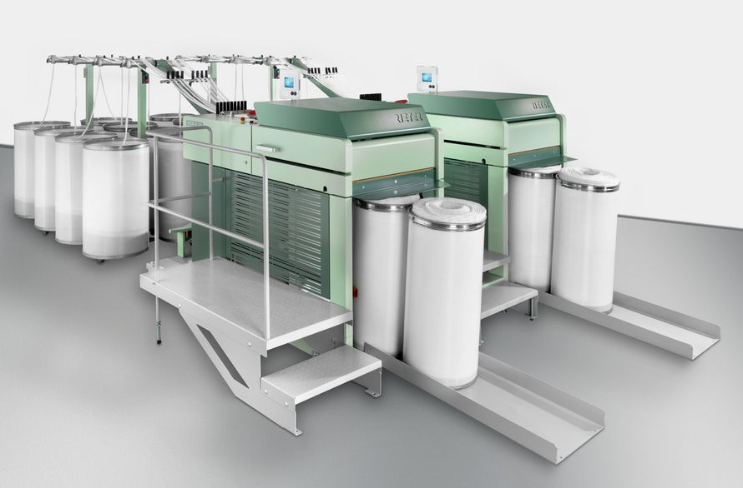
Draw Frame

Slide 8
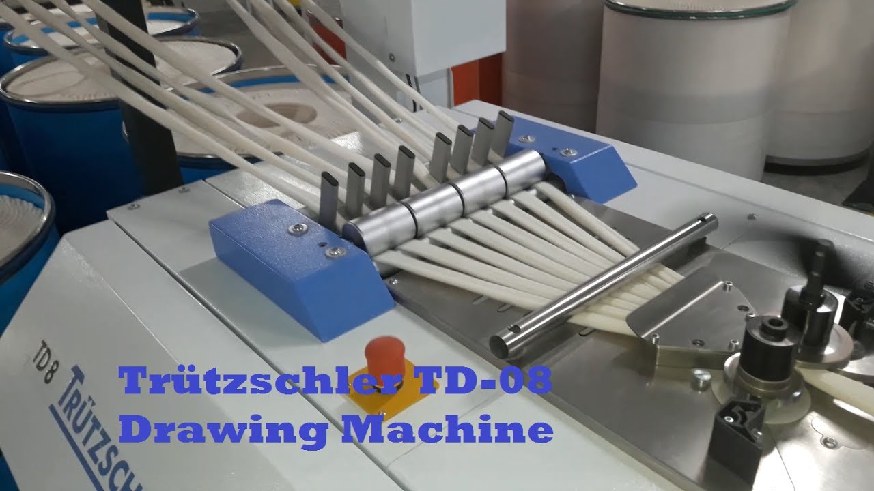
Draw Frame

Slide 9
Operating Principle of Draw Frame:
Four to eight card or draw frame slivers are fed to the drafting arrangement (3). A feed roller pair (2) above each can (1) feeds the material without false drafts. The slivers runs into the drafting arrangement, subjected to a draft of 4 to 8 and leave it as a web and condensed into a sliver immediately. This sliver is then guided through a tube (4) via a passage (6) of the tube gear into a can (7), in which it must be laid in clean coils with optimal utilization of the space in the can by sliver compressing with passing it through calendaring rollers (5).

Slide 10
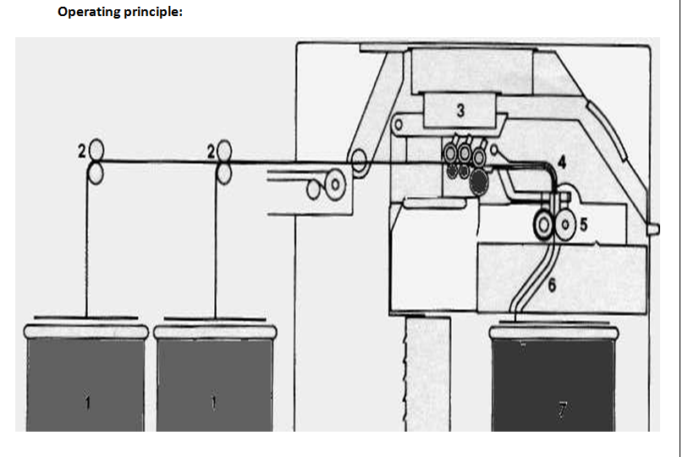
Passage diagram of draw frame

