Slide 1
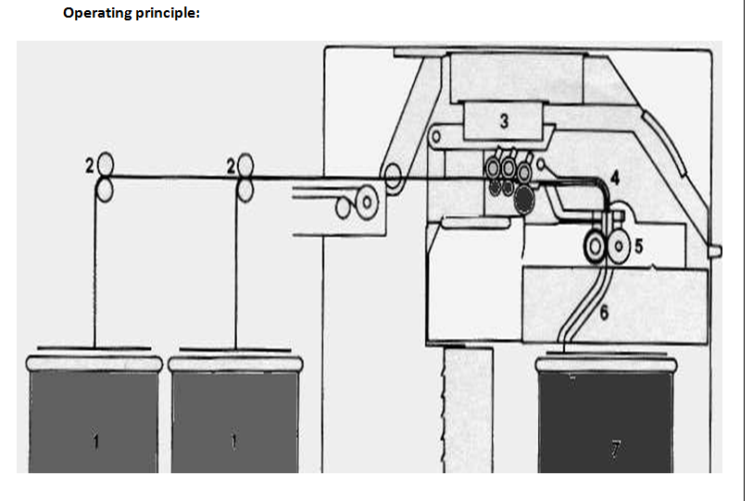
Operative devices of draw frame

Slide 2
Operating Devices
· Creel (Sliver Feed, it includes creel stand, creel roller, separator)
· The drafting Arrangement (top roller, bottom roller, roller pressure)
· Suction systems for the drafting arrangement
condensing devices ( Trumpet or funnel, calendar roller)
· Coiling
· Can charger

Slide 3
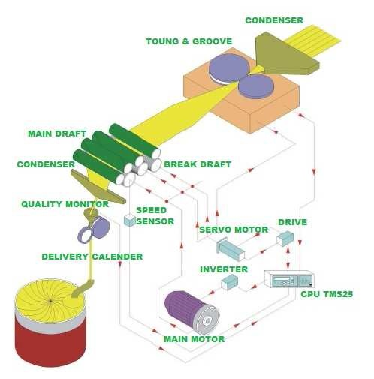
Operating devices

Slide 4
Creel
Creel is an arrangement of rollers which are able to feed the slivers into the machine. It is necessary to provide a driven roller or roller pair which can feed the slivers from above each can (sliver container). A guiding device (separator) for leading the slivers into the drafting arrangement is also required. The whole arrangement is hold by a creel stand.
The creel must be designed so that:-
· False Drafts are avoided.
· The machine stops upon accordance of the sliver break.
· Sliver breaks can be dealt with easily, comfortably and safely.

Slide 5
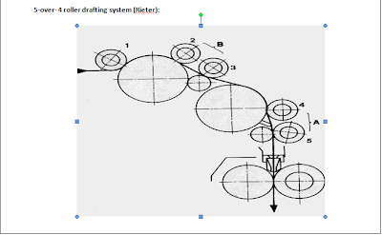
Drafting arrangement or system
Drafting arrangement or drafting system is the heart of a draw frame machine. It is an arrangement with several top rollers set axial position to the bottom rollers to make a pair. In draw fame, drafting system are of many types according to number of roller pairs and their arrangement. For example, 3 or 3 drafting system, 4 over 3, 4 over 4, 4 over 5 and so on.

Slide 6
Elements of drafting arrangement
a. Top rollers ( rubber coated)
b. Bottom rollers (steel fluted)
Roller pressure (spring loaded, pneumatic pressure etc.)

Slide 7
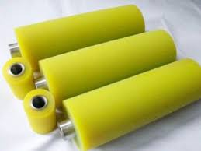
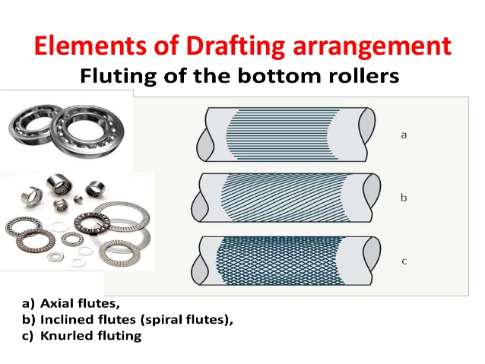
Elements of drafting system

Slide 8
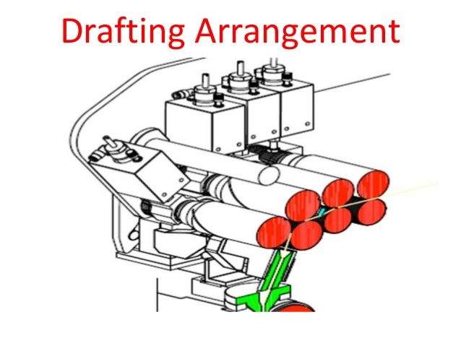
Drafting arrangement

Slide 9
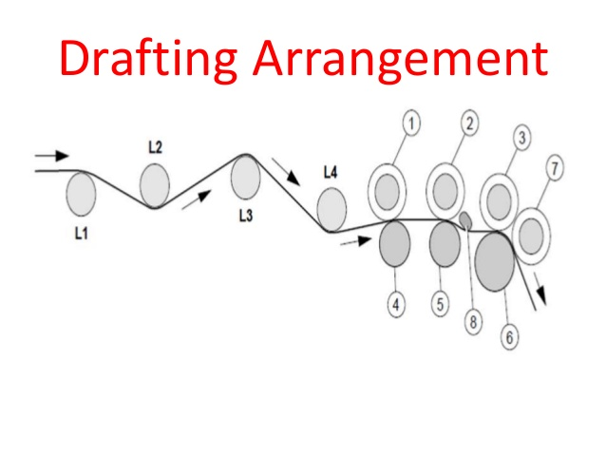
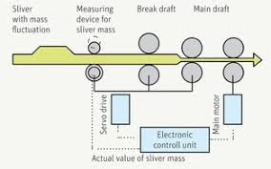
Drafting arrangement

Slide 10
Requirement of Drafting Arrangement
The drafting arrangement is the heart of draw frame and thus the part which influence the quality. The requirements placed on the drafting arrangement in general is correspondingly high.
I. Simple, uncomplicated construction.
II. Stable design with the smooth running of the rollers.
III. A mode of operation giving a high quality of the product even at high running speed.
IV. The high degree of flexibility i,e. suitable for all raw materials.
V. Optimal control over the movement of fibres during the drafting operations
VI. High precision both on operation and adjustment.
VII. Rapid and simple adjustability of roller spacing and draft levers.
VIII. Ease of maintenance and cleanings.
IX. Optimal economic design.

Slide 11
Factors depending upon the drafting arrangement
1) Diameter of the rollers.
2) Hardness of the top rollers.
3) Pressure exerted by the top rollers.
4) Surface characteristics of the top rollers.
5) Fluting the bottom rollers.
6) Type and form of fiber guiding devices, such as pressure rods, pin bars, aprons, condenser etc.
7) Clamping distance.
8) Level of the draft.

