Slide 1
Calculation of carding and draw frame
Draft calculation & DCP (Draft change pinion) calculation
Production calculation

Slide 2
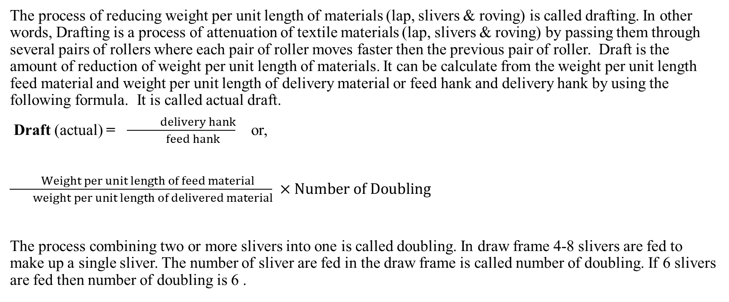
Some important formula
The process of reducing weight per unit length of materials (lap, slivers & roving) is called drafting. In other words, Drafting is a process of attenuation of textile materials (lap, slivers & roving) by passing them through several pairs of rollers where each pair of roller moves faster then the previous pair of roller. Draft is the amount of reduction of weight per unit length of materials. It can be calculate from the weight per unit length feed material and weight per unit length of delivery material or feed hank and delivery hank by using the following formula. It is called actual draft.
Draft (actual) = $\frac{ delivery hank}{ feed hank}$ or,
$\frac{ Weight per unit length of feed material}{ weight per unit length of delivered material} ×Number of Doubling$
The process combining two or more slivers into one is called doubling. In draw frame 4-8 slivers are fed to make up a single sliver. The number of sliver are fed in the draw frame is called number of doubling. If 6 slivers are fed then number of doubling is 6 .

Slide 3
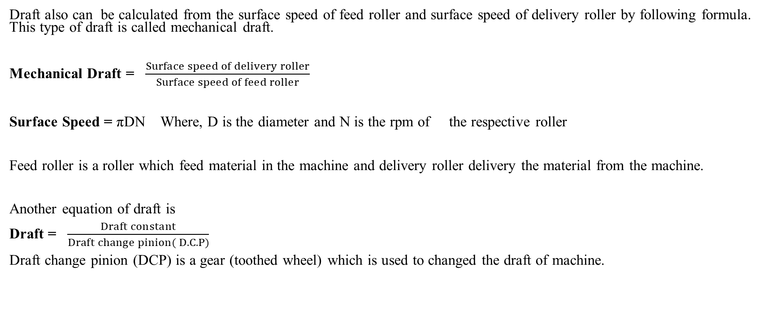
Some Important formula
Draft also can be calculated from the surface speed of feed roller and surface speed of delivery roller by following formula. This type of draft is called mechanical draft.
Mechanical Draft = $\frac{Surface speed of delivery roller}{Surface speed of feed roller}$
Surface Speed = πDN Where, D is the diameter and N is the rpm of the respective roller
Feed roller is a roller which feed material in the machine and delivery roller delivery the material from the machine.
Another equation of draft is
Draft = $\frac{Draft constant}{Draft change pinion( D.C.P)}$
Draft change pinion (DCP) is a gear (toothed wheel) which is used to changed the draft of machine.

Slide 4
Some Important formula
Production of carding or draw frame machine =
Production rate (inch/min or kg/hour) × Time× Machine Efficiency%
Production Rate = Surface speed of the delivery roller
= π × Diameter of the delivery roller × RPM of delivery roller
= πDN

Slide 5
Some important formula
Travel Rate of Flat bar = Pitch × No. of teeth of Flat sprocket × RPM of sprocket shaft
The distance between two consecutive flat bars is called pitch.

Slide 6
Problem 1
Find out the production of a carding machine in kg/day where the necessary data are given below:
Delivery roller speed 200 rpm, delivery roller diameter is 35mm, carded sliver is 55 gm/m and machine efficiency is 80%.
Solution:
We know,
Production of carding machine = Production rate (inch/min or kg/hour) × Time× Machine Efficiency%

Slide 7
Problem 1:
Here,
Production Rate = Surface speed of the delivery roller (πDN)
= π × Diameter of the delivery roller × RPM of delivery roller
= (3.14 ×35 mm ×200 rpm)
= 21980 mm/min
= 21.98 m/min
Time= 1day= (60×24) min

Slide 8
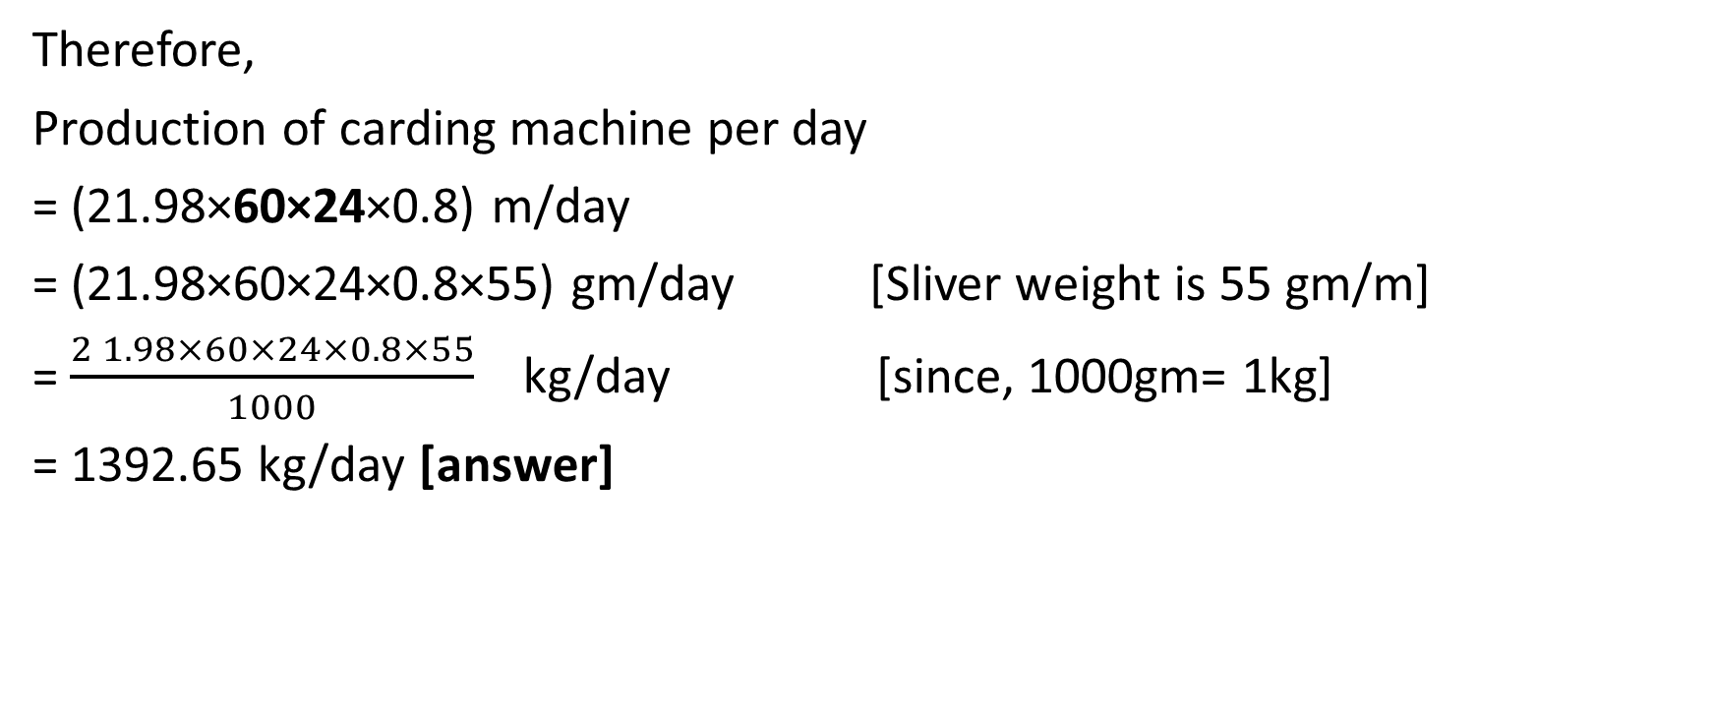
Problem 1:
Therefore,
Production of carding machine per day
= (21.98×60×24×0.8) m/day
= (21.98×60×24×0.8×55) gm/day [Sliver weight is 55 gm/m]
= $\frac{2 1.98×60×24×0.8×55}{1000}$ kg/day [since, 1000gm= 1kg]
= 1392.65 kg/day [answer]

Slide 9
Problem 2:
If a carding machine produce 21.98m/min sliver what will be the production of carding machine per shift in ton where carded sliver weight is 45 gm/yard and machine efficiency is 85%?
Solution:
We know,
Production of carding machine = Production rate (inch/min or kg/hour) × Time× Machine Efficiency%
Here, production rate is 21.98 m/min

Slide 10
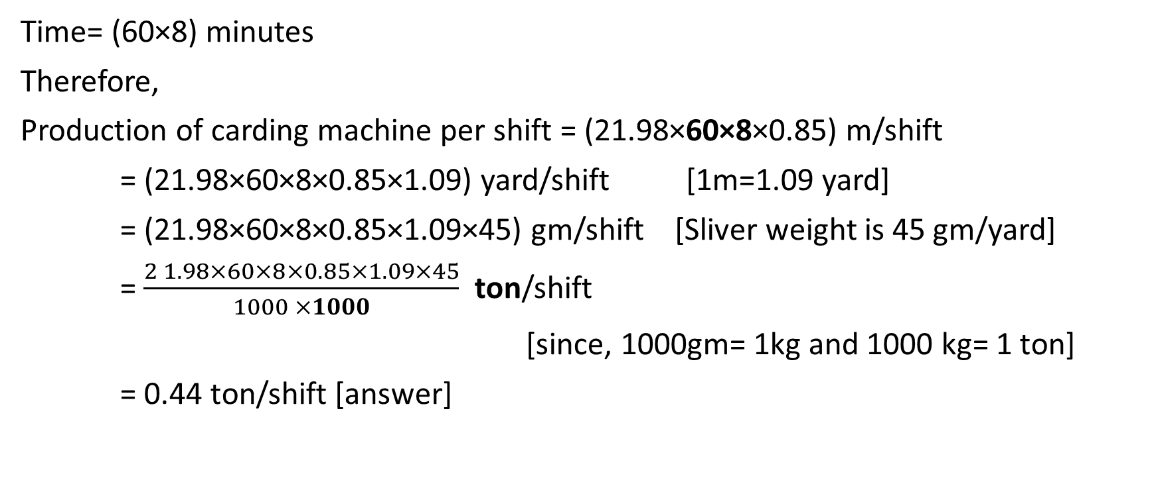
Problem 2:
Time= (60×8) minutes
Therefore,
Production of carding machine per shift = (21.98×60×8×0.85) m/shift
= (21.98×60×8×0.85×1.09) yard/shift [1m=1.09 yard]
= (21.98×60×8×0.85×1.09×45) gm/shift [Sliver weight is 45 gm/yard]
= $\frac{2 1.98×60×8×0.85×1.09×45}{1000 ×1000}$ ton/shift
[since, 1000gm= 1kg and 1000 kg= 1 ton]
= 0.44 ton/shift [answer]

Slide 11
Home work
Problem 3: Delivery roller speed and delivery roller diameter is 200 rpm and 35mm respectively, feed roller speed and feed roller diameter 5 rpm and 70 mm respectively. Find out the production of draw frame is in kg/hour. Where, carded sliver is 50 gm/yard and machine efficiency is 80%. Calculate the mechanical draft too.
Problem 4: If the carded sliver is 55gm/m and drawn sliver weight is 45gm/m, what will be the required DCP of draw frame? When draft constant is 340 and number of doubling 6.

