Slide 1
CSE544: SQL
Monday 3/27 and Wednesday 3/29, 2006

Slide 2
SQL Introduction
Standard language for querying and manipulating data
Structured Query Language
Many standards out there:
ANSI SQL, SQL92 (a.k.a. SQL2), SQL99 (a.k.a. SQL3), ….
Vendors support various subsets: watch for fun discussions in class !

Slide 3
SQL
Data Definition Language (DDL)
  Create/alter/delete tables and their attributes
  Following lectures...
Data Manipulation Language (DML)
  Query one or more tables – discussed next !
  Insert/delete/modify tuples in tables

Slide 4
Tables in SQL
Table name
Attribute names
Product
PName | Price | Category | Manufacturer
Gizmo | $19.99 | Gadgets | GizmoWorks
Powergizmo | $29.99 | Gadgets | GizmoWorks
SingleTouch | $149.99 | Photography | Canon
MultiTouch | $203.99 | Household | Hitachi
Tuples or rows

Slide 5
Tables Explained
The schema of a table is the table name and its attributes:
Product(PName, Price, Category, Manfacturer)
A key is an attribute whose values are unique;
we underline a key
Product(PName, Price, Category, Manfacturer)

Slide 6
Data Types in SQL
Atomic types:
  Characters: CHAR(20), VARCHAR(50)
  Numbers: INT, BIGINT, SMALLINT, FLOAT
  Others: MONEY, DATETIME, …
Every attribute must have an atomic type
  Hence tables are flat
  Why ?

Slide 7
Tables Explained
A tuple = a record
  Restriction: all attributes are of atomic type
A table = a set of tuples
  Like a list…
  …but it is unorderd:
  no first(), no next(), no last().

Slide 8
SQL Query
Basic form: (plus many many more bells and whistles)
SELECT <attributes>
FROM <one or more relations>
WHERE <conditions>

Slide 9
Simple SQL Query
Product
PName | Price | Category | Manufacturer
Gizmo | $19.99 | Gadgets | GizmoWorks
Powergizmo | $29.99 | Gadgets | GizmoWorks
SingleTouch | $149.99 | Photography | Canon
MultiTouch | $203.99 | Household | Hitachi
SELECT *
FROM Product
WHERE category=‘Gadgets’
PName | Price | Category | Manufacturer
Gizmo | $19.99 | Gadgets | GizmoWorks
Powergizmo | $29.99 | Gadgets | GizmoWorks
“selection”

Slide 10
Simple SQL Query
Product
PName | Price | Category | Manufacturer
Gizmo | $19.99 | Gadgets | GizmoWorks
Powergizmo | $29.99 | Gadgets | GizmoWorks
SingleTouch | $149.99 | Photography | Canon
MultiTouch | $203.99 | Household | Hitachi
SELECT PName, Price, Manufacturer
FROM Product
WHERE Price > 100
“selection” and
“projection”
PName | Price | Manufacturer
SingleTouch | $149.99 | Canon
MultiTouch | $203.99 | Hitachi

Slide 11
Notation
Input Schema
Product(PName, Price, Category, Manfacturer)
SELECT PName, Price, Manufacturer
FROM Product
WHERE Price > 100
Answer(PName, Price, Manfacturer)
Output Schema

Slide 12
Details
Case insensitive:
  Same: SELECT Select select
  Same: Product product
  Different: ‘Seattle’ ‘seattle’
Constants:
  ‘abc’ - yes
  “abc” - no

Slide 13
The LIKE operator
SELECT *
FROM Products
WHERE PName LIKE ‘%gizmo%’
s LIKE p: pattern matching on strings
p may contain two special symbols:
  % = any sequence of characters
  _ = any single character

Slide 14
Eliminating Duplicates
Category
Gadgets
Photography
Household
SELECT DISTINCT category
FROM Product
Compare to:
Category
Gadgets
Gadgets
Photography
Household
SELECT category
FROM Product

Slide 15
Ordering the Results
SELECT pname, price, manufacturer
FROM Product
WHERE category=‘gizmo’ AND price > 50
ORDER BY price, pname
Ties are broken by the second attribute on the ORDER BY list, etc.
Ordering is ascending, unless you specify the DESC keyword.

Slide 16
PName | Price | Category | Manufacturer
Gizmo | $19.99 | Gadgets | GizmoWorks
Powergizmo | $29.99 | Gadgets | GizmoWorks
SingleTouch | $149.99 | Photography | Canon
MultiTouch | $203.99 | Household | Hitachi
SELECT DISTINCT category
FROM Product
ORDER BY category
?
SELECT Category
FROM Product
ORDER BY PName
?
?
SELECT DISTINCT category
FROM Product
ORDER BY PName

Slide 17
Keys and Foreign Keys
Company
CName | StockPrice | Country
GizmoWorks | 25 | USA
Canon | 65 | Japan
Hitachi | 15 | Japan
Key
Product
PName | Price | Category | Manufacturer
Gizmo | $19.99 | Gadgets | GizmoWorks
Powergizmo | $29.99 | Gadgets | GizmoWorks
SingleTouch | $149.99 | Photography | Canon
MultiTouch | $203.99 | Household | Hitachi
Foreign
key

Slide 18
Union, Intersect, and Except Clauses
The UNION, INTERSECT, and EXCEPT clauses are used to combine or exclude like rows from two or more tables. They are useful when you need to combine the results from separate queries into one single result. They differ from a join in that entire rows are matched and, as a result, included or excluded from the combined result.

Slide 19
These operators can be used on any query; however, a couple simple of conditions must be met:
The number and order columns must be the same in both queries
The data types must be the same or compatible.

Slide 20
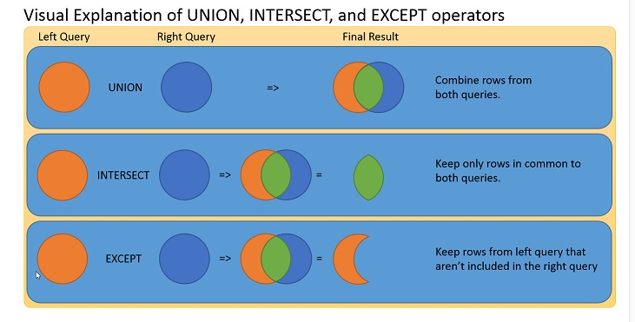

Slide 21
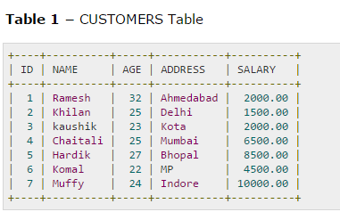
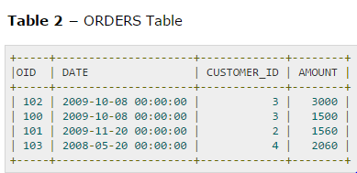

Slide 22
Union
The Union operator returns rows from both tables. If used by itself, UNION returns a distinct list of rows. Using UNION ALL, returns all rows from both tables. A UNION is useful when you want to sort results from two separate queries as one combined result. For instance if you have two tables, Vendor, and Customer, and you want combined list of names, you can easily do so using:
SELECT Id FROM Customers
Union
SELECT Customer_Id FROM Orders ORDER BY Name
Note the ORDER BY clause applies to the combined result.

Slide 23
INTERSECT Operator
Use an intersect operator to returns rows that are in common between two tables; it returns unique rows from both the left and right query. This query is useful when you want to find results that are in common between two queries. Continuing with Orders, and Customers, suppose you want to find those customers who have ordered products. You can do so easily using:
SELECT ID FROM Customers
INTERSECT
SELECT Customer_ID FROM Orders ORDER BY Name

Slide 24
You can also use an INNER JOIN to answer the same question.
SELECT ID FROM Customers
Inner join
SELECT Customer_Id FROM Orders on Cutomers.ID=Orders.Customer_ID ORDER BY Name
Or,
Select Customer.Id, Customer.Name,Customer.Age from Cutomer,Orders where Cutomers.ID=Orders.Customer_ID

Slide 25
EXCEPT Operator
Use the EXCEPT Operator to return only rows found in the left query. It returns unique rows from the left query that aren’t in the right query’s results. This query is useful when you’re looking to find rows that are in one set but not another. For example, to create a list of those customers who haven’t ordered you could write:
SELECT ID FROM Customers
EXCEPT
SELECT Customer_ID FROM Orders ORDER BY Name

Slide 26
Like INTERSECTION, EXCEPT has an equivalent SQL statement. In this case we can use this equivalent:
SELECT * from Customer
LEFT JOIN
Orders ON Cutomers.ID=Orders.Customer_ID where order.OID=null;

Slide 27
What is Join Operation??
Join operations take two relations and return another relation as the result.
Each of the variants of the join operations in SQL consists of a join type and a join condition. The join condition defines which tuples in the two relations match and what attributes are present in the result of the join.

Slide 28
Difference between inner and outer join
LEFT OUTER JOIN returns all the rows from the first table, even if there are no matches in the second table. RIGHT OUTER JOIN returns all the rows from the second table, even if there are no matches in the first table. INNER JOIN requires there is at least a match in comparing the two tables

Slide 29
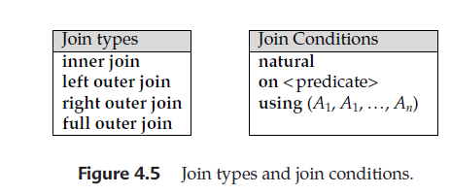
Join Types
INNER JOIN: Returns all rows when there is at least one match in BOTH tables
LEFT JOIN: Return all rows from the left table, and the matched rows from the right table
RIGHT JOIN: Return all rows from the right table, and the matched rows from the left table
FULL JOIN: Return all rows when there is a match in ONE of the tables

Slide 30
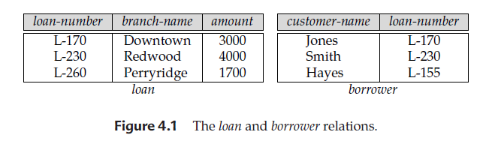
Loan and Borrower Relation

Slide 31
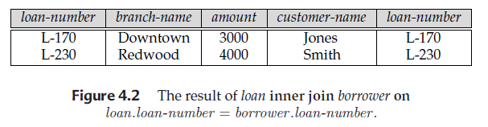
SQL syntax for inner join
loan inner join borrower on loan.loan-number = borrower .loan-number

Slide 32
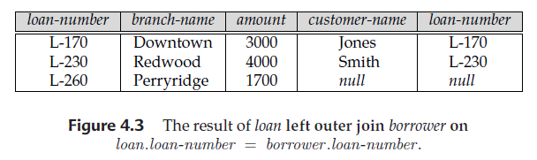
SQL syntax for left outer join
loan left outer join borrower on loan.loan-number = borrower.loan-number

Slide 33
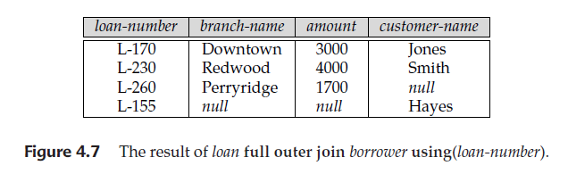
SQL syntax for full outer join
loan full outer join borrower using (loan-number)

Slide 34
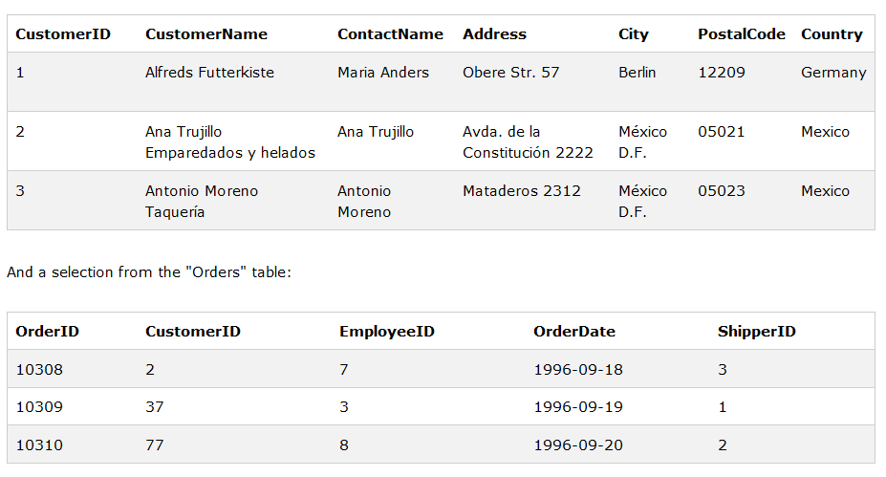
Customers and Orders Relation

Slide 35
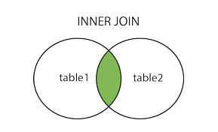
SQL INNER JOIN Syntax
SELECT column_name(s)
FROM table1
INNER JOIN table2
ON table1.column_name=table2.column_name;

Slide 36
SQL INNER JOIN Example
SELECT Customers.CustomerName, Orders.OrderID
FROM Customers
INNER JOIN Orders
ON Customers.CustomerID=Orders.CustomerID
ORDER BY Customers.CustomerName;

Slide 37
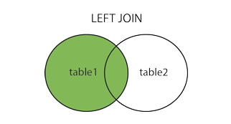
SQL LEFT JOIN Keyword
SELECT column_name(s)
FROM table1
LEFT OUTER JOIN table2
ON table1.column_name=table2.column_name;

Slide 38
SQL LEFT JOIN Example
SELECT Customers.CustomerName, Orders.OrderID
FROM Customers
LEFT JOIN Orders
ON Customers.CustomerID=Orders.CustomerID
ORDER BY Customers.CustomerName;

Slide 39
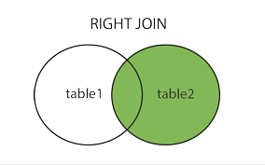
SQL RIGHT JOIN Keyword
SELECT column_name(s)
FROM table1
RIGHT OUTER JOIN table2
ON table1.column_name=table2.column_name;

Slide 40
SQL RIGHT JOIN Example
SELECT Orders.OrderID, Employees.FirstName
FROM Orders
RIGHT JOIN Employees
ON Orders.EmployeeID=Employees.EmployeeID
ORDER BY Orders.OrderID;

Slide 41
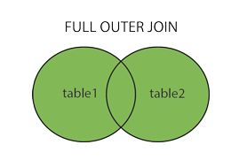
SQL FULL OUTER JOIN Syntax
SELECT column_name(s)
FROM table1
FULL OUTER JOIN table2
ON table1.column_name=table2.column_name;

Slide 42
SQL FULL OUTER JOIN Example
SELECT Customers.CustomerName, Orders.OrderID
FROM Customers
FULL OUTER JOIN Orders
ON Customers.CustomerID=Orders.CustomerID
ORDER BY Customers.CustomerName;

Slide 43
Joins
Product (pname, price, category, manufacturer)
Company (cname, stockPrice, country)
Find all products under $200 manufactured in Japan;
return their names and prices.
Join
between Product
and Company
SELECT PName, Price
FROM Product, Company
WHERE Manufacturer=CName AND Country=‘Japan’
AND Price <= 200

Slide 44
Joins
Product
Company
PName | Price | Category | Manufacturer
Gizmo | $19.99 | Gadgets | GizmoWorks
Powergizmo | $29.99 | Gadgets | GizmoWorks
SingleTouch | $149.99 | Photography | Canon
MultiTouch | $203.99 | Household | Hitachi
Cname | StockPrice | Country
GizmoWorks | 25 | USA
Canon | 65 | Japan
Hitachi | 15 | Japan
SELECT PName, Price
FROM Product, Company
WHERE Manufacturer=CName AND Country=‘Japan’
AND Price <= 200
PName | Price
SingleTouch | $149.99

Slide 45
More Joins
Product (pname, price, category, manufacturer)
Company (cname, stockPrice, country)
Find all Chinese companies that manufacture products both in the ‘electronic’ and ‘toy’ categories
SELECT cname
FROM
WHERE

Slide 46
A Subtlety about Joins
Product (pname, price, category, manufacturer)
Company (cname, stockPrice, country)
Find all countries that manufacture some product in the ‘Gadgets’ category.
SELECT Country
FROM Product, Company
WHERE Manufacturer=CName AND Category=‘Gadgets’
Unexpected duplicates

Slide 47
A Subtlety about Joins
Product
Company
Name | Price | Category | Manufacturer
Gizmo | $19.99 | Gadgets | GizmoWorks
Powergizmo | $29.99 | Gadgets | GizmoWorks
SingleTouch | $149.99 | Photography | Canon
MultiTouch | $203.99 | Household | Hitachi
Cname | StockPrice | Country
GizmoWorks | 25 | USA
Canon | 65 | Japan
Hitachi | 15 | Japan
SELECT Country
FROM Product, Company
WHERE Manufacturer=CName AND Category=‘Gadgets’
What is
the problem ?
What’s the
solution ?
Country
??
??

Slide 48
Subqueries Returning Relations
Company(name, city)
Product(pname, maker)
Purchase(id, product, buyer)
Return cities where one can find companies that manufacture
products bought by Joe Blow
SELECT Company.city
FROM Company
WHERE Company.name IN
(SELECT Product.maker
FROM Purchase , Product
WHERE Product.pname=Purchase.product
AND Purchase .buyer = ‘Joe Blow‘);

Slide 49
Subqueries Returning Relations
Is it equivalent to this ?
SELECT Company.city
FROM Company, Product, Purchase
WHERE Company.name= Product.maker
AND Product.pname = Purchase.product
AND Purchase.buyer = ‘Joe Blow’
Beware of duplicates !

Slide 50
Removing Duplicates
SELECT DISTINCT Company.city
FROM Company
WHERE Company.name IN
(SELECT Product.maker
FROM Purchase , Product
WHERE Product.pname=Purchase.product
AND Purchase .buyer = ‘Joe Blow‘);
SELECT DISTINCT Company.city
FROM Company, Product, Purchase
WHERE Company.name= Product.maker
AND Product.pname = Purchase.product
AND Purchase.buyer = ‘Joe Blow’
Now
they are
equivalent

Slide 51
Subqueries Returning Relations
You can also use: s > ALL R
s > ANY R
EXISTS R
Product ( pname, price, category, maker)
Find products that are more expensive than all those produced
By “Gizmo-Works”
SELECT name
FROM Product
WHERE price > ALL (SELECT price
FROM Purchase
WHERE maker=‘Gizmo-Works’)

Slide 52
Question for Database Fans and their Friends
Can we express this query as a single SELECT-FROM-WHERE query, without subqueries ?

Slide 53
Question for Database Fans and their Friends
Answer: all SFW queries are monotone (figure out what this means). A query with ALL is not monotone

Slide 54
Correlated Queries
Movie (title, year, director, length)
Find movies whose title appears more than once.
correlation
SELECT DISTINCT title
FROM Movie AS x
WHERE year <> ANY
(SELECT year
FROM Movie
WHERE title = x.title);
Note (1) scope of variables (2) this can still be expressed as single SFW

Slide 55
Complex Correlated Query
Product ( pname, price, category, maker, year)
Find products (and their manufacturers) that are more expensive than all products made by the same manufacturer before 1972
Very powerful ! Also much harder to optimize.
SELECT DISTINCT pname, maker
FROM Product AS x
WHERE price > ALL (SELECT price
FROM Product AS y
WHERE x.maker = y.maker AND y.year < 1972);

Slide 56
Aggregation
SELECT avg(price)
FROM Product
WHERE maker=“Toyota”
SELECT count(*)
FROM Product
WHERE year > 1995
SQL supports several aggregation operations:
sum, count, min, max, avg
Except count, all aggregations apply to a single attribute

Slide 57
Aggregation: Count
COUNT applies to duplicates, unless otherwise stated:
SELECT Count(category)
FROM Product
WHERE year > 1995
same as Count(*)
We probably want:
SELECT Count(DISTINCT category)
FROM Product
WHERE year > 1995

Slide 58
More Examples
Purchase(product, date, price, quantity)
SELECT Sum(price * quantity)
FROM Purchase
What do
they mean ?
SELECT Sum(price * quantity)
FROM Purchase
WHERE product = ‘bagel’

Slide 59
Simple Aggregations
Purchase
Product | Date | Price | Quantity
Bagel | 10/21 | 1 | 20
Banana | 10/3 | 0.5 | 10
Banana | 10/10 | 1 | 10
Bagel | 10/25 | 1.50 | 20
SELECT Sum(price * quantity)
FROM Purchase
WHERE product = ‘bagel’
50 (= 20+30)

Slide 60
Grouping and Aggregation
Purchase(product, date, price, quantity)
Find total sales after 10/1/2005 per product.
SELECT product, Sum(price*quantity) AS TotalSales
FROM Purchase
WHERE date > ‘10/1/2005’
GROUP BY product
Let’s see what this means…

Slide 61
Grouping and Aggregation
1. Compute the FROM and WHERE clauses.
2. Group by the attributes in the GROUPBY
3. Compute the SELECT clause: grouped attributes and aggregates.

Slide 62
1&2. FROM-WHERE-GROUPBY
Product | Date | Price | Quantity
Bagel | 10/21 | 1 | 20
Bagel | 10/25 | 1.50 | 20
Banana | 10/3 | 0.5 | 10
Banana | 10/10 | 1 | 10

Slide 63
3. SELECT
Product | Date | Price | Quantity
Bagel | 10/21 | 1 | 20
Bagel | 10/25 | 1.50 | 20
Banana | 10/3 | 0.5 | 10
Banana | 10/10 | 1 | 10
Product | TotalSales
Bagel | 50
Banana | 15
SELECT product, Sum(price*quantity) AS TotalSales
FROM Purchase
WHERE date > ‘10/1/2005’
GROUP BY product

Slide 64
GROUP BY v.s. Nested Quereis
SELECT product, Sum(price*quantity) AS TotalSales
FROM Purchase
WHERE date > ‘10/1/2005’
GROUP BY product
SELECT DISTINCT x.product, (SELECT Sum(y.price*y.quantity)
FROM Purchase y
WHERE x.product = y.product
AND y.date > ‘10/1/2005’)
AS TotalSales
FROM Purchase x
WHERE x.date > ‘10/1/2005’

Slide 65
Another Example
What does
it mean ?
SELECT product,
sum(price * quantity) AS SumSales
max(quantity) AS MaxQuantity
FROM Purchase
GROUP BY product

Slide 66
HAVING Clause
Same query, except that we consider only products that had
at least 100 buyers.
SELECT product, Sum(price * quantity)
FROM Purchase
WHERE date > ‘10/1/2005’
GROUP BY product
HAVING Sum(quantity) > 30
HAVING clause contains conditions on aggregates.

Slide 67
General form of Grouping and Aggregation
SELECT S
FROM R₁,…,R_{n}
WHERE C1
GROUP BY a₁,…,a_{k}
HAVING C2
S = may contain attributes a₁,…,a_{k} and/or any aggregates but NO OTHER ATTRIBUTES
C1 = is any condition on the attributes in R₁,…,R_{n}
C2 = is any condition on aggregate expressions
Why ?

Slide 68
General form of Grouping and Aggregation
SELECT S
FROM R₁,…,R_{n}
WHERE C1
GROUP BY a₁,…,a_{k}
HAVING C2
Evaluation steps:
Evaluate FROM-WHERE, apply condition C1
Group by the attributes a₁,…,a_{k}
Apply condition C2 to each group (may have aggregates)
Compute aggregates in S and return the result

Slide 69
Advanced SQLizing
Getting around INTERSECT and EXCEPT
Quantifiers
Aggregation v.s. subqueries

Slide 70
1. INTERSECT and EXCEPT:
INTERSECT and EXCEPT: not in SQL Server
If R, S have no
duplicates, then can
write without
subqueries
(HOW ?)
(SELECT R.A, R.B
FROM R)
INTERSECT
(SELECT S.A, S.B
FROM S)
SELECT R.A, R.B
FROM R
WHERE
EXISTS(SELECT *
FROM S
WHERE R.A=S.A and R.B=S.B)
(SELECT R.A, R.B
FROM R)
EXCEPT
(SELECT S.A, S.B
FROM S)
SELECT R.A, R.B
FROM R
WHERE
NOT EXISTS(SELECT *
FROM S
WHERE R.A=S.A and R.B=S.B)

Slide 71
2. Quantifiers
Product ( pname, price, company)
Company( cname, city)
Find all companies that make some products with price < 100
SELECT DISTINCT Company.cname
FROM Company, Product
WHERE Company.cname = Product.company and Product.price < 100
Existential: easy ! ☺

Slide 72
2. Quantifiers
Product ( pname, price, company)
Company( cname, city)
Find all companies that make only products with price < 100
same as:
Find all companies s.t. all of their products have price < 100
Universal: hard ! ☹

Slide 73
2. Quantifiers
1. Find the other companies: i.e. s.t. some product ≥ 100
SELECT DISTINCT Company.cname
FROM Company
WHERE Company.cname IN (SELECT Product.company
FROM Product
WHERE Produc.price >= 100
2. Find all companies s.t. all their products have price < 100
SELECT DISTINCT Company.cname
FROM Company
WHERE Company.cname NOT IN (SELECT Product.company
FROM Product
WHERE Produc.price >= 100

Slide 74
3. Group-by v.s. Nested Query
Author(login,name)
Wrote(login,url)
Find authors who wrote ≥ 10 documents:
Attempt 1: with nested queries
This is
SQL by
a novice
SELECT DISTINCT Author.name
FROM Author
WHERE count(SELECT Wrote.url
FROM Wrote
WHERE Author.login=Wrote.login)
> 10

Slide 75
3. Group-by v.s. Nested Query
Find all authors who wrote at least 10 documents:
Attempt 2: SQL style (with GROUP BY)
This is
SQL by
an expert
SELECT Author.name
FROM Author, Wrote
WHERE Author.login=Wrote.login
GROUP BY Author.name
HAVING count(wrote.url) > 10
No need for DISTINCT: automatically from GROUP BY

Slide 76
3. Group-by v.s. Nested Query
Author(login,name)
Wrote(login,url)
Mentions(url,word)
Find authors with vocabulary ≥ 10000 words:
SELECT Author.name
FROM Author, Wrote, Mentions
WHERE Author.login=Wrote.login AND Wrote.url=Mentions.url
GROUP BY Author.name
HAVING count(distinct Mentions.word) > 10000

Slide 77
Two Examples
Store(sid, sname)
Product(pid, pname, price, sid)
Find all stores that sell only products with price > 100
same as:
Find all stores s.t. all their products have price > 100)

Slide 78
SELECT Store.name
FROM Store, Product
WHERE Store.sid = Product.sid
GROUP BY Store.sid, Store.name
HAVING 100 < min(Product.price)
Why both ?
SELECT Store.name
FROM Store
WHERE
100 < ALL (SELECT Product.price
FROM product
WHERE Store.sid = Product.sid)
Almost equivalent…
SELECT Store.name
FROM Store
WHERE Store.sid NOT IN
(SELECT Product.sid
FROM Product
WHERE Product.price <= 100)

Slide 79
Two Examples
Store(sid, sname)
Product(pid, pname, price, sid)
For each store,
find its most expensive product

Slide 80
Two Examples
This is easy but doesn’t do what we want:
SELECT Store.sname, max(Product.price)
FROM Store, Product
WHERE Store.sid = Product.sid
GROUP BY Store.sid, Store.sname
Better:
SELECT Store.sname, x.pname
FROM Store, Product x
WHERE Store.sid = x.sid and
x.price >=
ALL (SELECT y.price
FROM Product y
WHERE Store.sid = y.sid)
But may
return
multiple
product names
per store

Slide 81
Two Examples
Finally, choose some pid arbitrarily, if there are many
with highest price:
SELECT Store.sname, max(x.pname)
FROM Store, Product x
WHERE Store.sid = x.sid and
x.price >=
ALL (SELECT y.price
FROM Product y
WHERE Store.sid = y.sid)
GROUP BY Store.sname

Slide 82
NULLS in SQL
Whenever we don’t have a value, we can put a NULL
Can mean many things:
  Value does not exists
  Value exists but is unknown
  Value not applicable
  Etc.
The schema specifies for each attribute if can be null (nullable attribute) or not
How does SQL cope with tables that have NULLs ?

Slide 83
Null Values
If x= NULL then 4*(3-x)/7 is still NULL
If x= NULL then x=“Joe” is UNKNOWN
In SQL there are three boolean values:
  FALSE = 0
  UNKNOWN = 0.5
  TRUE = 1

Slide 84
Null Values
C1 AND C2 = min(C1, C2)
C1 OR C2 = max(C1, C2)
NOT C1 = 1 – C1
Rule in SQL: include only tuples that yield TRUE
SELECT *
FROM Person
WHERE (age < 25) AND
(height > 6 OR weight > 190)
E.g.
age=20
heigth=NULL
weight=200

Slide 85
Null Values
Unexpected behavior:
Some Persons are not included !
SELECT *
FROM Person
WHERE age < 25 OR age >= 25

Slide 86
Null Values
Can test for NULL explicitly:
  x IS NULL
  x IS NOT NULL
Now it includes all Persons
SELECT *
FROM Person
WHERE age < 25 OR age >= 25 OR age IS NULL

Slide 87
Outerjoins
Explicit joins in SQL = “inner joins”:
Product(name, category)
Purchase(prodName, store)
SELECT Product.name, Purchase.store
FROM Product JOIN Purchase ON
Product.name = Purchase.prodName
Same as:
SELECT Product.name, Purchase.store
FROM Product, Purchase
WHERE Product.name = Purchase.prodName
But Products that never sold will be lost !

Slide 88
Outerjoins
Left outer joins in SQL:
Product(name, category)
Purchase(prodName, store)
SELECT Product.name, Purchase.store
FROM Product LEFT OUTER JOIN Purchase ON
Product.name = Purchase.prodName

Slide 89
Product
Purchase
Name | Category
Gizmo | gadget
Camera | Photo
OneClick | Photo
ProdName | Store
Gizmo | Wiz
Camera | Ritz
Camera | Wiz
Name | Store
Gizmo | Wiz
Camera | Ritz
Camera | Wiz
OneClick | NULL

Slide 90
Application
Compute, for each product, the total number of sales in ‘September’
Product(name, category)
Purchase(prodName, month, store)
SELECT Product.name, count(*)
FROM Product, Purchase
WHERE Product.name = Purchase.prodName
and Purchase.month = ‘September’
GROUP BY Product.name
What’s wrong ?

Slide 91
Application
Compute, for each product, the total number of sales in ‘September’
Product(name, category)
Purchase(prodName, month, store)
SELECT Product.name, count(*)
FROM Product LEFT OUTER JOIN Purchase ON
Product.name = Purchase.prodName
and Purchase.month = ‘September’
GROUP BY Product.name
Now we also get the products who sold in 0 quantity

Slide 92
Outer Joins
Left outer join:
  Include the left tuple even if there’s no match
Right outer join:
  Include the right tuple even if there’s no match
Full outer join:
  Include the both left and right tuples even if there’s no match

Slide 93
Modifying the Database
Three kinds of modifications
Insertions
Deletions
Updates
Sometimes they are all called “updates”

Slide 94
Insertions
General form:
INSERT INTO R(A1,…., An) VALUES (v1,…., vn)
Example: Insert a new purchase to the database:
INSERT INTO Purchase(buyer, seller, product, store)
VALUES (‘Joe’, ‘Fred’, ‘wakeup-clock-espresso-machine’,
‘The Sharper Image’)
Missing attribute → NULL.
May drop attribute names if give them in order.

Slide 95
Insertions
INSERT INTO PRODUCT(name)
SELECT DISTINCT Purchase.product
FROM Purchase
WHERE Purchase.date > “10/26/01”
The query replaces the VALUES keyword.
Here we insert many tuples into PRODUCT

Slide 96
Insertion: an Example
Product(name, listPrice, category)
Purchase(prodName, buyerName, price)
prodName is foreign key in Product.name
Suppose database got corrupted and we need to fix it:
Purchase
Product
prodName | buyerName | price
camera | John | 200
gizmo | Smith | 80
camera | Smith | 225
name | listPrice | category
gizmo | 100 | gadgets
Task: insert in Product all prodNames from Purchase

Slide 97
Insertion: an Example
INSERT INTO Product(name)
SELECT DISTINCT prodName
FROM Purchase
WHERE prodName NOT IN (SELECT name FROM Product)
name | listPrice | category
gizmo | 100 | Gadgets
camera | - | -

Slide 98
Insertion: an Example
INSERT INTO Product(name, listPrice)
SELECT DISTINCT prodName, price
FROM Purchase
WHERE prodName NOT IN (SELECT name FROM Product)
name | listPrice | category
gizmo | 100 | Gadgets
camera | 200 | -
camera ?? | 225 ?? | -
Depends on the implementation

Slide 99
Deletions
Example:
DELETE FROM PURCHASE
WHERE seller = ‘Joe’ AND
product = ‘Brooklyn Bridge’
Factoid about SQL: there is no way to delete only a single
occurrence of a tuple that appears twice
in a relation.

Slide 100
Updates
Example:
UPDATE PRODUCT
SET price = price/2
WHERE Product.name IN
(SELECT product
FROM Purchase
WHERE Date =‘Oct, 25, 1999’);

