Slide 1
Wet Processing-III
Lab
Experiment 01

Slide 2
Name of the Experiment
Dyeing off 100% cotton knit fabric with reactive dye to produce combined shade

Slide 3
Objectives
To learn about the dyeing process of cotton fabric by reactive dye.
To learn about the characteristics of reactive dye & cotton fibre.
To know about the recipe & also the recipe calculation.
To learn about how to utilize the instruments properly.
To know about the combined shade

Slide 4
Theory
Nowadays reactive dyes are very popular for textile coloration because of its some specific properties like colourfastness, wide range of shade, brilliance of shade and simple application procedure.
The reactive dye having the reactive group, anionic in nature & it reacts with fibre by the formation of covalent bond in presence of alkali and adheres as a part of fibre.

Slide 5
Material and Equipment
Sample: 100% cotton knitted pre-treated fabric.
Dyes & Chemicals:
Name of chemicals | Function
Reactive Dye | Coloring Substances to dye the fabric.
Levelling Agent | Reduce surface tension for easy penetration of dyes into fabric.
Sequestering Agent | To remove the water hardness
Anti-creasing Agent | To remove the crease mark from thr fabric surface
Soda Ash | To maintain pH of the dye bath
Glauber Salt | Used as electrolyte.

Slide 6
Equipment List:
  Beaker.
  Measuring Cylinder.
  Pipette.
  Pot.
  Tri-pod stand.
  Gas Burner.
  Pot.
  Digital Balance.
  Scissor.

Slide 7
Working Procedure: (Recipe)
SL | Chemical/Process Parameter | Unit | Dossing | Stock soln:
01 | Levelling Agent | g/L | 1 | 1%
02 | Sequestering Agent | g/L | 1 | 1%
03 | Reactive Red | % | 0.8 | 1%
04 | Reactive Yellow | % | 0.5 | 1%
05 | Reactive Blue | % | 0.7 | 1%
06 | Glauber Salt | g/L | 40 | 15%
07 | Soda Ash | g/L | 10 | 10%
08 | Sample Weight | gm | 5 | ---
09 | M:L | ----- | 1:30 | ---
10 | Temperature | degC | 60 | ---
11 | Time | min | 20 | ----

Slide 8

Recipe Calculation
Total Liquor = Material Weight × L { M:L }
= 5gm × 30
= 150 mL
Reactive Red = $\frac{5 ×0.8\%}{1\%}$ mL ($\frac{Material weight X chemical amount (\%)}{stock solution (\%)}$)
= 4 mL

Slide 9
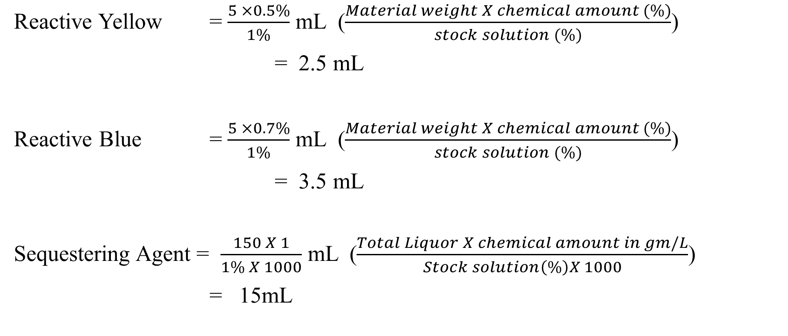
Recipe Calculation
Reactive Yellow = $\frac{5 ×0.5\%}{1\%}$ mL ($\frac{Material weight X chemical amount (\%)}{stock solution (\%)}$)
= 2.5 mL
Reactive Blue = $\frac{5 ×0.7\%}{1\%}$ mL ($\frac{Material weight X chemical amount (\%)}{stock solution (\%)}$)
= 3.5 mL
Sequestering Agent = $\frac{150 X 1}{1\% X 1000}$ mL ($\frac{Total Liquor X chemical amount in gm/L}{Stock solution\left(\%\right)X 1000}$)
= 15mL

Slide 10
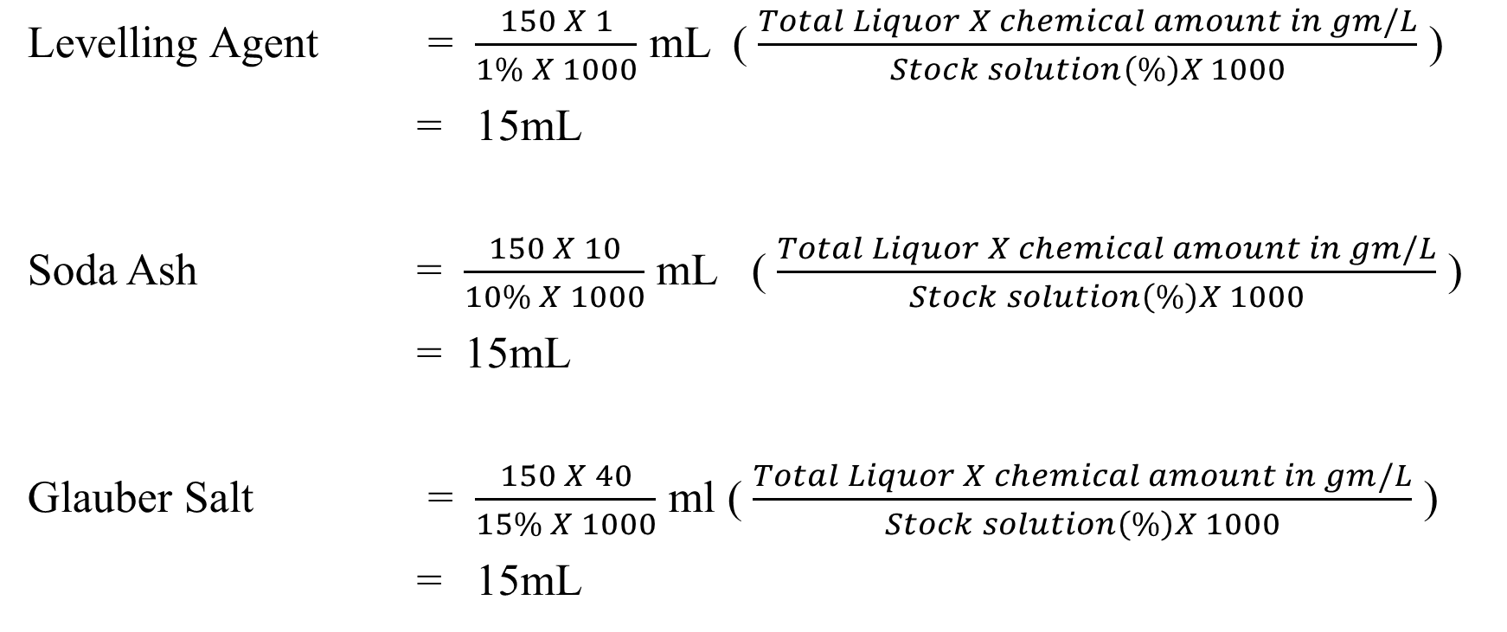
Recipe Calculation
Levelling Agent = $\frac{150 X 1}{1\% X 1000}$ mL ( $\frac{Total Liquor X chemical amount in gm/L}{Stock solution\left(\%\right)X 1000}$ )
= 15mL
Soda Ash = $\frac{150 X 10}{10\% X 1000}$ mL ( $\frac{Total Liquor X chemical amount in gm/L}{Stock solution\left(\%\right)X 1000}$ )
= 15mL
Glauber Salt = $\frac{150 X 40}{15\% X 1000}$ ml ( $\frac{Total Liquor X chemical amount in gm/L}{Stock solution\left(\%\right)X 1000}$ )
= 15mL

Slide 11
Recipe Calculation
Initial Water = Total Liquor - (chemicals)
= 150- (4+2.5+3.5+15+15+15+15) mL
= 150 -70 ml
= 80ml

Slide 12
Process Flow Chart
Collection of pre-treated sample
↓
Set water level
↓
Add leveling agent
↓
Add dye solution
↓
Add salt solution
↓
Add soda ash solution
↓

Slide 13
Process Flow Chart
Add fabric sample
↓
Raise the temperature to 60°c
↓
Run time for 30 minute
↓
Bath drop
↓
Rinsing
↓
Hot wash at 90°c for 10minute
↓
Drying

Slide 14
Process Curve:
Add sample
Wetting Agent
60º C
Levelling Agent
Soda ash
20 min
Temperature
Dyes
Salt
2º C/min
30º C
Bath Drain
Time
Figure: Dyeing Curve with Reactive Dyes

Slide 15
Process Curve
At first we have to set water level of our dye bath and add all chemicals and dyes according to recipe and immerse fabric in it. Then we have to run the dyeing process at 60°C for 20 minute. After bath drain we have added some hot wash and rinsing to remove access dyes particle from fabric surface.

Slide 16
Precautions
  Taking chemicals as per recipe provided by the Instructor.
  Taking every weight of chemicals carefully.
  Switch off the safety system of gas cylinder after complete the experiment.

Slide 17
Result & Discussion:
Sample Attachment:
Discussion: We observed here the fabric absorbed dyes solution very well.

Slide 18
Conclusion/Comments
We can say this experiment is successful because our treated fabric absorbed the dye solution & we also observed it bleed very low amount of dyes during hot & cold wash its due to optimum temperature and good quality of dyes and chemicals

Slide 19
Thank You

