Slide 1
Wet Processing-III Lab
Experiment 02

Slide 2
Name of the Experiment
Dyeing off 100% Polyester woven fabric with disperse dye to produce combined shade

Slide 3
Objectives
To learn about the dyeing process of polyester fabric by disperse dye
To learn about the characteristics of disperse dye & polyester fibre
To know about the recipe & also the recipe calculation
To learn about how to utilize the instruments properly
To know about the combined shade

Slide 4
Theory
The term “disperse dye” have been applied to the organic colouring substances which are free from ionizing groups, are of low water solubility and are suitable for dyeing hydrophobic fibres. Disperse dyes have substantivity for one or more hydrophobic fibres e.g. cellulose acetate, nylon, polyester, acrylic and other synthetic fibres.
The negative charge on the surface of hydrophobic fibres like polyester cannot be reduced by any means, so non-ionic dyes like disperse dyes are used which are not influenced by that surface charge. Carrier used in disperse dyes to reduce the temperature compare to conventional high temperature method.

Slide 5
Material and Equipment
Sample: 100% polyester woven fabric.
Dyes & Chemicals:
Name of chemicals | Function
Disperse Dye | Coloring Substances to dye the fabric.
Acetic Acid | To maintain pH of the dye bath.
Dispersing Agent | To reduce molecular size of disperse dye.
Carrier | It helps to increase affinity between dyes and fabric surface.

Slide 6
Equipment List:
Beaker.
Measuring Cylinder.
Pipette.
Pot.
Tri-pod stand.
Gas Burner.
Pot.
Digital Balance.
Scissor.

Slide 7
Working Procedure: (Recipe)
SL | Chemical/Process Parameter | Unit | Dossing | Stock soln:
01 | Disperse Red | % | 1 | 1%
02 | Disperse Yellow | % | 0.5 | 1%
03 | Disperse Blue | % | 0.8 | 1%
04 | Carrier | g/L | 2 | 1%
05 | Dispersing Agent | g/L | 1 | 1%
06 | Aceic Acid | ml | 0.5 | -
07 | M : L | --- | 1:30 | -
08 | Fabric Weight | gm | 5 | -
09 | Temperature | °C | 100 | -
10 | Time | min | 20 | -

Slide 8
Process Flow Chart
Collection of sample
↓
Set water level
↓
Add Acetic acid solution
↓
check pH
↓
Add carrier solution
↓
Add dispersing agent solution

Slide 9
Process Flow Chart
Add disperse dye solution
↓
Add fabric sample
↓
Raise temperature to 100°C
↓
Run time for 20 minutes
↓
Bath Drop
↓
Rinsing
↓
Drying

Slide 10
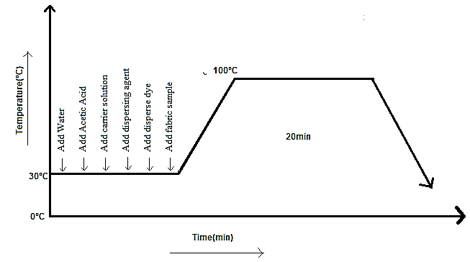
Process Curve

Slide 11
Process Curve
At first we have to set water level of our dye bath and add all chemicals and dyes according to recipe and immerse fabric in it. Then we have to run the dyeing process at 100°C for 20 minute. After bath drain we have added some hot wash and rinsing to remove access dyes particle from fabric surface.

Slide 12
Precautions
Taking chemicals as per recipe provided by the Instructor.
Taking every weight of chemicals carefully.
Switch off the safety system of gas cylinder after complete the experiment.

Slide 13
Result & Discussion:
Sample Attachment:
Discussion: We observed here the fabric absorbed dyes solution very well.

Slide 14
Conclusion/Comments
We can say this experiment is successful cause our treated fabric absorbed the dye solution & we also observed it bleed very low amount of dyes during hot & cold wash its due to optimum temperature and good quality of dyes and chemicals.

Slide 15
Thank You

