Slide 1
Wet Processing-III Lab
Experiment 05

Slide 2
Name of the Experiment
Pigment Dyeing of 100% cotton fabric to produce combined shade

Slide 3
Objectives
To learn about the dyeing process of cotton fabric by pigment.
To learn about the characteristics of pigment, binder & fixer.
To know about the recipe & also the recipe calculation.
To learn about how to utilize the instruments properly.
To know about the combined shade

Slide 4
Material and Equipment
Sample: 100% cotton knitted pre-treated fabric.
Dyes & Chemicals:
Name of chemicals | Function
Pigment | Coloring Substances to dye the fabric.
Binder | (see theory part)
Fixer | Make Cross Link (see theory part)

Slide 5
Equipment List:
Beaker.
Measuring Cylinder.
Pipette.
Pot.
Tri-pod stand.
Gas Burner.
Pot.
Digital Balance.
Scissor.

Slide 6
Working Procedure: (Recipe)
SL | Process Parameter | Unit | Dossing | Stock Solution
01 | Binder | g/L | 1 | 1%
02 | Fixer | g/L | 2 | 1%
03 | Pigment Red | % | 0.5 | 1%
04 | Pigment Yellow | % | 1 | 1%
05 | Pigment Blue | % | 0.5 | 1%
06 | Sample Weight | gm | 5 | ---
07 | M:L | ----- | 1:30 | ---
08 | Temperature | °C | 60 | ---
09 | Time | min | 20 | ----

Slide 7
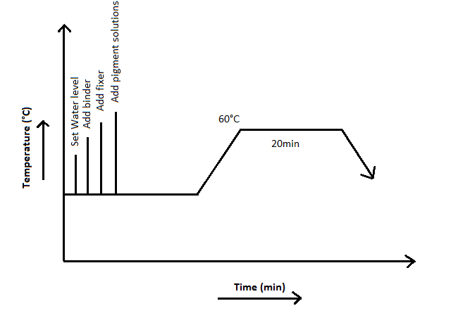
Process Curve

Slide 8
Precautions
Taking chemicals as per recipe provided by the Instructor.
Taking every weight of chemicals carefully.
Switch off the safety system of gas cylinder after complete the experiment.

Slide 9
Result & Discussion:
Sample Attachment:
Discussion: We observed here the fabric absorbed dyes solution very well.

Slide 10
Conclusion/Comments
We can say this experiment is successful because our treated fabric absorbed the dye solution & we also observed it bleed very low amount of dyes during hot & cold wash its due to optimum temperature and good quality of pigment and chemicals

Slide 11
Thank You

