Slide 1
Content
Transfer Printing
Ink Jet Printing
Flock Printing
Burnout Printing

Slide 2
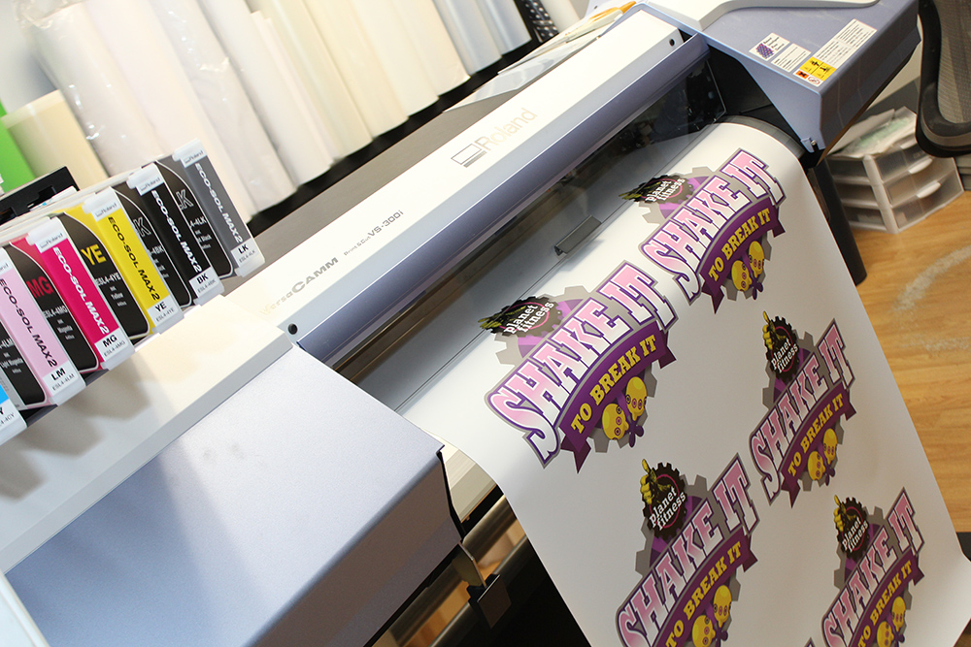
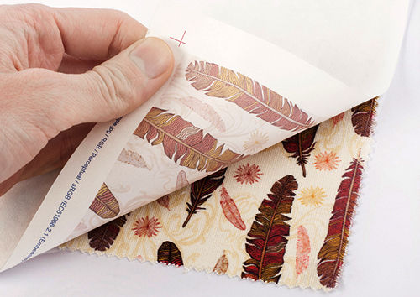
Transfer Printing

Slide 3
Transfer Printing
High Temperature and Pressure
Printed design on paper
Fabric (that is on to the bed)
Definition:
Transfer of design from paper onto fabric at high temperature and Pressure within short time (15-60s) without any image distortion.

Slide 4
Objectives
Critical or complex design
No limitation of color in the pattern
Low cost
Quicker and easier method
High production
To avoid the after treatment
To reduce the water pollution
To improve customer service

Slide 5
Conditions
Dyes are not soluble, sublime, substantive, less affinity to paper
Molecular weight should be 230-370
Physical, chemical and thermoplastic property of fibre should be good
Sublime readily at high temperature
High quality of paper
Easy transformation of design

Slide 6
Types of Transfer Printing
Four types :
Sublimation Transfer
Melt Transfer
Film Release
Wet Transfer

Slide 7
1.Sublimation Transfer
Dry, Vapor, Heat Transfer
Use volatile dyes
Dye is adsorbed from the vapor phase
1st step of Sublimation transfer:
Paper
Print paste
Paper Printing
Paper is dried at low temperature
2nd step of Sublimation transfer:
Sublime
Diffusion
Condensation
Diffusion again into interior of the fibre of the fabric

Slide 8
2. Melt Transfer
Design is printed on paper using a waxy ink
A hot iron applied to its reverse face & presses the paper against the fabric
Ink melts
Start printing (Italy in the late 1940s)

Slide 9
3. Film Release
Similar to melt transfer
Design is held in an ink layer

Slide 10
4. Wet Transfer
Water soluble dyes are incorporated into a printing ink
Transferred to a moistened textile
Aqueous medium

Slide 11
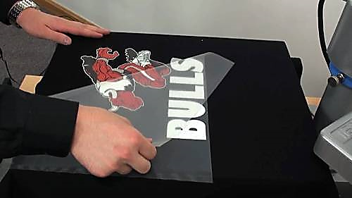
Quality of a transfer print paper
Weight : 35 to 115 gsm
Prevent the tearing in high speed printing
Exhibit good “hold-out”
Dimensionally stable
Good release of dye vapor
Thermally stable
Low permeability to the dye vapor
Smooth surface and metal free

Slide 12
Tradenames of Dyestuff suitable for transfer printing
Teraprint (Ciba-geigy) Swisscolor
Tranforon (Sandoz) Clariant
Resoline (Bayer) Dystar
Latyl (Du Pont)

Slide 13
Qualities of Printing Ink
Dyes must be volatile
Dyes molecules must be relatively small in size and should contain as few ionic substituents as possible
Vehicles (Solvents) should be a volatile liquid
Minimum number of polar auxochromes
Specially purified and dispersing agents
Most of the dyes are disperse dyes

Slide 14
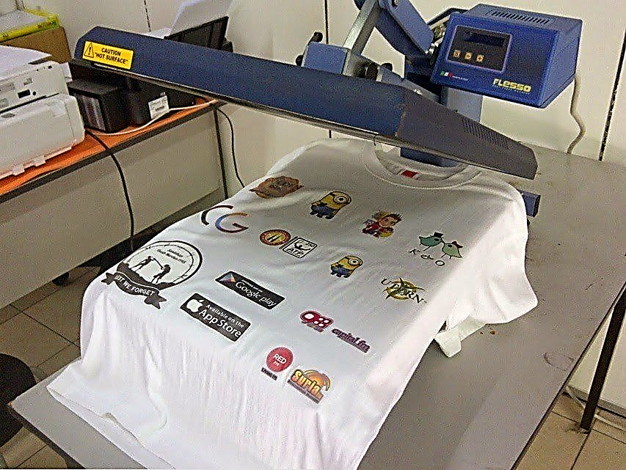
Types of Transfer Printing Machine
3 types-
Flat bed process transfer printing machine
Continuous transfer printing machine
Vacuum transfer printing machine
(Self Study)

Slide 15
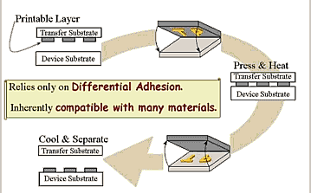
Mechanism of dye transfer
The stages of dye migration in transfer printing
Sublimation of the dyestuff on the paper
Diffusion ink layer into the gap between paper and fibre
Adsorption at the fibre surface
Diffusion of the dye from the surface to the fabric
Transfer Printing Methodology

Slide 16
Advantages of Transfer Printing
The capital cost of the equipment is low.
Space required is also small.
A skill printer is not required through careful control of temperature and pressure.
A clear and sharp definition of all objects is possible.
The proportion of sub-standard quantity is as low as 20%
Since the printed fabric does not required any after treatment, it does not contribute to water pollution problem.
It gives good prints on well prepared knitted goods.
No adverse effect on fabric’s feel and luster.
It allows excellent dye penetration into the fiber ( because transfer takes place at very high temperature).
Steaming, Washing, drying etc are not necessary.
Quicker reaction to changes in fashions.

Slide 17
Disadvantages of Transfer Printing
There is some restriction of the production of deep shade
High temp and pressure is required
Once printed cannot be corrected
Only limited dyestuff can be used for transfer printing
Lower production speed due to existing transfer calendars
Storage of large quantities of paper over prolonged period of time is a risk.

Slide 18
Limitations of Transfer Printing
Not applicable to all fiber specially which cannot stand under required temperature and pressure.
Sometimes the print paper is not available.

Slide 19
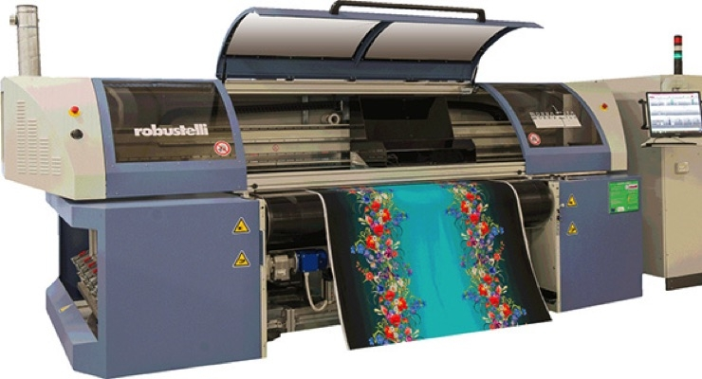
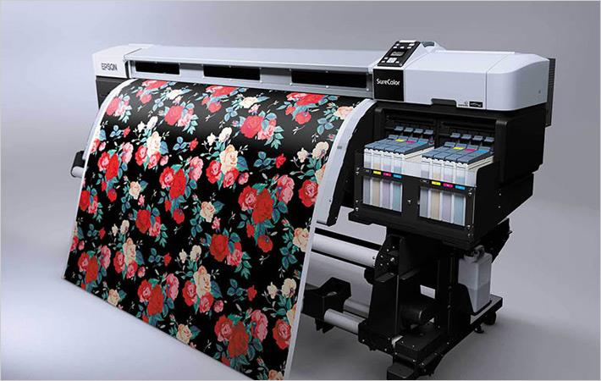
Ink Jet Printing
Definition : This is an innovative method of printing for the application of wonderful patterns to the textile materials where small droplets of dye solution are ejected and applied to a precise location.

Slide 20
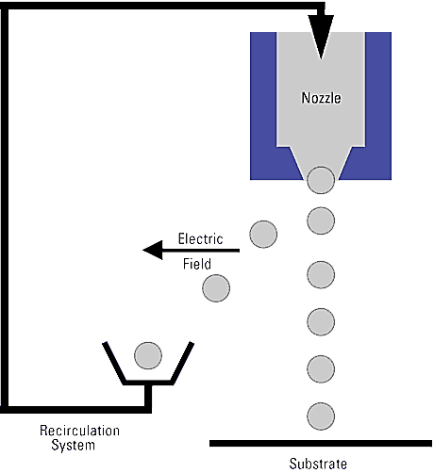
Types of Ink Jet Printing
Two types :
Continuous inkjet
Drop on Demand

Slide 21
1.Continuous inkjet
In this process drops are continuously produced & selectively printed.
The ink is forced at high pressure through a nozzle from 10 to 100 microns in dia.
The emerging stream of ink breaks into a small droplets.
Electric charge is imparted to the drops by placing a charge electrode.
The charge drops are deflected when they subsequently pass through an electric field.
The charge drops are used for printing and uncharged drops are collected in a catcher.

Slide 22
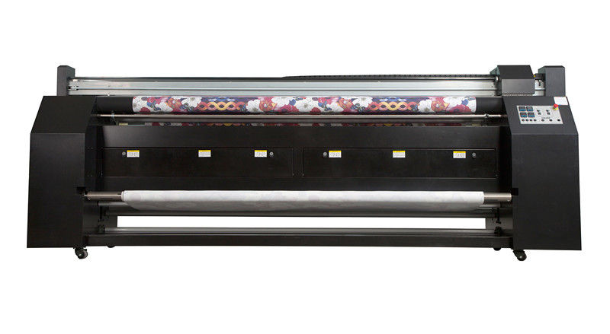
Process Flow-chart
Ink Unit
Design with CAD > CPU < Printer
Input
It is possible to control up to 30 different dot positions per nozzle (Multi-level application)
Figure : High Resolution Mimaki Textile Printer

Slide 23
2. Drop on Demand
In this process drops are produced when required.
Design Preparation
Scanning
Create the design in CAD
Directly formatting the digital pattern
Ink Formulation
Binder : 10 to 15%
Pigment : 2 to 4%
UV light Ink : 1 to 2%
Additives : 1 to 2%
Water : 70 to 80%

Slide 24
Types of Ink Used
For Cotton fibre
Reactive Inks (e.g. CibacronRAC X00 reactive inks, Huntsman, JetterxR reactive inks/ Dystar)
For Polyester fibre
Disperse inks (e.g. TerasilRAC X00 disperse inks, Huntsman, JetterxR disperse inks/ Dystar)
For Wool, Silk, Polyamaide fibres
Acid inks (e.g. LanaSetRAC X00 acid inks, Huntsman)
For all fibres
Pigment Inks (e.g. Helizarin EVO P 100 pigment inks, BASF)

Slide 25
Merits
Unlimited colors
Unlimited repeat length
Screen preparation is not required
Saving of expensive printing materials
Low energy consumption
High flexibility in exclusive design
Eco-friendly ( No wastage of print paste)
CAD system can be attached to the method

Slide 26
Demerits
Printing machine are not available commercially
Expensive machinery price
Printing speed limited
Very skilled operator is required

Slide 27
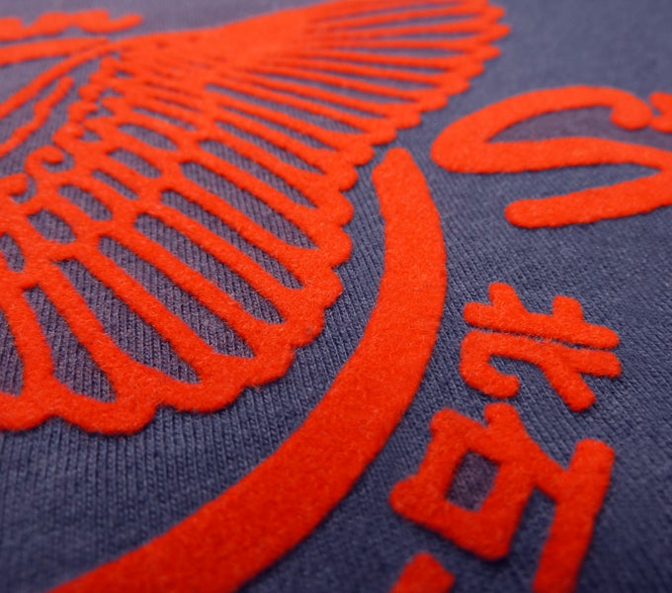
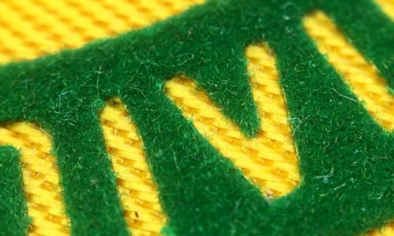
Flock Printing
Definition : Flock is the short fibre (0.5-1.0 mm) obtained from the spinning & weaving mills as dust or wastes.
Flock can be made by cutting filaments into small length of 0.5 to 1.0 mm.
Flocks may be white or colored. The process of flock application is called flocking.

Slide 28
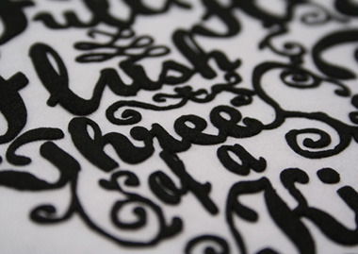
Process of Flocking
Flock preparation
Flock dyeing (Solid/Multi)
Fabric preparation
Adhesive applied on the fabric
(Fabric speed : 4-6 m/min)
Flock applied / Sprayed
Curing (for fixation)
Unfixed flocks are removed by air

Slide 29
Ways of application
There are two ways of application :
Flocks can be applied in flat form or
Can be applied right angle to the fabric surface and the end being anchored in the adhesive.
Methods of application
Dusting through a sieve or sprinkling with hand
Pneumatic or spraying with air under pressure
Electronic method
Adhesive : Synthetic resin can serve as a best adhesive for flock printing

Slide 30
A Typical Recipe
Paralac 67 : 40 Parts
Paralac 11 : 10 Parts
White spirit : 34 Parts
China Clay : 15 Parts
Lead Naphtholate (3% solution) : 0.8 Parts
Covalt Naphtholate (8% solution) : 0.3 Parts
Water : X Parts
Total : 1000 Parts

Slide 32
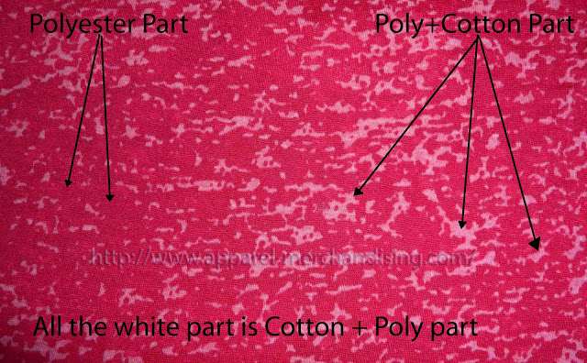
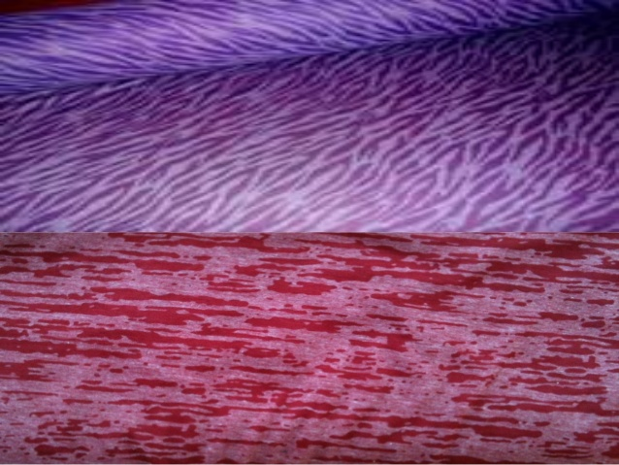
Burn Out Printing

Slide 33
Burn Out Printing
Nowadays Print is a very important thing for this textile sector. Print makes a clothes attractive. We can’t imagine a dress or clothes without print. Printing sector is also expanding and changing every day with the fashion trend. We are discovering new technic and qualities of print day by day. Print technology is growing up with the Clothes industry. 99% fashion clothes are now must have any print on it.
There are many kinds of print we can do on the clothes or fabric. Some print very basic and normal, these prints are very cheap also. But some print is very critical and rare. These kinds of print are more costly than basic normal print. But print makes a dress or clothes attractive and salable.

Slide 34
Burn Out Printing
The printing factory makes this print with the flat bed printing machine. The printing way of this print is same as a normal flat bed print, just printers use acid type chemical instead of color.
We can do this print only some selected fabric. This print is not possible on 100% cotton fabric. The best composition for this burn out print is 60% polyester and 40% cotton fabric. This print is also possible on 60% cotton and 40% polyester.
The main technique of burnout print is destroys the cotton portion of the fabric with Acid / Chemical. When the chemical flow over the fabric and contact with cotton portion, then it burn out the cotton by chemical reaction. Actually cotton is the victim here.

Slide 35
Chemicals of Burn Out Printing:
PC or CVC fabric
Paste + Any acid liberating salt (like NaCl, Na2SO4)
Steaming
Washing
Burnout print complete Only print technicians will understand the above 5 points.

Slide 36
Step by Step Printing Process of Burn out Print:
1st Step: Develop the print design and screen with the buyer provided artwork.
2nd Step: Knit the fabric with the yarn of following composition a) 60% polyester 40% cotton OR b) 40% polyester 60% cotton Or similar like that.
3rd Step: After complete the knitting of fabric send the gray or scouring fabric to printing factory.
4th Step: Perform the print on this fabric. Here, the cotton part will be destroyed by the acid but polyester portion will be remain same.
5th Step: Then we will dye and finished the fabric as per our require color. Hope, above description of burn out print is clear to all.

Slide 37
Important points regarding the Burnout print:
Burnout print is not possible on 100% cotton fabric. Clothes should be PC or CVC
60% polyester 40% cotton is the best composition for Burnout print.
Process loss is very high. More than 35%
Single jersey construction is the best construction for Burnout print.
If you need the finished fabric with 120 to 130 GSM then you should knit the fabric with 160 to 170 GSM.
Burnout print is not only expensive but also lucrative with nice feelings.

Slide 38
Faults of burn out printing
1. Extra burn
2. Wrong placement
3. Faulty fabric
4. Stains
5. Miss fitting of the design
6. Printing Machine Stop
7. Color out

Slide 39
Remedies of burn out printing
Control burn
Right placement
Quality full fabric can use
Checking all elements
Need skill full trainer

Slide 40
Thank you All

