Slide 1
Identifying and Preventing Hazards in Food Safety, Hygiene, and Sanitation Lab
Best Practices and Protocols for Safe Food Handling

Slide 2
Introduction
Importance of food safety, hygiene, and sanitation in the lab. Significance of identifying and preventing hazards for public health and safety

Slide 3
Objectives
Understanding common hazards, learning methods to identify and prevent hazards, implementing best practices for maintaining food safety

Slide 4
Common Hazards
Biological hazards (e.g., bacteria, viruses), Chemical hazards (e.g., cleaning agents, pesticides), Physical hazards (e.g., glass, metal fragments).

Slide 5
Biological Hazards
Bacteria (e.g., Salmonella, E. coli), Viruses (e.g., Norovirus, Hepatitis A), Parasites (e.g., Cryptosporidium, Trichinella), mycotoxin( fungul and mold)

Slide 6
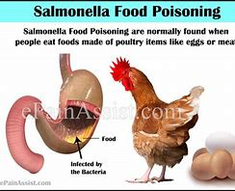
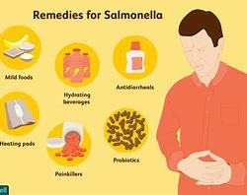
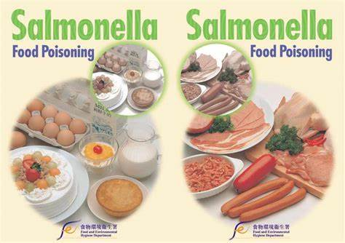
Salmonella poisoning

Slide 7
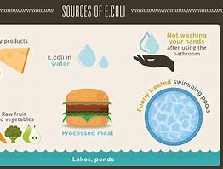
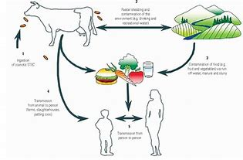
E.Coli

Slide 8
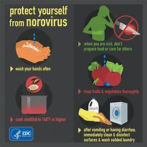
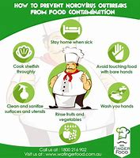
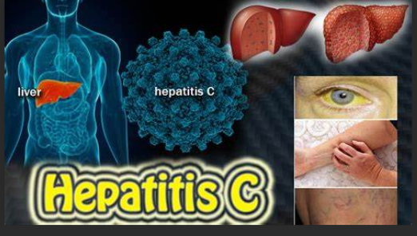
Norovirus and hepatitis

Slide 9
Video

Slide 10
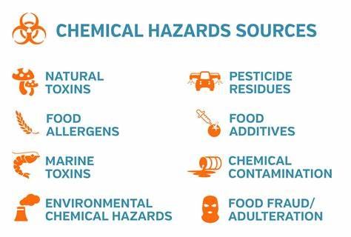
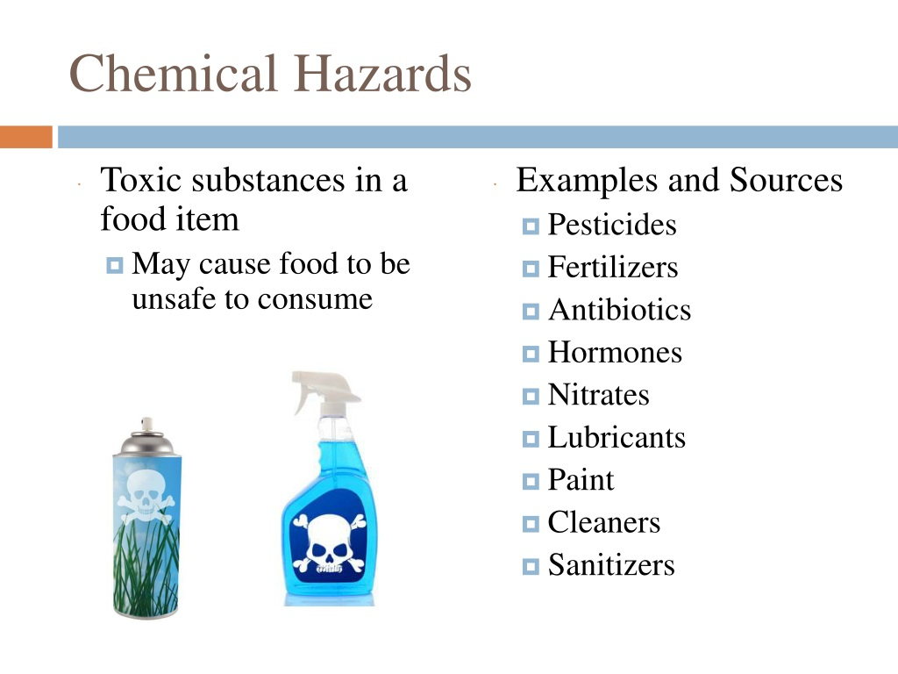
Chemical Hazards
Cleaning agents (e.g., bleach, ammonia), Pesticides and herbicides, Food additives and preservatives.

Slide 11
Video

Slide 12
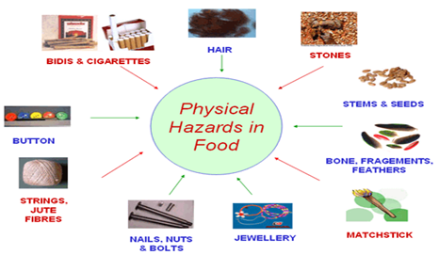
Physical Hazards
Glass or metal fragments from equipment, Foreign objects like hair or jewelry, Contaminants from packaging materials

Slide 13
Video

Slide 14
Identifying Hazards
Regular inspections and audits, Hazard analysis and critical control points (HACCP), Training staff on hazard recognition and reporting procedures

Slide 15
Preventing Hazards
Proper sanitation and hygiene practices, Using personal protective equipment (PPE), Storing chemicals and hazardous materials safely, Regular equipment maintenance and calibration

Slide 16
Best Practices
Handwashing protocols, Proper food storage and handling techniques, Temperature control measures, Cross-contamination prevention

Slide 17
Conclusion
Summary of key points discussed. Importance of vigilance in identifying and preventing hazards to maintain food safety

