Slide 1
Food Processing in the Kitchen
Enhancing Safety and Efficiency

Slide 2
Content
Explanation of why food processing is crucial in the kitchen
Benefits of proper food processing techniques

Slide 3
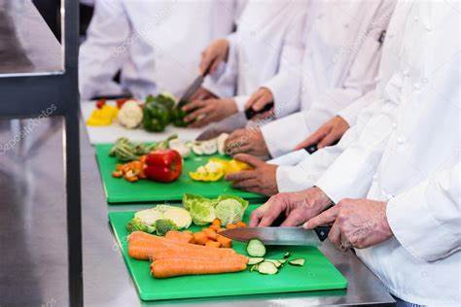
Introduction to Food Processing
Food processing refers to the transformation of raw ingredients into consumable food products through various techniques and methods

Slide 4
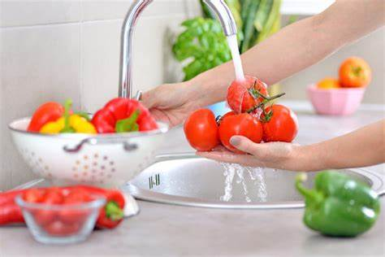
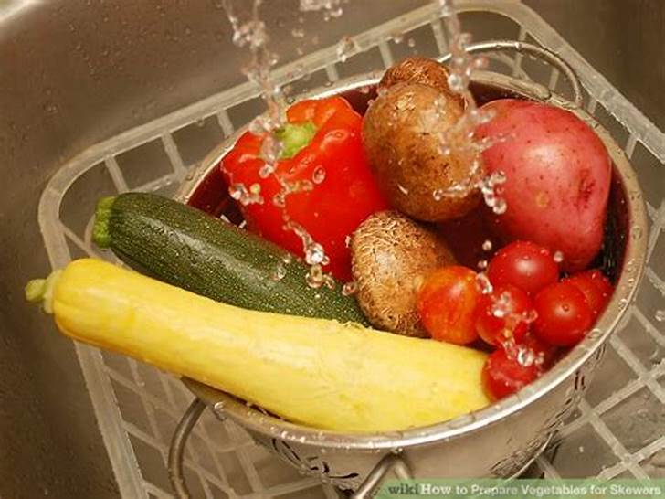
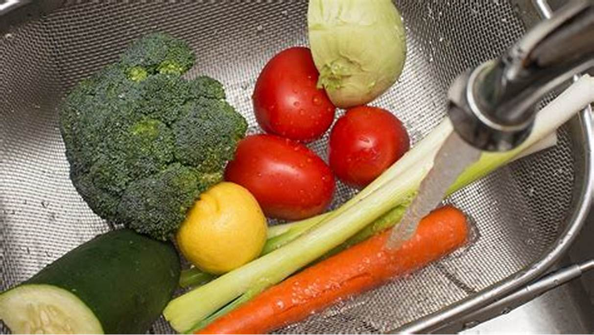
Importance of Food Processing
Food processing helps improve food safety, extend shelf life, enhance flavor, and increase convenience

Slide 5
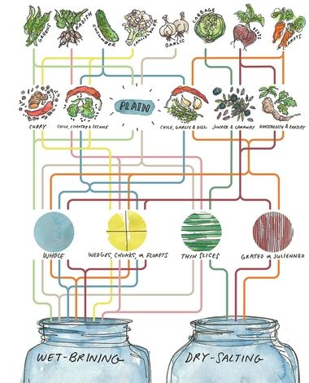
Methods of Food Processing
There are various methods of food processing, including chopping, blending, cooking, freezing, and fermenting

Slide 6
Fermentation Process
Fermentation is a process by which microorganisms (such as- yeast or bacteria) eating carbohydrates in food. This transform them into alcohol, acids, heat and carbon di oxide
In restaurant or kitchen , fermented food product can easily available
To begin, , start by slicing up vegetables of choice
transfer the cut vegetables into non- reactive container and add a salt brine. 2.5% of ratio is widely used in vegetables
we use Noma’s fermentation video

Slide 7
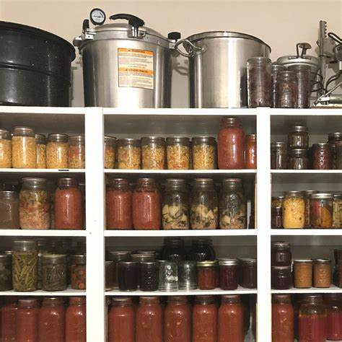
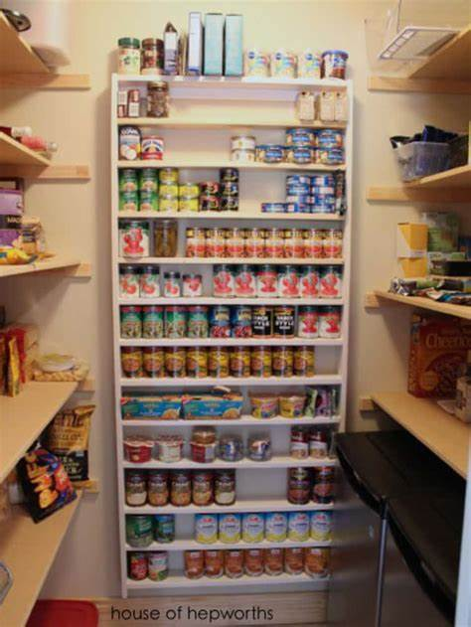
Safety Measures in Food Processing
Safety measures in food processing involve proper hygiene, temperature control, cross-contamination prevention, and equipment sanitation

Slide 8
Canned food
Canning is a method of food preservation in which food is processed and sealed in an airtight container
Canning provides a shelf life that typically ranges from one to five years
Canned food can be contaminated by Fungus mold , only one bacteria Clostridium botulinum ( neurotoxin)
seafood, meat, beef, corn, peas can be canned under some circumtances

Slide 9
Blenching
Blenching is scaling vegetable in boiling water or steam for a short time
It is typically followed by quick, thorough cooling in very cold and ice water
Blenching stops enzyme reactions which otherwise cause loss of flavor, color and texture
Improper blenching can cause harm. It have a risk to contaminated food

Slide 10
Common Tools and Equipment
Common tools and equipment used in food processing include knives, blenders, food processors, mixing bowls, and cooking appliances

Slide 11
Challenges and Solutions
Challenges in food processing may include time constraints, ingredient availability, and equipment maintenance
Processing of food can decrease its nutritional density. The amount of nutrients lost depends on the food and processing method. For example, heat destroys vitamin C. Therefore, canned fruits possess less vitamin C than their fresh alternatives. The USDA conducted a study of nutrient retention in 2004, creating a table of foods, levels of preparation, and nutrition

Slide 12
Solutions involve proper planning, substitution of ingredients, and regular equipment maintenance
Proper Planning:
Develop a detailed schedule for each batch, considering factors like temperature and fermentation time
Substitution of Ingredients:
Use high-quality, fresh ingredients and experiment with different types for unique flavors
Equipment Maintenance:
Regularly clean and sanitize equipment, and ensure proper functioning of temperature controls
Quality Control:
Monitor the process closely for correct fermentation or blanching, and taste-test samples regularly
Documentation and Record-Keeping:
Keep detailed records of each batch to identify trends and troubleshoot issues
Training and Education:
Provide staff training on proper techniques and food safety practices

