Slide 1
Sensory Evaluation in Food Service
Made by- Nuvia

Slide 2
Introduction
- Sensory evaluation is a scientific discipline that analyses and measures human responses to the composition and nature of foods and beverages
- In food service, sensory evaluation plays a crucial role in ensuring product quality, customer satisfaction, and menu development

Slide 3
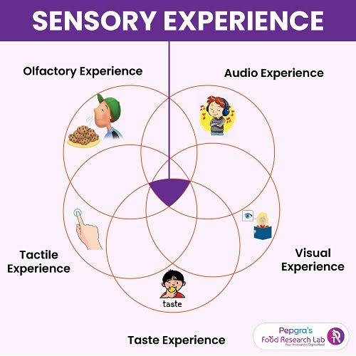
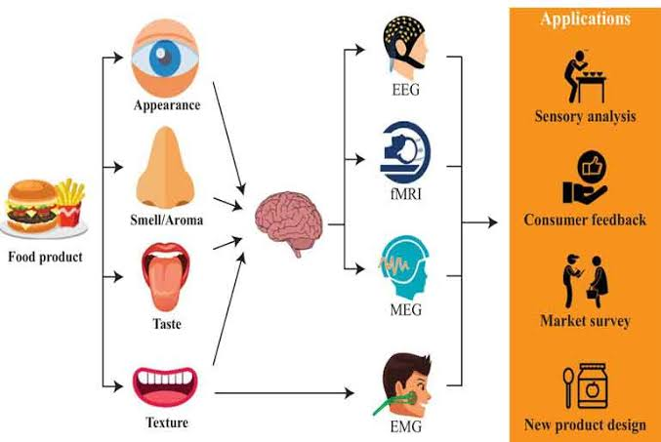
Sensory Experience

Slide 4
Objectives of Sensory Evaluation in Food Service
- Quality Control: Assessing the consistency of and quality of food products meet standard
- Product Development: creating and refining new recipes or menu items based on consumer preferences
- Customer Satisfaction: Understanding and meeting the sensory expectations and preferences
- Market Research: Gathering feedback on products to identify trends and opportunities in the market
- Training: educating staff on sensory evolution techniques to maintain product consistency and quality

Slide 5
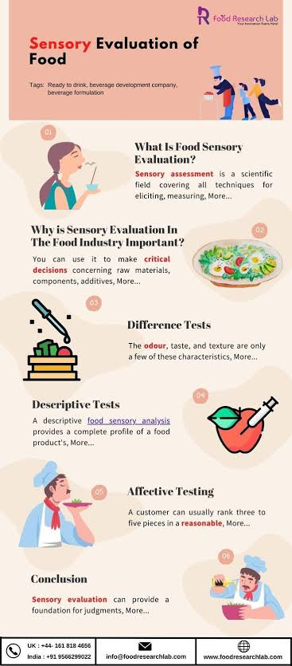

Slide 6
Key Components of Sensory Evaluation:
- Sensory Attributes- identifying and defining sensory characteristics
- Evaluation Methods- Utilizing sensory evaluation technique including discrimination tests, descriptive analysis and consumer testing
- Panel Selection- Recruiting trained sensory panelists or consumers representative of target market to evaluate products
- Data Analysis- analyzing sensory data to draw conclusion and make informed decisions about product quality and consumer preferences

Slide 7
Practical Applications
- Menu Development- Using sensory evaluation to create appealing and flavorful menu items that resonate with customers
- Quality Assurance- Implementing sensory evaluation protocols to ensure consistent product quality and adhere to standard
- Marketing- Highlighting sensory attributes in product descriptions and promotions to attract customers
- Product Differentiation- leveraging unique sensory characteristics to distinguish products from competitors in the market

Slide 8
Conclusion
- Sensory evaluation is a valuable tool in food service operations for maintaining quality, meeting customer expectations, and driving business success.
- By understanding and utilizing sensory data effectively, food service professionals can enhance product offerings and stay competitive in the industry.

