Slide 1
Idea Generation Techniques

Slide 2
Forced Relationship
Isolate the elements of the problem
Find the relationships between these elements (Similarities/Differences/Analogies/Causes and effects)
Record the relationships in an orderly form
Analyze the resulting relationships to find ideas or patterns
Develop new ideas from these patterns

Slide 3
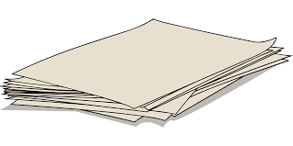
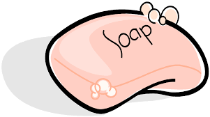

Slide 4
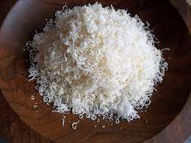
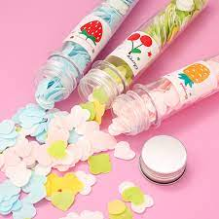
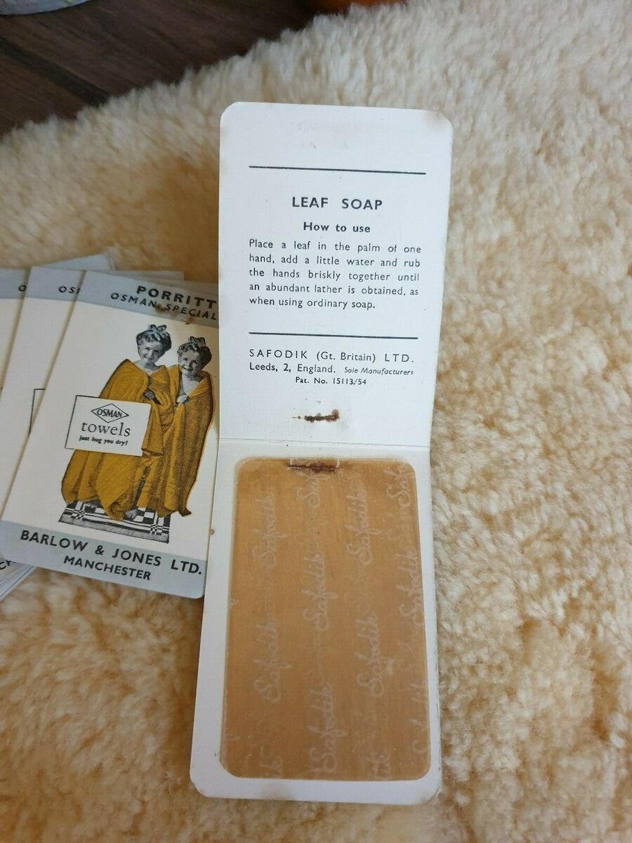
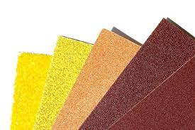
Illustration of “Forced Relationship” technique
Elements: Soap and Paper
Relationship/Combination | Idea/Pattern
Soapy paper Papery soap Paper soaps Soaped papers Soap “cleans” paper Soap “wets” paper | Wash and dry travel aid Flakes Tough paper impregnated with soap and usable for washing surfaces Booklets of soap leaves In coating and impregnation processes Suggests Wallpaper cleaner

Slide 10
Thank You!

