Slide 1
Airplane Game

Slide 2
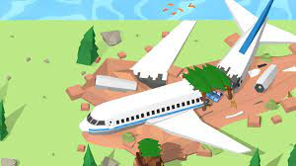

Slide 3
The plane will explode after 10 minutes!

Slide 4
There are 15 things in the airplane out of which you can take only 3
Box of matches
Crate of beer
Crate of water
5 warm sweaters
First Aid Kit
Transistor Radio
Axe
Gun with 20 bullets
Bag with 25 magazines
Inflatable lifeboat for 2
Compass
Anti insect spray
Sewing Kit
Flashlight
Bag with 5 big blankets

Slide 5
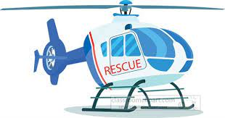

Slide 6
!!!!!!!!!
But in the midway, pilot finds out there isn't enough kerosine oil, the plane needs to reduce weight, only one person among the group of five can stay along with the pilot, rest 4 needs to sacrifice their lives.
Through mutual discussion each team has to come up with a decision who will stay

Slide 7
Q&A
Was it easy to come to an unified decision together?
What worked?
What didn't work?
Who took the lead?
Who preferred to be leaded?
How can you make a decision even faster without losing the quality of the decision?

