Slide 1
Pharmaceutical Biotechnology (BPH 421)
Galib Muhammad Abrar Ishtiaque
Lecturer (Senior Scale)
Department of Pharmacy
Daffodil International University

Slide 2
Gene Therapy
CONTENTS
Gene Therapy
Gene Therapy Based on Cell Types
Gene Therapy Techniques
Gene Therapy Approaches
Gene Delivery Systems
Transgenic vs Knockout Animals
Problems Associated with Gene Therapy

Slide 3
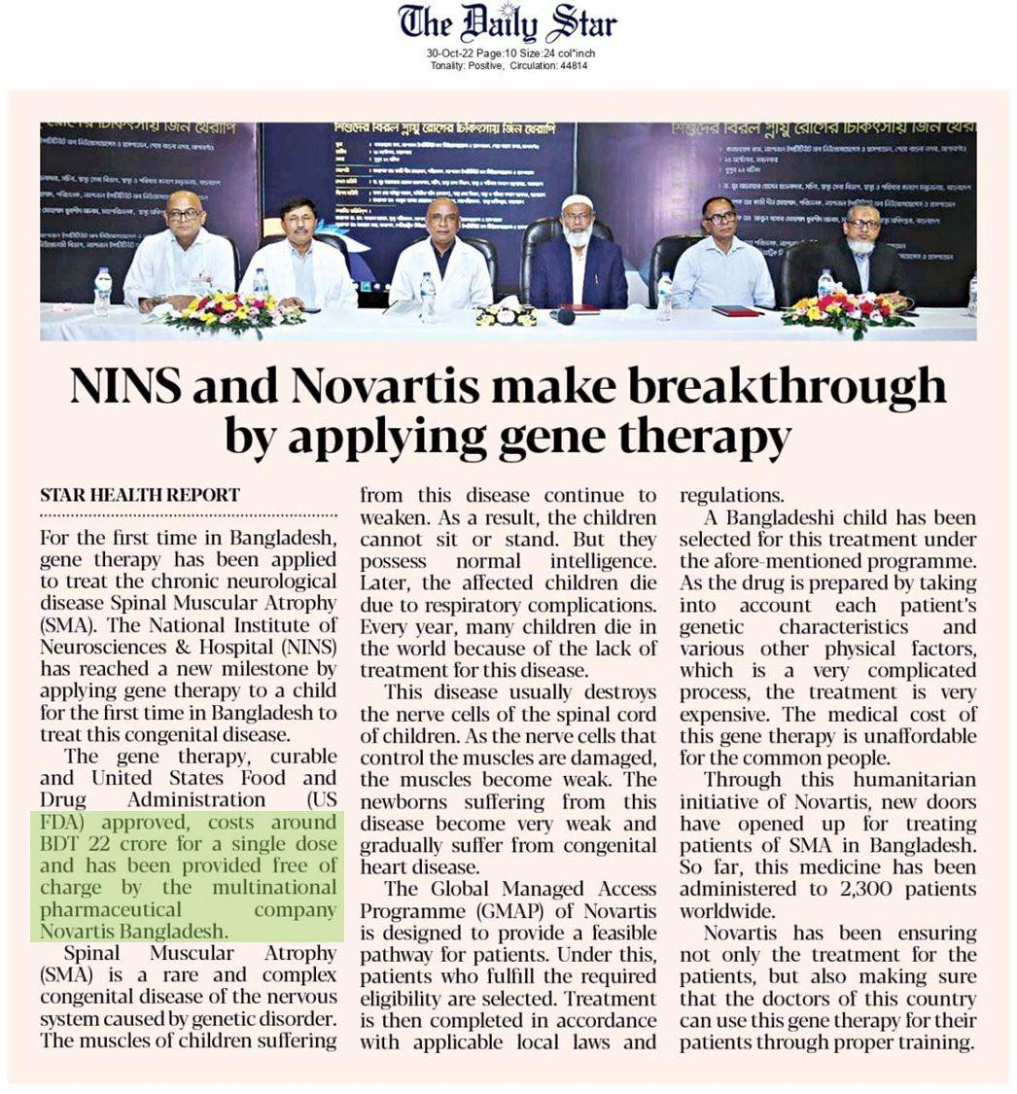
Gene Therapy

Slide 4
Gene Therapy
Gene therapy is a medical field which focuses on the genetic modification of cells to produce a therapeutic effect or the treatment of disease by repairing or reconstructing defective genetic material.
Gene therapy is when DNA is introduced into a patient to treat a genetic disease.
The new DNA usually contains a functioning gene to correct the effects of a disease-causing mutation.

Slide 5
Gene Therapy Based on Cell Types
Gene therapy can be classified in two types based on the cells that are being treated:
Germline Gene Therapy
Somatic Gene Therapy
Germline gene therapy involves transfer of a section of DNA to cells that produce eggs or sperm. Effects of gene therapy will be passed onto the patient’s children and subsequent generations.
Somatic gene therapy involves transfer of a section of DNA to any cell of the body that doesn’t produce sperm or eggs. Effects of gene therapy will not be passed onto the patient’s children.

Slide 6
Gene Therapy Techniques
There are various techniques applied to perform gene therapy:
Gene Augmentation Therapy
Gene Inhibition Therapy
Killing Specific Cells

Slide 7
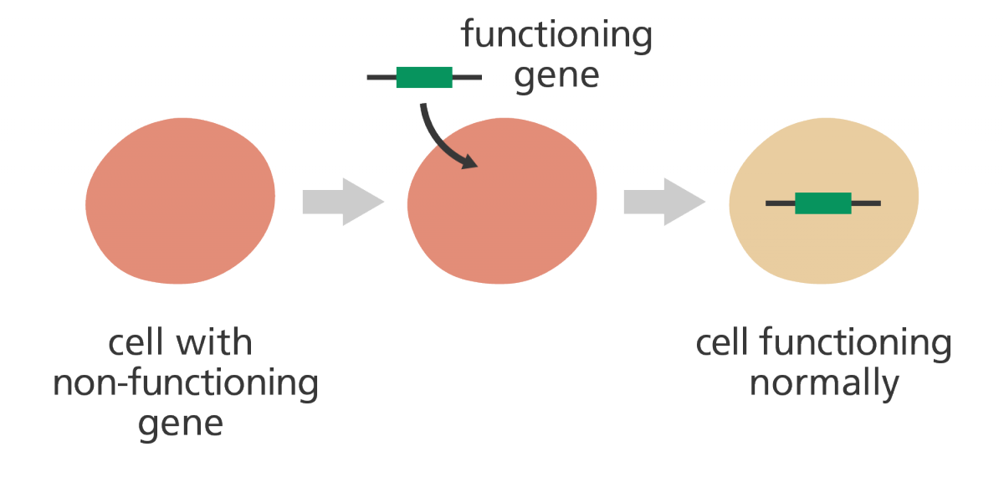
Gene Therapy Techniques
Gene Augmentation Therapy:
Here a functional gene is introduced, which produces sufficient levels of proteins to compensate for non-functional genes. This is used to treat disease where there is a loss of function. E.g. cystic fibrosis, adenosine deaminase (ADA) deficiency, etc.

Slide 8
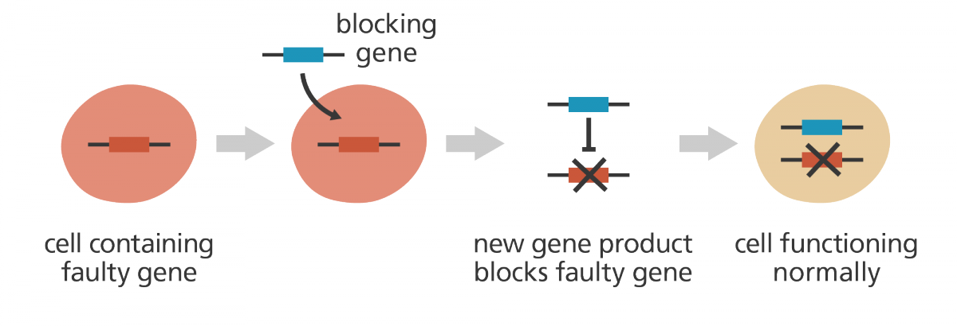
Gene Therapy Techniques
Gene Inhibition Therapy:
This is used when a gene activity is altered and needs to be suppressed, e.g. cancer, infectious diseases. Here a gene is introduced, which either inhibits the gene expression of another gene or interferes with the activity of another gene product. E.g. gene inhibition therapy can be used to eliminate the activity of oncogenes and prevent further uncontrolled growth of cells.

Slide 9
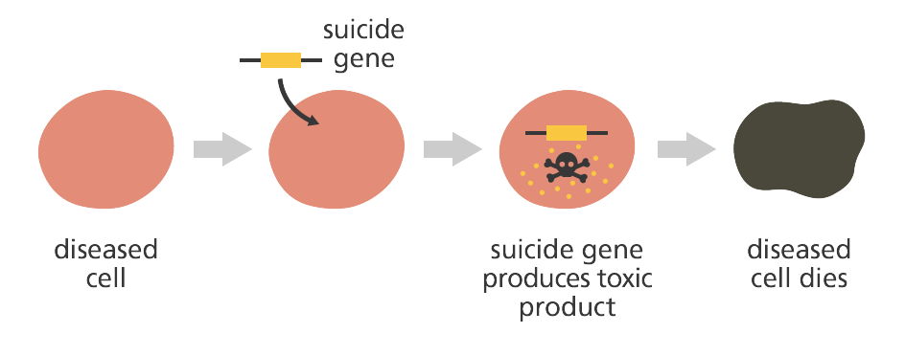
Gene Therapy Techniques
Killing Specific Cells:
This is used to destroy a group of cells such as in cancer. Here a specific DNA called suicide DNA is inserted into diseased cells in order to destroy it. The inserted DNA produces a product that helps the immune system to identify and attack those cells. It is important to target only diseased cells so that functional cells do not die.

Slide 10
Gene Therapy Approaches
Gene therapy involves either any one of three approaches mentioned below:
In vitro Approach
In situ Approach
In vivo Approach

Slide 11
Gene Therapy Approaches
In vitro Approach:
This is the most common approach.
The in vitro approach involves the initial removal of the target cells from the body.
These are then cultured in vitro and incubated with a vector containing the nucleic acid to be delivered.
The genetically altered cells are then re-introduced into the patient’s body.
In order to be successful, the target cells must be relatively easy to remove from the body and reintroduce into the body.
Such in vitro approaches have been including blood cells, stem cells, epithelial cells, muscle cells, and hepatocytes.

Slide 12
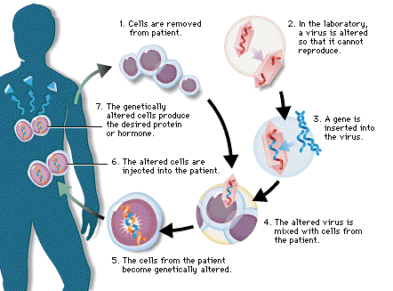
Gene Therapy Approaches
In vitro Approach:

Slide 13
Gene Therapy Approaches
In situ Approach:
A second approach involves the direct injection administration of nucleic acid containing vector to the target cells in situ (localized tissue) in the body.
Examples of this approach includes the direct injection of vectors into a tumor mass, as well as aerosol administration of vectors (e.g. containing the cystic fibrosis gene) to respiratory tract epithelial cells.
It possesses several advantages, such as the reduction in potential side effects, the need for a lower vector dose, and, as a consequence, reduced costs, compared to intravenous administration.
In situ injection of vector into the target cell is not always feasible if the target cells are not localized to one specific area of the body (e.g. blood cells).

Slide 14
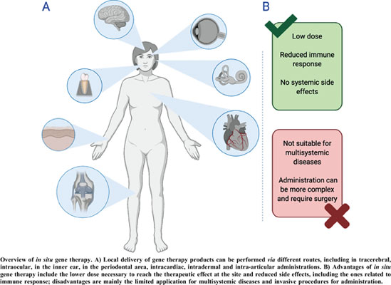
Gene Therapy Approaches
In situ Approach:

Slide 15
Gene Therapy Approaches
In vivo Approach:
In vivo approach involves the utilization of vectors capable of recognizing and binding only to specific, predefined types of cells which administered easily by IV infusion.
Through appropriate bio-specific interactions, they deliver their nucleic acid to specific target cells. The simplicity & specificity makes it the method of choice.

Slide 16
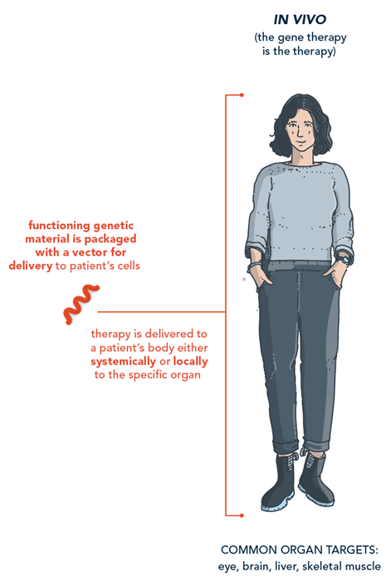
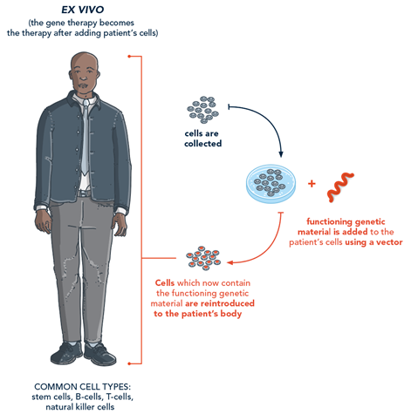
Gene Therapy Approaches
In vivo Approach:

Slide 17
Gene Therapy Approaches
Term | Meaning (Latin) | Location of Study | Example | Key Use
In Vivo | “Within the living” | Inside a living organism | Testing a drug in a live mouse | Whole-organism studies (physiology, pharmacology)
In Vitro | “In glass” | Outside the organism, in a controlled environment (e.g., test tube, culture dish) | Culturing cells in a petri dish | Cell biology, drug screening, molecular biology
In Situ | “In its original place” | In the natural location within the body/tissue | In situ hybridization on tissue sections | Localized molecular detection or analysis (without removal)
Ex Vivo | “Out of the living” | On organs/tissues removed from the body, studied immediately or short-term | Studying heart tissue contractions outside the body | Organ/tissue function, transplantation research
Ex Vitro | “Out of glass” | Material removed from in vitro conditions and transferred elsewhere (less commonly used term) | Moving cultured plantlets from lab to soil | Plant biology, tissue engineering transition phase

Slide 18
Gene Delivery Systems
A carrier molecule called a vector must be used to deliver the therapeutic gene to the patient's target cells.
There are two major delivery systems for gene transfer﻿﻿.
Viral-mediated gene delivery:
Various viruses are used as carrier, e.g. retrovirus, adenovirus. adeno-associated virus, herpes simplex virus, etc.﻿﻿﻿
Non viral-mediated gene delivery:
Various types of synthetic vectors are used, e.g. gold, silver, silica, carbon nanotube, etc.

Slide 19
Gene Delivery Systems
Viral-mediated gene delivery:
Retroviruses: A class of viruses that can create double-stranded DNA copies of their RNA genomes. These copies of its genome can be integrated into the chromosomes of host cells. Human immunodeficiency virus (HIV) is a retrovirus.
Adenoviruses: A class of viruses with double-stranded DNA genomes that cause respiratory, intestinal, and eye infections in humans. The virus that causes the common cold is an adenovirus.
Adeno-associated Viruses: A class of small, single-stranded DNA viruses that can insert their genetic material at a specific site on chromosome 19.
Herpes Simplex Viruses: A class of double-stranded DNA viruses that infect a particular cell type, neurons. Herpes simplex virus type 1 is a common human pathogen that causes cold sores.

Slide 20
Gene Delivery Systems
Non viral-mediated gene delivery:
Non-viral vectors principally comprise cationic liposomes, which are effectively cationic lipid bilayers capable of enveloping (anionic) plasmid DNA.
Liposomes can incorporate into cell membranes, liberating their DNA content into the cytoplasm.
Liposomes have found favor in many quarters because they are relatively easy to produce and administer.
Liposomes do not carry the theoretical risks of oncogenesis or superinfection that may accompany the use of some viruses.
Liposomes are biologically inert, and thus amenable to repeated administration without inducing inflammatory or immune responses, although this position has been challenged recently.

Slide 21
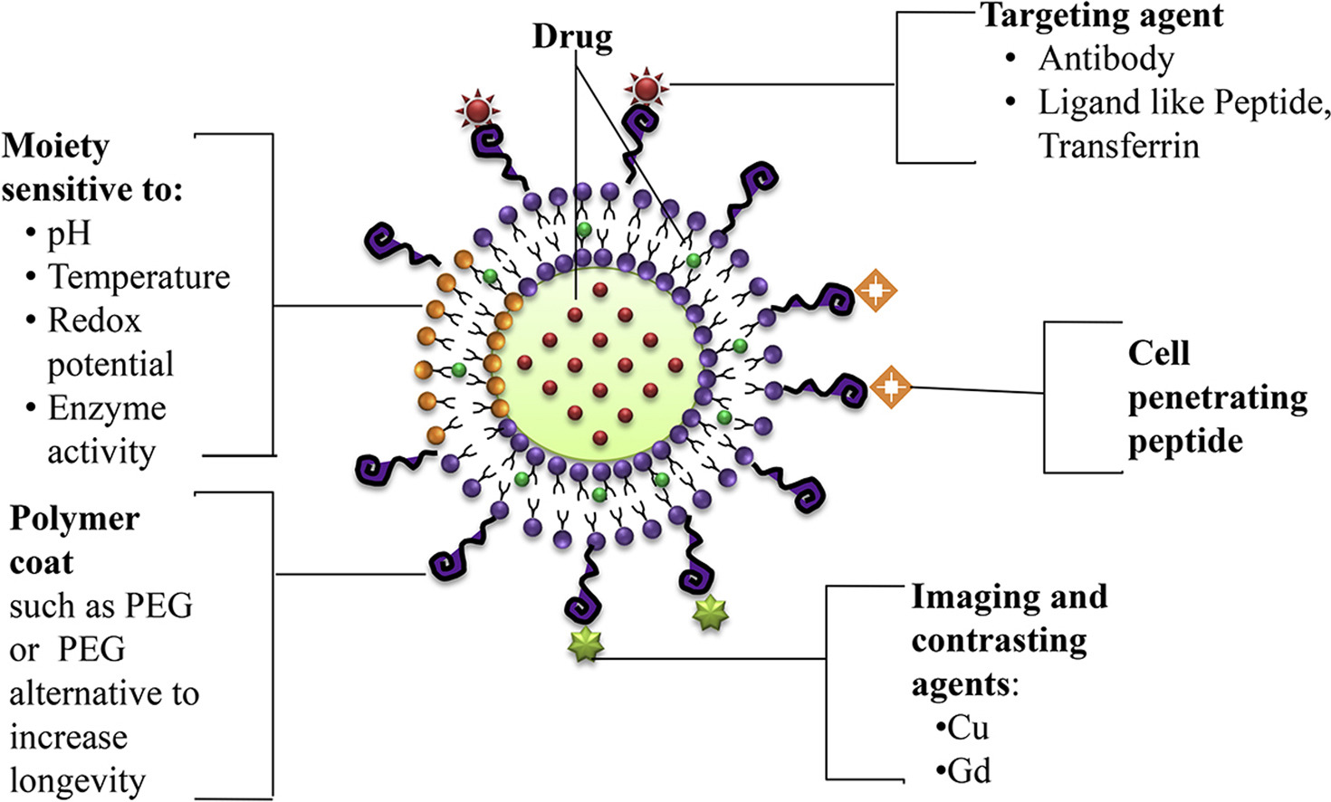
Gene Delivery Systems
Non viral-mediated gene delivery:

Slide 22
Gene Delivery Systems
PEGylation method is important for protein drug delivery because:
Since PEG contains the –OH group, it has enhanced solubility, so increases distribution.
Although it is synthetic, it bypasses the immune response.
Normal cell cytoplasm pH and cancerous cell cytoplasm pH differs. PEGylated liposomes specifically target cancer cells (low in pH), and not regular cell cytoplasm.
However, a major limitation of liposome vector includes vast majority of the nucleic acid carried into cells is directed into, and degraded by endosomes before reaching the nucleus.
The small proportion of DNA reaching the nucleus is usually only transiently and weakly expressed.

Slide 23
Transgenic vs Knockout Animals
A transgenic animal is one that carries a foreign gene that has been deliberately inserted into its genome. The foreign gene is constructed using recombinant DNA methodology. In addition to a structural gene, the DNA usually includes other sequences to enable it (i) to be incorporated into the DNA of the host and (ii) to be expressed correctly by the cells of the host.
A knockout animal is a genetically engineered animal in which one or more genes have been turned off through a gene knockout. Knockout mice are important animal models for studying the role of genes which have been sequenced, but have unknown functions. By causing a specific gene to be inactive in the mouse, and observing any differences from normal behavior or condition, researchers can infer its probable function.

Slide 24
Transgenic vs Knockout Animals
Use of Transgenic animals:
Transgenic animals are used as experimental models to perform phenotypic tests with genes whose function is unknown or to generate animals that are susceptible to certain compounds or stresses for testing in biomedical research.
Transgenic mice are often used to study cellular and tissue-specific responses to disease.
Other applications include the production of human hormones, such as insulin.
Transgenic sheep and goats have been produced that express foreign proteins in their milk.
Transgenic chickens are now able to synthesize human proteins in the "white" of the eggs.

Slide 25
Transgenic vs Knockout Animals
Use of Knockout animals:
Knocking out the activity of a gene provides information about what that gene normally does. Humans share many genes with mice. Consequently, observing the characteristics of knockout mice gives researchers information that can be used to better understand how a similar gene may cause or contribute to disease in humans.
Examples of research in which knockout mice have been useful include studying and modeling different kinds of cancer, obesity, heart disease, diabetes, arthritis, substance abuse, anxiety, aging and Parkinson's disease.
Knockout mice also offer a biological and scientific context in which drugs and other therapies can be developed and tested.

Slide 26
Problems Associated with Gene Therapy
Short-lived nature and impact on multigenetic disorders:
Gene therapies are short-lived in nature.
So, it is sometimes necessary to have multiple rounds of therapy.
Heart disease, high blood pressure, Alzheimer’s, arthritis and diabetes are hard to treat because you need to introduce more than one gene.
This may induce a tumor if integrated in a tumor suppressor gene because of insertional mutagenesis.

Slide 27
Problems Associated with Gene Therapy
Effects on the immune response:
The role of the immune system is to fight off intruders.
Sometimes new genes introduced by gene therapy are considered potentially-harmful intruders.
This can spark an immune response in the patient, that could be harmful to them.
Scientists therefore have the challenge of finding a way to deliver genes without the immune system ‘noticing’.
This is usually by using vectors that are less likely to trigger an immune response.

Slide 28
Problems Associated with Gene Therapy
Selective function of the new gene without disruption of the function of other genes:
Ideally, a new gene introduced by gene therapy will integrate itself into the genome of the patient and continue working for the rest of their lives.
There is a risk that the new gene will insert itself into the path of another gene, disrupting its activity.
This could have damaging effects, for example, if it interferes with an important gene involved in regulating cell division, it could result in cancer.

Slide 29
Problems Associated with Gene Therapy
Delivering the gene to the right place and switching it on:
It is crucial that the new gene reaches the right cell.
Delivering a gene into the wrong cell would be inefficient and could also cause health problems for the patient.
Even once the right cell has been targeted the gene has to be turned on.
Cells sometimes obstruct this process by shutting down genes that are showing unusual activity.

Slide 30
Problems Associated with Gene Therapy
The cost of gene therapy:
Many genetic disorders that can be targeted with gene therapy are extremely rare.
Gene therapy therefore often requires an individual, case-by-case approach.
This may be effective, but may also be very expensive.

Slide 31
The End

