Slide 1
Decision Support Systems and Business Intelligence
MIS 406: Decision Support Systems

Slide 2
Managerial Decision Making
Management is a process by which organizational goals are achieved by using resources
  Inputs: resources
  Output: attainment of goals
  Measure of success: outputs / inputs
Management ≅ Decision Making
Decision making: selecting the best solution from two or more alternatives

Slide 3
The nature of managers’ work
Mintzberg's 10 Managerial Roles
Interpersonal
1. Figurehead
2. Leader
3. Liaison
Informational
4. Monitor
5. Disseminator
6. Spokesperson
Decisional
7. Entrepreneur
8. Disturbance handler
9. Resource allocator
10. Negotiator

Slide 4
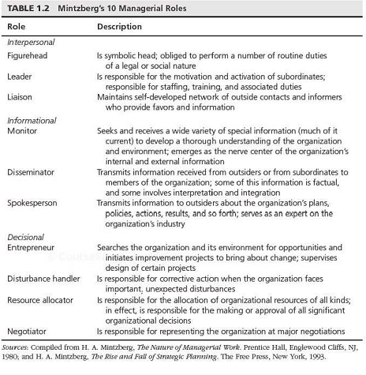

Slide 5
The process of decision making
Managers usually make decisions by following a four-step process (the scientific approach)
  Define the problem (or opportunity)
  Construct a model that describes the real-world problem
  Identify possible solutions to the modeled problem and evaluate the solutions
  Compare, choose, and recommend a potential solution to the problem

Slide 6
The process of decision making
y= mx + c
Total cost= variable cost per unit × production unit+ fixed cost
Solution model for the problem of finding the minimum total cost.

Slide 7
Decision making is difficult, because
Technology, information systems, advanced search engines, and globalization result in more and more alternatives from which to choose
Government regulations and the need for compliance, political instability and terrorism, competition, and changing consumer demands produce more uncertainty, making it more difficult to predict consequences and the future
Other factors are the need to make rapid decisions, the frequent and unpredictable changes that make trial-and-error learning difficult, and the potential costs of making mistakes

Slide 8
Information Systems Support for Decision Making (why use computerized decision support?)
Group communication and collaboration
Improved data management
Managing data warehouses and Big Data
Analytical support
Overcoming cognitive limits in processing and storing information
Knowledge management
Anywhere, anytime support

Slide 9
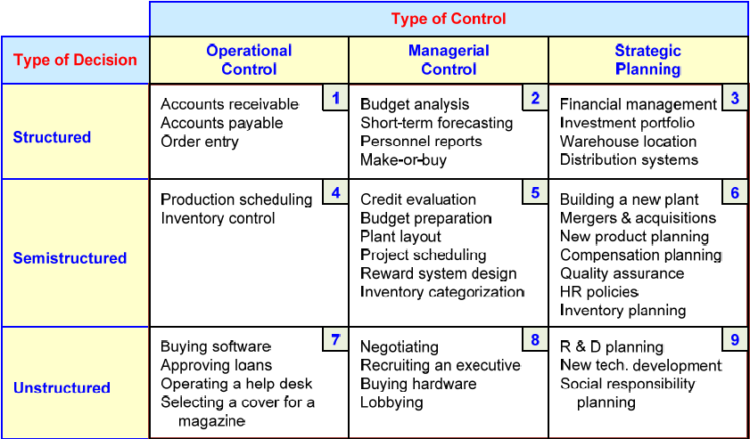
An Early Framework for Computerized Decision Support
(The Gorry and Scott-Morton Classical Framework)

Slide 10
An Early Framework for Computerized Decision Support
(The Gorry and Scott-Morton Classical Framework)
Degree of Structuredness (Simon, 1977)
  Decision / Decision making process are classified as
    Highly structured ( programmed)
    Semi-structured
    Highly unstructured (i.e., non-programmed)
Types of Control (Anthony, 1965)
  Strategic planning (top-level, long-range)
  Management control (tactical planning, mid-level)
  Operational control (low-level)

Slide 11
An Early Framework for Computerized Decision Support
(The Gorry and Scott-Morton Classical Framework)
  Types of control in all managerial activities
    Strategic planning
      Defining long range of goals and policies for resource allocation
    Management control
      Acquisition and efficient use of resources for organizational goal
    Operational control
      Efficient and effective execution of specific task.
  The decision support matrix
    For semi-structured decisions and unstructured decisions, conventional MIS and MS (mgt Sc) tools are insufficient
    Decision support systems (DSS) are used for unstructured problems.

Slide 12
Computer Support for Structured Decisions
Structured problems: encountered repeatedly, have a high level of structure.
It is possible to abstract, analyze, and classify them into specific categories
  e.g., make-or-buy decisions, capital budgeting, resource allocation, distribution, procurement, and inventory control
For each decision category, an easy-to-apply prescribed model and solution approach have been developed, generally as quantitative formulas. Therefore, a scientific approach can be used to automate portions of managerial decision-making. This process is called Management Science
Notes:
Management science- The application of a scientific approach and mathematical models to the analysis and solution of managerial decision situations (e.g., problems, opportunities)
Automated Decision Making –
A relatively new approach to supporting decision-making
Applies to highly structured decisions
An ADS is a rule-based system that provides a solution, usually in one functional area, to a specific repetitive managerial problem, usually in one industry.
e.g., simple-loan approval system
ADS initially appeared in the airline industry called revenue (or yield) management (or revenue optimization) systems
dynamically price tickets based on actual demand
Today, many service industries use similar pricing models
ADS are driven by business rules!

Slide 13
Computer Support for
Unstructured Decisions
Unstructured problems can be only partially supported by standard computerized quantitative methods
They often require customized solutions
They benefit from data and information from corporate or external data sources.
Intuition and judgment may play a role in this decision
Computerized communication and collaboration technologies, along with knowledge management, are often used.
Notes:
Intuition- When talking about intuition we are describing something that is known, perceived, understood or believed by instinct, feelings or nature without actual evidence, rather than by use of conscious thought, reason, or rational processes.
This does not imply that intuitive decision making is irrational. Instead, we mean that the explanation for a choice is not directly available through conscious or logical thought.

Slide 14
Computer Support for
Semi-structured Problems
Solving semi-structured problems may involve a combination of standard solution procedures and human judgment
MS handles the structured parts, while DSS deals with the unstructured parts
DSS can improve the quality of information on which decision is based by providing various alternative solutions and their potential impacts. Thus, to make better decisions.

Slide 15
Concept of Decision Support Systems
A Decision Support System is an interactive computer-based system or subsystem that helps people use computer, communications, data, documents, knowledge and models to identify and solve problems, complete decision process tasks, and make decisions.
Decision support systems are computer-based systems that bring together information from a variety of sources, assist in the organization and analysis of information, and facilitate the evaluation of assumptions underlying the use of specific models.
In other words, these systems allow decision makers to access relevant data across the organization as they need it to make choices among alternatives.

Slide 16
Types of DSS
Two major types:
  Model-oriented DSS
    quantitative models used to generate a recommended solution to a problem.
    These are used by managers and staff members of a business, or people who interact with the organization, for a number of purposes depending on how the model is set up - scheduling, decision analyses, etc.
  Data-oriented DSS
    support ad-hoc reporting and queries.
    Examples: computer-based databases that have a query system to check (including the incorporation of data to add value to existing databases.
Notes:
Model-oriented DSS
quantitative models used to generate a recommended solution to a problem.
complex systems that help analyse decisions or choose between different options. These are used by managers and staff members of a business, or people who interact with the organization, for a number of purposes depending on how the model is set up - scheduling, decision analyses, etc.
Data-oriented DSS
support ad-hoc reporting and queries.
It is used to query a database or data warehouse to seek specific answers for specific purposes. It is deployed via a main frame system, client/server link, or via the web. Examples: computer-based databases that have a query system to check (including the incorporation of data to add value to existing databases.

Slide 17
Uses of a Decision Support System
Generally, it is accepted that DSS technology is warranted if the goal is to help decision-makers:
  Look at more facets of a decision
  Generate better alternatives
  Respond to situations quickly
  Solve complex problems
  Consider more options for solving a problem Brainstorm solutions
  Utilize multiple analyses in solving a problem
  Have new insights into problems and eliminate "tunnel vision" associated with premature evaluation of options
  Implement a variety of decision styles and strategies
  Use more appropriate data
  Better utilize models
  Consider "what if?" analyses
Notes:
Decision support systems are most useful when it is not obvious what information needs to be provided, what models need to be used, or even what criteria are most appropriate.
Furthermore, since DSS proceed with requests from decision makers in the order and manner selected by the user (and not necessarily linear in their application), they tend to be associated with situations where users proceed differently with each problem.
However, that does not mean a DSS cannot be useful for a more structured problem.
LaPlante (1993) notes that DSS are most useful when
(a) managers and their staffs spend significant time locating and analyzing data that are already stored electronically,
(b) management meetings stall because people challenge the validity of the data,
(c) management is frequently surprised by the data when end-of-month-type reports are generated, and
(d) decisions are too frequently made based upon anecdotal evidence instead of appropriate data even when data might be collected regularly.
In short, she notes that if the data are collected electronically but are not used to their full potential, a DSS is warranted.
Anecdotal information is not based on facts or careful study based on reports or things someone saw rather than on proven facts:

Slide 18
Evolution of DSS into Business Intelligence
Use of DSS moved from specialist to managers, and then whomever, whenever, wherever.
Enabling tools like OLAP, data warehousing, data mining, intelligent systems, delivered via Web technology have collectively led to the term “business intelligence” (BI) and “business analytics”.
BI is an evolution of decision support concepts over time
    Then: Executive Information System
    Now: Everybody’s Information System (BI)
BI systems are enhanced with additional visualizations, alerts, and performance measurement capabilities
The term BI emerged from industry

Slide 19
Definition of Business Intelligence (BI)
Business intelligence (BI) is a set of theories, methodologies, processes, architectures, and technologies that transform raw data into meaningful and useful information for business purposes.
BI can handle large amounts of information to help identify and develop new opportunities.
Notes:
Business intelligence (BI) is the use of computing technologies for the identification, discovery and analysis of business data - like sales revenue, products, costs and incomes.
BI technologies provide current, historical and predictive views of internally structured data for products and departments by establishing more effective decision-making and strategic operational insights through functions like online analytical processing (OLAP), reporting, predictive analytics, data/text mining, benchmarking and Business Performance Management (BPM). These technologies and functions are often referred to as information management.

Slide 20
A High-Level Architecture of BI
BI system has four major components-
  Data warehouse
  Business Analytics
  Business process management
  User interface

Slide 21
A High-Level Architecture of BI
1. Data warehouse
  The data warehouse is a large repository of well-organized historical data
  Today, some data warehouses include current data as well, so they can provide real time decision support
Notes:
Originally, included historical data that were organized and summarize, so end users could easily view or manipulate data and information
Today, some data warehouses include current data as well, so they can provide real time decision support

Slide 22
A High-Level Architecture of BI
2. Business analytics
  Business analytics are the tools that allow transformation of data into information and knowledge
  Reporting and queries
    Data mining
      A process of searching for unknown relationships or information in large databases or data warehouses, using intelligent tools such as neural computing, predictive analytics techniques, or advanced statistical methods

Slide 23
A High-Level Architecture of BI
3. Business performance management (BPM)
  (BPM) allows monitoring, measuring, and comparing key performance indicators
  An advanced performance measurement and analysis approach that embraces planning and strategy
Notes:
BPM extends the monitoring, measuring, and comparing of sales, profit, cost, profitability, and other performance indicators by introducing the concept of “management and feedback
BPM provides a top-down enforcement of corporate-wide strategy

Slide 24
A High-Level Architecture of BI
    4. User interface
    User interface (e.g., dashboards) allows access and easy manipulation of other BI components
    Includes dash boards and other information broadcasting tools:
      Dashboard-
        A visual presentation of critical data for executives to view. It allows executives to see hot spots in seconds and explore the situation. Dashboards integrate information from multiple business areas
      Visualization tools

Slide 25
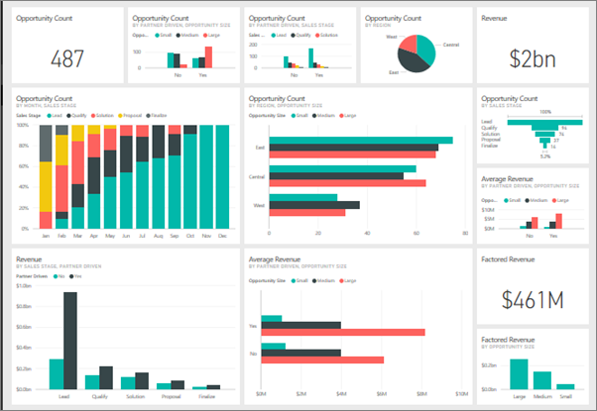
Dashboard

Slide 26
The Major Tools and Techniques of Managerial Decision Support
Source: Table 1.4
Computerized tools for decision support

