Slide 1
Decision Making, Systems, modeling, and support
Lecture 2
MIS 406: Decision Support Systems

Slide 2
Characteristics of Decision Making
Groupthink (i.e., group members accept the solution without thinking for themselves) can lead to bad decisions.
Decision makers are interested in evaluating what-if scenarios.
Experimentation with a real system (e.g., develop a schedule, try it, and see how well it works) may fail.
Experimentation with a real system is possible only for one set of conditions at a time and can be disastrous.
Changes in the decision-making environment may occur continuously, leading to invalidating assumptions about a situation (e.g., deliveries around holiday times may increase, requiring a different view of the problem).
Changes in the decision-making environment may affect decision quality by imposing time pressure on the decision maker.
Collecting information and analyzing a problem takes time and can be expensive. It is difficult to determine when to stop and make a decision.
There may not be sufficient information to make an intelligent decision.
Too much information may be available (i.e., information overload).

Slide 3
Decision Making
A process of choosing among two or more alternative courses of action for the purpose of attaining a goal(s)
Problem-solving
Problem solving is the process of defining a problem, identifying its root cause, prioritizing and selecting potential solutions, and implementing the chosen solution
Notes:
Managerial decision making is synonymous with the entire management process - Simon (1977)
e.g., Planning
What should be done? When? Where? Why? How? By whom?
Other managerial functions, such as organizing and controlling, also involve decision making.

Slide 4
Decision-Making Disciplines
Behavioral: anthropology, law, philosophy, political science, psychology, social psychology, and sociology
Scientific: computer science, decision analysis, economics, engineering, the hard sciences (e.g., biology, chemistry, physics), management science/operations research, mathematics, and statistics
Effectiveness versus Efficiency
Effectiveness → “goodness” “accuracy”
Efficiency → “speed” “less resources”
A fine balance is what is needed!
Notes:
Each discipline has its own set of assumptions about reality and method. Each contributes a unique, valid view of how people make decisions

Slide 5
Decision Style
Decision style is the manner by which decision makers think and react to problems
This includes the way
they perceive a problem,
their cognitive responses, and
how values and beliefs vary from individual to individual and from situation to situation.
Personality temperament tests are often used to determine decision styles
Various tests measure somewhat different aspects of personality. So, they cannot be equated!
Notes:
When making decisions, people…
follow different steps/sequence
give different emphasis, time allotment, and priority to each steps.

Slide 6
Decision Style
Decision-making styles
Heuristic versus Analytic
Autocratic versus Democratic
Consultative (with individuals or groups)
Many combinations and variations of styles( e.g. a person can be analytic and autocratic)
Notes:
A successful computerized system should fit the decision style and the decision situation
Should be flexible and adaptable to different users (e.g. what-if and goal-seeking questions)
Individual vs group decision makers (Individual decision makers need access to data and to experts who can provide advice, whereas groups additionally need collaboration tools).
There are many tests to identify their style-
Meyers/Briggs, myersbriggs.org,
True Colors (Birkman): birkman.com,
Keirsey Temperament Theory: keirsey.com
Others:
16personalities.com/free-personality-test

Slide 7
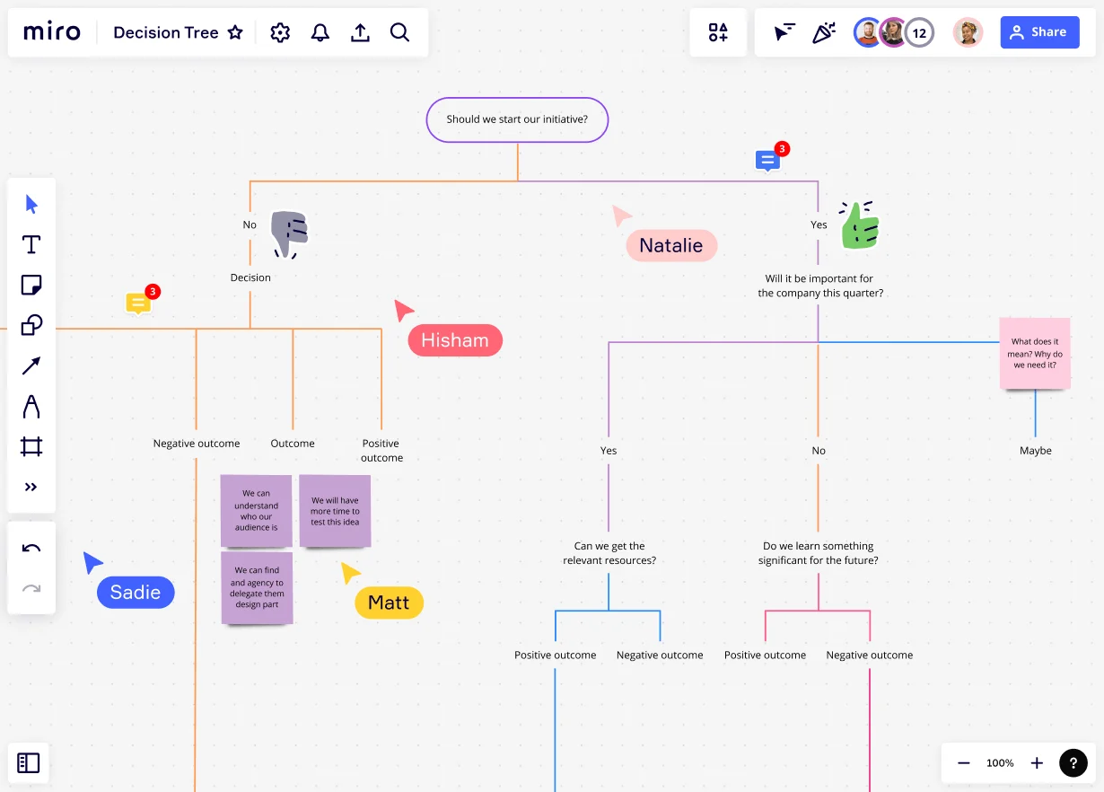

Slide 8
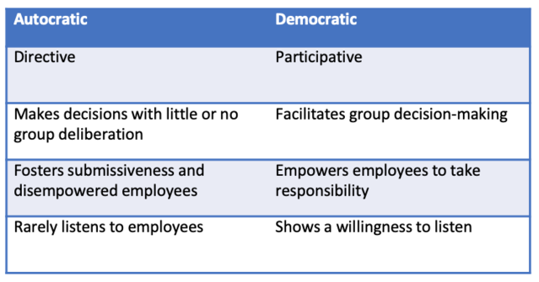
Autocratic vs. democratic

Slide 9
Decision Makers
Decisions in small organizations are
Often made by individuals,
especially at lower managerial levels and
there may be conflicting objectives
Most major decisions in medium-sized and large organizations
are made by groups.
there are often conflicting objectives
Different styles, backgrounds, expectations, personality types
Consensus is often difficult to reach
Group decision making can be enhanced by computerized support, group support systems (GSS), enterprise resource planning (ERP), supply chain management (SCM), knowledge management systems (KMS), and customer relationship management (CRM) systems.
Try out mentimetre: https://www.mentimeter.com/app/presentation/al6fqm81mcqan3hnf7tfrrgyoncwxtfh/edit?source=share-invite-modal

Slide 10
Types of Models
Models can be classified based on their degree of abstraction
Iconic models (scale models)
Analog models
Mental Models
Mathematical (quantitative) models
Less
Degree of abstraction
More

Slide 11
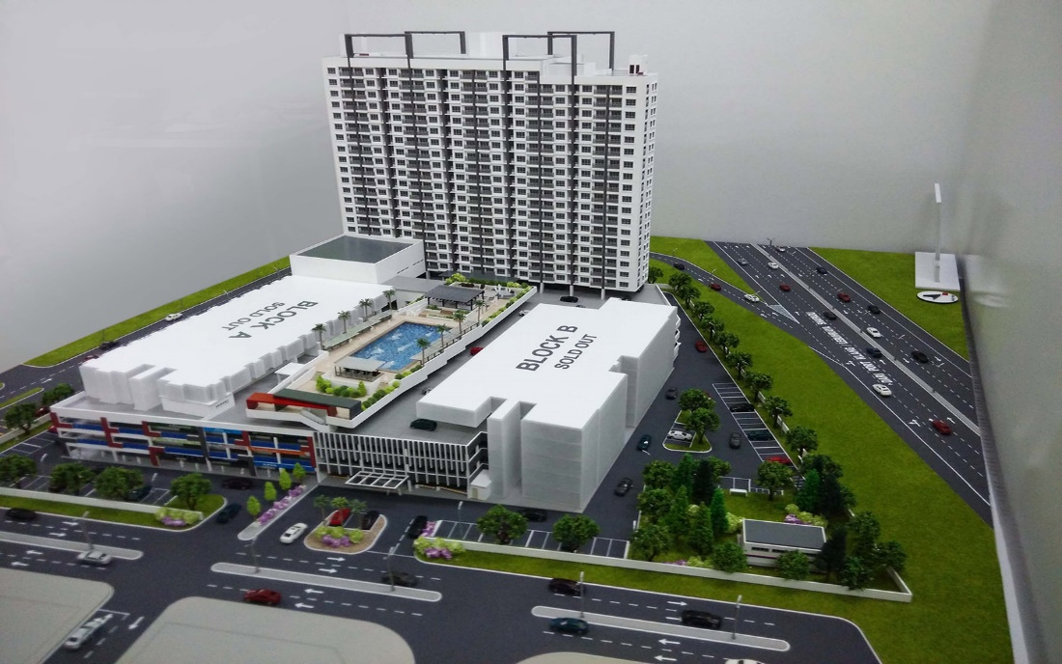
Types of Models
Iconic model
Also called scale model
Least abstract type of model
A physical replica of a system, on a different scale from the original.
May be 3D: model of an aeroplane, a car, a bridge
2D iconic model: photographs

Slide 12
Types of Models
Analog model
An abstract, symbolic model of a system that behaves like the system but does not look like it
More abstract than an iconic model and symbolic representation of reality
2D charts and diagrams.
Examples:
Organization charts
Maps
Stock Market Charts
Blueprint of a machine or house
Animations, videos, and movies
Notes:
Organization charts: depict structure, authority, responsibility relationship
Maps: different colour represent different objects, such as bodies of water or mountains.
Stock Market Charts: represent the price movements of stocks
Blueprint of a machine or house
Animations, videos, and movies

Slide 13
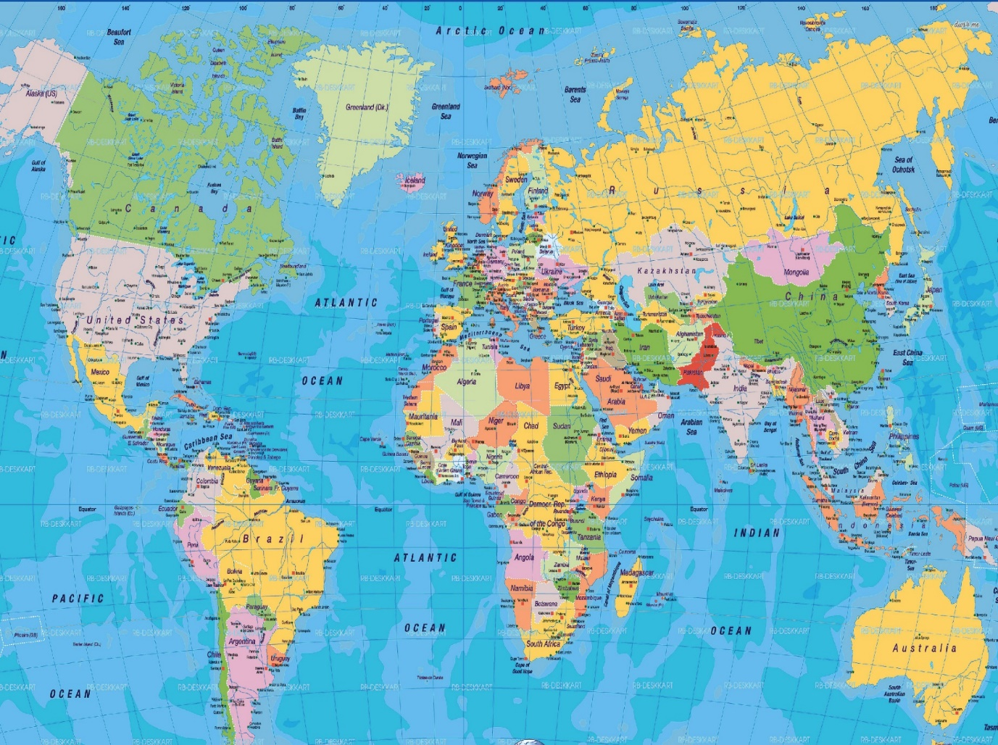
Analog model

Slide 14
Types of Models
Mental model
Used in the time-pressure situation (airplane pilot consider whether to fly)
Are descriptive representations of decision making situations that people form in their heads and think about.
Cognitive maps
Notes:
The mechanisms or images through which a human mind performs sense-making in decision making
Thought process work through scenario to consider the utility & risks of each potential alternative
When mostly qualitative factors are in decision making

Slide 15
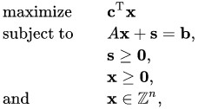
Types of Models
Mathematical (quantitative) model
A system of symbols and expressions that represent a real situation
The complexity of relationships in many organization can’t be represented by icons or analogically. (cumbersome and time consuming).
More abstract models are described mathematically.
Notes:
Most DSS analyses are performed numerically with mathematical or other quantitative models.

Slide 16
The Benefits of Models
Model manipulation is much easier than manipulating a real system
Models enable the compression of time
The cost of modeling analysis is much lower
The cost of making mistakes during a trial-and-error experiment is much lower when models are used than with real systems
With modeling, a manager can estimate the risks resulting from specific actions within the uncertainty of the business environment
Mathematical models enable the analysis of a very large number of possible solutions
Models enhance and reinforce learning and training
Models and solution methods are readily available on the Web
Many Java applets are available to readily solve models

Slide 17
Phases of the Decision Making Process
1. Intelligence phase
The initial phase of problem identification and definition in decision making. Problem ownership is established as well.
2. Design phase
The second decision-making phase, which involves finding possible alternatives in decision making and assessing their contributions.
3. Choice phase
The third phase in decision making, in which an alternative is selected
4. Implementation phase
The fourth decision-making phase, involving actually putting a recommended solution to work

Slide 18
Simon’s Decision-Making Process
There is a continuous flow of activity from intelligence to design to choice (see the bold lines in Figure 2.1), but at any phase, there may be a return to a previous phase (feedback). Modelling is an essential part of this process. The seemingly chaotic nature of following a haphazard path from problem discovery to solution via decision-making can be explained by these feedback loops.
FIGURE 2.1 The Decision-Making/Modeling Process.
Notes:
There is a continuous flow of activity from intelligence to design to choice (see the bold lines in Figure 2.1), but at any phase, there may be a return to a previous phase (feedback). Modeling is an essential part of this process. The seemingly chaotic nature of following a haphazard path from problem discovery to solution via decision making can be explained by these feedback loops.

Slide 19
Decision-Making: Intelligence Phase
Intelligence in decision making involves-
Scan the environment, either intermittently or continuously
Identify problem situations or opportunities
Monitor the results of the implementation
Problem ( or opportunity ) identification:
Determine whether a problem exists, identify its symptoms, determine its magnitude and explicitly define it
Problem is the difference between what people desire (or expect) and what is actually occurring
Symptom versus Problem
Timely identification of opportunities is as important as identification of problems
Notes:
Often, what is described as a problem (e.g., excessive costs) may be only a symptom (i.e., measure) of a problem (e.g., improper invento1y levels)

Slide 20
Decision-Making: Intelligence Phase
Problem Classification
Problem classification is the conceptualization of a problem in an attempt to place it in a definable category
Classification of problems according to the degree of structuredness
Problem Decomposition
Dividing complex problems into simpler sub-problems may help in solving the complex problem
Information/data can improve the structuredness of a problem situation
Problem Ownership
Assignment of authority to solve a problem is called “problem ownership”
Example: high-interest rate, what is the managerial role?
Outcome of intelligence phase: A formal problem statement
Notes:
For example, a manager may feel that he or she has a problem because interest rates are too high. Because interest rate levels are determined at the national and international levels, and most managers can do nothing about them, high interest rates are the problem of the government, not a problem for a specific company to solve. The problem companies actually face is how to operate in a high-interest-rate environment. For an individual company, the interest rate level should be handled as an uncontrollable (environmental) factor to be predicted.

Slide 21
Decision-Making: The Design Phase
Finding or developing and analyzing possible courses of action.
These include understanding the problem and testing solutions for feasibility.
A model of the decision-making problem is constructed, tested, and validated.
A significant part of many DSS and BI tools (notably those of business analytics)
A model is a simplified representation (or abstraction) of reality.
Often, reality is too complex to describe.
Much of the complexity is actually irrelevant in solving a specific problem.
Models can represent systems/problems at various degrees of abstraction.

Slide 22
Decision-Making: The Design Phase
Models have:
decision variables that describe the alternatives from among which a manager must choose (e.g., how many cars to deliver to a specific rental agency, how to advertise at specific times, which Web server to buy or lease),
a result variable or a set of result variables (e.g., profit, revenue, sales) that describes the objective or goal of the decision-making problem, and
uncontrollable variables or parameters (e.g., economic conditions) that describe the environment.
The process of modeling involves determining the (usually mathematical, sometimes symbolic) relationships among the variables.

Slide 23
Decision-Making: The Design Phase
Selection of a Principle of Choice
It is a criterion that describes the acceptability of a solution approach
In a model, it is the result variable
Selecting a principle of choice is not part of the choice phase but involves how a person establishes decision-making objective(s) and incorporates the objective(s) into the model(s).
Choosing and validating against
High-risk versus low-risk
Optimize versus satisfice
Among the many principles of choice, normative and descriptive are of prime importance.

Slide 24
Decision-Making: The Design Phase
Selection of a Principle of Choice
Normative models (= optimization)
Heuristic models (= suboptimization)
Descriptive models
Good Enough, or Satisficing

Slide 25
Decision-Making: The Design Phase
Normative models (= optimization)
the chosen alternative is demonstrably the best of all possible alternatives
To find it, the decision maker should examine all the alternatives and prove that the one selected is indeed the best, which is what the person would normally want.
This process is basically optimization. This is typically the goal of what we call prescriptive analytics.
Three ways to achieve optimization:
Get the highest level of goal attainment from a given set of resources
Find the alternatives with the highest ratio of goal attainment to cost
Find the alternative with the lowest cost (or smallest amount of other resources) that will meet an acceptable level of goals.

Slide 26
Decision-Making: The Design Phase
Heuristic models (= suboptimization)
the chosen alternative is the best of only a subset of possible alternatives
One part of organization rather than whole.
Often, it is not feasible to optimize realistic (size/complexity) problems
Suboptimization may also help relax unrealistic assumptions in models
Apply when simplifying assumptions are used in modelling a problem
Help reach a good enough solution faster

Slide 27
Decision-Making: The Design Phase
Descriptive models
Describe things as they are or as they are believed to be (mathematically based)
Check the performance of the system for a given set of alternative
Examples of descriptive models-
Simulation-
Most common descriptive modeling method (imitation of reality or mathematical depiction of systems in a computer environment)
Allows experimentation with the descriptive model of a system
Nonmathematical descriptive models
Cognitive map ( Software: Decision Explorer)
Narrative

Slide 28
Decision-Making: The Design Phase
Good Enough, or Satisficing
“Something less than the best”
Satisficing- A process by which one seeks a solution or goal or desired level of performance that will satisfy a set of constraints.
A form of suboptimization.
There may be a best solution, an optimum, but it would be difficult, if not impossible, to attain it.
Reasons: time pressure, ability to achieve optimization, marginal benefit vs marginal cost.
Benefit: time saving
Simon’s idea of bounded rationality- Rationality is bounded not only by limitations on human processing capacities, but also by individual differences, such as age, education, knowledge, and attitudes.
Notes:
Intuition is a critical factor that decision makers use in solving unstructured and semistructured problems. The best decision makers recognize the trade-off between the marginal cost of obtain ing further information and analysis versus the benefit of making a better decision. But sometimes decisions must be made quickly, and, ideally, the intuition of a seasoned, excellent decision maker is called for.

Slide 29
Decision-Making: The Design Phase
Developing (Generating) Alternatives
In optimization models (such as linear programming), the alternatives may be generated automatically .
In most MSS situations, however, it is necessary to generate alternatives manually
Use of GSS helps generate alternatives
The search for alternatives usually occurs after the criteria for evaluating the alternatives are determined
Outcome of proposed alternative must be established

Slide 30
Decision-Making: The Design Phase
Measuring/ranking the outcomes
The value of an alternative is evaluated in terms of goal attainment
Outcome expressed in terms of goal
Risk
Unstable environment (unpredictable event)
Lack of precise knowledge (uncertainty)
Risk can be measured with probability
Attribute a level of risk to the outcome associated with each potential alternative being considered

Slide 31
Decision-Making: The Design Phase
Scenario (what-if case)
A statement of assumptions about the operating environment (variables) of a particular system at a given time
Change the scenario of problem and examine the result
There may be thousands of possible scenarios for every decision situation. However, the following are especially useful in practice
The worst possible scenario
The best possible scenario
The most likely scenario
The average scenario
Errors in Decision Making
Validating the model before it is used is critical.
Gathering the right amount of information, with the right level of precision and accuracy, to incorporate into the decision-making process is also critical.

Slide 32
Decision-Making: The Choice Phase
The actual decision is made and the commitment to follow a certain course of action is made here
The boundary between the design and choice is often unclear
Includes the search, evaluation, and recommendation of an appropriate solution to the model
Solving a model is not the same as solving the problem the model represents.
Search approaches
Analytic techniques (solving with a formula)
Algorithms (step-by-step procedures)
Heuristics (rule of thumb, problem solving aid)
Blind search (truly random search)
Additional activities
Sensitivity analysis (effect of change in one on others)
What-if analysis ( explore major change in parameter )
Goal seeking ( determine value of decision variable to meet objective)
Notes:
Solving the model versus solving the problem
solving a model is not the same as solving the problem the model represents. The solution to the model yields a recommended solution to the problem. The problem is considered solved only if the recommended solution is successfully implemented.

Slide 33
Decision-Making: The Implementation Phase
The implementation phase involves putting a recommended solution to work, not necessarily implementing a computer system.
Implementation also includes a thorough understanding of project management.
Implementation must also involve collecting and analyzing data to learn from the previous decisions and improve the next decision.

Slide 34
How Decisions Are Supported

Slide 35
How Decisions Are Supported
Support for the Intelligence Phase
Enabling continuous scanning of external and internal information sources to identify problems and/or opportunities
Resources/technologies: Web; ES, OLAP, data warehousing, data/text/Web mining, EIS/Dashboards, KMS, GSS, GIS,…
Business activity monitoring (BAM)
Business process management (BPM)
Product life-cycle management (PLM)

Slide 36
How Decisions Are Supported
Support for the Design Phase
Enabling generating alternative courses of action, determining the criteria for choice
Generating alternatives
Structured/simple problems: standard and/or special models
Unstructured/complex problems: human experts, ES, KMS, brainstorming/GSS, OLAP, data/text mining
A good “criteria for choice” is critical!

Slide 37
How Decisions Are Supported
Support for the Choice Phase
Enabling selection of the best alternative given a complex constraint structure
Use sensitivity analyses, what-if analyses, goal seeking
Resources
KMS
CRM, ERP, and SCM
Simulation and other descriptive models

Slide 38
How Decisions Are Supported
Support for the Implementation Phase
Enabling implementation/deployment of the selected solution to the system
Decision communication, explanation and justification to reduce resistance to change
Resources
Corporate portals, Web 2.0/Wikis
Brainstorming/GSS
KMS , ES

