Slide 1
Wireless Ad Hoc Networks

Slide 2
Introduction
Two types of wireless networks:
  Infrastructured network:
    base stations are the bridges
    a mobile host will communicate with the nearest base station
    handoff is taken when a host roams from one base to another

Slide 3
  Ad hoc network:
    Infrastructure-less: no fixed base stations
    without the assistance of base stations for communication
    Due to transmission range constraint,
      two MHs need multi-hop routing for communication
    quickly and unpredictably changing topology

Slide 4
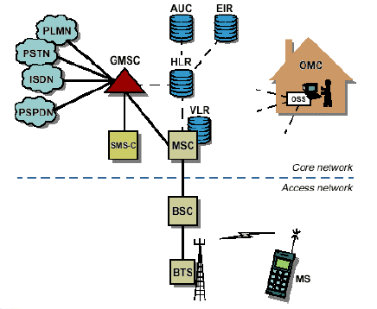
Infrastructured network

Slide 5
MANET = Mobile Ad Hoc Networks
  a set of mobile hosts, each with a transceiver
  no base stations; no fixed network infrastructure
  multi-hop communication
  needs a routing protocol which can handle changing topology

Slide 6
What is Ad-Hoc Network?
In Latin, ad hoc means "for this," further meaning "for this purpose only.”
All nodes are mobile and can be connected dynamically in an arbitrary manner.
No default router available.
Potentially every node becomes a router: must be able to forward traffic on behalf of others

Slide 7
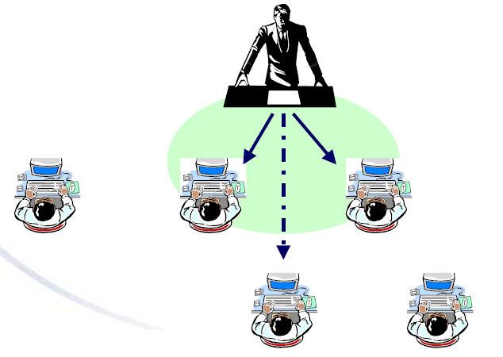
Single-Hop Ad Hoc

Slide 8
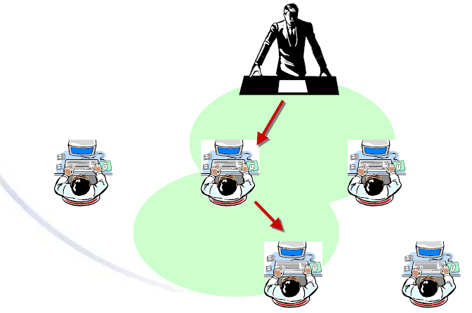
Multi-hop Ad Hoc

Slide 9
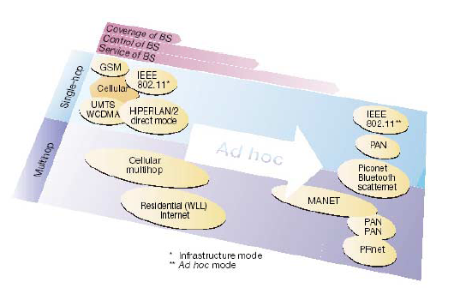
Single-hop Vs. Multi-hop systems

Slide 10
Ad-Hoc typical applications
Personal area networking
  cell phone, laptop, ear phone, wrist watch
Military environments
  soldiers, tanks, planes
Civilian environments
  car network
meeting rooms
  sports stadiums
  boats, small aircraft
Emergency operations
  search-and-rescue
  policing and fire fighting

Slide 11
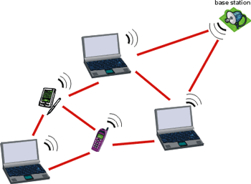
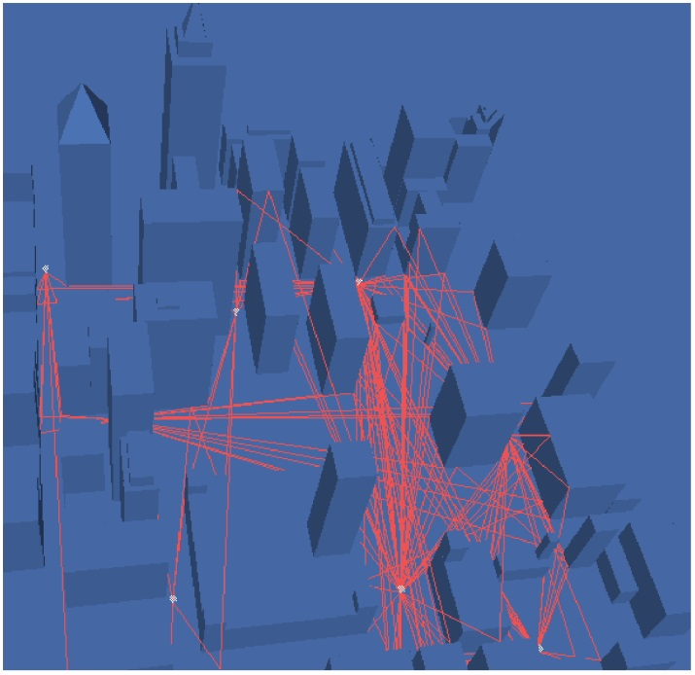
Example Ad hoc Networks
Mobile devices (laptop, PDAs)
Hybrid urban ad hoc network (vehicular, pedestrian, hot spots,…)

Slide 12
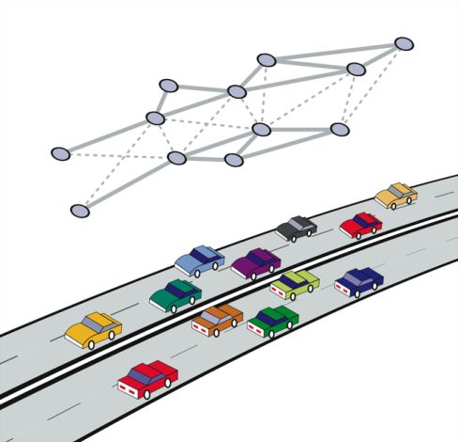
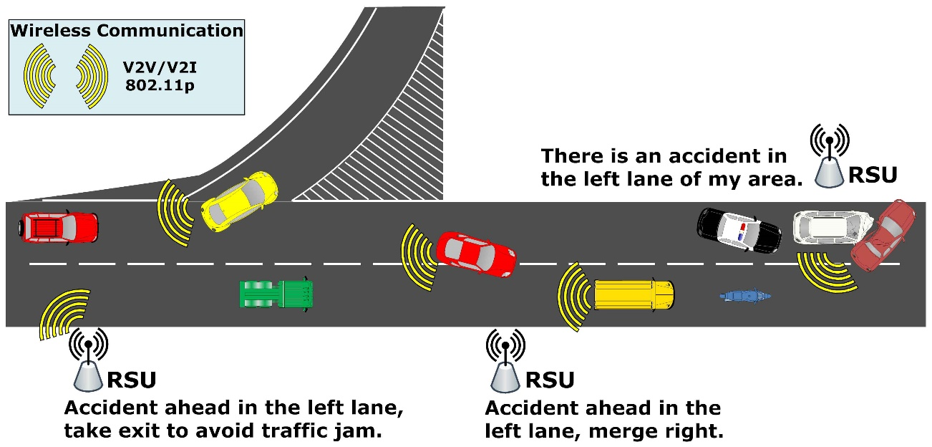
Vehicular Networks on Highways

Slide 13
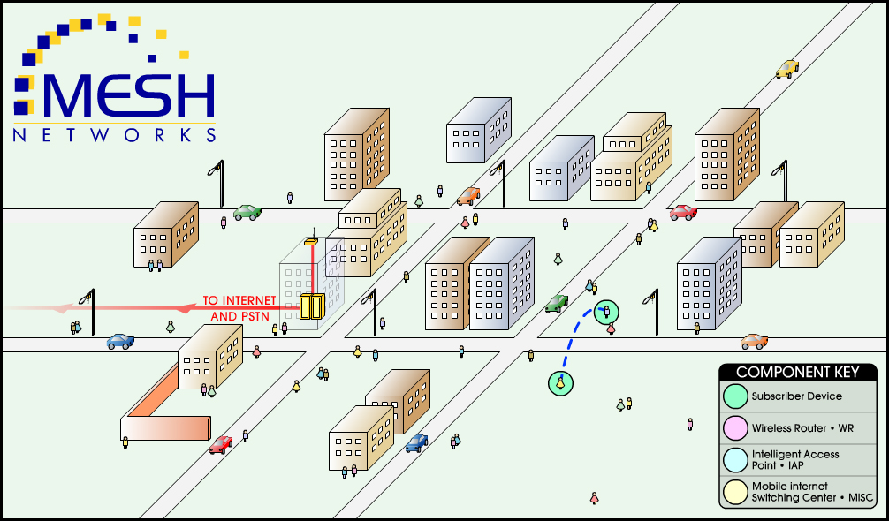
Peer-to-Peer

Slide 14
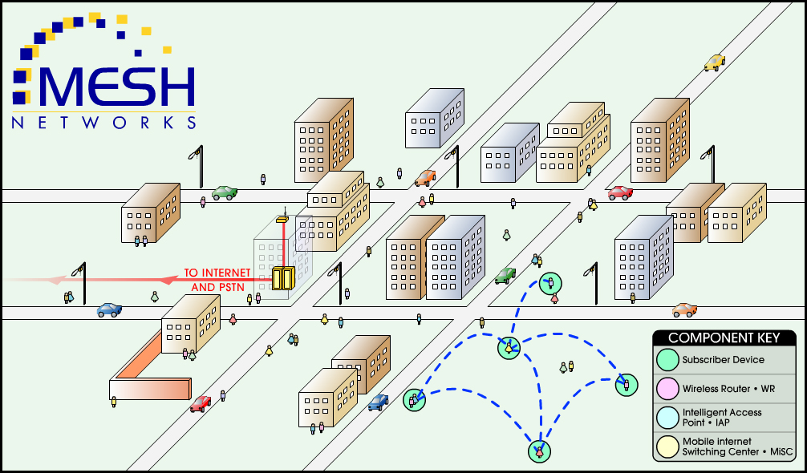
Multi-hop Peer-to-Peer

Slide 15

Multi-hopping via Wireless Router

Slide 16
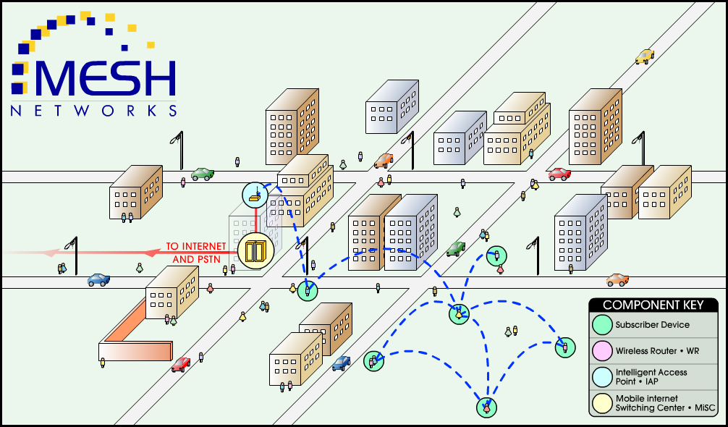
Hopping on the Network

Slide 17
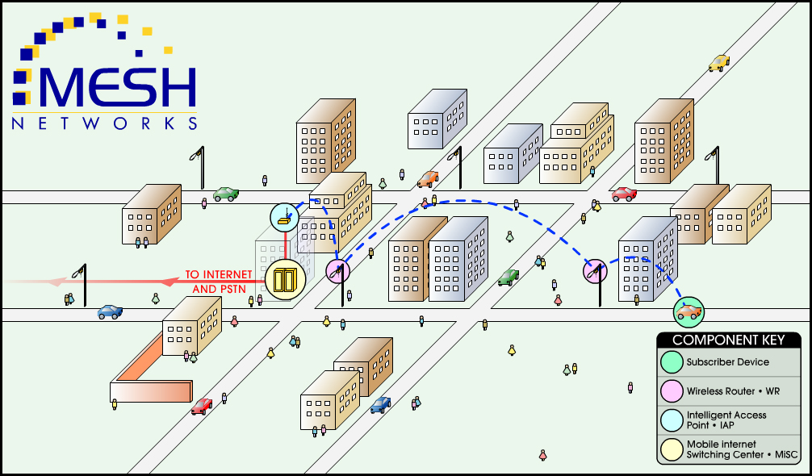
Supports Mobility

Slide 18
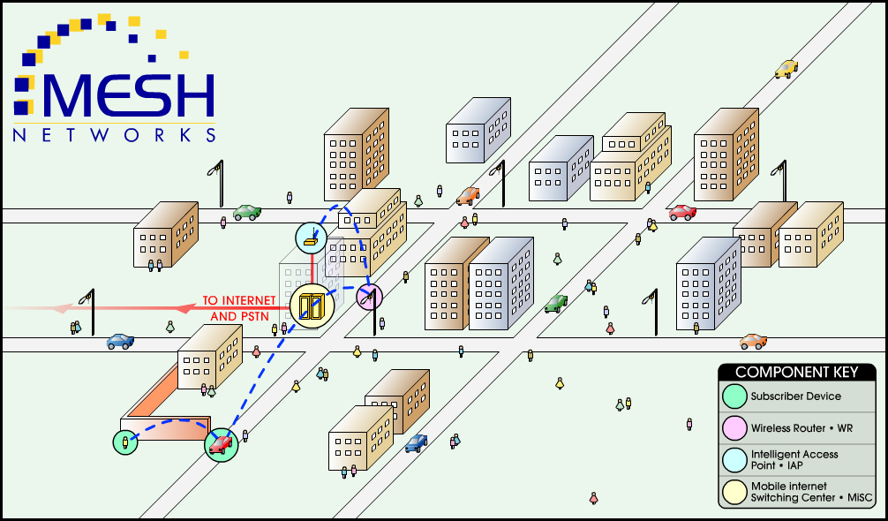
Supports Non Line-of-Sight

Slide 19
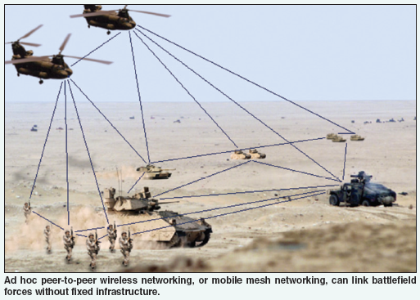
Military applications
  Situational Awareness (SA) and Command and Control (C2) for military.

Slide 20
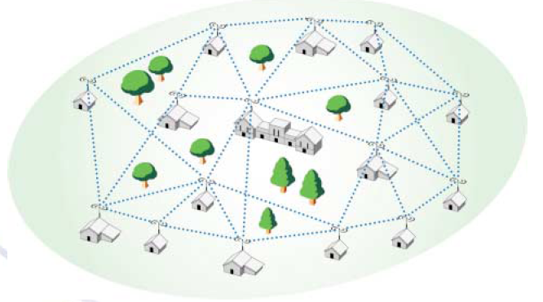
RoofTop Wireless Routing
  A wireless broadband solution for residential markets, based on a multihop Ad-Hoc (mesh) networking.

Slide 21
Characteristics and requirements
Distributed operation
Dynamic network topology
Fluctuating link capacity
Low-power devices

Slide 22
Challenges
  Broadcast nature of the wireless medium
    Hidden terminal problem
  Packet losses due to transmission errors
  Mobility-induced route changes
  Mobility-induced packet losses
  Battery constraints
  Potentially frequent network partitions
  Ease of snooping on wireless transmissions (security hazard)
  Quality of Service

Slide 23
Routing Protocols
We need a new routing and multicasts protocols that perform the following functions :
  Ensure routing in a dynamic, Ad-Hoc network through automatic detection of new or missing links.
  Automatically select the highest quality, least congested paths.
  Provide an efficient multicast mechanism across the wireless broadcast channel.

Slide 24
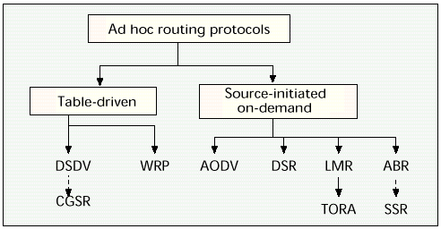
Overview of Current Routing Protocols

Slide 25
Routing in Ad-Hoc Networks
The lack of a backbone infrastructure makes packet routing in ad-hoc networks a challenging task. A routing protocol should be able to automatically recover from any problem in a finite amount of time without human intervention.
Identification of mobile terminals and correct routing of packets to and from each terminal while moving are certainly challenging. Here we will consider three routing protocols:
1. Destination-Sequenced Distance Vector (DSDV) Protocol
2. Cluster-Head Gateway Switch Routing Protocol
3. Dynamic Source Routing (DSR)

Slide 26
1. The Destination-Sequenced Distance Vector (DSDV) protocol is a table-driven routing protocol
Routing Tables
In addition to the destination address and next hop address, routing tables maintain the route metric (for example number of hops) and the route sequence number.
Periodically, or immediately when network topology changes are detected, each node will broadcast a routing table update packet. The update packet starts out with a metric of one. This signifies to each receiving neighbor they are one hop away from the node. The neighbors will increment this metric (in this case, to two) and then retransmit the update packet.
This process repeats itself until every node in the network has received a copy of the update packet with a corresponding metric. If a node receives duplicate update packets, the node will only pay attention to the update packet with the smallest metric and ignore the rest.

Slide 27
DSDV Packet Process Algorithm
If the new address has a higher sequence number, the node chooses the route with the higher sequence number and discards the old sequence number.
If the incoming sequence number is identical to the one belonging to the existing route, a route with the least cost metric is chosen.

Slide 28
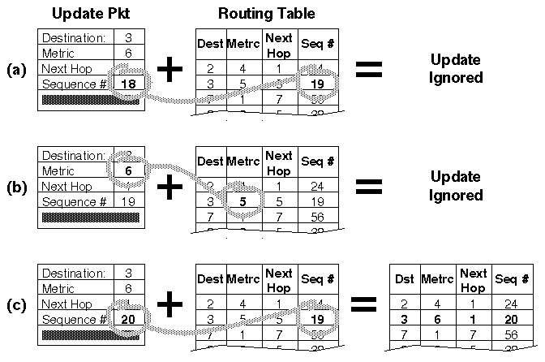
To distinguish state update packets from valid ones, each update packet is tagged by the original node with a sequence number. The sequence number is a monotonically increasing number which uniquely identifies each update packet from a given node. Consequently, if a node receives an update packet from another node, the sequence number must be equal to or greater than the sequence number already in the routing table; otherwise the update packet is stale and ignored. If the sequence number matches the sequence number in the routing table, then the metric is compared and updated as previously discussed.
Fig: A node receiving three update packets

Slide 29
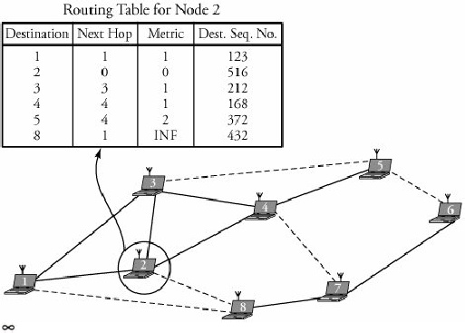
Fig.6 shows a routing table for node 2, whose neighbors are nodes 1, 3, 4, and 8. The dashed lines indicate no communications between any corresponding pair of nodes. Therefore, node 2 has no information about node 8.
Fig.6 A DSDV routing table

Slide 30
The packet overhead of the DSDV protocol increases the total number of nodes in the ad-hoc network. This fact makes DSDV suitable for small networks. In large ad-hoc networks, the mobility rate and therefore the overhead increase, making the network unstable to the point that updated packets might not reach nodes on time.

Slide 31
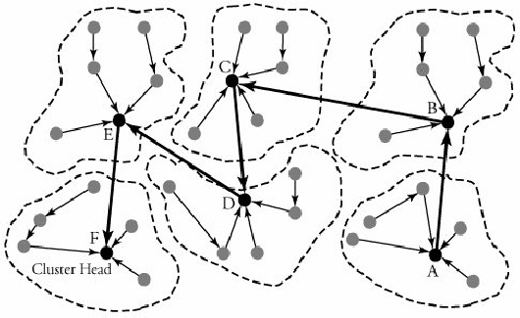
2. Cluster-Head Gateway Switch Routing Protocol
The Cluster-Head Gateway Switch Routing (CGSR) protocol is a table-driven routing protocol. In a clustering system each predefined number of nodes are formed into a cluster controlled by a cluster head, which is assigned using a distributed clustering algorithm.

Slide 32
However, with the clustering scheme, a cluster head can be replaced frequently by another node, for several reasons, such as lower-level energy left in the node or a node moves out of contact.
With this protocol, each node maintains two tables: a cluster-member table and a routing table. The cluster-member table records the cluster head for each destination node, and the routing table contains the next hop to reach the destination.

Slide 33
Fig 3 shows an example of routing in an area in which six clusters have been formed. A node in cluster A is transmitting a packet to a node in cluster F.
Nodes within each cluster route their packets to their own associated clusters. The transmitting node then sends its packet to the next hop, according to the routing table entry associated with that cluster head. The cluster head transmits the packet to another cluster head until the cluster head of the destination node is reached.
Fig.3 Communication with cluster head gateway switch routing (CGSR) protocol

Slide 34
Dynamic Source Routing (DSR)
When node S wants to send a packet to node D, but does not know a route to D, node S initiates a route discovery
Source node S floods Route Request (RREQ)
Each node appends own identifier when forwarding RREQ

Slide 35

Route Discovery in DSR
Y
Z
S
E
F
B
C
M
L
J
A
G
H
D
K
I
N
Represents a node that has received RREQ for D from S

Slide 36
Route Discovery in DSR
Y
Broadcast transmission
[S]
Z
S
E
F
B
C
M
L
J
A
G
H
D
K
I
N
Represents transmission of RREQ
[X,Y] Represents list of identifiers appended to RREQ

Slide 37
Route Discovery in DSR
Y
Z
S
E
[S,E]
F
B
C
M
L
J
A
[S,C]
G
H
D
K
I
N
Node H receives packet RREQ from two neighbors:
potential for collision

Slide 38
Route Discovery in DSR
Y
Z
S
E
F
[S,E,F]
B
C
M
L
J
A
G
H
D
K
I
[S,C,G]
N
Node C receives RREQ from G and H, but does not forward
it again, because node C has already forwarded RREQ once

Slide 39
Route Discovery in DSR
Y
Z
S
E
F
[S,E,F,J]
B
C
M
L
J
A
G
H
D
K
I
[S,C,G,K]
N
Nodes J and K both broadcast RREQ to node D
Since nodes J and K are hidden from each other, their
transmissions may collide

Slide 40
Route Discovery in DSR
Y
Z
S
E
F
[S,E,F,J,M]
B
C
M
L
J
A
G
H
D
K
I
N
Node D does not forward RREQ, because node D
is the intended target of the route discovery

Slide 41
Route Discovery in DSR
Destination D on receiving the first RREQ, sends a Route Reply (RREP)
RREP is sent on a route obtained by reversing the route appended to received RREQ
RREP includes the route from S to D on which RREQ was received by node D

Slide 42
Route Reply in DSR
Y
Z
S
E
RREP [S,E,F,J,D]
F
B
C
M
L
J
A
G
H
D
K
I
N
Represents RREP control message

Slide 43
Dynamic Source Routing (DSR)
Node S on receiving RREP, caches the route included in the RREP
When node S sends a data packet to D, the entire route is included in the packet header
  hence the name source routing
Intermediate nodes use the source route included in a packet to determine to whom a packet should be forwarded

Slide 44
Data Delivery in DSR
Y
DATA [S,E,F,J,D]
Z
S
E
F
B
C
M
L
J
A
G
H
D
K
I
N
Packet header size grows with route length

Slide 45
DSR Optimization: Route Caching
Each node caches a new route it learns by any means
When node S finds route [S,E,F,J,D] to node D, node S also learns route [S,E,F] to node F
When node K receives Route Request [S,C,G] destined for node, node K learns route [K,G,C,S] to node S
When node F forwards Route Reply RREP [S,E,F,J,D], node F learns route [F,J,D] to node D
When node E forwards Data [S,E,F,J,D] it learns route [E,F,J,D] to node D
A node may also learn a route when it overhears Data
Problem: Stale caches may increase overheads

Slide 46
Dynamic Source Routing: Advantages
Routes maintained only between nodes who need to communicate
  reduces overhead of route maintenance
Route caching can further reduce route discovery overhead
A single route discovery may yield many routes to the destination, due to intermediate nodes replying from local caches

Slide 47
Dynamic Source Routing: Disadvantages
Packet header size grows with route length due to source routing
Flood of route requests may potentially reach all nodes in the network
Potential collisions between route requests propagated by neighboring nodes
  insertion of random delays before forwarding RREQ
Increased contention if too many route replies come back due to nodes replying using their local cache
  Route Reply Storm problem
Stale caches will lead to increased overhead

Slide 48
Ad hoc On-demand Distance Vector (AODV) Routing Protocol
AODV is a packet routing protocol designed for use in mobile ad hoc networks (MANET)
Intended for networks that may contain thousands of nodes
One of a class of demand-driven protocols
  The route discovery mechanism is invoked only if a route to a destination is not known
UDP is the transport layer protocol
Source, destination and next hop are addressed using IP addressing
Each node maintains a routing table that contains information about reaching destination nodes.
  Each entry is keyed to a destination node.

Slide 49
AODV Operation – Message Types
The basic message set consists of:
  RREQ – Route request
  RREP – Route reply
  RERR – Route error
  HELLO – For link status monitoring

Slide 50
RREQ Message
A
B?
B?
B?
B?
B?
B?
B?
B

Slide 51
RREP Message
A
A
A
A
A
A
A
B

Slide 52
Message routing
Source
G
A
RREQ
RREQ
RREQ
RREP
RREQ
B
D
RREQ
RREP
RREQ
RREQ
RREP
F
C
Destination
RREQ
RREQ
E
How do they decide to throw away the RREQs from C, E and G? Hop Count field in the message is the key.

Slide 53
DSR vs. AODV
The DSR computes the routes and also updates them. The source routing is a technique in which the packet sender identifies the entire sequence of the node into which the packet has to pass through. The packet sender lists the route in the packet’s header so that the next node to which the packet has to be transmitted can be identified by the address on the way to the destination host.
The AODV uses a combination of a DSR and DSDV mechanism. It uses the route discovery and route maintenance from a DSR and hop-by-hop routing, periodic advertisements, sequence numbers from DSDV

