Slide 1
Path Loss Model in Mobile Cellular Network

Slide 2
Walfish-Ikegami Model
Okumura-Hata Model

Slide 3
Okumura-Hata Model
Microcellular areas span a few Kms.
Okumura in 1968 drew some path-loss curve in the range of 100MHz to 1920 MHz
Masaharu Hata developed empirical path-loss model based on measurement of Okumura known as Okumura-Hata model.
Here separation between BS and MS is greater that 1Km.

Slide 4
Empirical formulation of data provided by the Okumura model and is valid for frequencies in the range 150MHz-1500MHz
For large city,
For small and medium city,

Slide 5
For suburban and open rural area,
The model is suitable for a distance above 1 Km. The model does not support path specific correction
Coverage
Frequency: 150 MHz to 1500 MHz
Mobile Station Antenna Height: between 1 m and 10 m
Base station Antenna Height: between 30 m and 200 m
Link distance: between 1 km and 20 km.

Slide 6
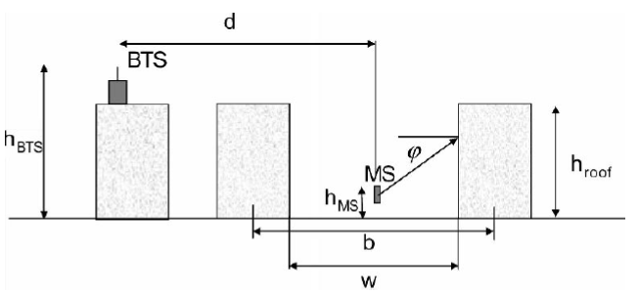
Walfish-Ikegami Model

Slide 7
The Walfish–Ikegami model is an empirical propagation model for an urban area, which is especially applicable for micro cells but can also be used for macro cells.
Model Parameters:
The mean value for street widths (w) is given in metres and the road orientation angle (θ or φ) in degrees. The mean value for building heights (h_{roof}) is an average over the calculation area and is given in metres. The mean value for building separation (b) is calculated from the centre of one building to the centre of another building and is also given in metres.

Slide 8
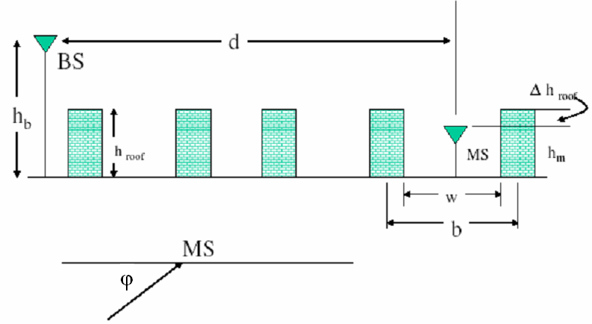
Walfish–Ikegami model is suitable for frequencies 800MHz to 2000 MHz where distance can be very small like 200m. Range of BS antenna height 4 to 50m and that of MS is 1 to 3m. Distance in the range of 20m to 5Km.

Slide 9
For LOS case,
L_{m}(db) = 42.6 +26log(d) + 20log(fc); d ≥ 20m
For NLOS case, we have to consider,
H_{roof} = Height of roof-top
Δh_{BS} = h_{BS} - h_{roof}
Δh_{MS} = h_{roof} - h_{MS}
w: width of street in meter
b: Building separation in meter along the radio path
φ: Road orientation w.r.t. the direction of radio propagation in degrees incident angle relative to the street).

Slide 10
NLOS path loss composed of three terms,
L_{P}(DB) = L₀ + L_{rts} + L_{msd}
The model works best for the BS much taller than the surrounding buildings.
L₀: Free space path loss = 32.4 + 20log(d) + 20log(fc)
Lrts: roof-street diffraction and scatter loss =
-16.9 -10log(w) + 10log(f_{c}) + 20log(Δh_{m}) + L_{ori}
L_{ori} is the street orientation loss:

Slide 11
L_{msd} = multiscreen diffraction loss
= L_{bsh}+ K_{a} + K_{d}log(d) + K_{f}log(fc) - 9log(b)

Slide 12
The parameter Ka increases the path loss in case the BTS is below the rooftop. The parameters K_{d} and K_{f} are for adjusting the correction between the distance and frequency with multiscreen diffraction.

Slide 13
Example:1
Find cell radius for the following parameters.
f_{c} =1800MHz
Street width (w) = 20m
Spacing between buildings (b) = 40m
Average roof height (h_{roof}) = 40m
Mobile antenna height (h_{m}) = 2m
BS antenna height (h_{b}) = 40m
Street orientation φ = 90⁰
Allowable path loss =140dB

Slide 14
Δh_{BS} = h_{BS} – h_{roof} = 40 – 40 = 0
Δh_{MS} = h_{roof} – h_{MS} = 40 – 2 = 38m
Orientation loss,
L_{ori} = 4 - 0.114(φ - 55) = 0.001
L_{bsh} = -18log(11) + (h_{BS} - h_{roof}) = -18.75dB
K_{a} = 54
K_{f} = 4 + 1.5(fc/925 -1) = 5.42
The roof street diffraction and scatter loss,
L_{rts} = -16.9 -10log(w) + 10log(fc) + 20log(ΔhMS) + L_{ori}
= -16.9 -10log(20) + 10log(1800) + 20log(38) + 0.001
=34.25dB

Slide 15
Free space path loss,
L₀ = 32.4 + 20log(r) + 20log(fc) = 97.5 + 20log(r) dB
Multi screen diffraction loss,
L_{msd} = L_{bsh}+ K_{a}+ K_{f}log(fc) - 9log(b) = 38.47 + 18log(r) dB
Allowable path loss,
140 = L₀ + L_{msd} + L_{rts}= 97.5 + 20log(r) + 38.47 +18log(r) + 34.25
Or, 38log(r) = -30.23
Or, r = 0.16Km = 160m

Slide 16
Large Scale Path Loss
Propagation model that predict the mean signal strength (not rapid change in amplitude of signal) for an arbitrary transmitter-receiver (T-R) separation distance are useful in estimating the radio coverage area of a transmitter are called large-scale propagation models. Since they characterize signal strength over large T-R separation (several hundreds or thousands of meters).
On the other hand, propagation model that characterize the rapid fluctuations of the received signal strength over very short travel distance (few wavelengths) or short time duration (on the order of seconds) are called small-scale or fading models.

Slide 17
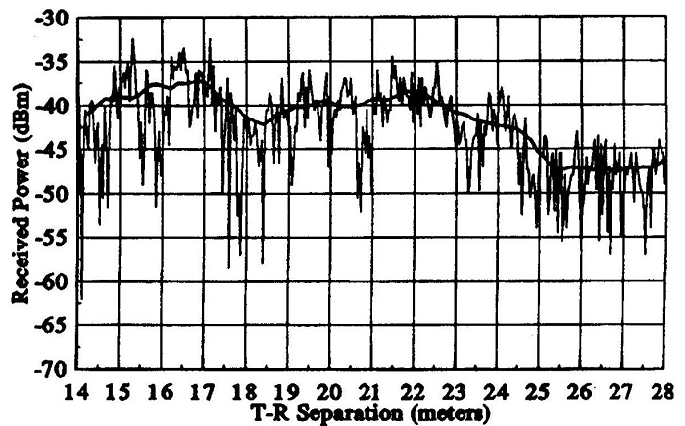
Fig.1 Small and large scale fading
Fig.1 shows the small scale fading (signal fades rapidly) and the more gradual large scale (local average signal) variation for an indoor radio communication system.

Slide 18
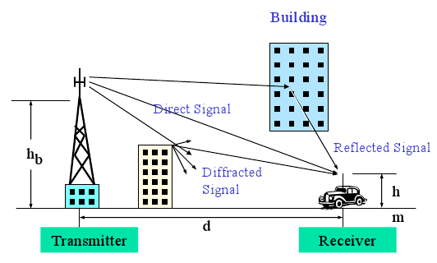
The three Basic Propagation Mechanisms

Slide 19
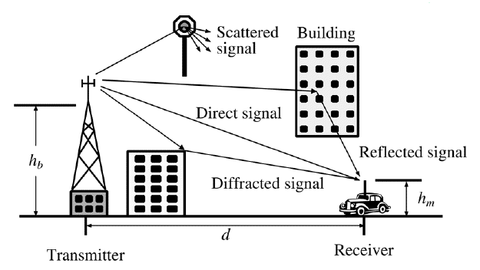

Slide 20
The three Basic Propagation Mechanisms
Reflection, diffraction and scattering are the three basic propagation mechanisms which impact propagation in mobile communication system.
Reflection
Reflection occurs when a propagating EM wave impinges upon an object which has very large dimensions compared to wavelength of the propagating wave. Reflection occur from the surface of the earth and from buildings and walls.

Slide 21
Diffraction
Diffraction occurs when the radio path between the transmitter and receiver is obstructed by a surface that has sharp irregularities (edges). The secondary waves resulting from the obstructing surface are present throughout the space and even behind the obstacle, giving rise to a bending of waves around the obstacle, even when the LOS path does not exist between T and R. Diffraction depends on the geometry of the object as well as the amplitude, phase and polarization of the incident wave at the point of diffraction.

Slide 22
Scattering
Scattering occurs when the medium through which the wave travels consists of objects with dimension that are small compared to the wavelength and where the number of obstacles per unit volume is large. Scattered waves are produced by rough surfaces, small objects or by other irregularities in the channel.
Absorption
Attenuation by solid material (for example wall)

Slide 23
Diffraction
T
R
1st Fresnel zone
Obstruction
Diffraction occurs when waves hit the edge of an obstacle
  “Secondary” waves propagated into the shadowed region
  Excess path length results in a phase shift

Slide 24
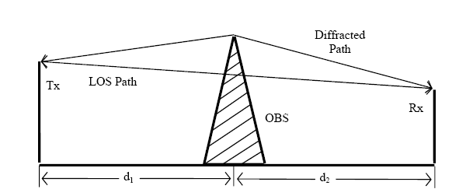
Huygen’s Principle
All points on wave front can be considered as point sources to produce secondary wavelets and these wavelets combine (vecctor sum) to form a new wave in the direction of propagation.

Slide 25
Diffraction
Phenomena: Radio signal can propagate around the curved surface of the earth, beyond the horizon and behind obstructions.
Although the received field strength decreases rapidly as a receiver moves deeper into the obstructed ( shadowed ) region, the diffraction field still exists and often has sufficient strength to produce a useful signal.
The field strength of a diffracted wave in the shadowed region is the vector sum of the electric field components of all the secondary wavelets in the space around the obstacles.

Slide 26
α
h
T
β
γ
R
d₁
d₂
Consider a transmitter and receiver separated in free space and an obstructing screen of effective height h with infinite width be placed between them at a distance d₁ from the transmitter and d₂ from the receiver. It is apparent that the wave propagating from the transmitter to receiver via top of the screen travels a longer distance than if a direct LOS.

Slide 27



α
Derive the path length difference,
h
T
β
γ
R
d₁
d₂
The corresponding phase difference,
Fresnel-Kirchoff diffraction parameter,
Therefore
Which Depends on h, position of obstacle and location transmitter and receiver

Slide 28
Knife-edge Diffraction Model
Huygen’s secondary source
α
h
R
d₁
d₂
Knife edge obstruction
When shadowing is caused by a single object such as a hill or mountain, the attenuation caused by diffraction can be estimated by treating the obstruction as a diffracting knife edge. This is the simplest of diffraction models and the diffraction loss in this case can be readily estimated using the classical Fresnel solution for the filed behind a knife edge.

Slide 29
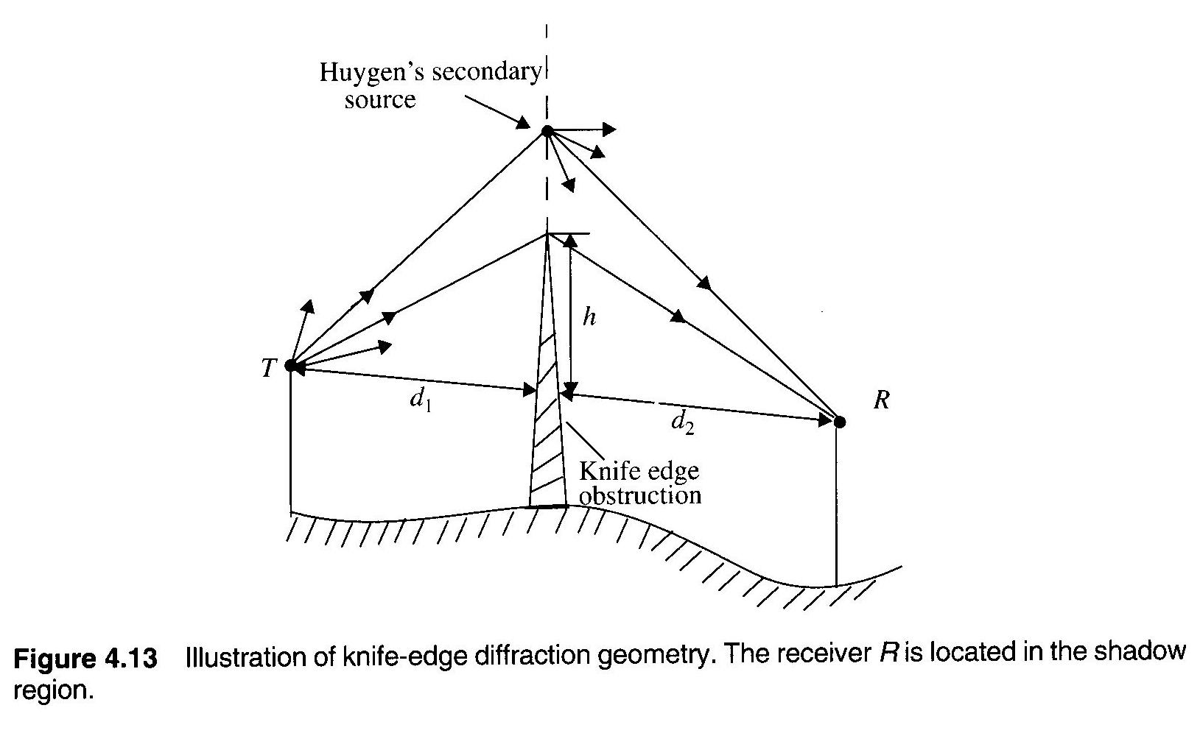
Consider a receiver at point R in the shadow region (also called the diffraction zone). The field strength a point R in above fig is a vector sum of the fields due to all of the secondary Huygen’s sources in the plane above the knife edge.

Slide 30
The electric field strength, E_{d} of a knife edge diffraction wave is,
Where E₀ is the free space field strength in the absence of both the ground and the knife edge and F(v) is the complex Fresnel integral. The Fresnel integral F(v) is a function of the Fresnel-Kirchoff diffraction parameter v.

Slide 31
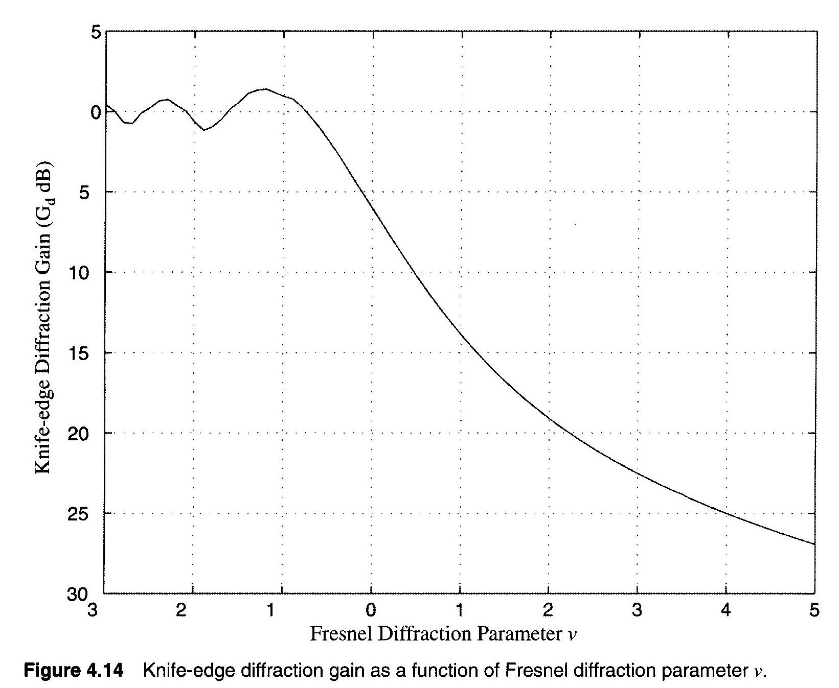
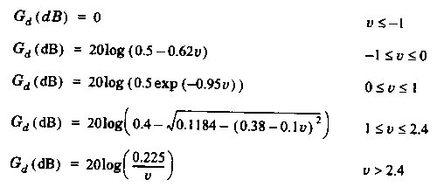
The diffraction gain due to the presence of a knife edge, as compared the free space E-field.
G_{d}(dB) = 20log|F(v)|.
An approximate solution of above equation is,

Slide 32
Fresnel zones under different knife-edge diffraction scenarios
α
h
α
d₁ d₂
h
d₁ d₂
α and v are positive since h is positive
α
α and v are 0 since h is 0
h
d₁ d₂
A family of ellipsoids can be constructed between transmitter and receiver by joining all points for which the excess path delay is an integral multiple of λ/2. The ellipsoids represent Fresnel zones.
α and v are negative since h is negative

Slide 33
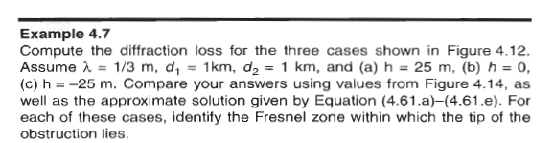
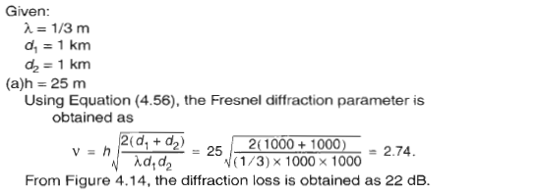

Slide 34
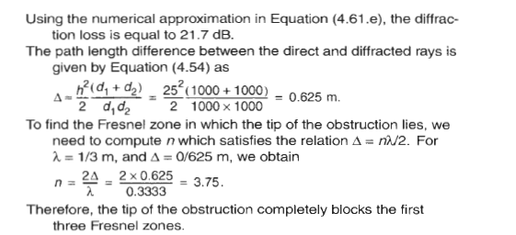

Slide 35
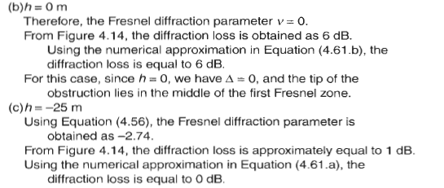

Slide 36
Example-1
For the following geometry determine (i) loss due to knife edge diffraction and (ii) height of the obstruction due to 6dB diffraction loss where f = 900MHz.
T
100m
R
50m
25m
10Km
2Km

Slide 37
α
Redrawing the geometry subtracting the height of the smallest structure
β
75m
25m
γ
10Km
2Km
The wavelength,

Slide 38
Now Fresnel-Kirchoff diffraction parameter,
The diffraction gain due to the presence of a knife edge,
ii)
For 6dB diffraction loss, v = 0,

Slide 39
Therefore the knife edge obstruction just touch the LOS. The geometry will take the form,
T
β
25m
H
γ
R
10Km
2Km

Slide 40
Scattering
Received signal strength is often stronger than that predicted by reflection/diffraction models alone
The EM wave incident upon a rough or complex surface is scattered in many directions and provides more energy at a receiver
  energy that would have been absorbed is instead reflected to the Rx.
Scattering is caused by trees, lamp posts, towers, etc.
flat surface → EM reflection (one direction)
rough surface → EM scattering (many directions)
Notes:
stronger

Slide 41
Scattering
When a radio wave impinges on a rough surface, the reflected energy is spread out (diffused) in all directions due to scattering. Flat surfaces that have much larger dimension than a wavelength may be modeled as reflective surfaces. However the roughness of such surfaces often induces propagation effects different from the specular reflection. Surface roughness is often tested using the Rayleigh criterion which defines a critical height (h_{c}) of surface protuberances for a given angle of incidence θi given by,
h_{c}=λ/8sin(θ_{i})
A surface is considered smooth if its minimum to maximum protuberance h is less than h_{c} and is considered rough if the protuberance is greater than h_{c}.

