Slide 1
Course: Introduction to Business 0413-112
Course Teacher:
Dewan Golam Yazdani Showrav
Assistant Professor
Daffodil International University
Email: dewan.bba@diu.edu.bd

Slide 2
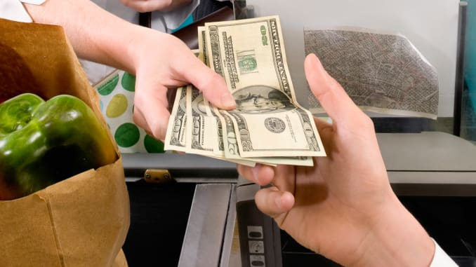
Chapter-1
Foundation of Business and Economics

Slide 4
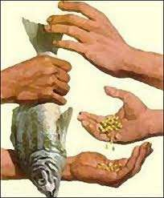
BARTER
It is the direct exchange of one goods for another without using anything as money or as a medium of exchange.
Barter is a type of trade where goods or services are exchanged for a certain amount of other goods or services;
no money is involved in the transaction.

Slide 6
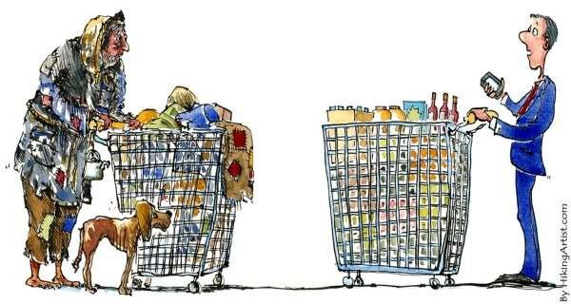
BUSINESS
Standard of Living
A measure of how well a person or family is doing in terms of satisfying needs and wants with goods and services.

Slide 7
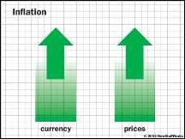
BUSINESS
Free Enterprise
It means that private businesses are able to conduct business activities competitively with minimal government regulation.
Inflation
Rate at which the general level of prices for goods and services is rising and purchase power
is falling.
(example: inflation rate goes up to 2%)

Slide 8
The Core of Business
The human element is the core of business. Business needs people as owners, managers, employees, and consumers. People need business for the production of goods and services and the creation of jobs. Whether business is transacted in Bangladesh, USA, Japan or Ghana dose not matter.

Slide 9
The Core of Business
Owners
People, who own a business as well as those who invest money in one, do so because they expect to earn profit.
Managers
The person responsible for operating the business may be the owner or a professional manager employed by the owner. An owner-manager is also called an entrepreneur.

Slide 10
The Core of Business
Managers (Contd...)
The owner-manager sets his/ her own objectives, whereas a professional manager attempts to achieve objectives set by others.

Slide 11
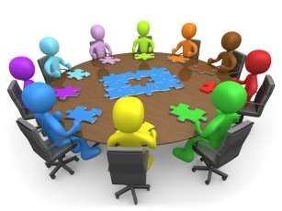
The Core of Business
Employees
Employees supply the skills and abilities needed to provide a product or service and to earn a profit. Most employees expect to receive an reasonable wage or salary and to be given regular increases in the amount they are paid for the use of their skills and abilities.

Slide 12
The Core of Business
Consumers
A consumer is a person or business who purchases a goods or services for personal and organizational use. A business enterprise attempts to satisfy consumer needs and desires while earning a profit.

Slide 13
Business Objectives
Survival
Growth
Social Responsibilities

Slide 14
Business Objectives
Survival
Survival objective is an obvious objective. Other objectives can be accomplished only if the business enterprise survives.
Growth
Growth is an objective because business does not stand still. Market share increase, personal and individual development and increase productivity are important growth objectives.

Slide 15
Business Objectives
Social Responsibilities
In recent years, meeting social responsibilities has been recognized as important objectives. Businesses, like each person in society, must accept their responsibilities in areas such as pollution control, eliminating discriminatory practices and energy conservation.

Slide 16
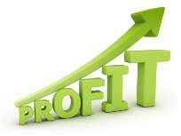
Business Objectives
Profit
The profit business.
objective plays the major role in
Business Profit
The difference between business expenses
business income and

Slide 17
Business Objectives
Activities Performed to earn Business Profit:
Risk Taking Evaluation of Demand
Well-organized Management

Slide 18
Business Objectives
Activities Performed to earn Business Profit:
Risk Taking
Toyota invested millions of dollars in promoting and selling small cars in the US. Today, this Japanese corporation is the largest small car seller in the US market.

Slide 19
Business Objectives
Activities Performed to earn Business Profit:
Evaluation of Demand

Slide 20
Business Objectives
Activities Performed to earn Business Profit:
Well-organized Management
Management of people, technology, materials and capital. Efficient planning, organizing, controlling, directing and staffing can earn satisfactory profit.

Slide 21
Business Objectives
Economic Profit
Opportunity Cost: Something you given up in order to get
something else.
Economic Profit:
What remains after the expenses and
opportunity costs are subtracted from income.
Selling Price: All costs of making and selling a product, including taxes.

Slide 22
Business Objectives
Economic Profit
Opportunity Cost
Mr. Rahman is working in Company X. Earning Tk 40,000/- per month. His office is near to his house. But he could earn Tk 60,000/- per month working in Company Y which is far from his house. His opportunity cost is Tk 20,000/-.

Slide 23
Economics:
The Foundation of Business
Economics
The study of how a society (people) chooses to use limited resources to produce goods and services and to distribute them to the people for consumption.
This definition raises certain issues that are key to understanding economics:

Slide 24
Economics:
The Foundation of Business
There are three factors:
Resources
Goods and Services
Allocation of Resources and Products
Resources
A nation’s resources consist of three broad areas:
Natural Resources 2. Capital Resources
3. Labor (Human Resources)

Slide 25
Economics:
The Foundation of Business
Resources
1. Natural Resources
Resources provided in limited amounts by nature such as oil, natural gas, minerals, timber and water.
Natural resources must be processed to become a product or to be used to produce other goods and services.
Example....Trees must be processed into lumber before
they can be used to build homes, offices, schools, etc.

Slide 26
Economics:
The Foundation of Business
Resources
2. Capital Resources
Goods produced for the purpose of making other types of goods and services. Some capital resources, called current assets have a short life and are used up in the production process.
Such as fuel, raw materials, paper, money.
Long-lived capital resources which can be used repeatedly in
the production process are called fixed capital.
Such as factory building, machineries, etc.
25

Slide 27
Economics:
The Foundation of Business
Resources
3. Labor Resources
Represent the human talent, skills and competence available to a nation.
To have value in the labor force, individuals must be trained to perform either skilled or semiskilled work.
This collection of human talent is the most valuable national resource. Without human resources, no productive use of either natural or capital resources is possible.

Slide 28
Economics:
The Foundation of Business
Goods and Services
A nation’s resources are used to produce goods and services that will meet people’s needs and wants.
Needs: goods and services people must have in order to survive. Example: food, clothing, shelter, medical needs, etc.
Wants: are things they would like to have but do not absolutely require for survival. Example: luxury holidays, fast foods (Burgers, Fries), etc.

Slide 29
Economics:
The Foundation of Business
Allocation of Resources and Products
The process of choosing how resources will be used to meet a society’s needs and wants and it also includes the distribution of products to customers.
Resources are Limited but Wants are Unlimited such as the Supply of Oil, Gas and other Petroleum Products.

Slide 30
END OF PART 1

