Slide 1

Introduction to Business
FUNDAMENTALS OF MANAGEMENT
Chapter # 7
PART II

Slide 2
Management Roles
θ Role is a set of expected behaviours. For example, a man may play the role of a father. As such he serves as a role
model; he is expected
to be kind, understanding, helpful and a good
example to his child.
Similarly a manager is expected to serve a number of roles and to be a good role model to his employees

Slide 3
Management Roles
A manager has three major roles to perform:
∅ Interpersonal
∅ Informational
∅ Decision-making

Slide 4
Management Roles
Firstly, a manager performs a number of interpersonal activities by virtue of their position in the managerial hierarchy.
Secondly, the communications that to flow to and from managers make it necessary for them to process information.
Third, the fact that a manager is a conduit
(person who
passes means
information) and
be
communicator
decisions
must
made; managers are the
key decision
makers in an organization.

Slide 5
Management Roles
Interpersonal Roles
The manager must be in frequent contact with ‘others to fulfill the organization’s objectives. Part of these activities requires the manager to lead subordinates.
Leadership is essential for influencing employees’ behavior and performance. Each time a manager influences an employee to work a little harder, to have confidence in the organization, or to report minor problems before they become major ones, he or she is acting as a conduit from management to the operating employees.
An important feature of influencing others is the ability to communicate confidence and mutual respect.

Slide 6
Management Roles
Information Roles
The manager is at the center of the business activities. He or she should have a total picture of the group, its strengths and weaknesses and its needs.
With this knowledge, managers process information flowing to and from the group, feeding the relevant information.

Slide 7
Management Roles
Decision Making Roles
Managers must accept responsibility for decision making. The manager must take bits of information from various sources, gives a personal opinion,
consider the present resources
situation, then tie
analyze the this altogether
available and
before reaching a decision. The information available from situation to situation.

Slide 8
Core Management Skills
Management Skills
The ability to use knowledge, behaviors and aptitudes (capacity) to perform a task.
Different types of Skills
  Technical Skills
  Human Relations Skills
  Conceptual Skills

Slide 9
Core Management Skills
Technical Skills
Technical skill is the skill that include knowledge of and proficiency in a certain specialized field. Skills involved in making a product or providing a service.
Technical skills are especially important at the first level management.
Human Relations Skills
Human skill is the ability to work well with other people both individually and in a group. The ability to relate and interact with subordinates, peers, superiors and customers or clients.

Slide 10
Core Management Skills
⎫ Conceptual Skills
Conceptual skill is the ability to think and to conceptualize about abstract situations, to see the organization as a whole and the relationships among its various subunits and to visualize how the organization fits into its broader environment.
Conceptual skills are especially important at the executive level of management.

Slide 11
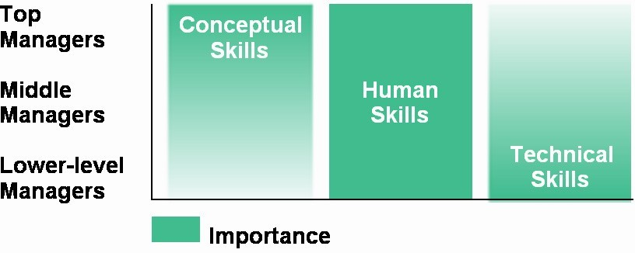
Skills Needed at Different Management Levels

Slide 12
END OF PART II

