Slide 1
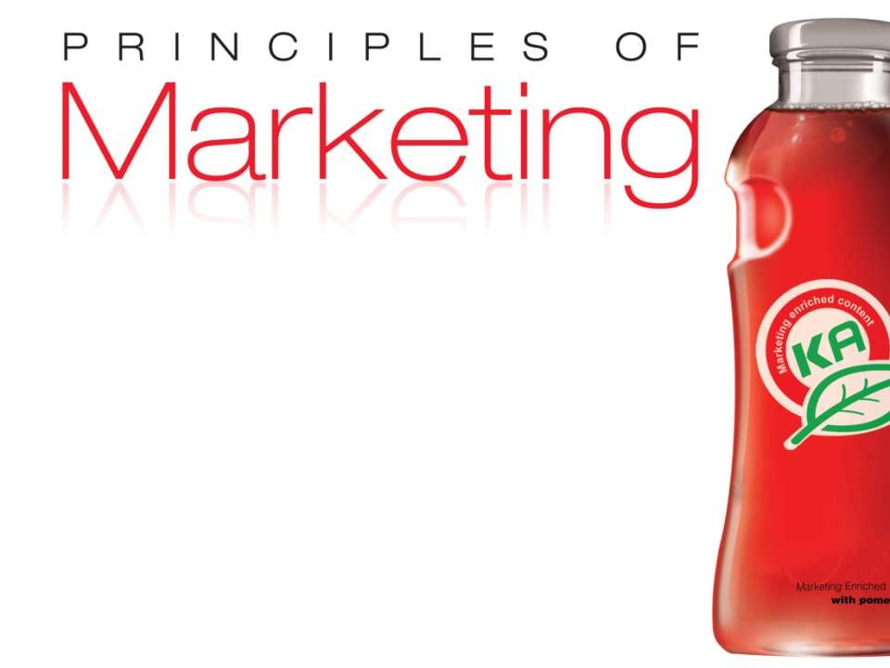
Chapter 13
Part-2
Marketing Strategy
Copyright © 2010 Pearson Education, Inc. _{Chapter 5- slide 1}
Publishing as Prentice Hall

Slide 2
Model of Consumer Behavior
Consumer buyer behavior refers to the buying behavior of final consumers— individuals and households who buy goods and services for personal consumption
Consumer market refers to all of the personal consumption of final consumers

Slide 3
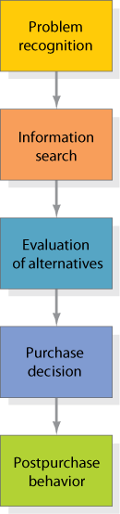
Figure 6.4
The Buying Decision Process
Notes:
Smart companies try to fully understand customers’ buying decision process—all the experiences in learning, choosing, using, and even disposing of a product. Marketing scholars have developed a “stage model” of the process. The consumer typically passes through five stages: problem recognition, information search, evaluation of alternatives, purchase decision, and postpurchase behavior. Clearly, the buying process starts long before the actual purchase and has consequences long afterward.

Slide 4
The Buyer Decision Process
Need Recognition
Occurs when the buyer recognizes a problem or need triggered by:
  Internal stimuli
  External stimuli

Slide 5
The Buyer Decision Process
Information Search Sources of Information
Personal sources—family and friends
Commercial sources—advertising, Internet
Public sources—mass media, consumer organizations
Experiential sources—handling, examining, using the product

Slide 6
The Buyer Decision Process
Evaluation of Alternatives
How the consumer processes information to arrive at brand choices

Slide 7
The Buyer Decision Process
Purchase Decision
The act by the consumer to buy the most preferred brand
The purchase decision can be affected by:
  Attitudes of others
  Unexpected situational factors

Slide 8
The Buyer Decision Process
Postpurchase Decision
The satisfaction or dissatisfaction that the consumer feels about the purchase
Relationship between:
  Consumer’s expectations
  Product’s perceived performance
The larger the gap between expectation and performance, the greater the consumer’s dissatisfaction
Cognitive dissonance is the discomfort caused by a postpurchase conflict

Slide 9
The Buyer Decision Process
Post-Purchase Decision
Customer satisfaction is a key to building profitable relationships with consumers—to keeping and growing consumers and reaping their customer lifetime value

