Slide 1
Saumik Shahriar ID : 0242310014121035 Section : C1
Dept. Of Textile Engineering, Daffodil International University.

Slide 2
Comparative Evaluation and Optimization of Dyeing Techniques for Cotton
A Process Optimization Plan for Reactive, Sulphur and Azoic Dyes

Slide 3
Introduction
The global textile industry's demand for vibrant, durable and cost-effective cotton dyeing. The challenges of balancing color fastness, cost-efficiency and environmental sustainability. Focus on reactive, sulphur and azoic dyes.

Slide 4
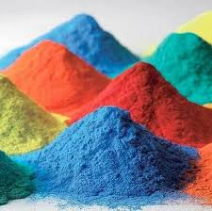
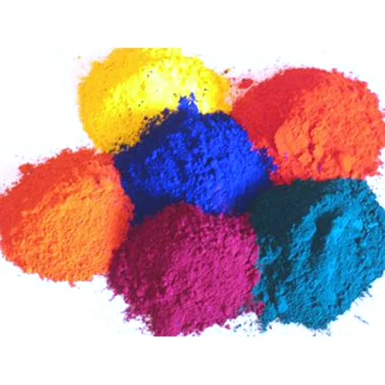
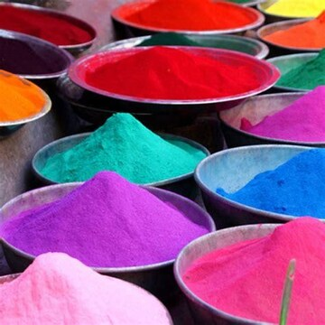
Theoretical Background of Dye Classes
Reactive Dyes: Covalent bonding mechanism, affinity for cotton, fixation methods (alkaline conditions), advantages (excellent wash fastness, bright shades), disadvantages (high cost, hydrolysis).
Sulphur Dyes: Insoluble transformation mechanism (reduction/oxidation), moderate affinity for cotton, fixation through oxidation, advantages (low cost, good light fastness), disadvantages (limited color range, poor rub fastness, environmental concerns).
Azoic Dyes: In-situ synthesis mechanism (diazo + coupling component), good naphthol affinity, fixation through insoluble dye formation, advantages (good light fastness, low cost), disadvantages (limited color range, uneven dyeing potential).

Slide 5
Laboratory Experiments and Methodology
Experimental Design:
Factorial design to investigate the effects of M:L ratio, temperature, pH, auxiliaries and time on dyeing performance.
Dyeing Procedure:
Detailed steps for each dye class (preparation, pre-treatment, dyeing, rinsing, after-treatment, drying).

Slide 6
Results and Comparative Analysis
Environmental Metrics:
Present data on water, energy and chemical consumption for each dye class.
Fastness Test Results:
Present results of wash, rub and light fastness tests for each dye class, visualized in bar charts or graphs.

Slide 7
Conclusion:
Reiterate the main findings and the significance of the optimized dyeing process in achieving superior color fastness, cost-efficiency, and environmental sustainability.

