Slide 1
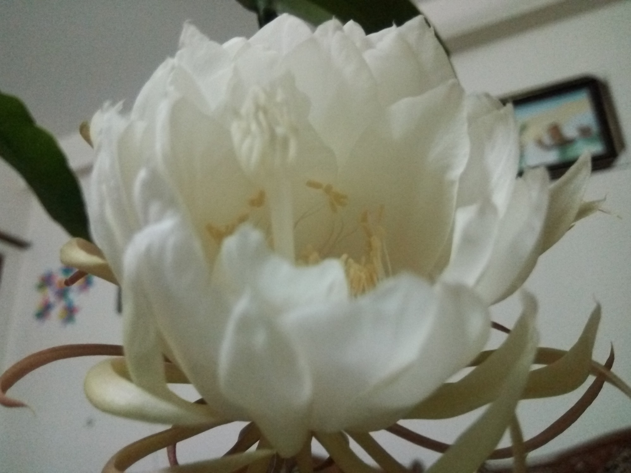
Welcome to the Introductory Class

Slide 2
One Question for You!
Why are you in here?

Slide 3
Education means???

Slide 4
Etymological Meaning of Education-1
In English the term “Education” has been derived from two Latin words Educare (Educere) and Educatum. “Educare” means to train or mould. It again means to bring up or to lead out or to draw out, propulsion from inward to outward. The term “Educatum” denotes the act of teaching. It throws light on the principles and practice of teaching.

Slide 5
Etymological Meaning of Education-2
In narrow sense, Education is a process in which and by which knowledge, character and behavior of the young are shaped and moulded (Drever). Education is conscious effort to develop and cultivate our innate powers (Mackenzie).The influence of the environment of the individual with a view to producing a permanent change in his habits of behavior, or thought and attitude (Thompso).

Slide 6
Etymological Meaning of Education-3
In the wider sense, education is that process by which an individual freely develops his self according to his nature in a free and uncontrolled environment. It is a process that goes on throughout life, and is promoted by almost every experience in life (Mackenzie). By education, I mean the all-round drawing out of the best in child and man’s body, mind and soul (Gandhi).

Slide 7
Means of Education
According to Rabindranath Tagore the aim of education is self-realization. The means of education is to understand the purpose of our life – the purpose of individual existence. Understand what it is towards which you are thriving. Then utilize every emotion, every thought to strengthen you. The highest function of education is to bring about an integrated individual who is capable of dealing with life as a whole. Education means a transformation of human mind and creation of new culture (Krishnamurti, 1973). According to Socrates, education means the bringing out of the ideas of universal validity which are latent in the mind of every man.

Slide 8
Introduction to Course
Md. Fouad Hossain Sarker
Associate Professor and Head
Department of Development Studies
Daffodil International University (DIU)

Slide 9
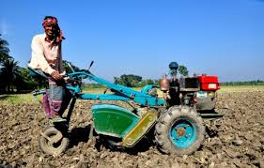
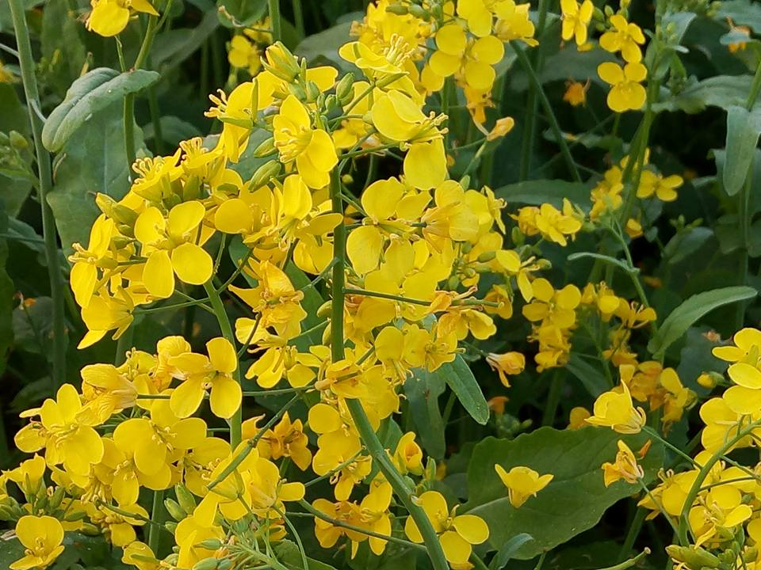
Unlock Your Potentiality!!

Slide 10
Can you define your role??

Slide 11
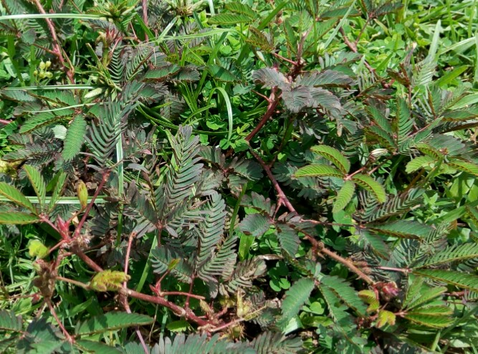
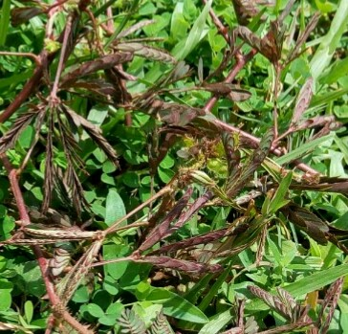
Your Role !!!

Slide 12
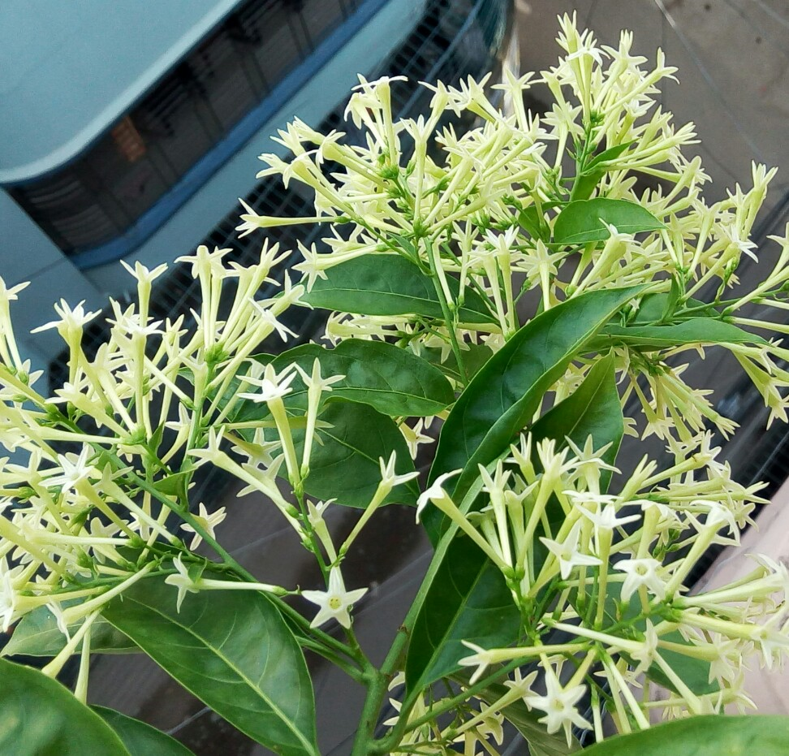
Reveal Yourself !!!!

Slide 13
Insight Values

Slide 14
Can you mention the
objectives of this session??

Slide 15
Objectives of this class
Explore the objectives of this course
Investigate the key issues of course outline
Demonstrate the course approach
Illustrate the way of teaching and learning
Analyze the rules and regulations

Slide 16
Objectives of this class
Identify some references for readings
Understand the students background and
Motivate them for future development
Signify the lecture areas and outcomes of this course

Slide 17
Student’s Observation
Mostak Ahmad 142-15-3800, Aug 8, 2015 (CSE)
First day of the 4th semester. I'm walking along the Dhanmondi 27 road. Usually, I should have a cheerful mind as after a long vacation of the semester break, I was going to meet with my beloved friends. But I didn't do so & the reason was something had been happened wrongly & this was I enrolled myself in the B section. Not because of I enrolled myself in the B section, actually, my mind was full of sorrows since in that section the Bangladesh Studies course would be taken by a Royal Bengal Tiger whose name Fouad Sarker or something else. I didn't know him but the senior brothers informed us that he is not less than as ferocious as a Royal Bengal Tiger.

Slide 18
Student’s Observation (Cont.)
The only difference between Fouad sir and Tiger uncle is, the Tiger uncle lives in the forest where Fouad sir at Daffodil varsity. After hearing this we got feared & we begged suggestion from them how we would be escaped. The senior brother's the only and the just only suggestion was not to be enrolled in the Fouad sir section. I was late as I had already enrolled myself in that section. My fearness grew little more when I had come to know to that lots of students left the section. However, nothing was to do then. I accepted my lot being compelled. I entered the class & did the whole class.

Slide 19
Student’s Observation (Cont.)
U may never believe what was my mind condition after the class. What I heard & what I had just enjoyed. What a fantastic teacher he is! What a wonderful skill to take a class he possesses! I really surprised. I have never seen such kind of ideal teacher in my life before. From the first class , he went to my heart. Nothing is constant in the earth. Beginning is the pre-alarm of the ending. In this flow today I'm going to attend to my last class of Bangladesh Studies. Same to the first class, I'm walking along the Dhanmondi 27 road.

Slide 20
Student’s Observation (Cont.)
But today I'm really feeling lucky to have such kind of teacher ' Fouad Sarker '. In my life I never forget him. He is not only a good teacher, his teaching technique is not only awesome , rather his attitude , his punctuality, his manner , specially his smile attract me most. I not only learn about my course from him , but learn how to possess a good personality , how to be a good human being.
At the last, I can proudly say that Bangladesh Studies teach me more than the course. I will really miss Bangladesh Studies... I will really miss Fouad Sir....

Slide 21
Insight Objective
What do you understand from the above picture?

Slide 22
Your Answer!
A
little
drop
of
water
makes
a
mighty
ocean.
A little drop of water makes a mighty ocean.

Slide 23
Why do you need to carry on your journey with this course??

Slide 24
Objectives of this Course
Rural Sociology is a multidisciplinary course designed to equip students with knowledge on understanding the social, economic, cultural, and political aspects of rural communities. It provides an overview of the specific context of Bangladesh especially, a densely populated country with a significant rural population, presents unique challenges and opportunities for the application of rural sociological concepts.

Slide 25
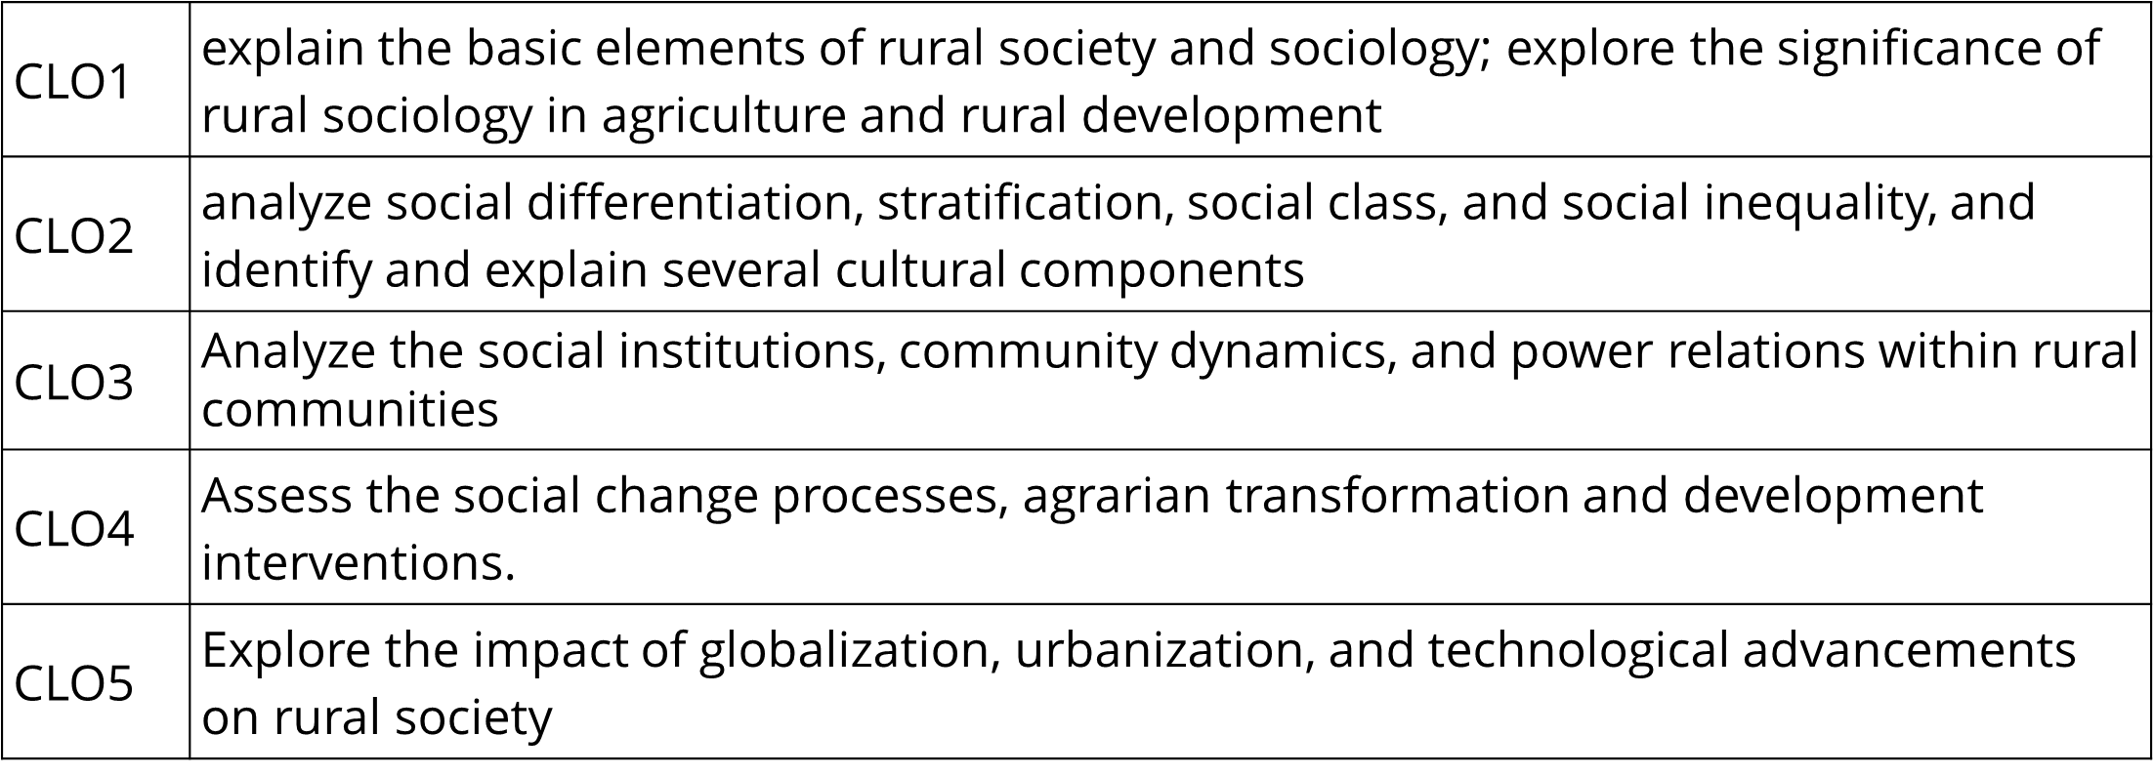
Course Learning Outcome: By the end of the course, student will be able to:

Slide 26
PLOs aligned with the Course
PLOs | Category | Program Outcomes
PLO3 | Design/Development of Solutions | Design solutions for Nutrition and Food Engineering related problems and design system components or processes that meet the specified needs with appropriate consideration for public health and safety and of cultural, societal and environmental concerns.
PLO6 | Nutritionist & Food Engineer in Society | Apply reasoning informed by contextual knowledge to assess societal, health, safety, legal and cultural issues and the consequent responsibilities relevant to professional practice.
PLO7 | Environment and Sustainability | Understand the impact of Nutrition and Food Engineering related solutions in societal and environmental contexts and demonstrate the knowledge of, and need for sustainable development.

Slide 27
PLOs aligned with the Course
PLOs | Category | Program Outcomes
PLO8 | Ethics | Apply ethical principles and commit to the professional ethics, responsibilities and the norms of the Nutrition and Food Engineering practice.
PLO10 | Communication | Communicate effectively about Nutrition and Food Engineering activities with the community and society. Be able to comprehend and write effective reports, design documentation, make effective presentations and give and receive clear instructions.
PLO12 | Life Long Learning | Recognize the need for and have the preparation and ability to engage in independent life learning in the broadest context of health and technological change.

Slide 28
Lecture Plans
Topic:1 Introduction to Course
Topic: 2 Understanding Basic Concepts of Rural Sociology
Topic: 3 Rural Livelihood and Sustainability
Topic: 4 Rural Social institutions, Culture and Structure
Topic: 5 Rural Social Change
Topic: 6 Rural Development

Slide 29
Lecture Plans (Cont.)
Topic: 7 Social Issues in Rural Areas
Topic: 8 Agriculture and Food Systems
Topic: 9 Rural Social Movements
Topic: 10 Rural Governance and Policy
Topic: 11 Future of Rural Sociology

Slide 30
Course Approach
The approach of this course highly imparts the neutral or rational tone to streamline the goal and ensure minimal academic jargon. Moreover, this course avoids all sorts of non-judgmental manners that impede to understand the insight values and facts of Bangladesh.

Slide 31
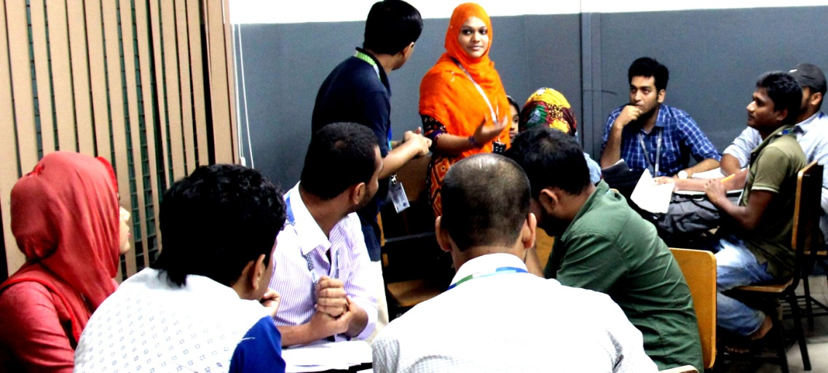
Methods of Teaching & Learning
Teaching will cover the areas of lectures, power point presentations, participative discussions and problem solving. Students are highly encouraged to participate in discussion and problem solving sessions. Active participation in the class will carry credit. On the other hand, Group study/Team work/Peer study method will be followed for better understanding.

Slide 32
Rules and Regulations
Students must wear DIU ID for entering the classroom
Active participation in both physical and digital will be encouraged
75% Class attendance is mandatory for assessing course teacher
University rules and regulations will be followed very strictly
Students must keep silence their mobile phone during the class
No dress code but have to ensure decency
Neat and clean and ensure rational manner in everywhere
If anyone miss any CT Exam, submission their assignment/ presentation in time, never give them any opportunity for future

Slide 33
Marks Distribution
S/N | Distribution Area | Marks
1 | Class Attendance | 07
2 | Quiz/ Class Test | 15
3 | Midterm Exam | 25
4 | Presentation | 08
5 | Assignment | 05
6 | Final Exam | 40

Slide 34
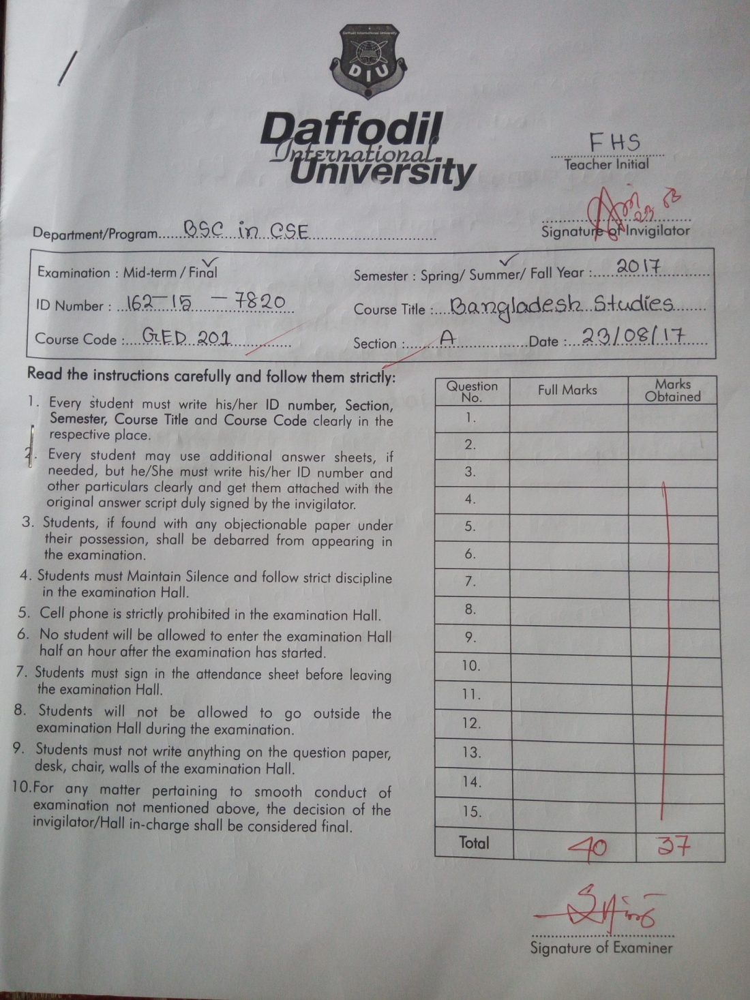
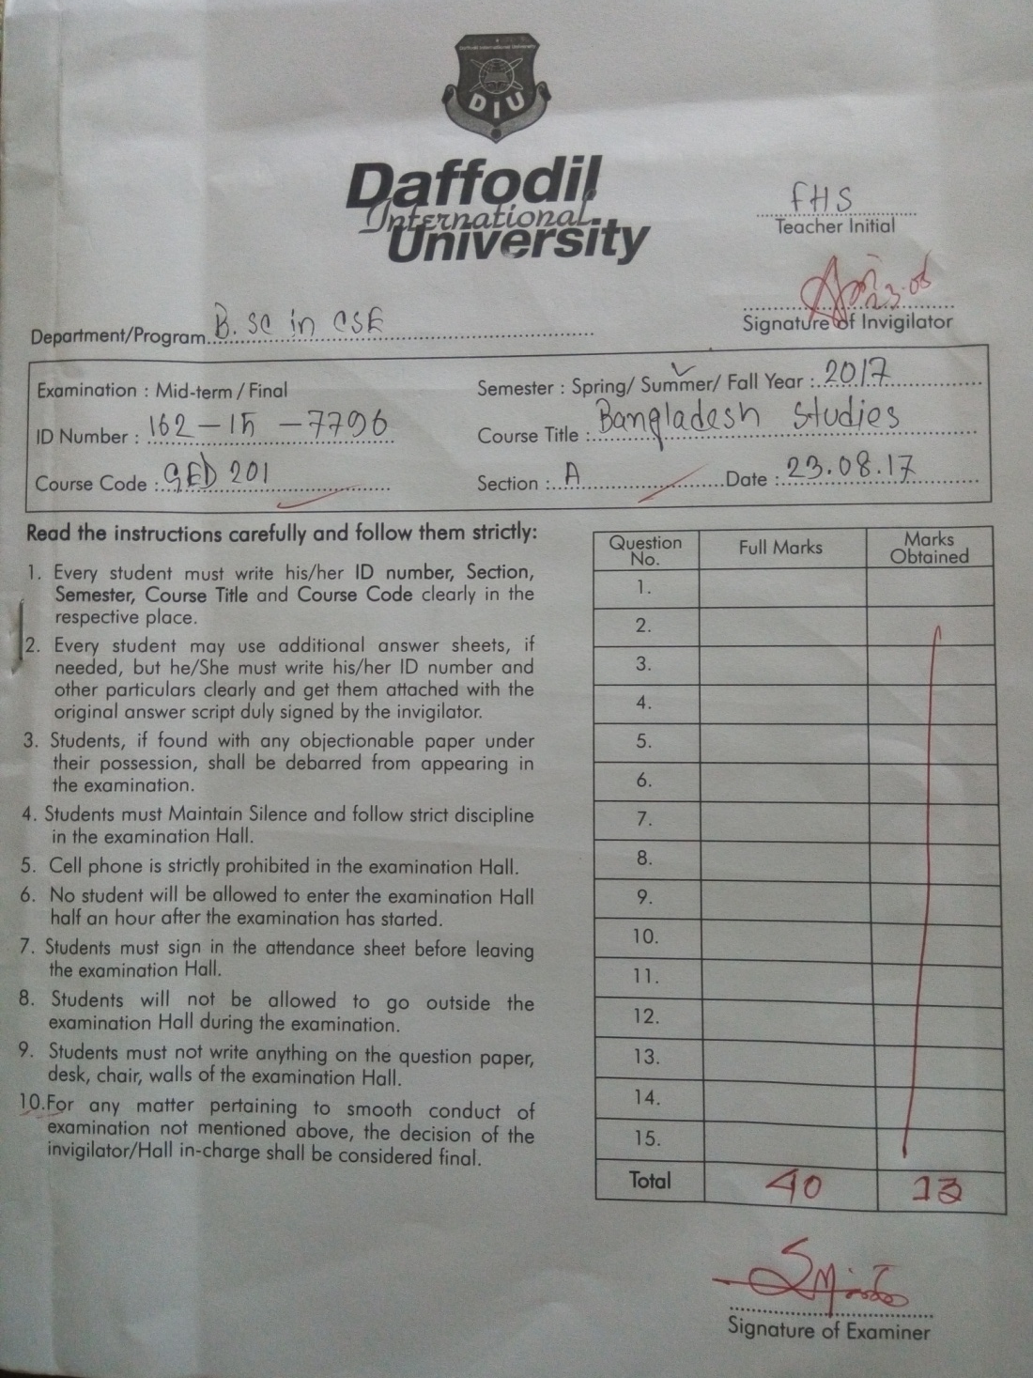
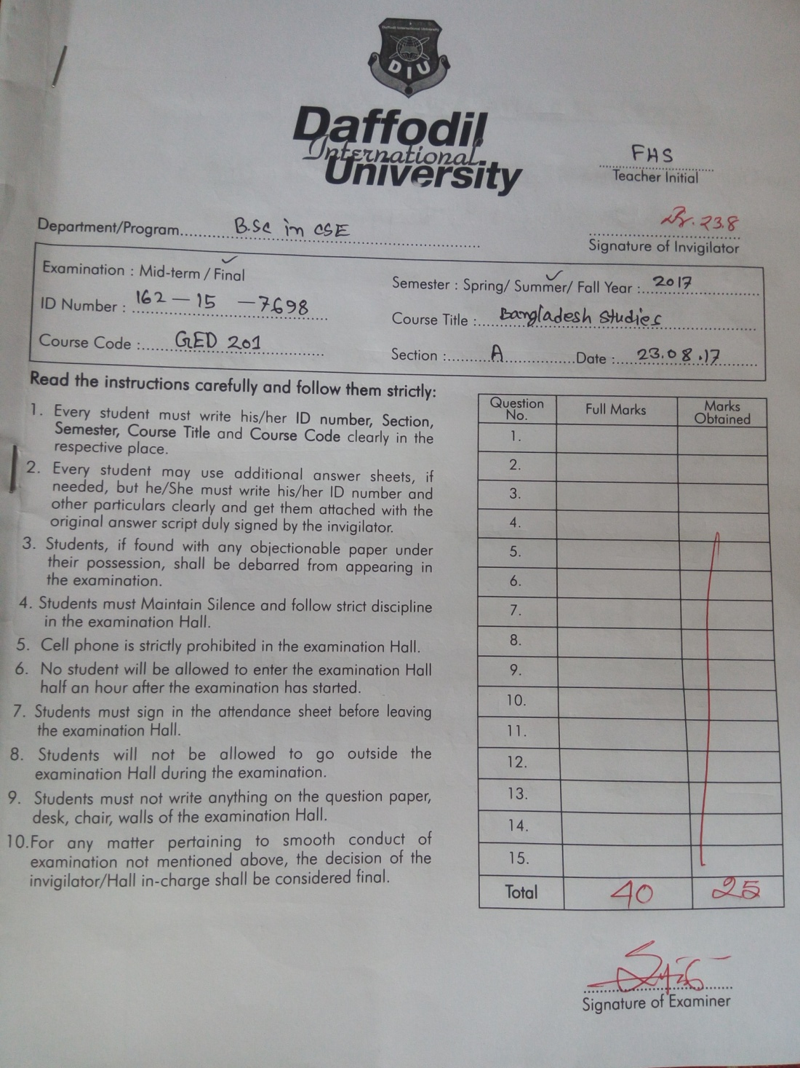
Answer Scripts !!

Slide 35
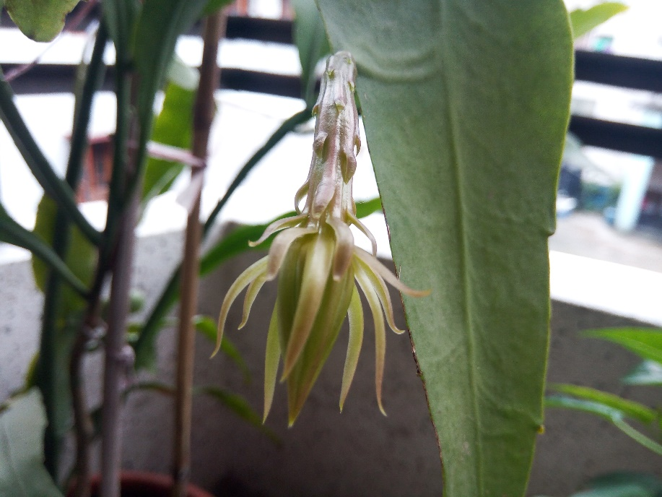
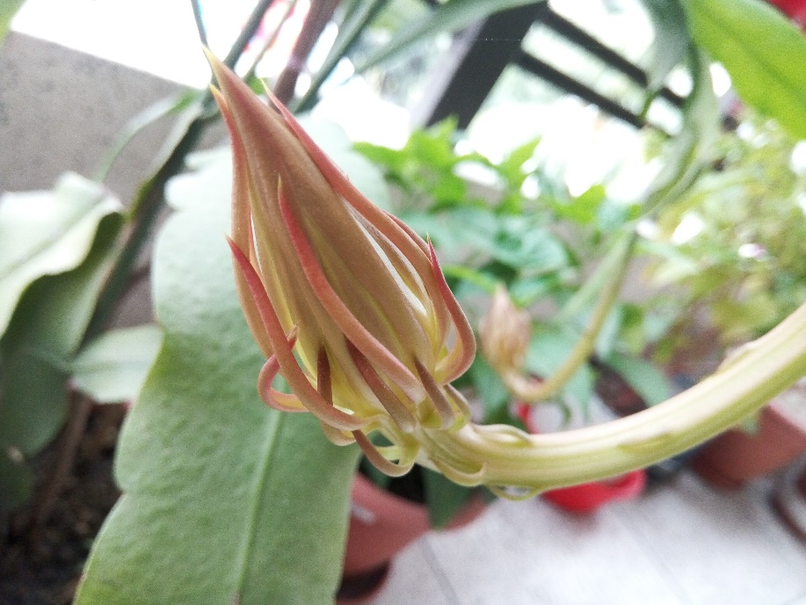
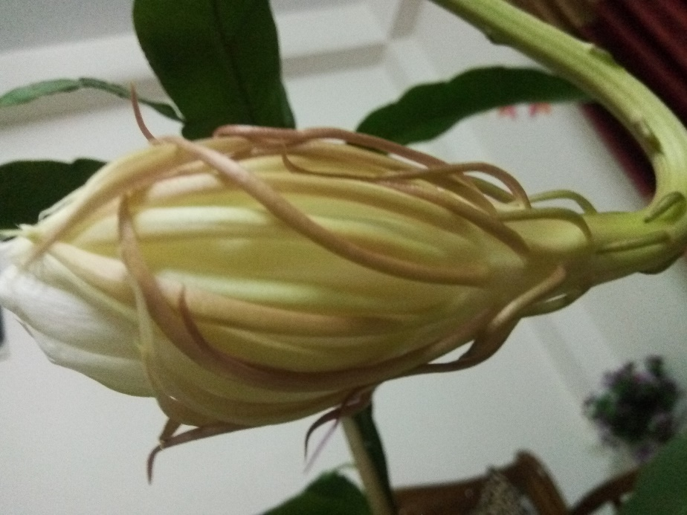
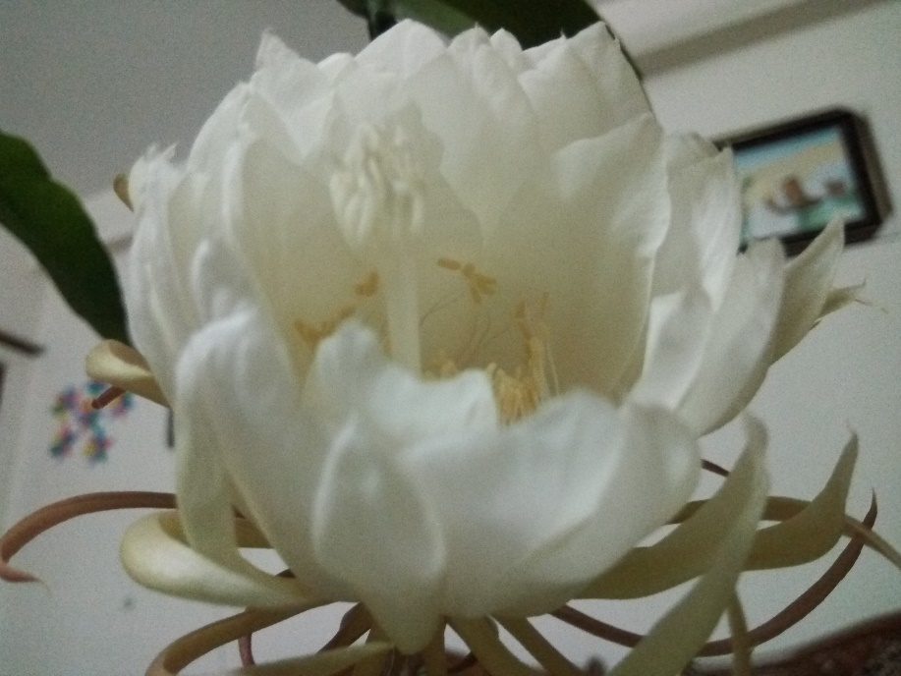
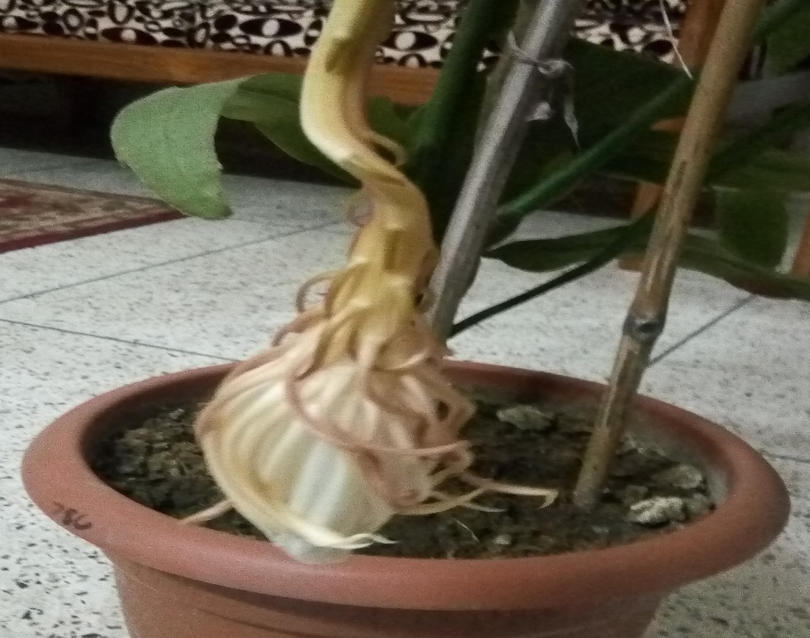
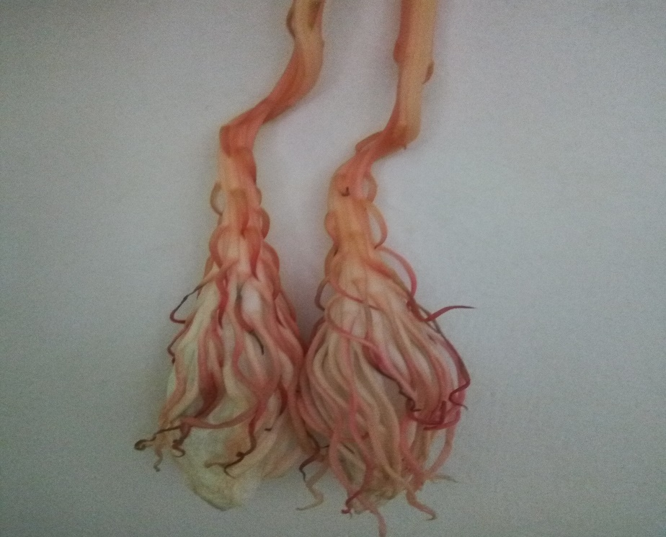
Role of Nature!!!

Slide 36
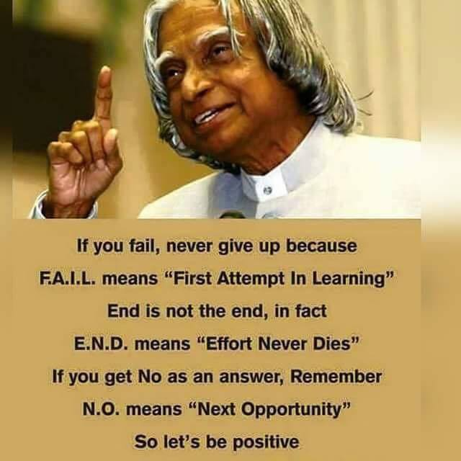
Be Positive

Slide 37
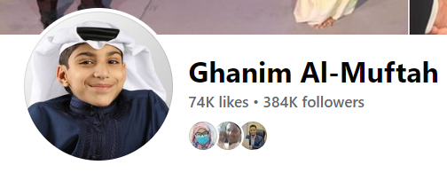
Unleashing Incredible Potential with a Mentor
Please Visit: https://youtu.be/zQSOFSsnE9w

Slide 38
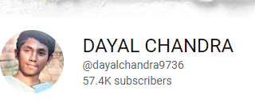
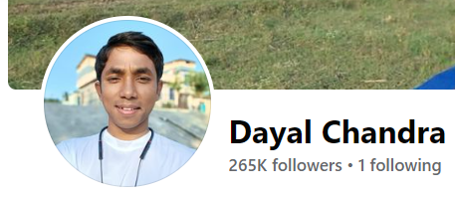
‘Talent is Nothing Without Hard Works’-Dayal Chandra
‘
Please Visit: https://www.youtube.com/watch?v=MN_msjj5nsM
https://www.youtube.com/watch?v=uogUizAgSmA
https://youtu.be/fJjKkTgYQf0
https://www.youtube.com/watch?v=jZs6YTs6Y9I
https://www.youtube.com/watch?v=WrJyVsXfQ6I
Faccbook: https://www.facebook.com/dayalchandra01

Slide 39
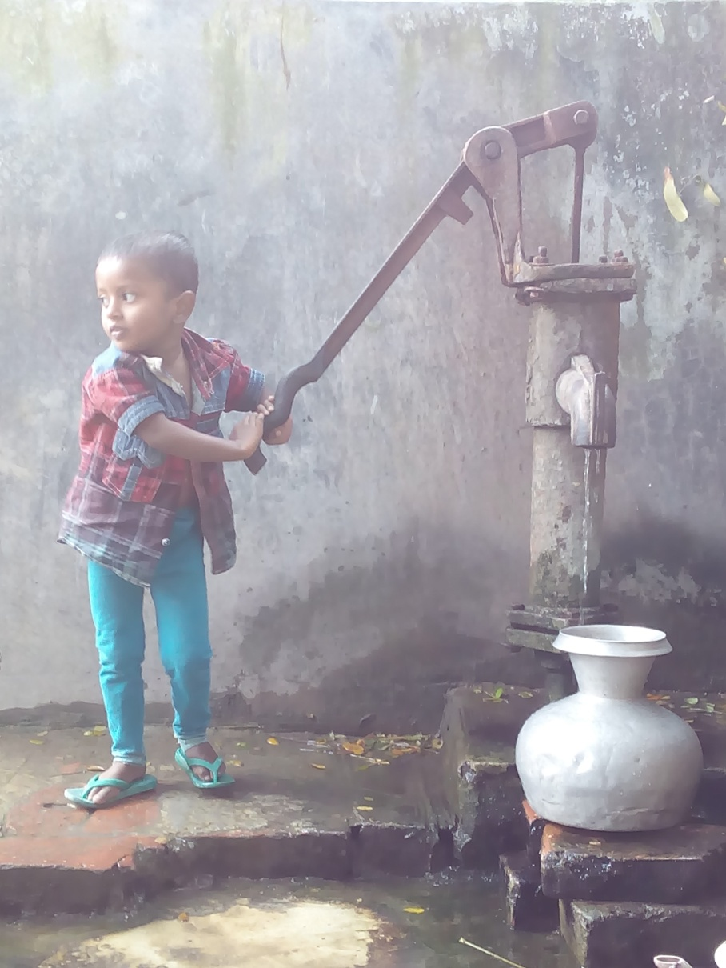
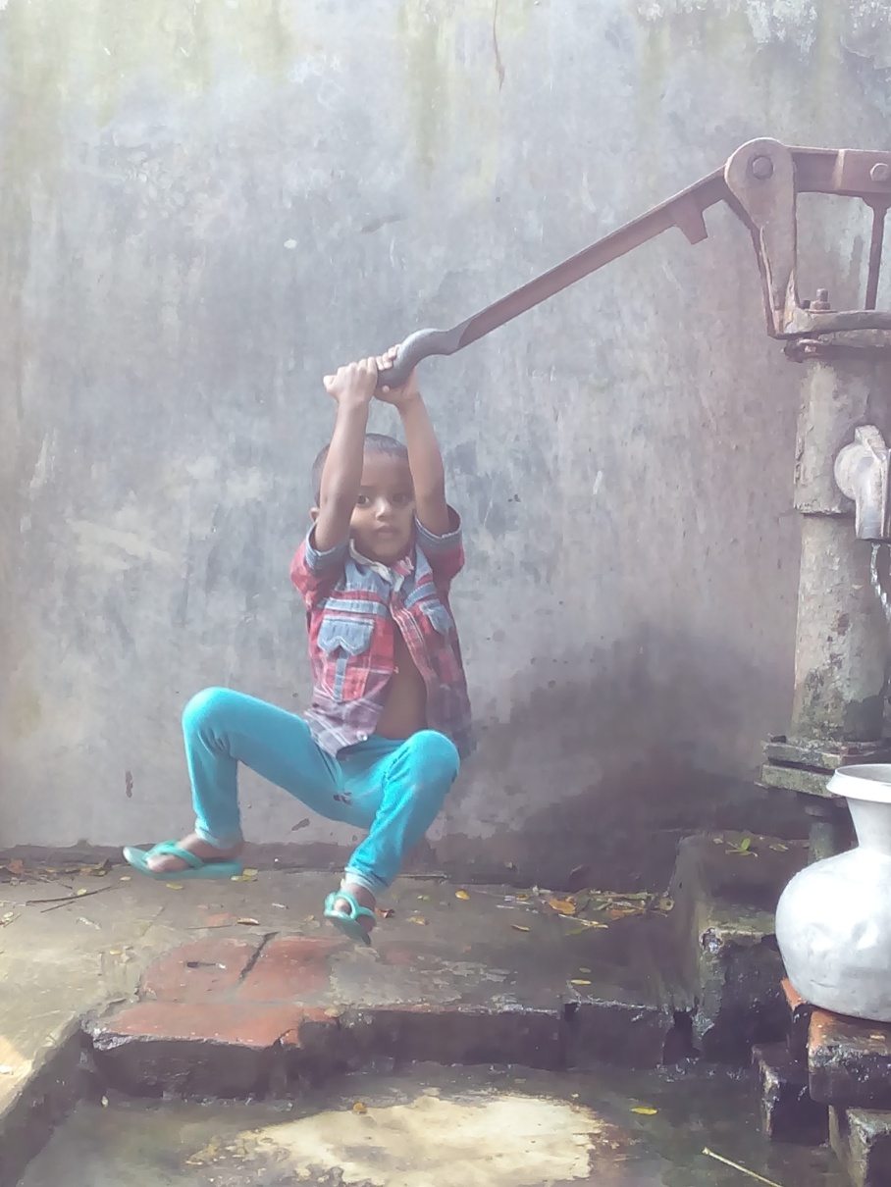
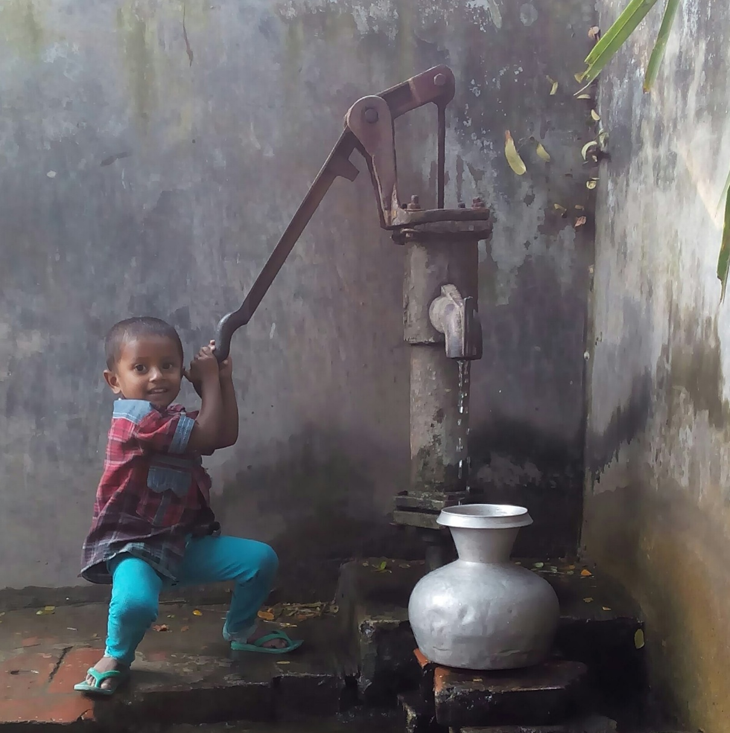
Come out of the Box

Slide 40
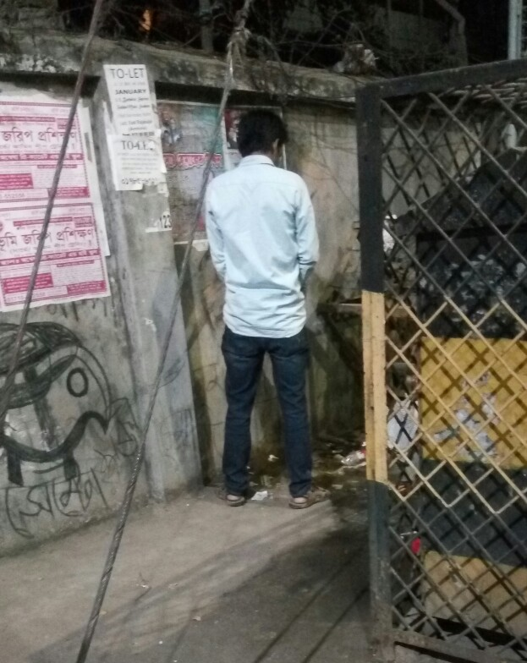
Can we change to make a better world?

Slide 41
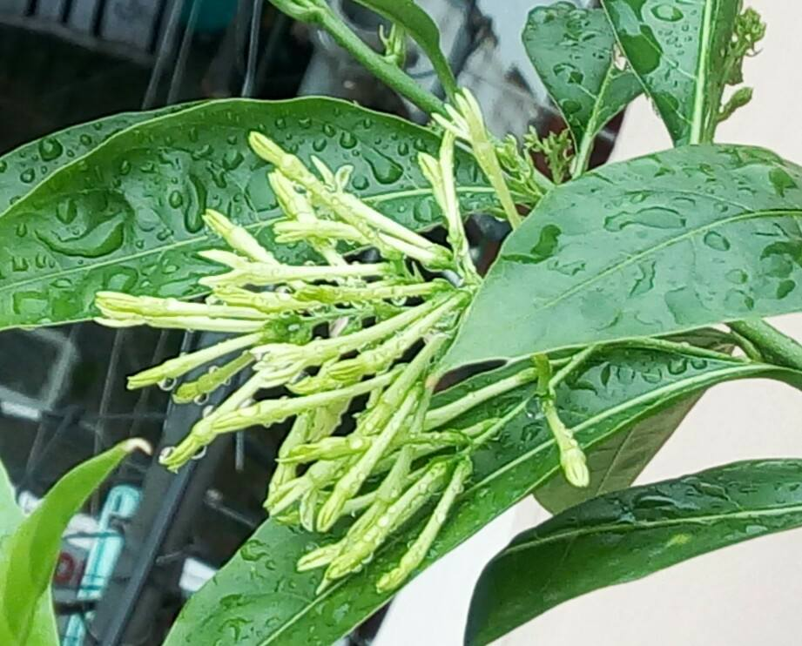
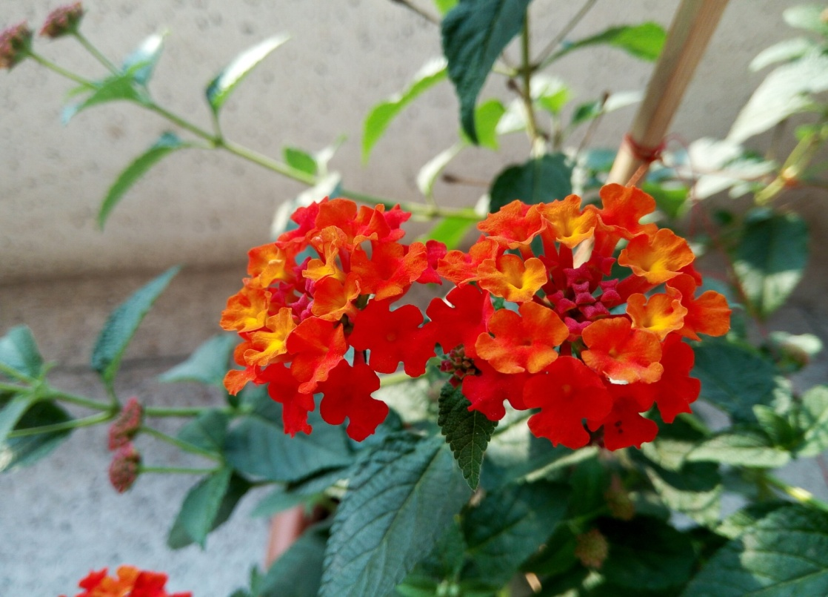
Commitment for Future
Change we believe in together

Slide 42
Approaching for Future Development
How to develop yourself? Your Commitment/passionate
Area of Development: Knowledge of English, IT, Smartness, and be Communicative
Never demean yourself, Philosophy: just make or mar
We have to love ourselves with all our heart and with all our soul and with all our mind and with all our strength.

Slide 43
Career Development Discourse
Avoiding most common mistakes in English
Use of capital letter
Use of auxiliary verb
Use of s/es
Use of article
Use of many/much/some /amount/number etc.
Spelling and finally
Organization of a sentence

Slide 44
Please listen the songs – Ami Shunechi Shedin Tumi, and Manush Manusher Jonne

Slide 45
Outcomes of this Course

Slide 46
Feedback
Q1: What do you think about our today’s class?
Q2: Can you assess this class? Is it participatory oriented?
Q3: Give your suggestions for making classroom very active.
Please answer through: gg.gg/fhsfeedback
Thank you all with the journey of Rural Sociology

