Slide 1
Understanding Basic Concepts of Rural Sociology
Md. Fouad Hossain Sarker
Associate Professor and Head, Department of Development Studies
Daffodil International University

Slide 2
Objectives of this Class
Providing the definition of Sociology and Rural Sociology
Exploring the origin and development of rural sociology
Examining the scope and importance of rural sociology
Exploring the role of Rural Sociologists and Agriculturists in
agriculture and rural development

Slide 3
General Ideas
What do you mean by “SOCIOLOGY”?

Slide 4
About Sociology

Slide 5
Meaning of Sociology
“Sociology” is composed of two words :
Latin “SOCIOUS” Companion/Associate
Greek “LOGOS” Science/ Study
The etymological meaning of “sociology” is thus ---- “The Science of Society.”

Slide 6
Definition of Sociology
The question “ what is sociology” is, indeed, a question pertaining to the definition of sociology.
Sociology is the academic study of social behavior, including its origins, development, organization, and institutions. It is a social science that uses various methods of empirical investigation and critical analysis to develop a body of knowledge about social order, social disorder and social change. Many sociologists aim to conduct research that may be applied directly to social policy and welfare, while others focus primarily on refining the theoretical understanding of social processes. Subject matter ranges from the micro level of individual agency and interaction to the macro level of systems and the social structure.

Slide 7
Founding Father of Sociology
Auguste Comte, a Frenchman, is traditionally considered to be the father of sociology.
Comte is accredited with the coining of the term “ Sociology” in 1839.
“Sociology” which had once been treated as-
“ social philosophy”, or the “philosophy of history” emerged as an independent social science in the 19th century.

Slide 8
About Auguste Comte and His Sociology

Slide 9
Definition of Rural Sociology
Rural sociology is a branch of sociology that focuses on studying and understanding the social structures, processes, and issues related to rural areas and their inhabitants. It examines the social, cultural, economic, and political aspects of rural communities, as well as the relationships between these communities and the broader society.
Rural sociology explores the unique characteristics of rural areas, such as their agricultural and natural resource-based economies, small population densities, spatial isolation, and close-knit social networks. It analyzes how these factors shape the social organization, community dynamics, and individual behaviors within rural settings.

Slide 10
Why Should We Study Rural Sociology?
1. To study in a scientific and systematic manner, the Rural Society and its various aspects and complexities.
2. To study the structure, functions and objective tendencies of development of the Rural Society.
3. To discover the laws of the development of the Rural Society.
4. To make a scientific study of the Rural Society in order to help in the task of planning for the reconstruction of the rural social life.

Slide 11
Significance of Rural Sociology
Understanding Rural Communities: Rural sociology helps us gain insights into the unique characteristics of rural communities, including their social dynamics, cultural practices, and economic systems.
Agricultural and Rural Development: Rural sociology plays a crucial role in examining agricultural practices and their impact on rural societies.
Rural-Urban Interactions: Rural sociology also examines the interplay between rural and urban areas. It explores the social and economic connections, migration patterns, and the impact of urbanization on rural communities.

Slide 12
Significance of Rural Sociology
Social Issues in Rural Areas: Rural sociology sheds light on the social issues prevalent in rural areas, such as poverty, inequality, access to healthcare and education, social cohesion, and community development.
Policy Formulation and Planning: Rural sociology contributes to policy formulation and planning by providing evidence-based research on rural issues.

Slide 13
Origin and Development of Rural Sociology
The birth of rural sociology was due to the requirement of the study of different conditions and aspects of rural life and the prevailing problems that outbreaks the rural society. As a systematic science, rural sociology emerged in United States of America and the American society was facing severe disintegration from the period of 1890 to 1920.
The Great Depression of 1930 provided another stimulus to the growth of rural sociology. In 1937, 'Rural Sociological Society' was formed. It started publishing a professional journal 'Rural Sociology' containing results of rural sociological research. C. J. Galpin of University of Wisconsin developed techniques for defining and delimiting the rural community.

Slide 14
Origin and Development of Rural Sociology
The Second World War gave yet another fillip to the growth of rural sociology. The heavy destruction and damage to human society caused by the war demanded reconstruction. The reconstruction work brought further encouragement to the science. By 1958 there were about 1000 professional rural sociologists in America. Rural sociology crossed the boundaries of America and became popular in Europe and Asia.
During the beginning of the 1950s, the sociologists and the social anthropologists began conducting extensive and innumerable studies in the field of rural sociology. The major concern of these studies was the scrutiny of the interrelationships between various dimensions of the rural organization. The field of rural sociology was enriched with the contributions by M.N.Srinivas (1960), McKim Marriott (1955), S.C.Dube (1955) and D.N.Majumdar (1955).

Slide 15
Emergence of Rural Sociology in Bangladesh
Emergence: Rural sociology as a field of study emerged in Bangladesh in the 1960s. This period marked a renewed focus on rural development and the recognition of the significance of understanding rural societies and their challenges.
Academic Institutions: The development of rural sociology in Bangladesh was influenced by the establishment of academic institutions that offered sociology programs.
Agrarian Structure and Rural Transformation: Bangladesh has a predominantly agrarian economy, and the agrarian structure has been a central area of study in rural sociology. Researchers examined the land tenure system, agricultural practices, rural labor markets, and rural-urban dynamics..

Slide 16
Emergence of Rural Sociology in Bangladesh
Rural Development Programs: Several rural development programs were implemented in Bangladesh, with a focus on poverty reduction, infrastructure development, and social empowerment.
Research and Publications: The growth of rural sociology in Bangladesh was supported by an increasing number of research studies and publications in academic journals.
Collaboration and International Support: The field of rural sociology in Bangladesh benefited from collaborations with international organizations and researchers.
Policy Implications: The research conducted in rural sociology has influenced policy-making processes in Bangladesh.

Slide 17
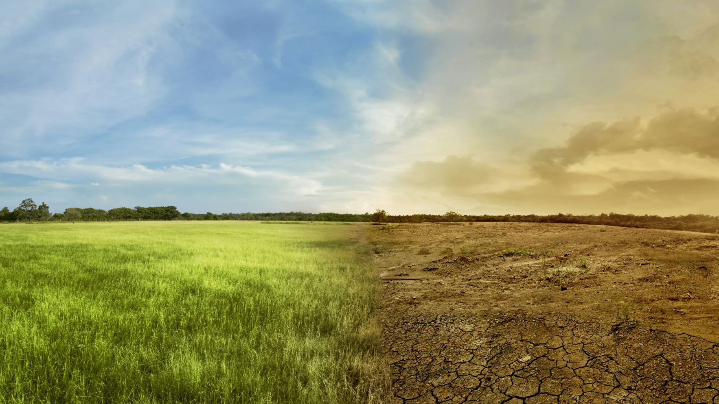
Field of Rural Sociology
The field of rural sociology covers a wide range of topics, including:
Rural communities and social change
Agriculture and rural livelihoods
Rural social institutions
Rural-urban interactions
Social inequality and rural poverty
Environmental and sustainability issues

Slide 18
Scope of Rural Sociology
According to Lowry Nelson, “The scope of Rural Sociology is the description and analysis of progress of various groups as they exist in the rural environment. In the words of Bertrand and his associates: “In its broadest definition Rural Sociology is the study of human relationship in rural environment.” On account of the opinions given by Sims, Nelson and Bertrand, it is observed that the scope of Rural Sociology revolves around rural people, their livelihood and social relationship in rural environment.

Slide 19
Scope of Rural Sociology
1. Rural Society
2. Rural Community
3. Rural Social Institutions
4. Rural Economy
5. Agriculture and Rural Livelihood
6. Rural-Urban Interaction
7. Rural Culture
8. Rural Planning and Reconstruction

Slide 20
What do you think, how rural sociologists and agriculturalists can play a role in rural development?

Slide 21
Brainstorming session
What do you think, how rural sociologists and agriculturalists can play a role in rural development??

Slide 22
The Role of Rural Sociologists
Research and Analysis: Rural sociologists conduct research to understand the social dynamics, structures, and challenges within rural communities. They analyze factors such as social organization, community development, social inequality, migration, cultural practices, and social institutions.
Community Engagement: Rural sociologists actively engage with rural communities, working closely with local organizations, community leaders, and stakeholders. They conduct participatory research, organize focus groups, and facilitate community dialogues to understand community aspirations, needs, and priorities.
Policy Development: Rural sociologists contribute to policy development by providing evidence-based recommendations to address social issues, promote social justice, and enhance community well-being.
Capacity Building: Rural sociologists engage in capacity-building activities to empower rural communities.

Slide 23
The Role of Agriculturists in Rural Development
Agricultural Research and Innovation: Agriculturists conduct research and develop innovative agricultural practices, technologies, and techniques to improve agricultural productivity, enhance food security, and promote sustainable farming practices.
Farmer Education and Extension: Agriculturists work closely with farmers, providing education, training, and technical assistance to enhance their knowledge and skills in agricultural practices.
Policy Advocacy: Agriculturists play a crucial role in advocating for policies and programs that support rural agricultural development. They advocate for policies that address challenges related to land tenure, access to credit, agricultural subsidies, market infrastructure, and rural infrastructure development.
Market Linkages and Value Chain Development: Agriculturists facilitate market linkages for rural farmers, connecting them to markets and helping them access fair prices for their agricultural produce.
Environmental Sustainability: Agriculturists promote sustainable agricultural practices that protect the environment, conserve natural resources, and mitigate the impact of climate change. They encourage the adoption of agroecological approaches, organic farming, and climate-smart techniques that minimize chemical inputs, preserve biodiversity, and promote resilience within agricultural systems.

Slide 24
Chapter Related Questions
1. Define Sociology and Rural Sociology?
2. Examine the scope and field of rural sociology?
3. Why we need to study Rural Sociology?
4. Describe the origin and development of rural sociology.
5. What is the role of Rural Sociologists and Agriculturists in rural development?

Slide 25
References
Sociology : C. N. Shankar Rao; 2007.
Introduction to Rural Sociology by Paul L. Vogt.
Rural Sociology by S.L. Doshi.
Introduction to Rural Sociology by Musa Dantani Baba.
Rural Sociology by Shambhu Lal Doshi.
https://www.cambridge.org/core/books/abs/cambridge-handbook-of-sociology/rural-sociology/BCB34E10FB97C27A0B472807B7B92C66
https://uogqueensmcf.com/wp-content/uploads/2020/BA%20Modules/Sociology/1.%20Sociology%20modiles/Year%20three/Semester%201/Rural%20sociology%20handaout%201st.pdf

Slide 26
THANK YOU!
https://www.youtube.com/watch?v=oSItEk7yNhQ

