Slide 1
Rural Livelihood and Sustainability
Md. Fouad Hossain Sarker
Associate Professor and Head
Department of Development Studies
Daffodil International University

Slide 2
Objectives of the Lecture
Providing the definition of livelihood and exploring changing socio-economic activities in rural society.
Exploring the activities and institutional arrangement of rural sociology.
Identifying the different livelihood strategies of rural people.
Analyzing the components and importance of integrated farming systems, agriculture, poultry, livestock, and rice-fish culture in the context of rural society.

Slide 3
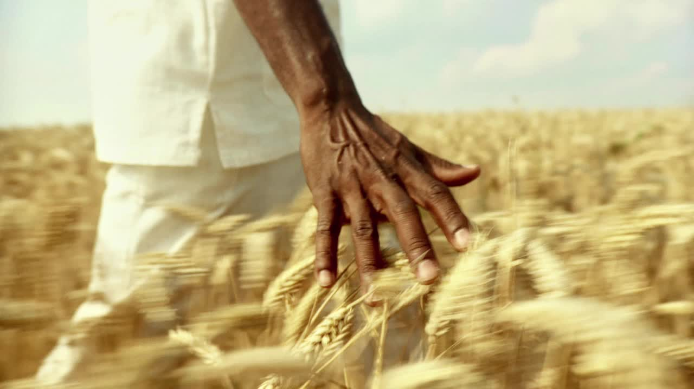
General Ideas
Can you please give me a definition of rural livelihood?

Slide 4
Meaning of Rural Livelihood
Livelihood refers to the means and activities through which individuals or households sustain their lives by earning income and meeting their basic needs. It encompasses the various sources of income and resources that people use to support themselves and their families, including employment, self-employment, and other income-generating activities.
Rural livelihood refers to the means and strategies through which people living in rural areas secure their basic necessities, generate income, and sustain their livelihoods. It encompasses the various activities, resources, and assets that rural communities utilize to support their well-being and meet their daily needs.

Slide 5
The Significance of Understanding the Livelihood of Rural People (1)
1. Poverty Alleviation: Many rural areas in developing countries like Bangladesh face significant poverty. Knowledge of livelihood strategies helps policymakers and organizations design targeted poverty alleviation programs
2. Sustainable Development: Rural livelihoods are often closely tied to natural resources and the environment. Understanding these strategies can help ensure that development initiatives are sustainable and do not degrade the environment or deplete resources, promoting long-term well-being for both the people and the ecosystem.
3. Policy Formulation: Governments need information about rural livelihoods to develop appropriate policies that support and strengthen rural economies.
4. Targeted Interventions: Different rural areas may have distinct livelihood patterns based on their geographic location, available resources, and socio-economic conditions.
5. Disaster Preparedness and Resilience: Climate change and natural disasters can significantly impact rural livelihoods. Knowing the existing strategies can help in assessing vulnerabilities, developing early warning systems, and creating resilience plans to cope with and recover from adverse events.

Slide 6
The Significance of Understanding the Livelihood of Rural People (2)
6. Employment Opportunities: Understanding the predominant livelihood strategies allows policymakers and local authorities to identify potential gaps in employment opportunities.
7. Improving Livelihoods: Knowledge of rural livelihood strategies allows for the identification of challenges and bottlenecks that people face in sustaining their lives.
8. Empowerment and Participation: Involving rural communities in decision-making processes is crucial for sustainable development. Understanding their livelihood strategies enables a more inclusive approach, empowering rural people by recognizing their expertise and traditional knowledge.
9. Education and Training: Knowing the prevalent livelihood strategies helps in designing relevant education and training programs.
10. Measuring Progress: Tracking changes in livelihood strategies over time provides valuable insights into the effectiveness of development programs and policies. It allows for the assessment of progress and the identification of areas that require further attention.

Slide 7
Types of Livelihood Strategies for Rural People: In the Context of Bangladesh (1)
1. Agriculture: Agriculture is the backbone of the rural economy in Bangladesh. Farmers cultivate various crops such as rice, jute, wheat, vegetables, and fruits. Livestock rearing, including poultry, cattle, and fish farming, is also prevalent.
2. Fishing: Given Bangladesh's extensive network of rivers, lakes, and ponds, fishing is a significant livelihood option for rural communities. Traditional and commercial fishermen engage in catching fish, shrimp, and other aquatic resources for sale or personal consumption.
3. Handicrafts: Rural artisans often engage in traditional handicraft activities like pottery, weaving, and basket-making. These products are sold locally or to urban markets, providing a source of income for the artisans.
4. Cottage Industries: Cottage industries, such as small-scale manufacturing units, are common in rural areas. These can include rice and oil mills, small garment factories, and food processing units.
5. Non-Farm Activities: Rural households often diversify their income by engaging in non-farm activities such as small retail shops, tea stalls, transportation services (rickshaw-pulling, boat services), and small-scale trading.

Slide 8
Types of Livelihood Strategies for Rural People: In the Context of Bangladesh (2)
6. Poultry Farming: Poultry farming, particularly chicken and duck rearing, is a popular livelihood option in rural Bangladesh. It requires relatively low investment and provides a steady income source.
7. Bamboo and Cane Craft: Rural communities in Bangladesh make use of natural resources like bamboo and cane to create various products like furniture, mats, and baskets, which are sold in local markets.
8. Brick Making: In some regions, brick-making units provide employment to rural people. They engage in making clay bricks, which are used in construction activities.
9. Aquaculture: Apart from traditional fishing, aquaculture or fish farming is gaining popularity as a livelihood option. Rural farmers cultivate fish in ponds and sell them for consumption or commercial purposes.
10. Beekeeping: Beekeeping is an emerging livelihood opportunity for rural communities. Honey production and other bee-related products contribute to income generation.
11. NGO and Microfinance Activities: Non-governmental organizations (NGOs) and microfinance institutions play a crucial role in providing financial and technical support to rural people engaged in various livelihood activities.

Slide 9
Brainstorming session
What do you think, why the socio-economic activities of rural people are changing over time??

Slide 10
The Causes of Changing Socio-Economic Activities of Rural Society (1)
1. Technological Advancements: The introduction of new technologies and agricultural practices has transformed the way rural people engage in farming and other economic activities. Mechanization, irrigation systems, improved seeds, and fertilizers have increased productivity and altered traditional farming practices.
2. Urbanization and Migration: Rural-urban migration has been a significant driver of change. As young people move to cities in search of better opportunities, the rural labor force shrinks, leading to changes in the types of activities pursued by those who remain in rural areas.
3. Globalization and Trade: Increased globalization and access to global markets have influenced rural economies. The demand for certain products, both agricultural and non-agricultural, has driven shifts in production and livelihood strategies to meet international demands.
4. Infrastructure Development: Improved infrastructure, such as better roads and transportation networks, has facilitated the movement of goods and people. This has opened up new markets and created opportunities for rural people to engage in non-farm activities.
5. Changing Demographics: Changes in population size, age distribution, and household composition influence the types of activities pursued. Aging populations may focus more on traditional practices, while younger generations seek diverse opportunities.

Slide 11
The Causes of Changing Socio-Economic Activities (2)
6. Environmental and Climate Changes: Climate change impacts have affected agricultural productivity and the availability of natural resources, necessitating adjustments in livelihood strategies.
7. Government Policies and Support: Shifts in government policies, subsidies, and support programs can incentivize or discourage certain activities. For example, policies promoting cash crops may influence farmers' choices.
8. Market Demand and Consumer Preferences: Changing consumer preferences and demands have driven shifts in production and livelihood choices. As consumer tastes evolve, rural producers may adapt their activities to cater to new market demands.
9. Education and Skills: Increased access to education and skill development opportunities can influence the types of livelihoods pursued. Educated individuals may opt for non-agricultural professions or seek employment in urban centers.
10. Emergence of New Industries: The rise of new industries and sectors can create alternative income-generating opportunities in rural areas. For instance, the growth of tourism may encourage rural communities to engage in hospitality and related services.

Slide 12
Institutional Arrangement of Rural Society (1)
1. Agriculture and Rural Development Agencies: Bangladesh being primarily an agrarian society, and several government and non-government agencies focus on agriculture and rural development. The Ministry of Agriculture and various agriculture-related departments work to improve farming practices, provide agricultural extension services, and promote rural economic development.
2. Local Government Institutions: Local government bodies, such as Union Parishads (at the union level) and Upazila Parishads (at the sub-district level), play an essential role in rural governance. These institutions are responsible for implementing government policies and development projects at the grassroots level.
3. Non-Governmental Organizations (NGOs): Bangladesh has a vibrant NGO sector, with numerous organizations working on various rural development issues. NGOs like BRAC, Grameen Bank, and CARE Bangladesh are well-known for their rural development initiatives, including microfinance, women's empowerment, education, and healthcare.
4. Rural Educational Institutions: Educational institutions in rural areas play a crucial role in providing access to education for rural communities. Primary schools, secondary schools, and madrasas (Islamic religious schools) are essential components of the rural education system.
5. Health and Social Welfare Institutions: Health and social welfare services are provided through government health centers, community clinics, and NGOs. These institutions work to improve the health and well-being of rural populations and address healthcare challenges

Slide 13
Institutional Arrangement of Rural Society (2)
6. Microfinance Institutions: Microfinance plays a significant role in empowering rural communities by providing access to financial services. Institutions like Grameen Bank pioneered microfinance in Bangladesh, offering small loans to rural entrepreneurs, especially women, to start or expand their businesses.
7. Agricultural Cooperatives: Agricultural cooperatives are formed to pool resources, provide mutual support, and enhance the bargaining power of farmers. These cooperatives enable smallholder farmers to access inputs, credit, and markets more efficiently.
8. Traditional Institutions: In rural Bangladesh, traditional institutions, such as local councils of elders and community leaders, continue to hold significant influence in resolving disputes, maintaining social cohesion, and preserving cultural practices.
9. Research and Academic Institutions: Research organizations and academic institutions, such as the Bangladesh Agricultural University and the Bangladesh Institute of Development Studies, conduct studies and research on rural issues, providing valuable insights for policymakers and development practitioners.
10. Government Ministries and Departments: Various government ministries and departments, such as the Ministry of Rural Development and Cooperatives, Ministry of Women and Children Affairs, and Ministry of Primary and Mass Education, are involved in rural development and welfare programs.

Slide 14
Sustainability
Sustainability refers to the ability to meet the needs of the present generation without compromising the ability of future generations to meet their own needs. In the context of rural society, sustainability encompasses the responsible and balanced use of natural resources, the preservation of cultural heritage, the promotion of social well-being, and the fostering of economic development that does not deplete or degrade the resources essential for the community's long-term survival and prosperity.

Slide 15
Components of Sustainability (1)
1. Environmental Sustainability: This component focuses on the conservation and sustainable use of natural resources, such as land, water, forests, and biodiversity. It involves adopting eco-friendly practices in agriculture, promoting renewable energy sources, and managing waste and pollution to reduce the ecological footprint on the environment.
2. Social Sustainability: Social sustainability involves fostering social cohesion, equity, and inclusivity within rural communities. It includes ensuring access to education, healthcare, and basic services for all residents, promoting gender equality, respecting cultural diversity, and addressing social issues like poverty and unemployment.
3. Economic Sustainability: Economic sustainability aims to develop a robust and diversified rural economy that can withstand economic shocks and provide livelihood opportunities for the population. It involves promoting sustainable agricultural practices, supporting rural industries, encouraging entrepreneurship, and ensuring fair trade practices for local products.
4. Governance and Institutions: Strong and effective governance structures and institutions are essential for ensuring sustainability in rural areas. Transparent and accountable governance helps in the fair distribution of resources, effective implementation of policies, and community involvement in decision-making processes.
5. Infrastructure Development: Adequate infrastructure is vital for rural sustainability. Access to reliable transportation, communication networks, clean water supply, and sanitation facilities are critical for improving the quality of life and enabling economic activities in rural communities.

Slide 16
Components of Sustainability (2)
6. Resilience and Disaster Management: Building resilience to natural disasters and climate change is crucial for rural sustainability. Implementing disaster preparedness and response plans, promoting climate-smart agriculture, and ensuring access to resources during emergencies can help rural communities cope with adverse events.
7. Education and Awareness: Promoting education and awareness about sustainable practices is essential for changing mindsets and behaviors within rural society. Educating the population about environmental conservation, health and sanitation, and sustainable farming techniques can lead to positive changes in behavior and practices.
8. Community Participation and Empowerment: Involving local communities in the decision-making process and empowering them to take ownership of development initiatives enhance the chances of successful and sustainable outcomes. Participatory approaches foster a sense of ownership and commitment to sustainable practices.
9. Conservation of Cultural Heritage: Preserving cultural traditions, practices, and heritage is essential for the identity and well-being of rural communities. Encouraging cultural activities and respecting local customs and traditions contribute to the overall sustainability of rural societies.

Slide 17
Integrated Farming System as a Livelihood Strategy for Sustainability
Integrated Farming System (IFS) is a sustainable agricultural approach that involves the combination of different farming activities to maximize productivity, resource efficiency, and income while minimizing negative environmental impacts. In rural areas, IFS is often practiced by small-scale farmers to optimize land and resource use.

Slide 18
Analysis of Agriculture, Poultry, Livestock, and Rice-Fish Culture in Integrated Rural Setting
1. Agriculture: Crop cultivation forms the core of the integrated farming system. Farmers grow a variety of crops, including staple foods (such as rice, wheat, or maize) and cash crops (like vegetables or fruits). Crop rotation and intercropping are often employed to enhance soil fertility, reduce pest pressure, and improve overall yields.
2. Poultry: Poultry farming, particularly chicken and ducks, is integrated into the farming system. Poultry birds are raised for eggs and meat. The birds help in pest control by consuming insects and weeds, reducing the need for chemical pesticides.
3. Livestock: Livestock, such as cattle, goats, or pigs, are an integral part of the integrated farming system. They provide a source of milk, meat, and other by-products like manure and hides. The manure is used to fertilize the crops, closing the nutrient loop and reducing the need for synthetic fertilizers.
4. Rice-Fish Culture: Rice-fish culture is a traditional practice in many Asian countries, including rural areas. In this system, fish species that are compatible with rice cultivation (such as carp or tilapia) are introduced into the rice fields during the wet season. The fish help control pests, weeds, and insect larvae, benefiting both rice production and fish growth.

Slide 19
Benefits of Integrated Farming System in Rural Areas
Efficient resource utilization: IFS optimizes the use of land, water, and nutrients by combining different farming activities, leading to increased productivity and reduced waste.
Diversified income: By integrating multiple activities, farmers can generate income from various sources, reducing dependency on a single crop or enterprise.
Enhanced resilience: The diversity in the farming system makes it more resilient to climate fluctuations and market risks, safeguarding rural livelihoods.
Environmental sustainability: IFS practices reduce the use of chemical inputs and promote natural pest control, contributing to ecological balance and reducing the environmental impact of agriculture.

Slide 20
Chapter Related Questions
1. Briefly define livelihood and sustainability.
2. Examine the significance of knowing the livelihood strategies of rural people.
3. What are the causes of changing socio-economic activities of rural people?
4. Define an integrated farming system. What are the benefits of an integrated farming system for the rural people?

Slide 21
References
Sociology : C. N. Shankar Rao; 2007.
Introduction to Rural Sociology by Paul L. Vogt.
Rural Sociology by S.L. Doshi.
Introduction to Rural Sociology by Musa Dantani Baba.
Rural Sociology by Shambhu Lal Doshi.
https://www.cambridge.org/core/books/abs/cambridge-handbook-of-sociology/rural-sociology/BCB34E10FB97C27A0B472807B7B92C66
https://uogqueensmcf.com/wp-content/uploads/2020/BA%20Modules/Sociology/1.%20Sociology%20modiles/Year%20three/Semester%201/Rural%20sociology%20handaout%201st.pdf

Slide 22
THANK YOU!

