Slide 1
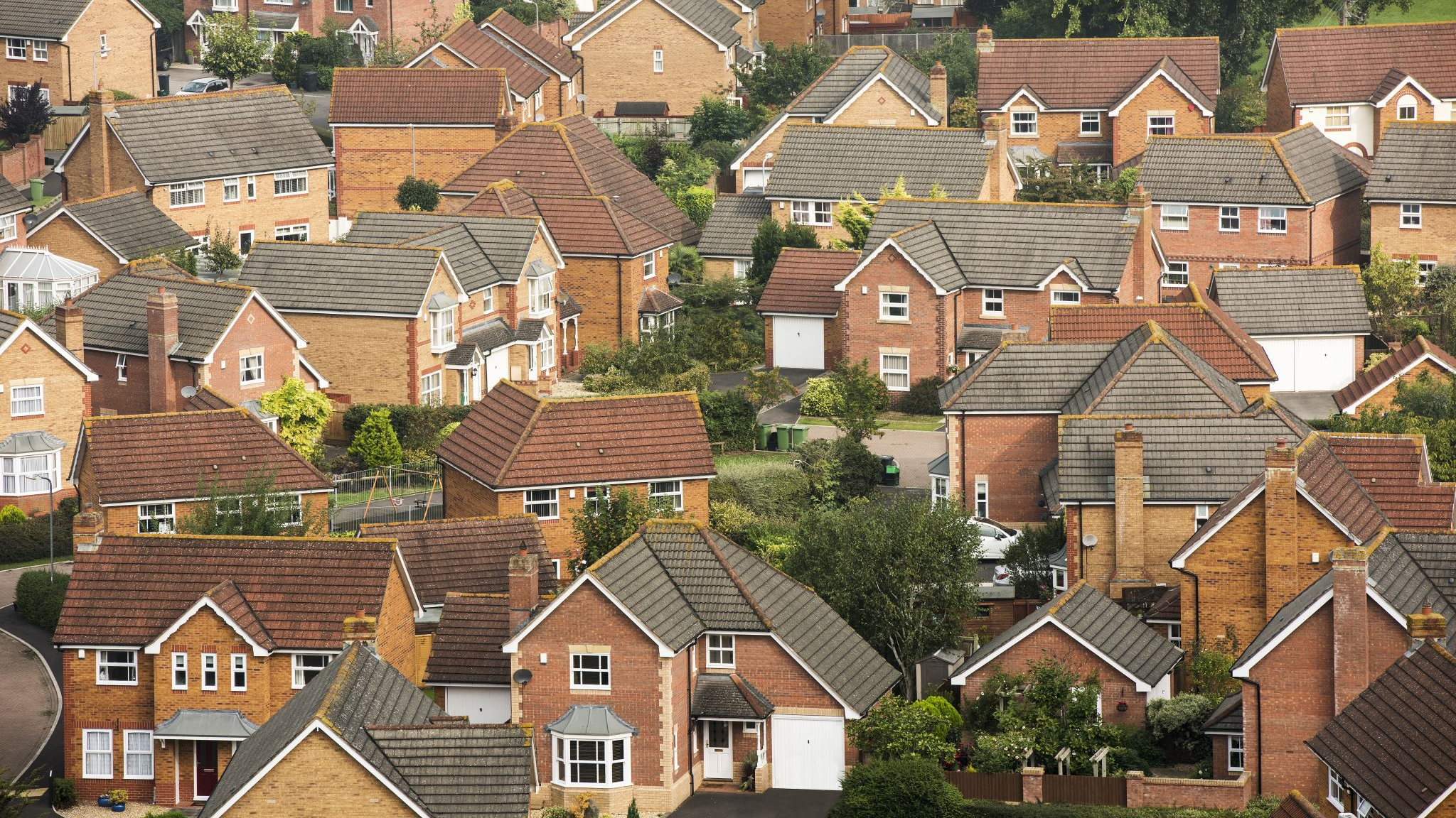
Rural Development
Md. Fouad Hossain Sarker
Associate Professor and Head, Department of Development Studies
Daffodil International University

Slide 2
Objectives of the Lecture
Understand the concept, importance, and different factors & and indicators behind rural development
Discuss the historical background, government policies and rural development programs
Identify the way forward to ensure sustainable rural development and environmental issues
Find out the role of NGOs and community-based organizations in rural development

Slide 3
Rural Development
Rural development refers to the process of improving the economic, social, and environmental conditions in rural areas. It encompasses a wide range of activities, policies, and strategies aimed at enhancing the quality of life and well-being of people living in rural regions.

Slide 4
The Importance of Rural Development (1)
In a country like Bangladesh, which has a predominantly rural population and economy, rural development is of paramount importance. Here are five key reasons why rural development is crucial for Bangladesh:
Poverty Alleviation: Bangladesh has a substantial rural population living in poverty. Rural development initiatives can create income-generating opportunities, improve access to basic services, and enhance living conditions for rural communities, thereby reducing poverty and improving the overall well-being of the population.
Agricultural Growth: Agriculture is the backbone of Bangladesh's economy, employing a significant portion of the population. Rural development, with a focus on modernizing farming techniques, providing access to credit, and improving agricultural infrastructure, can boost food production, increase farm incomes, and contribute to economic growth.

Slide 5
The Importance of Rural Development (2)
4. Rural Employment: Rural areas often face issues of underemployment and unemployment. Rural development programs that promote agribusiness, rural industries, and skill development can create job opportunities, particularly for the youth, reducing economic vulnerability and migration to urban areas.
5. Infrastructure Development: Rural development initiatives can lead to the construction and maintenance of essential infrastructure such as roads, bridges, irrigation systems, and electrification. Improved infrastructure not only facilitates economic activities within rural areas but also enhances connectivity to urban markets and services.
6. Social Inclusion and Equity: Addressing disparities between rural and urban areas is crucial for social cohesion and equity. Rural development can help bridge these gaps by improving access to education, healthcare, and social services in rural communities, promoting a more equitable society.

Slide 6
Objectives of Rural Development (1)
Economic Growth: Promoting economic opportunities in rural areas by supporting agriculture, agribusiness, small and medium-sized enterprises (SMEs), and other rural industries. This can involve investments in infrastructure, access to credit, and technology adoption to increase productivity and income.
Poverty Alleviation: Reducing poverty and improving the living standards of rural populations through initiatives like social welfare programs, job creation, and skills training.
Infrastructure Development: Building and maintaining essential infrastructure such as roads, bridges, schools, healthcare facilities, and clean water supply to improve access to services and connectivity in rural areas.
Agricultural Development: Enhancing agricultural productivity, diversification, and sustainability through modern farming techniques, research and development, and access to markets.
Access to Education and Healthcare: Ensuring that rural residents have access to quality education and healthcare services, which can contribute to improved human capital and overall well-being.

Slide 7
Objectives of Rural Development (2)
6. Natural Resource Management: Promoting sustainable use of natural resources like land, water, and forests to protect the environment and support rural livelihoods.
7. Governance and Institutions: Strengthening local governance structures, institutions, and policies to enable effective decision-making and community participation in rural development processes.
8. Rural Entrepreneurship: Encouraging entrepreneurship and innovation in rural areas, including support for small businesses, startups, and value-added processing of agricultural products.
9. Social Inclusion: Addressing social inequalities and ensuring that marginalized and vulnerable groups in rural communities have equal access to development opportunities and benefits.
10. Community Empowerment: Empowering rural communities to take an active role in their own development by fostering participatory approaches and local ownership of development projects.

Slide 8
General Idea
Can you identify some of the major factors which enhance rural development?

Slide 9
Factors which enhance Rural Development (1)
Access to Infrastructure: Adequate infrastructure, including roads, bridges, electricity, clean water supply, and communication networks, is crucial for rural development. Improved infrastructure facilitates transportation, connectivity, and access to essential services.
Agricultural Development: Agriculture is a cornerstone of rural economies. Investments in modern farming techniques, access to credit, agricultural extension services, and market linkages can enhance agricultural productivity and income for rural communities.
Education and Training: Access to quality education and vocational training programs can empower rural residents with the skills and knowledge necessary to pursue diverse economic opportunities and improve their livelihoods.
Healthcare Services: Availability of healthcare facilities and access to affordable healthcare services are essential for the well-being of rural populations. Improved health outcomes contribute to a productive and resilient rural workforce.

Slide 10
Factors which enhance Rural Development (2)
5. Financial Inclusion: Access to financial services, such as banking, microfinance, and savings programs, can help rural communities save, invest, and manage their finances effectively, promoting economic growth and stability.
6. Market Access: Enhancing access to markets, both for agricultural products and non-agricultural goods and services, can boost rural incomes. Improved transportation and distribution channels are critical in this regard.
7. Natural Resource Management: Sustainable management of natural resources, including land, water, and forests, is essential for long-term rural development and environmental conservation.
8. Community Empowerment: Engaging local communities in the decision-making process and empowering them to take an active role in their own development projects can lead to more sustainable and community-driven development outcomes.
9. Technology Adoption: The adoption of modern technologies.

Slide 11
Factors which enhance Rural Development (3)
10. Good Governance: Transparent and effective governance at the local and national levels is crucial for implementing rural development policies and programs. It helps ensure that resources are allocated efficiently and fairly.
11. Access to Credit and Finance: Rural development often requires capital for investment in businesses, agriculture, and other ventures. Access to credit and financial services can provide the necessary funds for growth and development.
12. Social Inclusion: Promoting social inclusion and addressing issues related to gender, caste, ethnicity, and other forms of discrimination can ensure that the benefits of rural development are distributed equitably.
13. Security and Stability: Political stability, law and order, and land tenure security are factors that can attract investment and promote economic activities in rural areas.
14. Research and Innovation: Encouraging research and innovation in agriculture and rural industries can lead to the development of new technologies and practices that improve productivity and sustainability.
15. Supportive Policies: Government policies and incentives that prioritize rural development and create an enabling environment for entrepreneurship and investment can significantly enhance rural development efforts.

Slide 12
Rural Development Indicators
Changes in agricultural productivity.
Changes in rural employment, unemployment and under employment
Changes in income of different income groups
Changes in the distribution of power, influence and participation.
Changes in literacy, schooling, literacy rate and life expectancy
Changes in values, believes and attitudes of members of state agencies as well as the rural policy making.

Slide 13
History of Rural Development
British Period:
The British created a loyal landed class of Zamidars through the Permanent Settlement Act of 1793.
Pakistan Period:
In 1950 Zamidari system was abolished. There had several programs on that time as like Village Agricultural and Industrial Development (V-AID) program. In 1959, A four-tier local government system was launched by the military government of Mohammad Ayub Khan.

Slide 14
History of Rural Development
Bangladesh Period:
In 1952 Bangladesh government activated the Integrated Rural Development Program (IRDP) to replicate and expand The Comilla Model in other parts of the country. Now it is worked as Bangladesh Rural Development Board (BRDB). CIRDAP was established as an inter-governmental organization to facilitate IRD in the Asia-Pacific region.

Slide 15
Rural Development Model: BARD
Bangladesh Academy for Rural Development (BARD) or The Comilla Model was a rural development program launched in 1959 by Akhter Hameed Khan in Comilla. The Features of the Comilla Model:
The promotion of development of various institutions, both public and private, and establishing a system of interrelationships between them;
Involvement of public and private sectors in the rural development;
Development of leadership in every village, including managers, model farmers, women organizers, youth leaders to sustain the development;
Development of three basic infrastructures;
Priority on decentralized and coordinated rural administration;
Ensure education, organization and discipline.
Focus on economic planning and technology.

Slide 16
Role of Government: Rural Development
The Comprehensive Village Development Program was launched by BARD in 1975.
The Small Farmers Development Program was introduced in 1993.
Major governmental rural development projects: (i) The Vulnerable Group Development, (ii) Thana Resource Development and Employment Project, (iii) Rural Social Service Program, (iv) Community Development Program, (v) Self-reliance Program for Rural Women, (vi) Technologies for rural employment.
Infrastructure Development: The government invests in and maintains essential rural infrastructure, including roads, bridges, and irrigation systems. Improving transportation networks and providing access to clean water and electricity are critical for rural development.
Agricultural Support and Extension Services: Agriculture is a primary source of livelihood for the majority of rural people in Bangladesh. The government provides various support measures to farmers, such as access to credit, agricultural inputs, and modern farming techniques through extension services.

Slide 17
Role of NGOs in Rural Development
1. NGO covers a wide range of rural development activities including: development of income and employment, health and sanitation, agriculture and rural craft, vocational education, relief and rehabilitation, family planning, mother and childcare.
2. Prominent NGOs are: The Bangladesh Rural Advancement Committee (BRAC), Grameen Bank, Proshika, Manobik Unnayan Kendra, ASA, Rangpur-Dinajpur Rural Service etc.
3. Community Empowerment: NGOs work closely with rural communities to empower them with knowledge, skills, and resources. They facilitate community participation in decision-making processes, helping locals identify their needs and priorities.
4. Capacity Building: NGOs provide training and capacity-building programs to enhance the skills of rural residents. This includes agricultural practices, healthcare, education, and vocational training, enabling individuals to improve their livelihoods.
5. Resource Mobilization: NGOs often secure funding from various sources, including government grants, international donors, and private sector partnerships. They direct these resources toward rural development projects, which may include infrastructure development, healthcare services, and education programs.
6. Advocacy and Awareness: NGOs advocate for the rights and interests of rural communities, raising awareness about their challenges and needs.

Slide 18
Role of NGOs (2)
7. Environmental Conservation: Many NGOs focus on sustainable environmental practices in rural areas. They promote conservation initiatives, sustainable farming techniques, and reforestation efforts to protect natural resources and improve rural livelihoods.
8. Healthcare Services: NGOs operate clinics, mobile health units, and awareness campaigns in rural areas to improve access to healthcare services. They often work to prevent and treat diseases prevalent in rural communities.
9. Education and Literacy: NGOs run schools, literacy programs, and scholarships to improve educational opportunities in rural areas. Education is a key driver of development, as it equips individuals with knowledge and skills for better livelihoods.
10. Microfinance and Entrepreneurship Support: NGOs provide access to microcredit and support entrepreneurship initiatives, helping rural residents start small businesses and income-generating activities.
11. Infrastructure Development: NGOs may contribute to the construction of rural infrastructure such as roads, bridges, schools, and water supply systems, which are essential for improving the quality of life in rural areas.
12. Social Inclusion and Gender Equality: NGOs work to promote social inclusion and gender equality in rural communities. They advocate for women's rights, access to education and healthcare, and the participation of marginalized groups in development activities.

Slide 19
Role of Microfinance : In the Context of Bangladesh
Poverty Alleviation
Women's Empowerment
Livelihood Diversification
Financial Inclusion
Access to Education and Healthcare
Rural Entrepreneurship
Community Development
Agricultural Productivity
Reduced Vulnerability to Shocks:
Financial Literacy
Sustainable Development
Reduced Dependency on Moneylender

Slide 20
Brainstorming session
Can you try to identify some of the adverse impacts of microfinance in the context of a country like Bangladesh?

Slide 21
Adverse Role of Microfinance: In the Context of Bangladesh
Over-Indebtedness: In some cases, easy access to microfinance loans has led to over-indebtedness among rural borrowers. When borrowers take on multiple loans to repay previous ones or to cover daily expenses, they may become trapped in a cycle of debt, which can have severe financial and psychological consequences.
High Interest Rates: Microfinance institutions (MFIs) often charge relatively high interest rates on loans to cover their operational costs and risks.
Loan Misuse: There have been instances of borrowers misusing microfinance loans for non-productive or consumption purposes, such as buying consumer goods or covering household expenses. This can hinder the intended economic development impact of microfinance.
Social Pressure and Group Dynamics: Many microfinance programs use group lending models where borrowers are collectively responsible for loan repayments. While this can foster social cohesion and support, it can also create pressure on individuals to repay loans even in cases of financial hardship.
Mission Drift: As microfinance institutions grow and face financial pressures, they may shift their focus away from the original mission of poverty alleviation and rural development. Commercialization and profit-maximizing motives can lead to mission drift, where MFIs prioritize profitability over the welfare of the rural poor.

Slide 22
Methods of ensuring Sustainable Rural and Environmental Development (1)
Promote Sustainable Agriculture: Encourage farmers to adopt sustainable farming practices such as crop rotation, organic farming, and agroforestry. Provide training and resources to reduce reliance on harmful pesticides and chemical fertilizers.
Rural Renewable Energy Initiatives: Invest in renewable energy sources like solar and wind power to provide clean and affordable energy to rural communities. This not only reduces greenhouse gas emissions but also creates jobs and stimulates local economies.
Affordable and Accessible Healthcare: Ensure that rural areas have access to quality healthcare services. Healthy communities are more productive and can better address environmental challenges.
Clean Water and Sanitation: Improve access to clean drinking water and proper sanitation facilities in rural areas. This reduces waterborne diseases and the environmental impact of pollution.

Slide 23
Methods of ensuring Sustainable Rural and Environmental Development (2)
Education and Skills Development: Invest in education and vocational training to empower rural residents with the skills needed for sustainable livelihoods. This can include training in sustainable farming, eco-tourism, and small-scale enterprises.
Biodiversity Conservation: Protect and restore natural ecosystems in rural areas. Establish conservation areas, enforce anti-poaching measures, and promote sustainable forestry practices to preserve biodiversity.
Waste Management and Recycling: Implement effective waste management systems that include recycling and composting. Encourage community involvement in waste reduction and recycling efforts.
Community-Based Conservation Programs: Engage local communities in decision-making processes related to land use, resource management, and environmental conservation. This fosters a sense of ownership and responsibility for the environment.

Slide 24
Chapter Related Questions
1. Briefly define social development.
2. Examine the factors behind social development.
3. Identify the role of government and NGOs in rural development.
4. Discuss the role of microfinance in rural development.
5. Find out the way forward to ensure sustainable rural and environmental development.

Slide 25
References
Ahmed A., J.K. Ahmed, and A. Mahmud, (2006), Making Dhaka Livable, World Bank Mimeo.
Bangladesh Bureau of Statistics, Statistical Year Book, from the year of 1996 to 2008.
Islam, N., Urbanization, Migration and Development in Bangladesh: Recent Trends and Emerging Issues.
World Bank (2007),Improving Living Conditions for the Urban Poor.
Urbanization in Bangladesh: Present Status and Policy Implications -By A.K.M. Helal uz Zaman
Agriculture in Bangladesh: Performance Problems and Prospects -By Mosharaff Hossain.
Rural Development in Bangladesh: Trends and Issues By Mohammad Mohabbat Khan, Habib Mohammad Zafarullah
World Urbanization Prospects: The 2014 Revision, United Nations New York, 2014
Bangladesh Studies: Politics, Administration, Rural Development, and Foreign Policy -By Mohammad Mohabbat Khan, Saiyada Anoyara Hosena

Slide 26
THANK YOU!

