Slide 1
Agricultural Transformation and Rural Development
in Bangladesh
Md. Fouad Hossain Sarker
Associate Professor and Head, Department of Development Studies
Daffodil International University

Slide 2
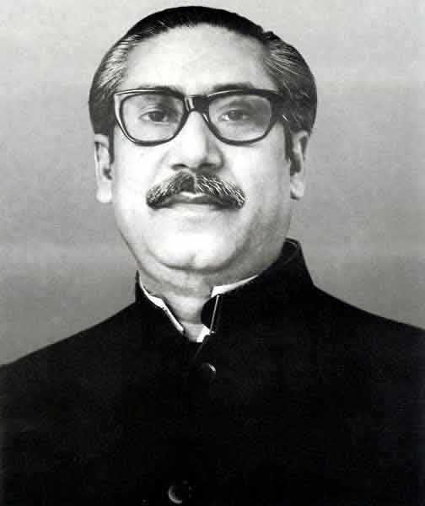
“শতকরা ৯০ জন মানুষ গ্রামে বাস করে। গ্রামের দিকে যেতে হবে। আমার অর্থনীতি যদি গণমুখী না করতে পারি এবং গ্রামের দিকে যদি না যাওয়া যায়, কৃষি বিপ্লব হবে না।”

Slide 3
Let’s begin with
The Dominant Theory

Slide 4
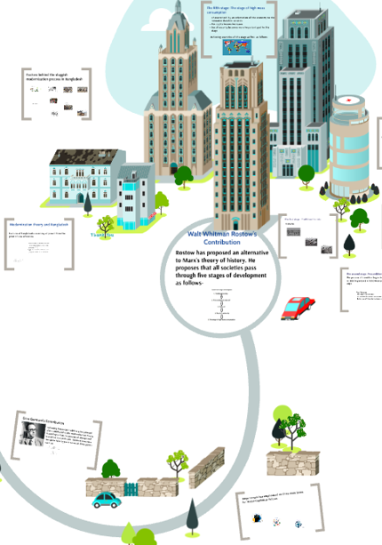
AGRICULTURE & ROSTOW’S STAGES OF GROWTH
Why did Rostow’s development model start from agriculture?
01
TRADITIONAL SOCIETY
Development of Agriculture
02
PRE CONDITION FOR TAKE OFF
03
TAKE OFF
04
DRIVE TO MATURITY
05
AGE OF HIGH MASS CONSUMPTION

Slide 5
Objectives of the lecture
To explore potentiality of the agricultural sector of Bangladesh
To explore the relation between agriculture and rural development
To analyze the activities taken by Govt. and NGOs for rural development
To identify the challenges and priorities for further growth and rural development

Slide 6
Discussion points
Exploring the agricultural sector of Bangladesh
Significance of agriculture and rural economy
Factors behind the agriculture sector’s growth
Highlighting the contribution of agriculture sector of Bangladesh
Policy support & strategies for agricultural development in Bangladesh
Discussing the rural development in Bangladesh
Activities taken by Govt. and NGOs for rural development
Challenges and priorities for further growth and rural development
Importance of research for sustainable agriculture and rural development

Slide 7
INTRODUCTION
Bangladesh government puts a high priority on agriculture and rural development for reducing rural poverty and improving the food security of the poor. The importance of rural development is recognized under the article 16 in the constitution of Bangladesh.
“The State shall adopt effective measures to bring about a radical transformation in the rural areas through the promotion of an agricultural revolution, the provision of rural electrification, the development of cottage and other industries, and the improvement of education, communications and public health, in those areas, so as progressively to remove the disparity in the standards of living between the urban and the rural areas”

Slide 8
SIGNIFICANCE OF AGRICULTURE AND RURAL ECONOMY
The rural economy in Bangladesh has been a powerful source of economic growth
.
.
.
Generates
6% increase
in non farm income
10% increase
in farm income
4.65%
Agriculture growth high between 2010-2018
87%
Rural household receive income from agriculture
65%
Household rely on both farm and non farm incomes
2x
Rural non farm relative to urban employment
Agriculture growth stimulates non farm income

Slide 9
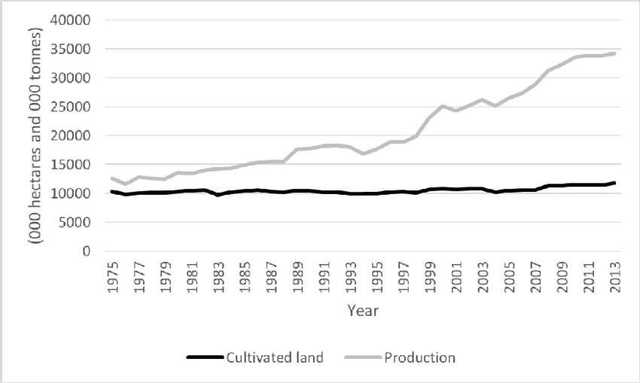
FACTORS BEHIND THE AGRICULTURE SECTOR’S GROWTH
Irrigation, high-yielding crop varieties, more efficient markets, and mechanization, enabled by policy reforms and investments in agriculture research, human capital, and roads have driven the agricultural growth.
Widespread mechanization
Improved technology
More efficient market
Irrigation expansion
Rice production in Bangladesh from 1975-2013
Sources: Handbook of agricultural statistics 2007

Slide 10
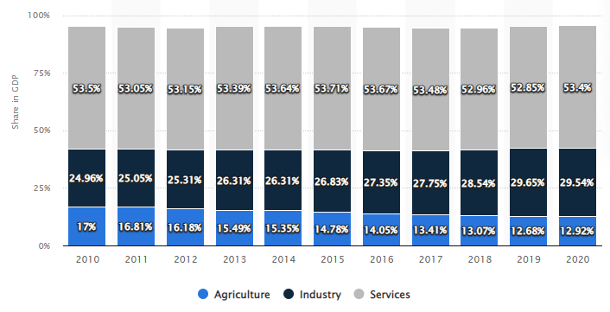
CONTRIBUTION OF AGRICULTURE SECTOR IN BANGLADESH
Share of Agriculture (% of GDP)
Source: World Bank

Slide 11
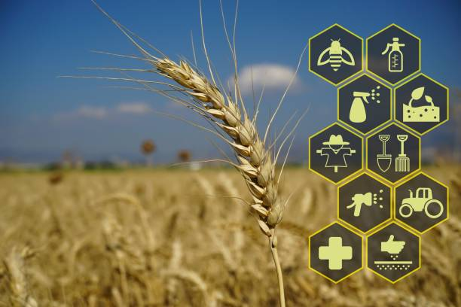
POLICY SUPPORT & STARTEGIES FOR AGRICULTURAL DEVELOPMENT IN BANGLADESH
Policy support
National Agricultural Policy-2013 (NAP)
New Agricultural Extension Policy 1993
National Food Policy 2006
Strategies
Self sufficiency in food : 2012
Ensuring food security: 2017
Middle income country: 2021
Vision 2021:Technology based agriculture
With a view to enhancing agricultural production and securing foo security, the target of agriculture is that- by 2021 food deficiency will be eliminated and the country will attain self sufficiency in food to meet nutritional requirements of population.

Slide 12
How can Bangladesh accelerate the rural development to sustain the economic development?

Slide 13
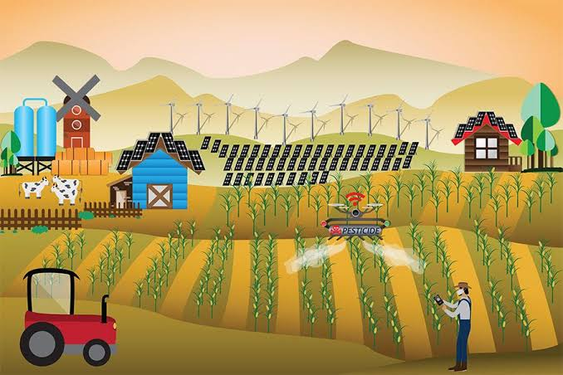
RURAL DEVELOPMENT IN BANGLADESH
Bangladesh Rural development is the betterment in the totality of the life for rural people. It is the process of improving the quality of life and economic well being of people living in relatively isolated and populated areas.
According to World Bank, “Rural development is a strategy designed to improve the economic and social life of rural people.”
Indicators of Rural Development
Changes in agricultural productivity
Changes in rural unemployment
Changes in income of the different income groups
Changes in distribution of power, influence and participation
Changes in literacy, schooling, healthcare services
Expand communication

Slide 14
INITIATIVES AND SUCCESS IN AGRICULTURE AND RURAL DEVELOPEMNT
Women’s participation in agriculture
Improved and adaptable varieties are being developed
Expedited, small and marginal farmers are being provided incentives for natural disasters
Free and subsidized high-yielding varieties are being distributed among farmers and development assistance is being provided in agricultural inputs including fertilizers
Mechanization of agriculture, innovation of new cropping systems, development of irrigation systems, production of transgenic crops etc. have been undertaken.
Development of marketing system, and ensuring fair prices for all agricultural products
Addressing the adverse impact of climate change
1 Cr 82 lakh farmer’s new bank account
Increased subsidy by the government
According to the Hon'ble Prime Minister's directives, 32 vegetable and nutrition gardens are being established in each union of the country with the goal of cultivating every inch of land and ensuring family nutrition security.

Slide 15
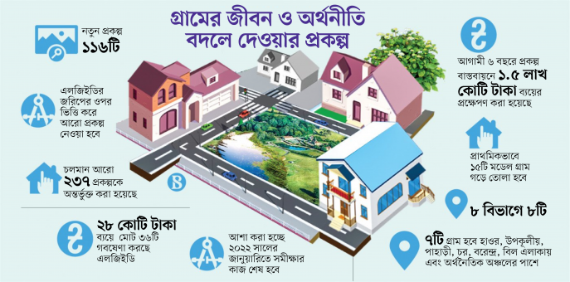
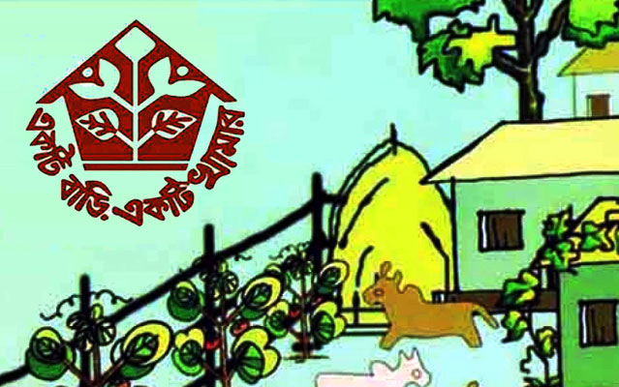
PROJECTS TAKEN BY GOVERNMENT FOR AGRICULTURE AND RURAL DEVELOPEMNT
Integrated Rural Development Programme (IRDP) (1972- )
The Swanirvar (Self-reliance) Movement (1967-1978)
Ektee Bari Ektee Khamar (2009)
My village my town

Slide 16
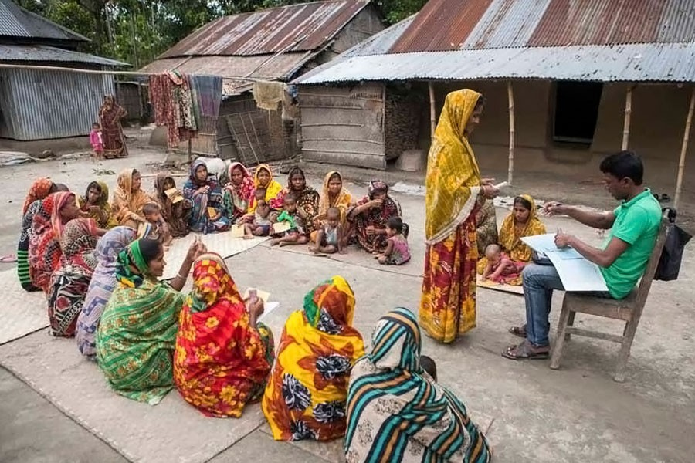
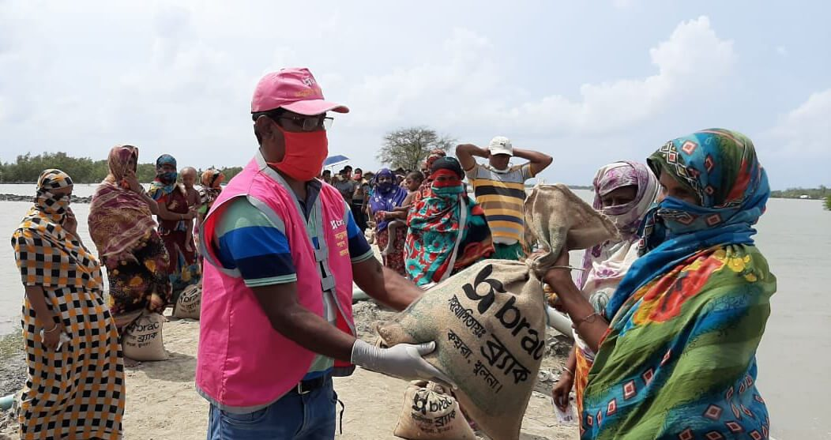
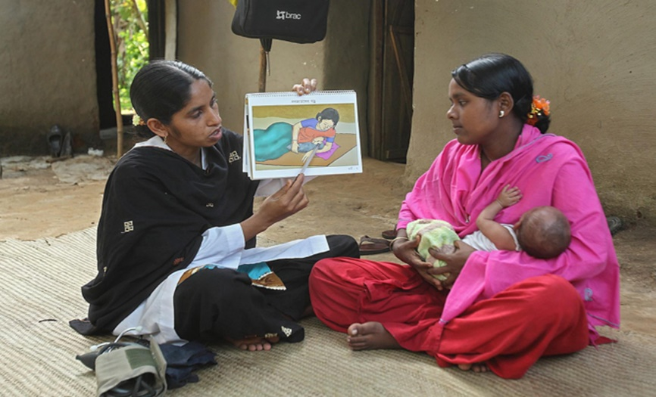
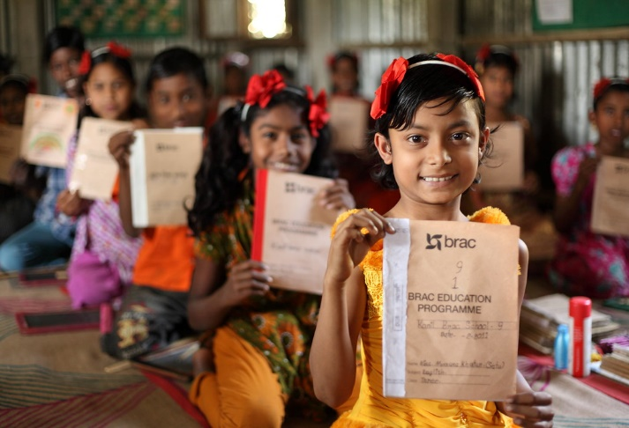
NGOs ACTIVITIES FOR RURAL DEVELOPMENT
Employment Generation
Micro Credit
Targeting Poor Rural Women as Beneficiary
Health, Nutrition and Hygiene
Relief and Rehabilitation Projects
Informal and Non-formal Education

Slide 17
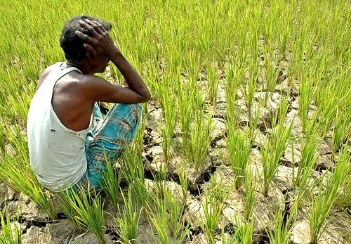
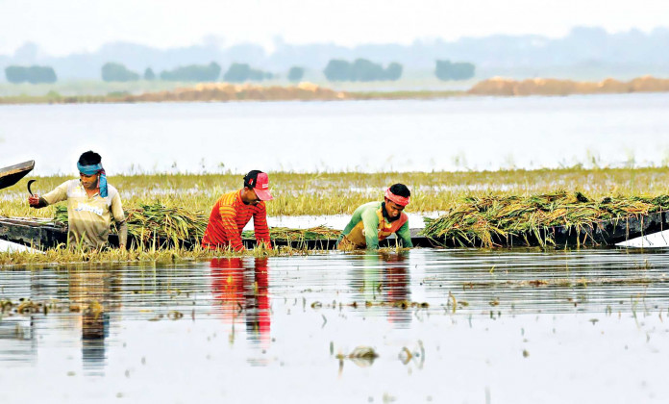
CHALLENGES BEHIND THE PATH OF SUSTAINABLE AGRICULTURE
Low Productivity
Institutional Bottleneck in Research-Extension-Farmer-Linkage
Climate Change
Degrading Natural Resource Base and Depleting Ground Water
Declining Availability of Agricultural Land
Poor Technological Assistance
Lack of Research and Human Capital
Challenges associated with storage, agro-processing and commercialization
Insufficient physical and economic connectivity

Slide 18
IMPORTANCE OF RESEARCH FOR AGRICULTURE & RURAL DEVELOPMENT
In the 8FYP, emphasis will be given on agricultural research promotion, focusing on developing and refining technologies that will bridge yield gaps and promote diversification and intensification.
For this purpose, budgetary allocation for research and extension should be expanded to at least 5 per cent of Agricultural GDP as against 1.5 per cent of current allocation.
More research should be conducted to assess how to reintegrate the reverse migrants into the rural economy during any kind of disaster or pandemic like covid19.

Slide 19
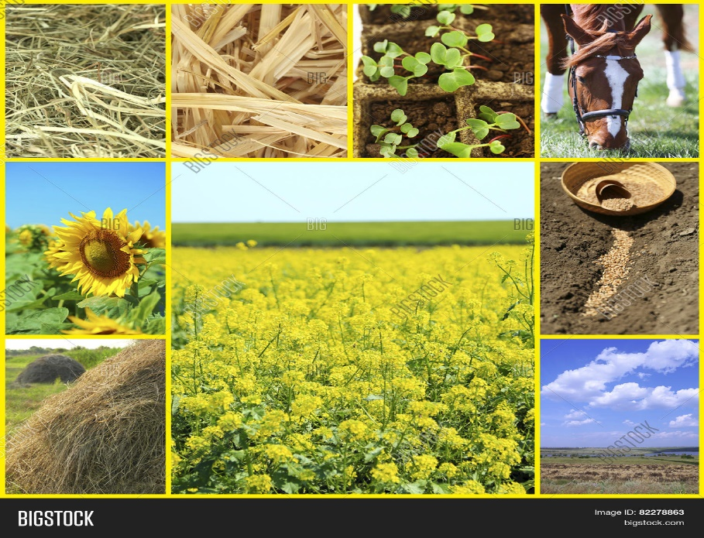
REALIGNING PRIORITIES TO SUSTAIN GROWTH INTO THE FUTURE
A balanced development strategy
More rapid diversification in agriculture
Improving the policy framework and rebalancing public expenditure priorities
Creating environment for robust rural non-farm growth and more efficient value chains
Continued investment in connectivity

Slide 20
References
Toufique, K. A. (2017). Bangladesh Experience in Rural Development: The Success and Failure of the Various Models Used. The Bangladesh Development Studies, 40(1 & 2), 97-117.
Ahmed, M. U. (2001). Efficacy of alternative poverty alleviation programmes in Bangladesh. Centre on Integrated Rural Development for Asia and the Pacific, Dhaka, BD.
Afsar, R. (2000). Rural-urban migration in Bangladesh: causes, consequences, and challenges. University Press.
Bose, S. (1974). The Comilla co-operative approach and the prospects for broad-based green revolution in Bangladesh. World Development, 2(8), 21-28.

Slide 21
Any Question Please?

Slide 22
THANK YOU

