Slide 1
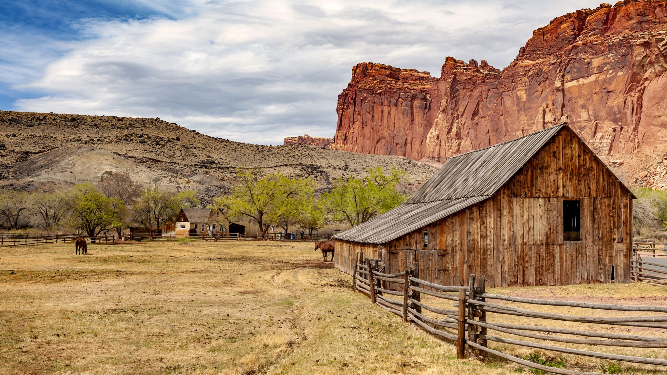
Rural Governance and Policy: In the Context of Bangladesh
Md. Fouad Hossain Sarker
Associate Professor and Head, Department of Development Studies
Daffodil International University

Slide 2
Objectives of the Lecture
Providing
Providing the definition and idea about rural governance policy.
Exploring
Exploring the functions of rural governance.
Identifying
Identifying the role of local government and community participation in rural governance.
Analyzing
Analyzing the challenges and opportunities of rural governance.

Slide 3
Defining Rural Governance
Rural governance refers to the systems, structures, and processes through which rural areas are managed and governed by local authorities, institutions, and communities.
It encompasses the various mechanisms and activities that enable the provision of public services, infrastructure, and decision-making within rural regions.
Rural governance typically involves a combination of local government bodies, community organizations, and other stakeholders working together to address the unique needs and challenges of rural areas.

Slide 4
Why Effective Rural Governance is Important?
Local Development: Effective rural governance ensures that local communities have a say in decisions that directly impact their lives. It facilitates the development of rural areas by addressing their specific needs and challenges, such as infrastructure, healthcare, education, and employment opportunities.
Community Empowerment: Rural governance empowers local residents to participate in decision-making processes and take ownership of development initiatives.
Resource Allocation: It allows for the efficient allocation of resources and public funds to rural areas. Effective governance ensures that budgets are directed toward projects and services that are in the best interest of the rural population, promoting economic growth and improved quality of life.
Poverty Reduction: Effective rural governance can address the root causes of poverty in rural areas, such as lack of access to basic services and economic opportunities. It can lead to poverty alleviation programs and initiatives that uplift the rural poor.
Sustainable Development: Rural governance plays a critical role in promoting sustainable development, including the responsible use of natural resources and environmental conservation.

Slide 5
Key Aspects of Rural Governance (1)
Local Government: Local municipalities or rural local governments play a central role in rural governance. They are responsible for making and implementing policies, managing public resources, and providing essential services in rural communities.
Community Involvement: Rural governance often emphasizes community participation and engagement in decision-making processes. Local residents and community organizations may have a say in matters that affect their region.
Infrastructure and Services: Rural governance is responsible for the development and maintenance of rural infrastructure, such as roads, utilities, schools, healthcare facilities, and other public services critical to rural well-being.
Resource Management: It includes the management of natural resources, such as land, water, and forests, to ensure sustainability and the well-being of rural populations.

Slide 6
Key Aspects of Rural Governance (2)
5. Economic Development: Rural governance aims to promote economic growth and livelihood opportunities in rural areas. This can involve supporting agriculture, small businesses, and other rural industries.
6. Policy Formulation: Rural governance bodies create policies and regulations that address the specific needs and challenges of rural areas, often distinct from urban areas.
7. Collaboration: Collaboration between various levels of government, non-governmental organizations, and the private sector is often necessary to address complex rural issues effectively.

Slide 7
Rural Governance Structure of Bangladesh
Union Parishads (Union Councils): These are the lowest administrative units in rural Bangladesh. There are approximately 4,547 Union Parishads in the country. Each Union Parishad is responsible for local governance, including basic service delivery, development projects, and community welfare. They are headed by elected chairmen and consist of elected members from different wards within the Union Parishad.
Upazilas (Sub-Districts): Upazilas are the next level of rural governance and act as an intermediary between Union Parishads and the district level. There are over 490 Upazilas in Bangladesh. Each Upazila has an elected chairman and a local council responsible for coordinating development activities within their jurisdiction.
Zilas (Districts): Districts are the highest administrative units in rural governance and provide oversight and coordination for all the Upazilas within their boundaries. Bangladesh is divided into 64 districts, each led by a Deputy Commissioner appointed by the central government. The Deputy Commissioner is responsible for implementing national policies at the district level.
Ministry of Local Government, Rural Development, and Co-operatives: At the national level, this ministry oversees rural governance, local government institutions, and rural development initiatives. It formulates policies, provides guidance, and allocates resources to support rural areas' development.
Ministry of Agriculture and other relevant ministries: Various ministries, including the Ministry of Agriculture, play a vital role in rural governance by formulating policies and implementing programs related to agriculture, rural infrastructure, education, and healthcare, among other sectors.

Slide 8
Decision-Making Process of Rural Governance
Identification of Issues and Needs: The process begins with the identification of issues and needs within the rural community. This often involves consultations, surveys, and discussions with local residents, community leaders, and relevant authorities to understand the challenges and opportunities in the area.
Policy Formulation: Once the issues are identified, policies and strategies are developed to address them. This may involve local government bodies, community organizations, and sometimes higher levels of government.
Community Participation: Community engagement is a crucial aspect of rural decision-making. Local residents are encouraged to participate in public meetings, town hall discussions, and other forums where they can voice their opinions, provide feedback, and contribute to the decision-making process.
Resource Allocation: Decisions about resource allocation are made, including budgetary allocations for development projects and services. These decisions consider the prioritization of various needs and the allocation of funds, personnel, and other resources to address them effectively.
Implementation and Monitoring: Once decisions are made, the policies and plans are put into action. This phase involves the execution of development projects, provision of services, and ongoing monitoring and evaluation to ensure that the intended outcomes are achieved.

Slide 9
Rural Policy Formulation and Implementation
Needs Assessment: The process typically begins with a thorough needs assessment to identify the specific challenges and opportunities in rural areas. This assessment may involve data analysis, surveys, consultations with local stakeholders, and expert input to understand the most pressing issues, such as infrastructure gaps, agricultural development, education, healthcare, and employment opportunities.
Policy Formulation and Implementation: Based on the needs assessment, policies are formulated to address the identified challenges. These policies are developed through a collaborative approach involving government agencies, rural development experts, local governments, and community representatives.
Resource Allocation: Adequate resources, including funding and personnel, are allocated to implement the policies effectively.
Implementation and Monitoring: Policies are put into action through various programs and projects. Continuous monitoring and evaluation mechanisms are established to track progress, assess the impact of policies, and make adjustments as necessary.
Community Engagement: Community involvement is crucial for the successful implementation of rural policies. Local residents, community organizations, and other stakeholders should be actively engaged in the decision-making and implementation processes.

Slide 10
Role of Local Government in Rural Governance
Service Delivery: Local governments in Bangladesh, such as Union Parishads and Upazilas, are responsible for delivering essential services and infrastructure development in rural areas. This includes services like healthcare, education, water supply, sanitation, and road maintenance.
Resource Allocation: They are in charge of allocating resources and budgets for local development projects, ensuring that funds are directed toward projects that meet the community's needs.
Policy Implementation: Local governments are responsible for implementing national and regional policies at the grassroots level, making sure that government initiatives are carried out effectively in rural areas.
Disaster Response: Local governments play a vital role in disaster response and management, especially in a country prone to natural disasters like cyclones and floods. They coordinate relief efforts and evacuation plans.
Local Representation: Local elected officials represent the community's interests at the local government level, advocating for rural issues and working to address local challenges

Slide 11
Community Participation in Rural Governance
Empowerment: Community participation empowers local residents to have a say in the development process. They are encouraged to voice their concerns, provide feedback, and actively engage in decision-making, which leads to a sense of ownership over their community's development.
Transparency: Involving the community in decision-making processes fosters transparency and accountability. It allows residents to understand how resources are allocated, how projects are implemented, and the impact of various policies.
Local Knowledge: Community members possess valuable local knowledge and insights that are essential for tailoring development projects to the specific needs and context of rural areas.
Social Capital: Community participation fosters social capital, strengthening social networks and trust within rural communities. This can lead to increased cooperation and collective action for development.
Monitoring and Feedback: Community participation extends to monitoring and providing feedback on project implementation. This helps identify problems early and allows for necessary adjustments to ensure project success.

Slide 12
Opportunities of Rural Governance
Agricultural Development: Bangladesh's economy is largely based on agriculture, and the majority of its population resides in rural areas.
Local Resource Utilization: Rural areas often have abundant natural resources, including arable land, water bodies, and forests. Effective rural governance can facilitate the sustainable management and utilization of these resources, creating livelihood opportunities and supporting environmental conservation.
Infrastructure Development: Rural areas in Bangladesh still face infrastructure challenges, such as inadequate roads, transportation, and utilities. Rural governance offers the opportunity to invest in and upgrade rural infrastructure, improving connectivity, access to education, healthcare, and market opportunities.
Community Empowerment: Empowering rural communities through local governance structures can help promote social cohesion and inclusivity.
Poverty Alleviation: A significant portion of Bangladesh's population lives below the poverty line, with a substantial proportion in rural areas. Rural governance provides an avenue for targeted poverty alleviation programs, social safety nets, and economic development initiatives that can improve the standard of living in rural communities.

Slide 13
Challenges of Rural Governance (1)
Limited Resources: Rural areas in Bangladesh often lack the financial and human resources required for effective governance. This leads to constraints in infrastructure development, service delivery, and poverty alleviation efforts.
Infrastructure Deficit: Inadequate rural infrastructure, including roads, bridges, and utilities, hinders economic growth and access to essential services. The vulnerability of infrastructure to natural disasters like floods and cyclones exacerbates the challenge.
Agricultural Sustainability: Agriculture is a cornerstone of the rural economy, but challenges such as land degradation, climate change impacts, and low crop productivity threaten the sustainability of this sector.
Population Pressure: Rapid population growth in rural areas strains the available resources and services, making it challenging to ensure access to education, healthcare, and employment opportunities for all.
Social Inequality: Rural governance in Bangladesh faces the challenge of addressing social disparities, including gender inequality and issues related to land rights and labor rights. Empowering marginalized groups, such as women and landless laborers, is crucial.

Slide 14
Challenges of Rural Governance (2)
6. Environmental Concerns: Bangladesh's rural areas are susceptible to environmental issues like flooding, river erosion, and water pollution. Managing and mitigating these environmental challenges requires significant resources and expertise.
7. Public Health and Sanitation: Ensuring access to clean drinking water, adequate sanitation, and healthcare services remains a significant challenge in many rural areas, contributing to health disparities.
8. Corruption and Governance Weaknesses: Corruption within local government bodies can hinder effective rural governance and the equitable distribution of resources. Ensuring transparency and accountability is essential.
9. Lack of Technical Capacity: Building and maintaining technical and administrative capacity at the local government level is an ongoing challenge. Local officials may require training and resources to effectively manage rural development initiatives.
10. Natural Disasters: Bangladesh is prone to natural disasters such as cyclones and floods. Rural governance must include disaster preparedness and response measures to protect the lives and livelihoods of rural residents.
11. Migration: Rural-to-urban migration, driven by limited economic opportunities in rural areas, poses challenges for rural governance. This migration can lead to depopulation, reducing the availability of labor for agriculture and local development efforts.
12. Political Factors: Rural governance can be influenced by political factors, including political patronage and clientelism. These can impact decision-making and resource allocation at the local level.

Slide 15
Way forward for mitigating the challenges
Invest in Rural Infrastructure: Allocate resources to upgrade rural infrastructure, including roads, bridges, and utilities, to improve access to markets, healthcare, and education. Implement disaster-resilient infrastructure to minimize damage from recurring natural disasters.
Promote Agricultural Innovation and Sustainability: Encourage the adoption of modern and sustainable agricultural practices through training and support for farmers. Promote crop diversification and value addition to increase agricultural productivity and income.
Enhance Social Services Access: Establish more schools and healthcare facilities in rural areas to improve access to quality education and healthcare services. Provide incentives to attract and retain qualified professionals in rural areas.
Empower Marginalized Groups: Implement policies that address gender inequality and ensure the rights of women, including access to land and credit. Support landless laborers and provide them with opportunities for skill development and employment.
Strengthen Local Governance and Accountability: Promote transparency and accountability in local governance by implementing e-governance and digital platforms for resource allocation and project management.

Slide 16
Chapter Related Questions
Briefly define rural governance and its decision-making process.
Discuss the significance and functions of rural governance.
Analyze the challenges of rural governance.
Assess the opportunities of rural governance and recommend some of the initiatives to mitigate the challenges of rural governance in your own words.

Slide 17
References
Sociology : C. N. Shankar Rao; 2007.
Introduction to Rural Sociology by Paul L. Vogt.
Rural Sociology by S.L. Doshi.
Introduction to Rural Sociology by Musa Dantani Baba.
Rural Sociology by Shambhu Lal Doshi.
https://www.ilo.org/dhaka/Areasofwork/labour-migration/lang--en/index.htm#:~:text=Each%20year%2C%20more%20than%20400%2C000,the%20Bangladesh%20for%20overseas%20employment.
https://www.cambridge.org/core/books/abs/cambridge-handbook-of-sociology/rural-sociology/BCB34E10FB97C27A0B472807B7B92C66
https://ictd.portal.gov.bd/sites/default/files/files/ictd.portal.gov.bd/page/6c9773a2_7556_4395_bbec_f132b9d819f0/ICT%20Roadmap_two-pager_The%20Labour%20Migration%20and%20Remittance%20sector%20%281%29.pdf

