Slide 1
Lecture 5-6
Alternative Development
And Role of NGOs
Mohammad Faisal Akber
Lecturer
Department of Development Studies
Daffodil International University

Slide 2
Key Objectives of This Class
Understanding the Concept of Alternative Development
Discussing about NGOs and development in terms of relationships
Reflecting on the relationship between NGOs and development alternatives
Reviewing both historical and contemporary experiences of the roles of NGOs in Development

Slide 3
NGO as Alternative Development
The United Nations General Assembly, in its twentieth special session on September 1998, recognized ‘Alternative Development’ as-
“a process to prevent and eliminate the illicit cultivation of plants containing narcotics and psychotropic substances through specifically designed rural development measures in the context of sustained national growth and sustainable development efforts in countries taking action against drugs, recognizing the particular socio-economic characteristics of the target communities and groups, within the framework of a comprehensive and permanent solution to the problem of illicit drugs.”

Slide 4
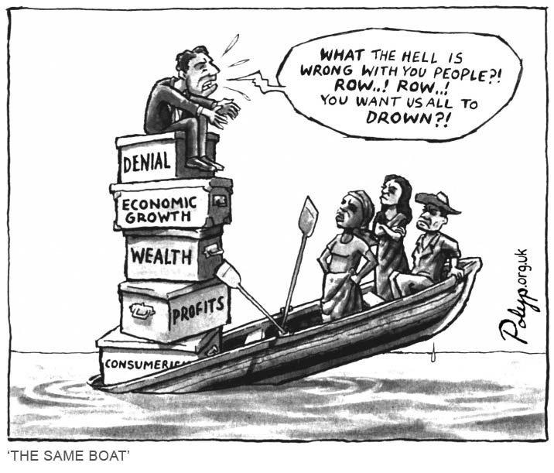

Slide 5
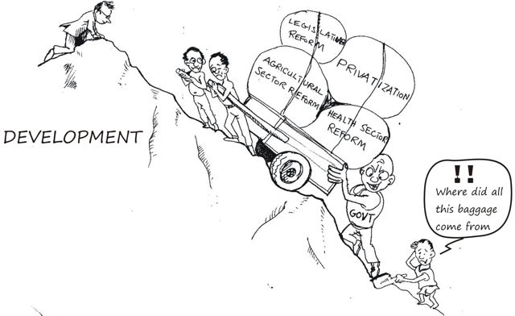

Slide 6
Alternative Development
Alternative development has been concerned with alternative practices of development – participatory and people-centered and with redefining the goals of development.
Since 1970 onwards alternative development approaches have emerged as people centered development. This development is geared to the satisfaction of needs of the people for whom development is directed.
The alternative development is also known as endogenous development.
Usually participatory method is also used for such approach. It is different from the earlier development approaches in respect of their methodology; a participatory, endogenous, self-sufficient and objectives oriented.

Slide 7
Alternative Development
Now, Anti-capitalism, green thinking, feminism, eco-feminism, democratization, new social movements are the theoretical cores for alternative development thinking.
According to Nerfin, alternative development is the terrain of citizen, or ‘Third System’ politics, the importance of which is apparent in view of the failed development efforts of govt. (1st system) and economic power (the merchant or 2nd system).
Today there is not much differences between the approaches of alternative development and mainstream development. The components of alternative development approach like, participation and sustainability have been adopted by the mainstream development. Slowly, this approach has become popular as Mainstream Alternative Development (MAD).

Slide 8
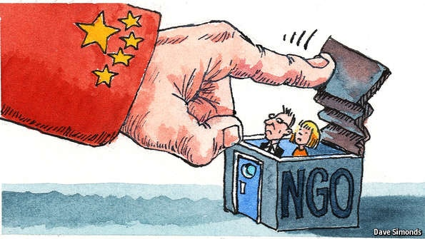
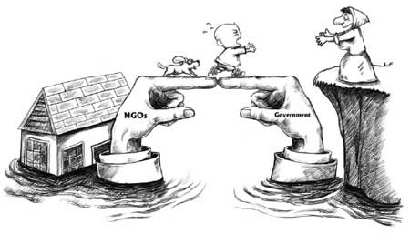

Slide 9
NGOs as Civil Society
Different Faces of NGOs in the Context of Alternative Development
The tripartite division is often used to understand and locate NGOs as civil society actors.
At the conceptual level, civil society is usually treated in terms of associations (so-called civil society organizations), or as an arena within which ideas about the ordering of social life are debated and contested.
Gramscian understanding of civil society as constituting an arena in which hegemonic ideas are both established and contested.

Slide 10
NGOs as water
NGO has little power except that which is generated by being a convener.
The NGO builds alliances with more powerful groups, social movements, political parties, rich donors etc.
They seek to respond to opportunities that emerge within these relationships.
They put emphasis on a process that draws in pro-poor individuals and groups, and they are essentially responsive to that process.
They have to be a water because they are dealing with powerful entities who don’t hesitate to contest the process.

Slide 11
NGOs as microchip
NGOs seek to be more proactive around the content that is considered within the engagement.
They are still concerned with process though less willing to relinquish leadership to others than in the jelly model.
They may seek to convince a more powerful actor, such as a state minister or agency professional
It is their intellectual contribution that enables them to bring actors together with some legitimacy
NGOs can add real insight to local grassroots and political strategies by broadening horizons and helping people learn and see things differently.

Slide 12
NGOs Three Dimensions
Perceiving development as both an underlying process of social change and as a targeted intervention.
Considering the tripartite division between the three key institutional arenas of state, civil society and market.
Referring to the relationships between localizing and globalizing tendencies in defining what NGOs do and are.

Slide 13
Background of NGOs
Until 1970s: A limited number of small NGOs receiving little external support constitute NGO sector.
1980s: The NGO decade takes place amidst the Western pursuit of neo-liberal agendas with promising development alternative.
1990s: Alongside emergence of the good governance agendas, the first concerns surrounding NGOs take off alongside a focus back to the role of the state.
2000s: A new International Aid Regime promises greater consultation and focus on non-growth factors (people centered, rights based, grassroots driven approaches)
2010s: With persistent concerns of NGOs remaining unaddressed and recognition of their limited success in advocacy and empowerment, there is increasing recognition that NGOs are only one sector within broader civil society and they must reorient themselves with their grassroots-roots.

Slide 14
Factors of the expansion of the NGOs
In addressing the needs of the population, NGOs are identified as possible alternative institutions to the public sectors (Brown and Korten, 1991). The following factors have contributed to the rapid growth of the NGOs all over the world in the last decade.
Changed Global Environment: The traditional dominant realist approach has lost a great deal of its explanatory power with the development of political economy based on internationalization of trade, production and finance. The transformation of the world environment have enabled the emergence of the notion of “international non-state actor”. [Mansbach 1976; Taylor 1984]
Changed International Political Philosophy: Economist Milton who was an advisor to the U.S. President Regan Administration, advocated to give up emphasize on less-government concept, which encouraged the flourishing of non-governmental sector. The same philosophy was fostered by the British Prime Minister M. Thatcher.

Slide 15
Factors of the expansion of the NGOs
Attraction and Trust of major donor agencies: As a result of changed global Political and economic environment, the policies of the major donor agencies gradually changed. In that situation the NGO sector was able to attract the attention of bilateral and multi-lateral donor agencies, who in the past, were little concerned with such local organizations. [World Bank, 1992]
Failure of Governments and Search for Alternative Model: In the situation of the inappropriateness of governmental efforts led to search for alternative models and approaches to development in the context of frustration at the failure of conventional approaches to achieve the goals set by development planners and policy makers. [Peggy, 1987]

Slide 16
Strengths of NGOs
In the present world, the NGOs are treated as promoters of alternative development strategies [Drabek: 1987].
The strengths of NGOs are:
Capacity to reach the poor and the remote areas: The NGOs focus on the poor segment of the society which in many cases don’t benefit from governmental services.
Capacity to promote local participation: The prime purpose of the NGOs is to encourage and develop local potentials. [Wilson, 1983].
Capacity to work with other agencies: Many NGOs are ready and able to assist governments, local government departments and local agencies.
Capacity to act quickly: Speed of action and a minimum of bureaucratic tangle is one of the greatest assets of Development NGOs.

Slide 17
Strengths of NGOs
Capacity to work with flexibility: Due to their small size the NGOs tend to be more flexible than government programs or local government programs.
Capacity to take risks and experiments: NGOs normally undertake pilot projects in order to experiment or act as a catalyst. To attain their objectives they take risk much more readily than government agencies.
Capacity of innovate and adopt: Through their continuous search for new approaches and experimentation the NGOs become creative and experienced especially in micro level planning of development activities. [Sultan, 1990]
Capacity to operate on low costs: Some large NGOs are able to implement national programs that are cost effective.

Slide 18
Strengths of NGOs
Capacity to facilitate local resource mobilization and ensure local development: The NGOs have demonstrated their ability to facilitate resource mobilization by promoting local participation and their willingness to adapt to local need and conditions in the support hey provide to these groups.
Capacity to advocacy: The NGOs have the capacity to press the public sector to be more responsive. Their successful initiatives make them able to influence national policies and give them the advocacy power to governmental organizations.
Besides-
NGOs have capacity to developing a sound management System
NGO sector uses bottom-up planning approaches.
NGOs provide an effective alternative to public agencies.
NGOs are administratively and fiscally stronger than a weak govt.

Slide 19
Reference
Friedmann, J. (1992). Empowerment: the politics of alternative development. Blackwell.
Pieterse, J. N. (1998). My paradigm or yours? Alternative development, post‐development, reflexive development. Development and change, 29(2), 343-373.
Berner, E., & Phillips, B. (2005). Left to their own devices? Community self-help between alternative development and neo-liberalism. Community Development Journal, 40(1), 17-29.
Sheth, D. L. (1987). Alternative development as political practice. Alternatives, 12(2), 155-171.
Cohen, P. T. (2009). The post-opium scenario and rubber in northern Laos: Alternative Western and Chinese models of development. International Journal of Drug Policy, 20(5), 424-430.
Sen, G., & Grown, C. (2013). Development crises and alternative visions: Third world women's perspectives. Routledge.

