Slide 1
PRESERVATION, PROCESSING AND QUALITY OF MEAT & MEAT PRODUCTS

Slide 2
Meat Preservation
Meat preservation is the process of extending the shelf life of meat while maintaining its quality, flavor, and safety. Various methods are employed to achieve this goal. Here are some common meat preservation techniques:
Chilling/Refrigeration
Freezing
Canning
Smoking
Dehydration
Fermentation
Vacuum Packaging
Curing
Irradiation

Slide 3
Meat Preservation
Refrigeration: Storing meat at low temperatures (typically between 32°F and 40°F or 0°C and 4°C) slows down bacterial growth and helps maintain freshness. Refrigeration is suitable for short-term preservation of fresh meat, typically up to a few days.
Freezing: Freezing meat at temperatures below 0°F (-18°C) inhibits bacterial growth and enzymatic activity, effectively preserving the meat for an extended period. Proper packaging, such as vacuum sealing or wrapping in moisture-proof materials, is essential to prevent freezer burn and maintain quality.
Canning: Canning involves heat-processing meat in jars or cans to kill bacteria and create a vacuum seal, preventing spoilage. Canned meat can be stored at room temperature for an extended period, making it a convenient option for long-term preservation.

Slide 4
Meat Preservation
Smoking: Smoking meat, which imparts flavor and helps preserve the meat by inhibiting microbial growth a exposes it to smoke from burning wood or other sources and reducing moisture content. Smoked meats, such as bacon and sausage, can be stored for extended periods under refrigeration.
Drying: Drying meat involves removing moisture through air-drying or dehydration, which inhibits bacterial growth and extends shelf life. Dried meats, such as beef jerky and biltong, can be stored at room temperature for long periods if properly dried and packaged.
Fermentation: Fermenting meat involves the growth of beneficial bacteria, which produce acids that lower the pH and inhibit the growth of harmful bacteria. Fermented meats, such as salami and sausages, undergo controlled fermentation and aging processes for preservation.
Vacuum Packaging: Vacuum packaging removes air from around the meat and seals it in airtight packaging, preventing oxidation and microbial growth. Vacuum-sealed meat can be stored in the refrigerator or freezer for extended periods without compromising quality.

Slide 5
Curing
Curing by common salt and sodium nitrite resulted in comparatively improved products. These days mild curing of meat products is practiced mainly for specific flavor and color development and preservative effects of curing ingredients is an added advantage. Sodium chloride, sodium nitrite, sodium nitrate and sugar are the main curing ingredients.
Sodium chloride (common salt) exerts its preservative action as follows:.
It acts by dehydration and alteration 'of osmatic pressure that inhibits the growth of spoilage bacteria.
Chloride ions in the salt directly act on the microorganisms.
It slows down the action of proteolytic enzymes in meat.
Besides, sodium chloride interacts with fatty acids to enhance the flavor of the cured products. It also contributes to the tenderness of the product.
Sodium nitrates and nitrite: Serve to stabilize the attractive cure meat color and impart characteristic cured meat flavor.

Slide 6
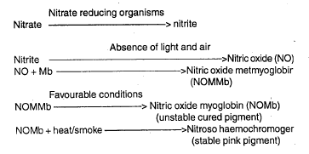

Slide 7
Irradiation
Radiation for Cold Sterilization: Electromagnetic radiation, such as gamma rays from isotopes like ₆₀Co and ₁₃₇Cs, is used for cold sterilization in food preservation. These rays have excellent penetration power and can destroy microorganisms by fragmenting their DNA and ionizing inherent water within them.
Gamma Radiation in Food Preservation: Gamma rays produce the desired effect only during food irradiation and have no residual effect after the radiation source is removed. They are widely used in food preservation to enhance shelf life and sterilize meats, poultry, and fish.
Doses and Effects: Specific doses of radiation are applied for different preservation purposes. For example, a dose of 50-100K rad (radurisation) can extend the shelf life of fresh meat cuts and poultry products by 19 days, while a dose of 4-5 Mrad (rad appertisation) can sterilize pork, poultry, and fish.

Slide 8
Irradiation
Non-Ionizing Radiation: Ultraviolet (UV) radiation of 2650A⁰ is bactericidal but has poor penetration power, limiting its use to surface sterilization of meats. Certain chemicals, like ascorbates, can increase the sensitivity of microorganisms to radiation.
Chemical Preservatives: Various chemicals act as preservatives by inhibiting microbial growth in foods. Organic acids like citric acid, propionic acid, benzoic acid, sorbic acid, and their salts are effective mold inhibitors. Acetic acid, lactic acid, sorbet, and acetate prevent bacterial and yeast growth in foods.
Hurdle Concept in Preservation: Modern meat food processors employ a combination of preservative factors, known as hurdles, in a balanced manner to maximize the preservation benefits. This approach involves utilizing various preservation techniques and chemicals to enhance the keeping quality of food products.

Slide 9
Processing of Meat & Meats Products
Basic meat plant operations such as cutting, trimming, .Deboning and grinding do not constitute meat processing.
Processing refers to any treatment including salting which brings about a substantial chemical and physical change
Basic processing procedure
Comminution
Emulsification
Meat extension
Hot processing
Cooking

Slide 10
Processing of Meat & Meats Products
Comminution
All processed meats can be classified as either non-comminuted or comminuted products
Non-comminuted products are generally processed from intact cuts.(Usually cured, smoked and cooked, e.g. Ham and bacon)
Comminution refers to subdivision or reduction of raw meat into meat pieces or particles.
Size reduction helps in the uniform distribution of seasonings (eliminates the toughness
Associated with meat of old animals and lowers the fuel cost for cooking )

Slide 11
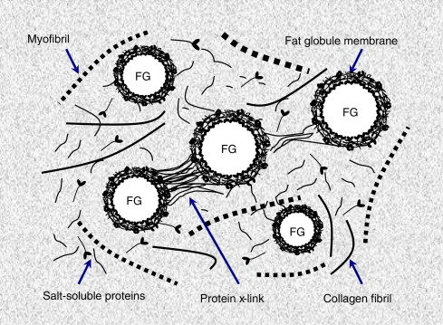
Processing of Meat & Meats Products
Emulsification
Meat emulsion, a true emulsion, consists of fat droplets in a water matrix stabilized by proteins.
Meat emulsion comprises of a dispersed phase of solid or liquid fat droplets and a continuous phase of water containing salt and proteins
Salt soluble proteins have a relatively high emulsifying capacity.
For the preparation of a good meat emulsion, lean meat is first chopped with salt to extract salt soluble proteins and then fat and other ingredients are added.

Slide 12
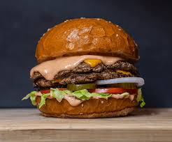
Processing of Meat & Meats Products
Meat extension
A lot of non-meat food items can be incorporated in meat products
In developing countries, soy products, potato starch and flours of wheat, rice, pea, corn etc. are used as fillers to reduce the cost of formulations
These are generally termed as extenders, although these may be specifically referred as fillers, binders, emulsifiers or stabilizers depending on the purpose of their incorporation
Pre blending
Refers to the mixing of a part or all the curing ingredients (salt, nitrite, nitrate etc.) with ground meat in a specified proportion.
This process allows better extraction of proteins which in turn helps in the formation of stable emulsion.

Slide 13
Processing of Meat & Meats Products
Hot processing
It refers to the processing of carcass as soon as possible after slaughter
It accelerates the processing steps and entire processing time is reduced
Improvement the cooking sensory quality of the product
Cooking
Cooked by any one or a combination of three methods
Dry heat, moist heat and microwave cooking.
Dry heat cooking involves either roasting or frying
Moist heat cooking, hot water or steam is continuously kept in contact with meat for cooking
Pressure cooking, stewing, simmering etc. Are popular moisture cooking procedures.

Slide 14
Meat Products
Processing of meat products is divided into the following groups for further discussion:
Cured and smoked meats
Sausages
Intermediate moisture and shelf stable meat products
Restructured meat products
Other popular meat products

Slide 15
Cured and Smoked Meats
All meat products belonging to this class are cured, whereas only some of them are smoked.
Hams
These are classified in several ways:
According to weight: light, medium and heavy
According to trimming: rough, regular, skinned and skinless
According to presence of bone: bone-in, semiboneless and boneless.

Slide 16
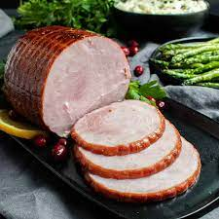
Cured and Smoked Meats
Commercial processing of ham
In three steps-curing, smoking and cooking.
Curing is usually done by artery pumping or stitch pumping to 10% of the green weight.
Artery pumping involves injecting curing solution directly into the artery of the meat.
Stitch pumping involves injecting the solution throughout the meat by stitching it in.
The hams are now shifted to smoke chamber which is maintained at 75-85°C temperature and 30-40% relative humidity for 5-6 hours.

Slide 17
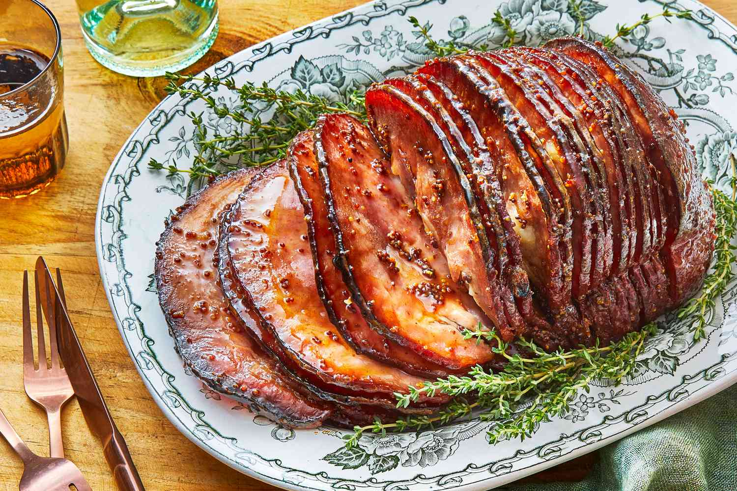
Cured and Smoked Meats
Cooked ham
These hams are deboned and cured in the pickle but smoking is not done.
Stuffed tightly into metal moulds and cooked in a water tank at 75-85°C for 2-3 hours depending on the weight of the ham.
Chilled in a tank maintained at 0°C for 12 hrs.
These hams are then sliced and packed.

Slide 18
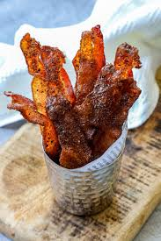
Cured and Smoked Meats
Bacon
Pork bellies are generally processed as cured and smoked bacon.
There is no fixed criteria for the classification of bacon.
Commercial Processing of Bacon
Green bellies are first cleared of rind and stitch pumped with a curing pickle.
These are now transferred to smoke chamber maintained at a temperature of 60-65°C and a relative humidity of 30-40%
The cooking time depends on the size of bellies although an internal temperature of 55°C must be achieved
After smoking and cooking, bacon is chilled to 0°C to allow it to retain proper shape

Slide 19
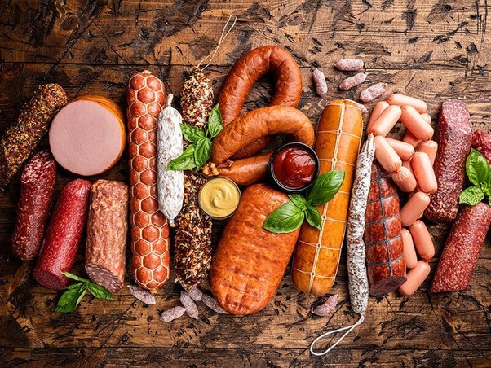
Sausages
Latin word 'salsus' meaning salt.
Refer to ground meat which was salted and stuffed in animal casings
Presently, sausage may be defined as a meat product which is prepared from minced and seasoned meat and .Formed into cylindrical shape by natural or synthetic casings.

Slide 20
Classification of Sausages
Based on degree of chopping
Coarse ground sausage
Emulsion type sausage
Based on moisture content
Fresh sausage
Smoked uncooked sausage
Cooked sausage
Dry and semi-dry sausage
Based on fermentation
Fermented sausage
Non-fermented sausage

Slide 21
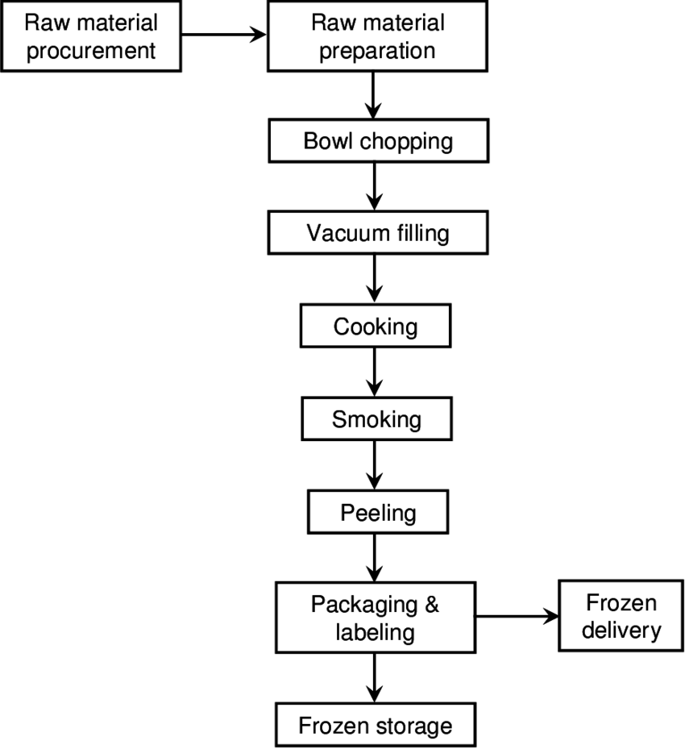
Sausages
Processing Steps
Grinding or mincing
Mixing
Chopping and emulsifying
Stuffing
linking and Tying
Smoking and cooking
Chilling
Peeling and packaging

Slide 22
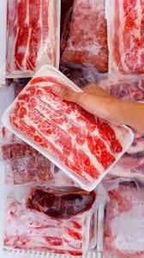
Frozen Meats
Frozen meat refers to meat products that have been preserved by freezing at temperatures below 0°F (-18°C).
Benefits of Freezing Meats
Preservation of freshness: Freezing halts the growth of microorganisms and slows down enzymatic reactions, preserving the freshness of meat.
Extended shelf life: Properly frozen meat can be stored for several months to a year without significant loss of quality.
Convenience: Freezing allows for bulk purchase and storage of meats, enabling consumers to have a variety of options readily available.

Slide 23
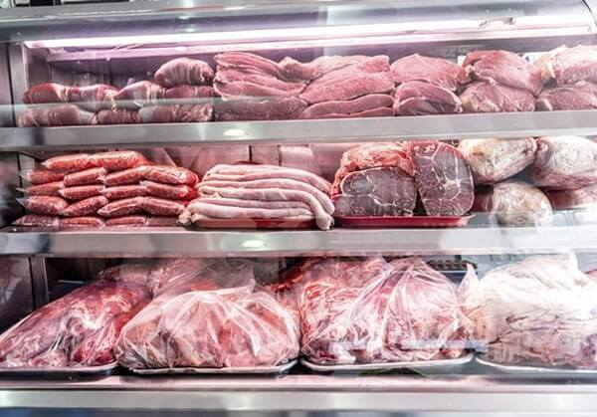
Meat Storage
Meat storage refers to the process of preserving meat products to maintain their quality, safety, and freshness over time.
Proper meat storage is crucial to prevent spoilage, bacterial contamination, and foodborne illnesses.

Slide 24
Factors Affecting Meat Storage
Temperature: Meat should be stored at the appropriate temperature to slow down bacterial growth and maintain freshness. Refrigeration or freezing is commonly used for meat storage.
Humidity: Proper humidity levels help prevent meat from drying out or becoming too moist, which can affect its texture and flavor.
Air exposure: Exposure to air can lead to oxidation and spoilage of meat. Vacuum-sealing or using airtight packaging helps minimize air exposure.
Light: Light exposure can cause discoloration and off-flavors in meat. Storing meat in opaque containers or wrapping it in foil can protect it from light.

Slide 25
Different Storage Methods
Refrigeration: Ideal for short-term storage (typically 3-5 days) of fresh meat. Keep meat in the coldest part of the refrigerator (usually the back or bottom shelf) and use a meat drawer if available.
Freezing: Suitable for long-term storage of meat. Freeze meat at 0°F (-18°C) or below to maintain its quality and prevent bacterial growth. Proper packaging is essential to prevent freezer burn.
Curing: Preserving meat through salting, smoking, or drying. Commonly used for cured meats like bacon, ham, and salami. Requires careful monitoring of salt and moisture levels.
Canning: Processing meat in airtight containers and heat-sealing them to kill bacteria and prevent spoilage. Canned meats have a long shelf life and are convenient for storage and use.

Slide 26
Safety Considerations & Best Practices
Safety Considerations
Temperature control
Cross-contamination
Thawing
Inspection
Best Practices
Proper packaging: Use airtight containers, vacuum-sealed bags, or freezer wrap to protect meat from air exposure and prevent freezer burn.
Labeling and dating: Label meat packages with the type of meat and date of purchase or freezing to keep track of storage time and ensure timely use.
Organization: Arrange meat in the refrigerator or freezer for easy access and proper air circulation. Rotate older items to the front for timely use.

Slide 27
Quality Parameters of Meat
Meat Color: The color of meat can vary depending on factors such as the animal's age, diet, and storage conditions. In general, fresh meat should have a vibrant, consistent color.
Water holding capacity: The water holding capacity (WHC) of meat refers to its ability to retain water during cooking and processing. Which affects the juiciness, tenderness, and overall eating experience of meat. It involves careful handling, processing, and cooking techniques to preserve moisture and enhance the eating experience.
Marbling: The distribution of intramuscular fat within the meat. Higher marbling generally indicates better quality, as it contributes to tenderness, juiciness, and flavor.

Slide 28
Quality Parameters of Meat
Quantum of Connective tissue: The quantum of connective tissue in meat refers to the amount of collagen and elastin present in the muscle fibers. Connective tissue provides structural support to muscles and contributes to their texture and toughness.
Firmness: High-quality meat should have a firm texture when touched, indicating freshness and proper handling.
Meat storage condition: Proper storage of meat is crucial to maintain its quality, freshness, and safety. Temperature: Meat should be stored at temperatures below 40°F (4°C) to slow bacterial growth and maintain freshness. Refrigerators should be set to temperatures between 32°F and 40°F (0°C to 4°C). Freezers should be set to 0°F (-18°C) or lower for long-term storage. Thawing: When thawing frozen meat, it's best to do so in the refrigerator to maintain a safe temperature and minimize bacterial growth. Alternatively, you can use the microwave or cold water methods for faster thawing, but be sure to cook the meat immediately afterward.

Slide 29
Microbial and other deteriorative change in Meats
Sources of Microbial Contamination of Meat
There are a number of potential sources of contamination of meat within the abattoir itself. These include:
Hides/skin and feet
Gastrointestinal contents
Instruments such as knives, cleavers saws, hooks etc.
Water used for washing carcasses and instruments
Airborne contamination
Hands and clothing of the personnel

Slide 30
Deteriorative Changes in Meat
Microbial Contribution to Spoilage: Microorganisms, intrinsic enzymes, and insects contribute to meat spoilage. Spoilage can occur on the surface of fresh chilled meat under aerobic conditions and within the meat at higher temperatures.
Aerobic Spoilage Characteristics: Aerobic spoilage exhibits symptoms like surface slime formation, discoloration, and off-odors due to bacterial and yeast activity. Proteolysis of meat proteins and lipids occurs, yielding peptides, amino acids, and oxidizing agents.

Slide 31
Deteriorative Changes in Meat
Anaerobic Spoilage Attributes: Under anaerobic conditions, meat decomposition is offensive, with putrefaction occurring in deep tissues like lymph nodes and bone joints, accompanied by foul odors and souring from organic acid accumulation.
End Products of Spoilage: Aerobic conditions yield simple peptides, amino acids, and oxidizing agents, while anaerobic conditions produce sulfur dioxide, ammonia, amines, and ketones. Residual carbohydrates yield skatol and indole, and molds may grow on semi-dried meats, causing stickiness and whiskers.

Slide 32
Identification of Meat Spoilage
Some physical observations such as discoloration, Slime formation, stickiness, whiskers etc. give a clear indication of spoiled meats.
At low temperature, meat spoilage is accompanied by the formation of many off-flavor compounds. Many of them owe their origin to free amino acids and related substances. The production of H₂S and mercaptans can be measured to ascertain meat spoilage. Chemical determinations for the presence of ammonia, indole, skatol, di- and tri-methylamine etc. can be carried out to detect microbial spoilage in meats.
The extract release volume (ERV) determination is particularly helpful in detecting the incipient spoilage in meats. ERV refers to the volume of aqueous extract released by a meat homogenate when it is passed through a filter for a given period of time. As meats undergo microbial spoilage, there is a complete hydrolysis of proteins, which significantly decrease the ERV.

Slide 33
Identification of Meat Spoilage
Dye (usually resazurin) reduction test is many times used to detect spoilage in meats. Spoiled raw or cooked meat homogenate prepared from stomacher could bring about resazurin reduction within 2 hours. This method shows a very good correlation with bacterial numbers.
Incipient spoilage of meat shows a simultaneous rise in pH, bacterial counts and water holding capacity of meat proteins. At the time of incipient spoilage, pH value is more than 6.5 in ground meat but it may even increase to 8.5 in putrid meats.
High thiobarbituric acid and peroxide values indicate chemical spoilage of meat and meat products

Slide 34
Quality Control Measures for Meat and Meat Products
Meat being a highly perishable commodity requires strict quality control right from slaughter ope1ations till ultimate consumption.
The basic objectives of quality control are:
Protection of public health
Extension of product shelf life
Provision of consumer satisfaction
Compliance of regulatory legislation
Competitive edge in the trade

Slide 35
The general principles of meat product quality control involve
Raw material control
Control of processing operations
Finished product inspection and control
It is very difficult to examine meat and meat products for every pathogenic, toxigenic and spoilage microorganisms. However, a product cannot be improved unless some objective assess.f11ent of its quality is available. But the methods adopted should be simple with quick results. Hence, the following indicator organisms are relied upon to determine the sanitary and safety status of these items:
Total Viable Counts
Coliforms
Enterococci

Slide 36
Standards in Meat Industry
Quality control departments frequently utilize the reliable methods and techniques for establishing the standards. A standard can be referred as carefully drawn specification with respect to a food product. The specifications give comprehensive instructions to ensure correct and reliable process control. The compliance of specifications increases the confidence of top executives in the production and marketing of perishable food items.
HACCP
ISO-9000

