Slide 1
Post-mortem Changes in Fish

Slide 2
What will Happen When Fish died?

Slide 3
What will Happen When Fish died?

Slide 4
Fig: Generation consequences following death of an animal (adapted from Lawrie, 1966 and Eskin et al., 1971)

Slide 6
HOW RIGOR OCCUR
1. Death of fish.
2. Calcium released from the cell
3. Calcium activates ATPase
4. ATPase activates ATP to break down to ADP and further compounds
5. In the process of ATP breakdown to ADP, energy is released.
6. This chemical energy is converted to mechanical energy.
7. This mechanical energy pushes the two major protein in fish muscle (Actin and Myosin) to produce Actomyosin which results in the stiffening of fish known as RIGOR MORTIS.

Slide 8
Post-mortem Changes in Fish
1. Sensory changes
2. Autolytic changes
3. Bacteriological changes
4. Lipid oxidation and hydrolysis

Slide 9
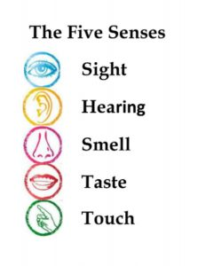
Sensory changes
Sensory changes are those perceived with the senses, i.e., appearance, odour, texture and taste. Two major sensory changes are observed:
Changes in appearance and texture
Changes in eating quality

Slide 10
Changes in Appearance and Texture
Occurrence of rigor mortis
The most dramatic change is onset of rigor mortis.
Immediately after death the muscle is totally relaxed and the limp elastic texture usually persists for some hours, where after the muscle will contract.
When it becomes hard and stiff the whole body becomes inflexible and the fish is in rigor mortis.
This condition usually lasts for a day or more and then rigor resolves.
The resolution of rigor mortis makes the muscle relax again and it becomes limp, but no longer as elastic as before rigor.
The rate in onset and resolution of rigor varies from species to species and is affected by temperature, handling, size and physical condition of the fish.

Slide 11
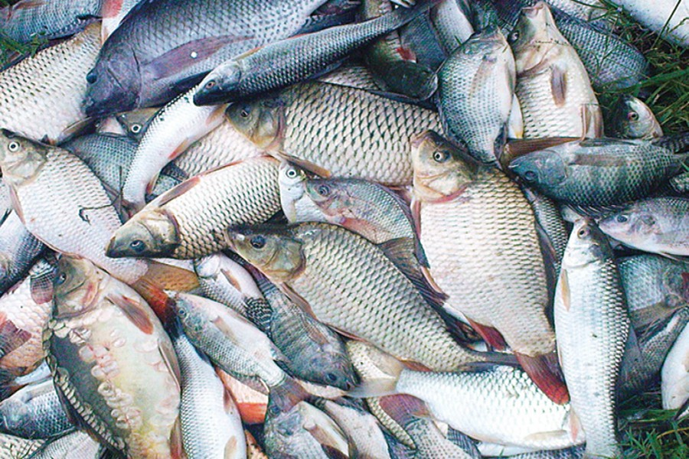
How long a fish stay in rigor?
The time a fish takes to go into, and pass through, rigor depends on the following factors:
the species,
physical condition,
the degree of exhaustion before death,
its size,
the amount of handling during rigor and
the temperature at which it is kept.

Slide 12
Rigor Mortis

Slide 13
Factors Affecting Rigor Mortis
The time a fish takes to go into, and pass through, rigor depends on the following factors:
Species: Some species take longer than others to go into rigor, because of differences in their chemical composition. White fish, for example, go into rigor very quickly and may be completely stiff one hour after death, whereas fatty fish stored under the same conditions may take as long as 22 hours to develop full rigor.
Condition: The poorer the physical condition of a fish, that is the less well nourished it is before capture, the shorter will be the time it takes to go into rigor; this is because there is very little reserve of energy in the muscle to keep it pliable. Fish that are spent after spawning are very susceptible to rigor.

Slide 14
Factors Affecting Rigor Mortis
Degree of exhaustion:
In the same way, fish that have struggled in the net for a long time before they are hauled, have much less reserve of energy than those that entered the net just before hauling, and thus will go into rigor more quickly.
Size:
Small fish usually go into rigor faster than large fish of the same species.
Handling:
To much handling after catching may increase the rate of rigor mortis. Handling includes different activities like washing, cleaning, exchange of fish from one container to another.

Slide 15
Factors Affecting Rigor Mortis
Temperature:
This is perhaps the most important factor governing the time a fish takes to go into, and pass through rigor.
The warmer the fish, the sooner it will go into rigor and pass through rigor.
For example, cod fish kept at 32-35°F may take about 60 hours to pass through rigor, whereas the same fish kept at 87°F may take less than 2 hours.
To sum up, small fish with low reserves of energy, that is exhausted and in poor condition, and kept at a high temperature will enter and pass through rigor very quickly.
On the other hand, large, rested, well-fed fish kept at a low temperature will take a very long time to enter and pass through rigor.

Slide 16
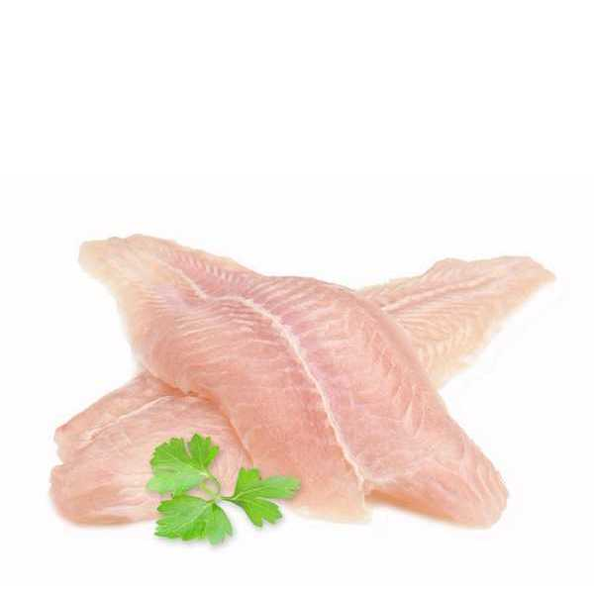
Significance of Rigor
The technological significance of rigor mortis is of major importance when the fish is filleted before or in rigor.
In rigor the fish body will be completely stiff; the filleting yield will be very poor.
If the fillets are removed from the bone pre-rigor the muscle can contract freely and the fillets will shorten following the onset of rigor.
Dark muscle may shrink up to 52% and white muscle up to 15% of the original length.

Slide 17
Significance of Rigor
If the fish is cooked pre-rigor the texture will be very soft and pasty.
In contrast, the texture is tough but not dry when the fish is cooked in rigor.
Post-rigor the flesh will become firm, succulent (juicy) and elastic.
Whole fish and fillets frozen in pre-rigor can give good products if they are carefully thawed at a low temperature in order to give rigor mortis time to pass while the muscle is still frozen.

Slide 18
Changes in Eating Quality
A characteristic pattern of the deterioration of eating quality of fish stored in ice can be found and divided into the following four phases:
Phase 1: The fish is very fresh and has a sweet, natural and delicate (Delicious) taste.
Phase 2: There is a loss of the characteristic odour and taste. The flesh becomes neutral but has no off-flavours. The texture is still pleasant.

Slide 19
Changes in Eating Quality
Phase 3:
There is sign of spoilage and a range of volatile, unpleasant-smelling substances is produced depending on the fish species and type of spoilage (aerobic, anaerobic).
One of the volatile compounds may be trimethylamine (TMA) derived from the bacterial reduction of trimethyl-amino-oxide (TMAO).
TMA has a very characteristic "fishy" smell.
At the beginning of the phase the off-flavour may be slightly sour and slightly bitter, especially in fatty fish.
During the later stages sickly sweet, cabbage-like, ammoniacal, sulphurous and rancid smells develop. The texture becomes either soft and watery or tough and dry.
Phase 4: The fish can be characterized as spoiled and putrid.

Slide 20
Autolytic Changes
Autolysis means "self-digestion".
It has been known for many years that there are at least two types of fish spoilage: bacterial and enzymatic.
In others, autolysis contributes to varying degrees to the overall quality loss in addition to microbially-mediated processes.

Slide 21
Bacteriological Changes
Microorganisms are found on all the outer surfaces (skin and gills) and in the intestines of live and newly caught fish.
The total number of organisms vary enormously.
A normal range of 10²-10⁷ cfu/cm² is found on the skin surface.
The gills and the intestines both contain between 10³ and 10⁹ cfu/gm.
The bacterial flora on newly-caught fish depends on the environment in which it is caught rather than on the fish species.
Fish caught in very cold, clean waters carry the lower numbers whereas fish caught in warm waters have slightly higher counts.
Very high numbers, i.e., 10⁷ cfu/cm² are found on fish from polluted warm waters.

Slide 22
Responsible Microorganism for fish spoilage

Slide 23
Responsible Microorganism

Slide 24
Find out Responsible Microorganism?
Some genera of microorganisms have already been studied for proteolytic activity,
such as Bacillus,
Pseudomonas,
Penicillium,
Aspergillus and
Fusarium

Slide 25
Lipid Oxidation and Hydrolysis
Oxidation and hydrolysis are the two distinct reactions in fish lipids of importance for quality deterioration are:
They result in production of a range of substances among which some have unpleasant (rancid) taste and smell.
Some may also contribute to texture changes by binding covalently to fish muscle proteins.
The various reactions are either non-enzymatic or catalysed by microbial enzymes or by intracellular or digestive enzymes from the fish.
The relative significance of these reactions, therefore, mainly depends on fish species and storage temperature.
Fatty fish are, of course, particularly susceptible to lipid degradation which can create severe quality problems even on storage at subzero temperatures.

Slide 26
Oxidation
Enzymatic oxidation (lipoxygenase)
Generation of characteristic fresh fish odour.
Autoxidation
Oxygen reacts with double bonds of unsaturated fatty acids.
Affects nutritional value, taste, odour, colour and texture.

Slide 27
Hydrolysis
The phenomenon is more profound in ungutted than in gutted fish probably because of the involvement of digestive enzymes.
formation of free fatty acids.
normally this does not cause problems in fish but causes an off-flavour in oils (soapy).
Ungutted?
Gutted= contain internal organ like intestine.

Slide 28
Mechanism of ATP degradation

Slide 29
Mechanism of ATP degradation

Slide 30
Mechanism of ATP degradation
The pathways o ATP breakdown in both vertebrates and invertebrates are shown above.
Various steps involved arc carried out by different enzymes present in the fish tissues as well as in bacteria.
Hypoxanthin is formed by the action of tissue enzymes and later by bacterial enzymes.
The values of hypoxanthin progressively increase from near zero in fresh fish to Levels as high as 8 micro moles/g when the fish is considered spoiled.
Hence the values of hypoxanthin can be considered as the measure of both autolytic deterioration and bacterial spoilage.

Slide 31
Mechanism of ATP degradation
The values of hypoxanthin and freshness of fish correlate well with flavour changes in the period of storage.
It is, therefore, considered as a useful index of freshness provided the limits of acceptability are known for a particular species of fish.
However, sometimes in certain species very low hypoxanthin values are observed despite the progress and onset of spoilage.
This is because in those species hypoxanthin is immediately broken down into uric acid due to high degree of xanthin Oxidase activity, in certain other species, the breakdown of IMP to hypoxanthin is slow due to reduced activity of some enzymes.

