Slide 1
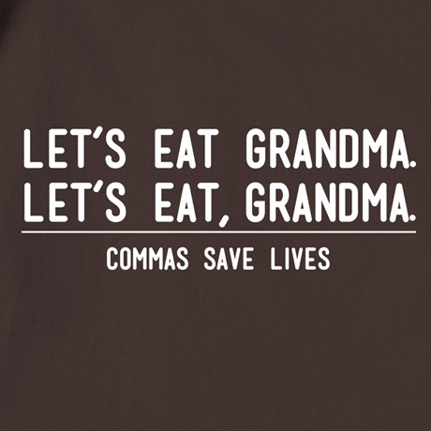

Slide 2
http://www.grammarbook.com/punctuation/commas.asp

Slide 3
1.
Use commas to separate words and word groups in a simple series of three or more items.
Example: My estate goes to my husband, son, daughter-in-law, and nephew.

Slide 4
Oxford Comma
Note: When the last comma in a series comes before and or or (after daughter-in-law in the above example), it is known as the Oxford comma. Most newspapers and magazines drop the Oxford comma in a simple series, apparently feeling it's unnecessary. However, omission of the Oxford comma can sometimes lead to misunderstandings.

Slide 5
Oxford Comma
Example: We had coffee, cheese and crackers and grapes.
Example: We had coffee, cheese and crackers, and grapes.
Adding a comma after crackers makes it clear that cheese and crackers represents one dish. In cases like this, clarity demands the Oxford comma.

Slide 6
Fiction and nonfiction books generally prefer the Oxford comma. Writers must decide Oxford or no Oxford and not switch back and forth, except when omitting the Oxford comma could cause confusion as in the cheese and crackers example.

Slide 7
2.
Use a comma to separate two adjectives when the order of the adjectives is interchangeable.
Example: He is a strong, healthy man.
We could also say healthy, strong man.
Example: We stayed at an expensive summer resort.
We would not say summer expensive resort, so no comma.

Slide 8
Another way to determine if a comma is needed is to mentally put and between the two adjectives. If the result still makes sense, add the comma. In the examples above, a strong and healthy man makes sense, but an expensive and summer resort does not.

Slide 9
3a
Many inexperienced writers run two independent clauses together by using a comma instead of a period. This results in the dreaded run-on sentence or, more technically, a comma splice.
Incorrect: He walked all the way home, he shut the door.
There are several simple remedies:
Correct: He walked all the way home. He shut the door.
Correct: After he walked all the way home, he shut the door.
Correct: He walked all the way home, and he shut the door.

Slide 11
3b
In sentences where two independent clauses are joined by connectors such as and, or, but, etc., put a comma at the end of the first clause.
Incorrect: He walked all the way home and he shut the door.
Correct: He walked all the way home, and he shut the door.
Some writers omit the comma if the clauses are both quite short:
Example: I paint and he writes.

Slide 12
3c
If the subject does not appear in front of the second verb, a comma is generally unnecessary.
Example: He thought quickly but still did not answer correctly.

Slide 13
But sometimes a comma in this situation is necessary to avoid confusion.
Confusing: I saw that she was busy and prepared to leave.
Clearer with comma: I saw that she was busy, and prepared to leave.
Without a comma, the reader is liable to think that "she" was the one who was prepared to leave.

Slide 14
4a
When starting a sentence with a dependent clause, use a comma after it.
Example: If you are not sure about this, let me know now.

Slide 15
Follow the same policy with introductory phrases.
Example: Having finally arrived in town, we went shopping.
However, if the introductory phrase is clear and brief (three or four words), the comma is optional.
Example: When in town we go shopping.
But always add a comma if it would avoid confusion.
Example: Last Sunday, evening classes were canceled. (The comma prevents a misreading.)

Slide 16
When an introductory phrase begins with a preposition, a comma may not be necessary even if the phrase contains more than three or four words.
Example: Into the sparkling crystal ball he gazed.

Slide 17
If such a phrase contains more than one preposition, a comma may be used unless a verb immediately follows the phrase.
Examples:
Between your house on Main Street and my house on Grand Avenue, the mayor's mansion stands proudly.
Between your house on Main Street and my house on Grand Avenue is the mayor's mansion.

Slide 18
4b
A comma is usually unnecessary when the sentence starts with an independent clause followed by a dependent clause.
Example: Let me know now if you are not sure about this.

Slide 19
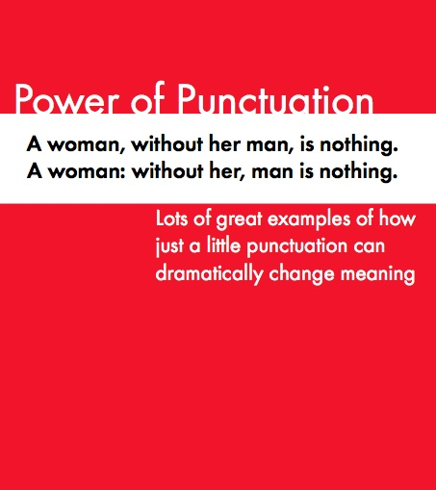

Slide 20
5
Use commas to set off nonessential words, clauses, and phrases (see Who, That, Which, Rule 2b).
Incorrect: Jill who is my sister shut the door.
Correct: Jill, who is my sister, shut the door.
Incorrect: The man knowing it was late hurried home.
Correct: The man, knowing it was late, hurried home.
In the preceding examples, note the comma after sister and late. Nonessential words, clauses, and phrases that occur midsentence must be enclosed by commas. The closing comma is called an appositive comma. Many writers forget to add this important comma. Following are two instances of the need for an appositive comma with one or more nouns.

Slide 21
Incorrect: My best friend, Joe arrived.
Correct: My best friend, Joe, arrived.
Incorrect: The three items, a book, a pen, and paper were on the table.
Correct: The three items, a book, a pen, and paper, were on the table.

Slide 22
6.
If something or someone is sufficiently identified, the description that follows is considered nonessential and should be surrounded by commas.
Examples:
Freddy, who has a limp, was in an auto accident.
If we already know which Freddy is meant, the description is not essential.
The boy who has a limp was in an auto accident.
We do not know which boy is meant without further description; therefore, no commas are used.

Slide 23
Example: My brother Bill is here.
Example: My brother, Bill, is here.
Careful writers and readers understand that the first sentence means I have more than one brother. The commas in the second sentence mean that Bill is my only brother.
Why? In the first sentence, Bill is essential information: it identifies which of my two (or more) brothers I'm speaking of. This is why no commas enclose Bill.
In the second sentence, Bill is nonessential information—whom else but Bill could I mean?—hence the commas.

Slide 24
Comma misuse is nothing to take lightly. It can lead to a train wreck like this:
Example: Mark Twain's book, Tom Sawyer, is a delight.
Because of the commas, that sentence states that Twain wrote only one book. In fact, he wrote more than two dozen of them.

Slide 25
7a
Use a comma after certain words that introduce a sentence, such as well, yes, why, hello, hey, etc.
Examples:
Why, I can't believe this!
No, you can't have a dollar.

Slide 26
7b
Use commas to set off expressions that interrupt the sentence flow (nevertheless, after all, by the way, on the other hand, however, etc.).
Example: I am, by the way, very nervous about this.

Slide 27
8
Use commas to set off the name, nickname, term of endearment, or title of a person directly addressed.
Examples:
Will you, Aisha, do that assignment for me?
Yes, old friend, I will.
Good day, Captain.

Slide 28
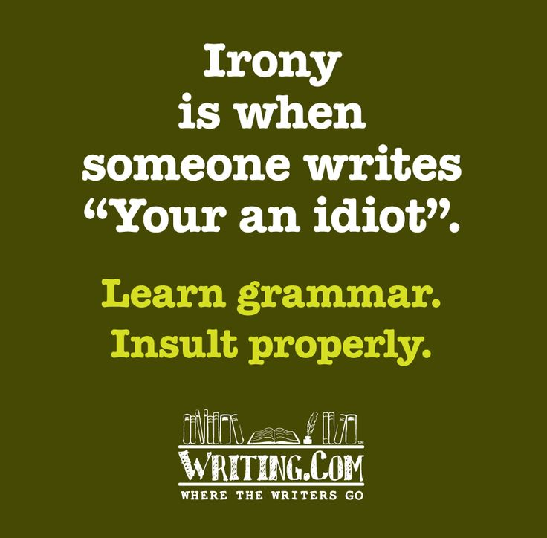

Slide 29
9
Use a comma to separate the day of the month from the year, and—what most people forget!—always put one after the year, also.
Example: It was in the Sun's June 5, 2003, edition.
No comma is necessary for just the month and year.
Example: It was in a June 2003 article.

Slide 30
10
Use a comma to separate a city from its state, and remember to put one after the state, also.
Example: I'm from the Akron, Ohio, area.

Slide 31
11
Traditionally, if a person's name is followed by Sr. or Jr., a comma follows the last name: Martin Luther King, Jr. This comma is no longer considered mandatory. However, if a comma does precede Sr. or Jr., another comma must follow the entire name when it appears midsentence.
Correct: Al Mooney Sr. is here.
Correct: Al Mooney, Sr., is here.
Incorrect: Al Mooney, Sr. is here.

Slide 32
12
Similarly, use commas to enclose degrees or titles used with names.
Example: Al Mooney, M.D., is here.

Slide 33
13a
Use commas to introduce or interrupt direct quotations.
Examples:
He said, "I don't care."
"Why," I asked, "don't you care?“
This rule is optional with one-word quotations.
Example: He said "Stop."

Slide 34
13b
If the quotation comes before he said, she wrote, they reported, Dana insisted, or a similar attribution, end the quoted material with a comma, even if it is only one word.
Examples:
"I don't care," he said.
"Stop," he said.

Slide 35
13c
If a quotation functions as a subject or object in a sentence, it might not need a comma.
Examples:
Is "I don't care" all you can say to me?
Saying "Stop the car" was a mistake.

Slide 36
13d
If a quoted question ends in midsentence, the question mark replaces a comma.
Example: "Will you still be my friend?" she asked.

Slide 37
14
Use a comma to separate a statement from a question.
Example: I can go, can't I?

Slide 38
15
Use a comma to separate contrasting parts of a sentence.
Example: That is my money, not yours.

Slide 39
16a
Use a comma before and after certain introductory words or terms, such as namely, that is, i.e., e.g., and for instance, when they are followed by a series of items.
Example: You may be required to bring many items, e.g., sleeping bags, pans, and warm clothing.

Slide 40
16b
A comma should precede the term etc. Many authorities also recommend a comma after etc. when it is placed midsentence.
Example: Sleeping bags, pans, warm clothing, etc., are in the tent

Slide 41
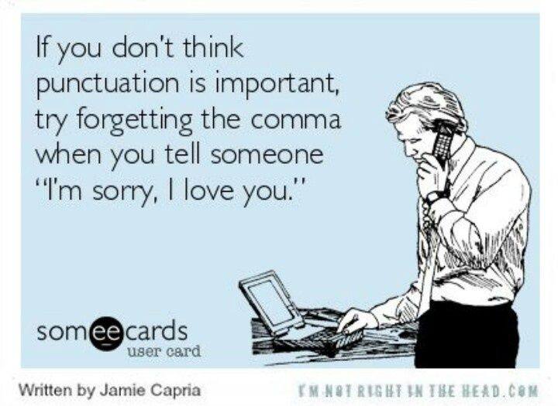

Slide 42
There are two quiz-links given at the bottom of the webpage. Please take those quizzes and check your understanding.
http://www.grammarbook.com/punctuation/commas.asp

