Slide 1
Communication Skills
Prepared by
Emran Khan
Lecturer
Department of English
Daffodil International University

Slide 2
Being able to communicate effectively is perhaps the most important of all life skills. It is what enables us to pass information to other people, and to understand what is said to us. You only have to watch a baby listening intently to its mother and trying to repeat the sounds that she makes to understand how fundamental is the urge to communicate.
Communication, at its simplest, is the act of transferring information from one place to another. It may be vocally (using voice), written (using printed or digital media such as books, magazines, websites or emails), visually (using logos, maps, charts or graphs) or non-verbally (using body language, gestures and the tone and pitch of voice). In practice, it is often a combination of several of these.
Communication skills may take a lifetime to master—if indeed anyone can ever claim to have mastered them. There are, however, many things that you can do fairly easily to improve your communication skills and ensure that you are able to transmit and receive information effectively.

Slide 3
Here are few effective communication techniques that help you become an excellent communicator
Have a proper body language
Frame your views
Try to understand, not just to listen
Get to know your audience before you communicate
Ask open-ended questions
Always be honest

Slide 4
Types of Communication
Intrapersonal Communication
Interpersonal Communication
Group Communication
Public Communication
Mass Communication

Slide 5

Intrapersonal Communication
Intrapersonal communication is communication with oneself using internal vocalization or reflective thinking. Like other forms of communication, intrapersonal communication is triggered by some internal or external stimulus. We may, for example, communicate with our self about what we want to eat due to the internal stimulus of hunger

Slide 6

Interpersonal Communication
Interpersonal communication is communication between people whose lives mutually influence one another. Interpersonal communication builds, maintains, and ends our relationships, and we spend more time engaged in interpersonal communication than the other forms of communication.

Slide 7
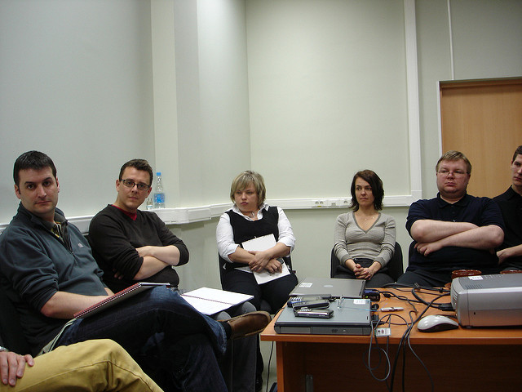
Group Communication
Group communication is communication among three or more people interacting to achieve a shared goal. You have likely worked in groups in high school and college, and if you’re like most students, you didn’t enjoy it. Even though it can be frustrating, group work in an academic setting provides useful experience and preparation for group work in professional settings. Organizations have been moving toward more team-based work models, and whether we like it or not, groups are an integral part of people’s lives.

Slide 8

Public Communication
Public communication is a sender-focused form of communication in which one person is typically responsible for conveying information to an audience. Public speaking is something that many people fear, or at least don’t enjoy. But, just like group communication, public speaking is an important part of our academic, professional, and civic lives. When compared to interpersonal and group communication, public communication is the most consistently intentional, formal, and goal-oriented form of communication we have discussed so far.

Slide 9

Mass Communication
Public communication becomes masss communication when it is transmitted to many people through print or electronic media. Print media such as newspapers and magazines continue to be an important channel for mass communication, although they have suffered much in the past decade due in part to the rise of electronic media. Television, websites, blogs, and social media are mass communication channels that you probably engage with regularly. Radio, podcasts, and books are other examples of mass media.

