Slide 1
Presentation on……
DBScan Algorithom and Outliers.

Slide 2
We are going to talking about…
DBScan Concepts
DBScan Parameters
DBScan Connectivity and Reachability
DBScan Algorithm , Flowchart and Example
Advantages and Disadvantages of DBScan
DBScan Complexity
Outliers related question and its solution.

Slide 3
Concepts: Preliminary
DBSCAN is a density-based algorithm
DBScan stands for Density-Based Spatial Clustering of Applications with Noise
Density-based Clustering locates regions of high density that are separated from one another by regions of low density
  Density = number of points within a specified radius (Eps)

Slide 4
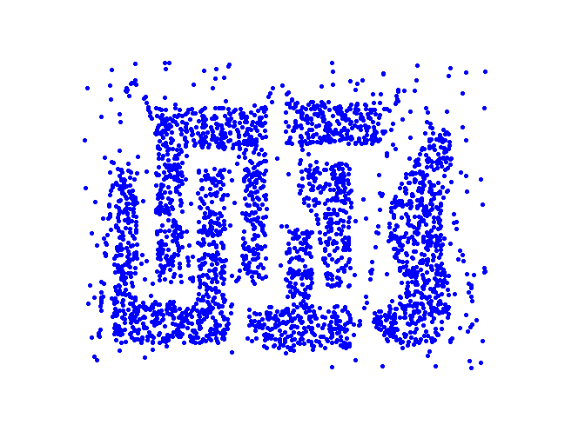
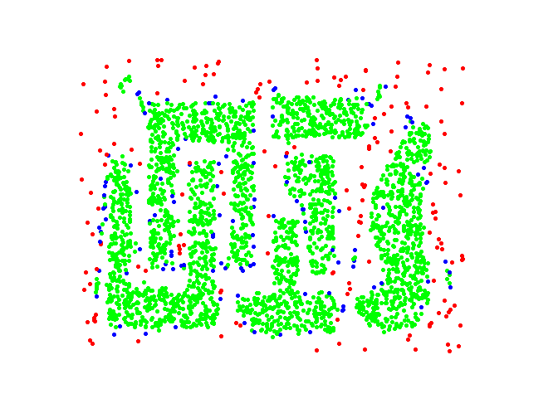
Concepts: Preliminary
Original Points
Point types: core, border and noise
Eps = 10, MinPts = 4

Slide 5
Concepts: Preliminary
  A point is a core point if it has more than a specified number of points (MinPts) within Eps
    These are points that are at the interior of a cluster
  A border point has fewer than MinPts within Eps, but is in the neighborhood of a core point
  A noise point is any point that is not a core point or a border point

Slide 6
Concepts: Preliminary
  Any two core points are close enough– within a distance Eps of one another – are put in the same cluster
  Any border point that is close enough to a core point is put in the same cluster as the core point
  Noise points are discarded

Slide 7
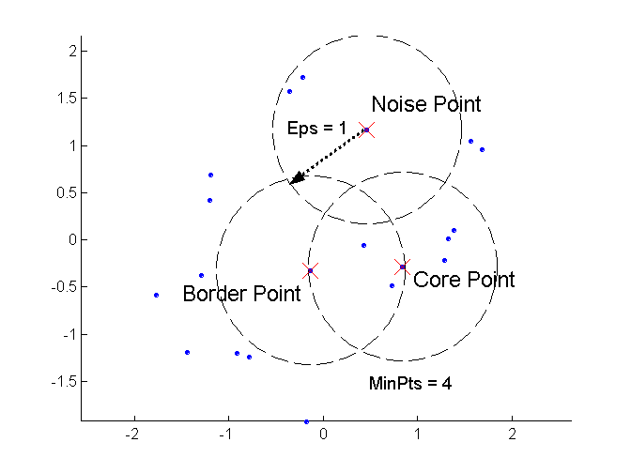
Concepts: Core, Border, Noise

Slide 8
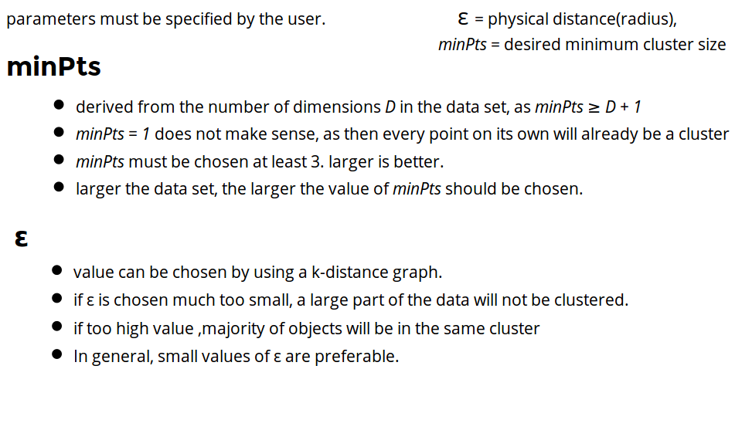
Parameter Estimation

Slide 9
Concepts: ε-Neighborhood
ε-Neighborhood - Objects within a radius of ε from an object. (epsilon-neighborhood)
Core objects - ε-Neighborhood of an object contains at least MinPts of objects
ε-Neighborhood of p
ε
ε
ε-Neighborhood of q
q
p
p is a core object (MinPts = 4)
q is not a core object

Slide 10
DBScan : Reachability
Directly density-reachable
  An object q is directly density-reachable from object p if q is within the ε-Neighborhood of p and p is a core object.
q is directly density-reachable from p
p is not directly density- reachable from q.
ε
ε
q
p

Slide 11
DBScan : Reachability
q
p

Slide 12
DBScan :Connectivity
Density-connectivity
  Object p is density-connected to object q w.r.t ε and MinPts if there is an object o such that both p and q are density-reachable from o w.r.t ε and MinPts
P and q are density-connected to each other by r
Density-connectivity is symmetric
q
r
p

Slide 13
Core, Border, Noise points representation
Original Points
Point types: core, border and noise
Eps = 10, MinPts = 4

Slide 14
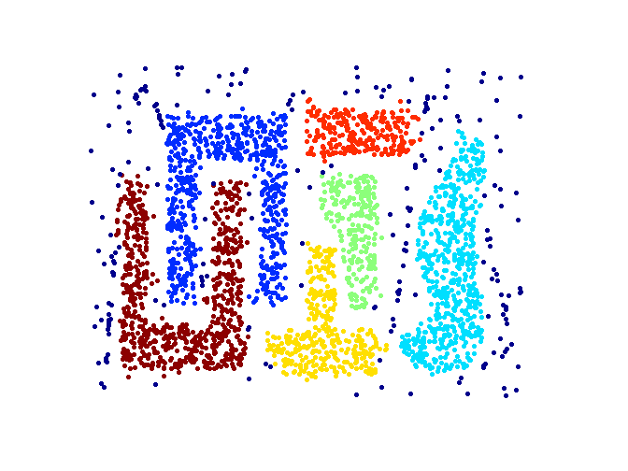
Clustering
Original Points
Clusters
Resistant to Noise
Can handle clusters of different shapes and sizes

Slide 15
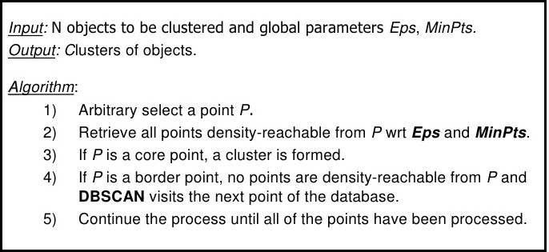
DBScan Algorithm

Slide 16
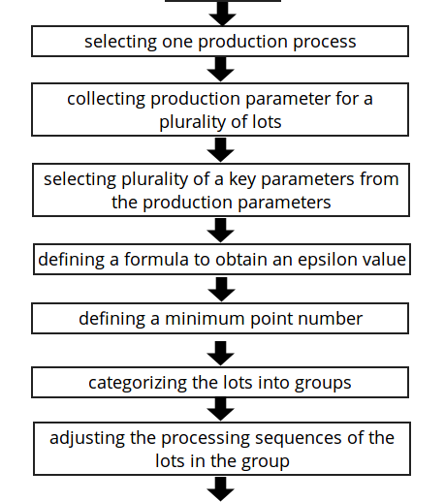
DBScan :Flowchart
Start
End

Slide 17
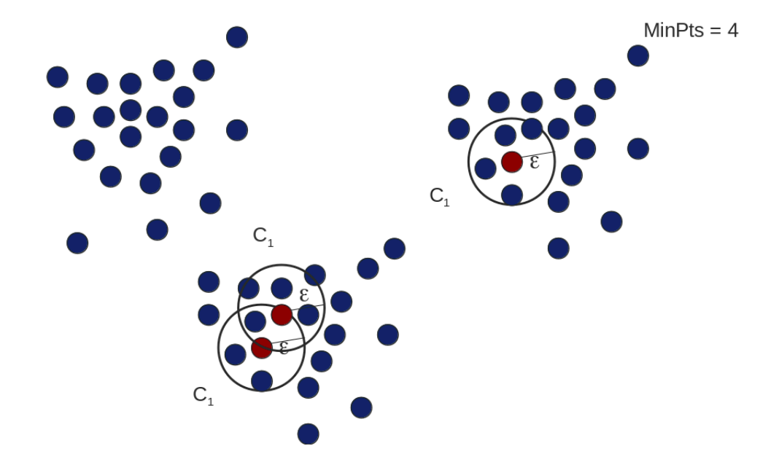
DBScan : Example

Slide 18
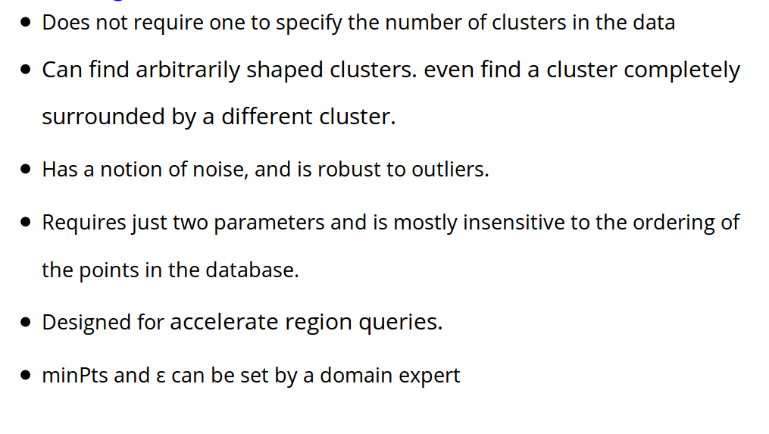
DBSCAN : Advantages

Slide 19
DBSCAN : Disadvantages
DBSCAN is not entirely deterministic: Border points that are reachable from more than one cluster can be part of either cluster, depending on the order the data is processed.
The quality of DBSCAN depends on the distance measure used in the function regionQuery. (such as Euclidean distance)
If the data and scale are not well understood, choosing a meaningful distance threshold ε can be difficult.

Slide 20
DBSCAN : Complexity
Time Complexity: O(n²)
for each point it has to be determined if it is a core point.
can be reduced to O(n*log(n)) in lower dimensional spaces by using efficient data structures (n is the number of objects to be clustered);
Space Complexity: O(n).

Slide 21
Summary of DBSCAN
Good:
can detect arbitrary shapes,
not very sensitive to noise,
supports outlier detection,
complexity is kind of okay,
beside K-means the second most used clustering algorithm.

Slide 22
Summary of DBSCAN
Bad:
does not work well in high-dimensional datasets,
parameter selection is tricky,
has problems of identifying clusters of varying densities (→SSN algorithm),
density estimation is kind of simplistic (→does not create a real density function, but rather a graph of density-connected points)

Slide 23
Question: what is Outliers? Outliers are often discarded as noise but some applications these noisy data can be more interesting than the more regularly occurring ones. why ?

Slide 24
Solution :
The points marked as outliers aren't discarded as such, they are just points not in any cluster. You can still inspect the set of non-clustered points and try to interpret them.
DBSCAN is designed to give clusters without any knowledge of how many clusters there are or what shape they are. It does this by iteratively expanding clusters from starting points in sufficiently dense regions. Outliers are just the points that are in sparsley populated regions (as defined by the eps and minPoints parameters).

Slide 25
In practice, it takes some care to choose parameters that won't include those outliers. If they are included in clusters they often act as a bridge between clusters and cause them to merge together into an analytically useless blob.

Slide 26
Thank You

Slide 27
References
# https://en.wikipedia.org/wiki/DBSCAN
#http://www3.cs.stonybrook.edu/~mueller/teaching/cse590_dataScience/DBSCAN
#http://www3.cs.stonybrook.edu/~mueller/teaching/cse590_dataScience/DBSCAN

