Slide 1
4
Completing the Accounting Cycle
Learning Objectives
1
Prepare a worksheet.
2
Prepare closing entries and a post-closing trial balance.
Explain the steps in the accounting cycle and how to prepare correcting entries.
3
4
Identify the sections of a classified balance sheet.

Slide 2
LEARNING
OBJECTIVE
Prepare a worksheet.
1
Worksheet
  Multiple-column form used in preparing financial statements.
  Not a permanent accounting record.
  May be a computerized worksheet using an electronic spreadsheet program such as Excel.
  Prepared using a five step process.
  Use of worksheet is optional.
LO 1

Slide 3
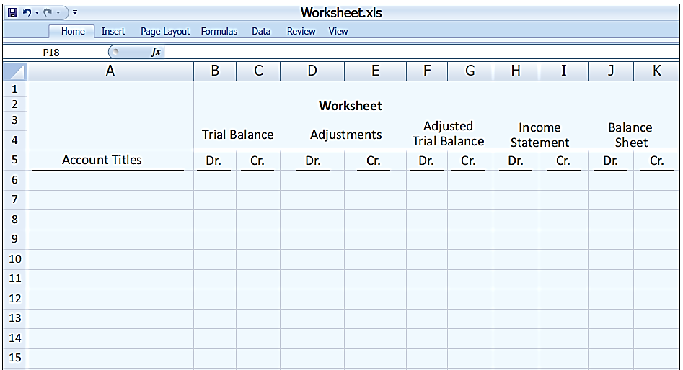
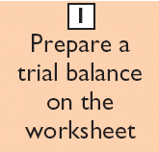
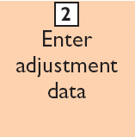
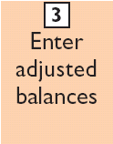
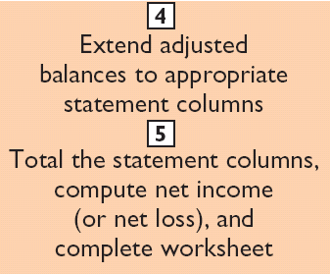
Steps in Preparing a Worksheet
Illustration 4-1

Slide 4
Steps in Preparing a Worksheet
Illustration 4-2
STEP 1: PREPARE A TRIAL BALANCE ON THE WORKSHEET
Trial balance amounts come directly from ledger accounts.
Include all accounts with balances.
LO 1

Slide 5
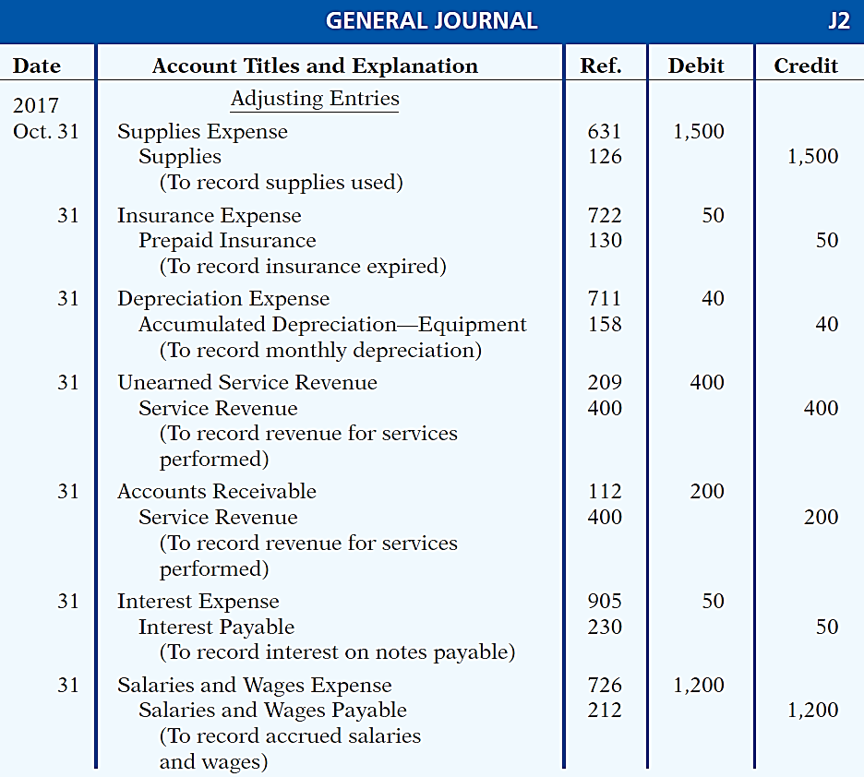
Steps in Preparing a Worksheet
Illustration 3-23
General journal showing adjusting entries
Adjusting Journal Entries
(Chapter 3)
LO 1

Slide 6
Steps in Preparing a Worksheet
Illustration 4-3
STEP 2: ENTER THE ADJUSTMENTS IN THE ADJUSTMENTS COLUMNS
(a)
(b)
Adjustments Key:
(a) Supplies Used.
(b) Insurance Expired.
(c) Depreciation Expensed.
(d) Service Revenue Recognized.
(e) Service Revenue Accrued.
(f) Interest Accrued.
(g) Salaries Accrued.
(d)
(d)
(e)
(g)
(a)
(b)
(c)
(c)
(e)
Enter adjustment amounts, total adjustments columns,
and check for equality.
(f)
(f)
(g)
Add additional accounts as needed.
LO 1

Slide 7
Steps in Preparing a Worksheet
Illustration 4-4
STEP 3: COMPLETE THE ADJUSTED TRIAL BALANCE COLUMNS
(a)
(b)
(d)
(d)
(e)
(g)
(a)
(b)
(c)
(c)
(e)
(f)
(f)
(g)
Total the adjusted trial balance columns and check for equality.
LO 1

Slide 8
Steps in Preparing a Worksheet
Illustration 4-5
STEP 4: EXTEND AMOUNTS TO FINANCIAL STATEMENT COLUMNS
(a)
(b)
(d)
(d)
(e)
(g)
(a)
(b)
(c)
(c)
(e)
(f)
(f)
(g)
Extend adjusted trial balance amounts to appropriate financial statement columns.
LO 1

Slide 9
Steps in Preparing a Worksheet
Illustration 4-6
STEP 5: TOTAL COLUMNS, COMPUTE NET INCOME (LOSS)
(a)
(b)
(d)
(d)
(e)
(g)
(a)
(b)
(c)
(c)
(e)
(f)
(f)
(g)
Compute Net Income or Net Loss.
LO 1

Slide 10
Steps in Preparing a Worksheet
Question
Net income is shown on a worksheet in the:
  income statement debit column only.
  balance sheet debit column only.
  income statement credit column and balance sheet debit column.
  income statement debit column and balance sheet credit column.
LO 1

Slide 11
Preparing Financial Statements from a Worksheet
  Income statement is prepared from the income statement columns.
  Balance sheet and owner’s equity statement are prepared from the balance sheet columns.
  Companies can prepare financial statements before they journalize and post adjusting entries.
LO 1

Slide 12

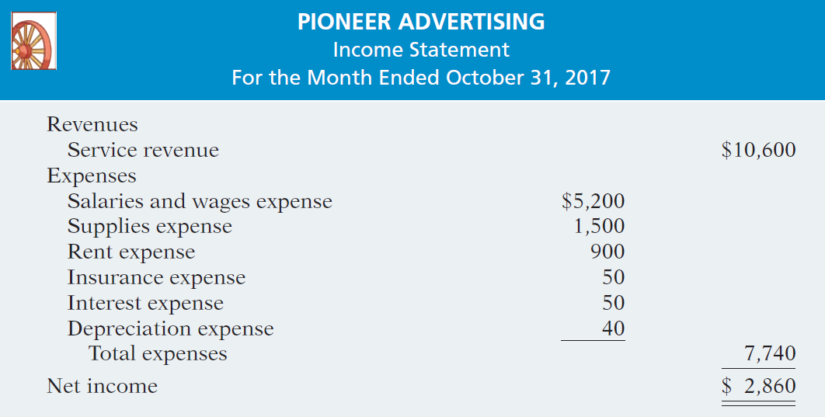
Preparing Statements from a Worksheet
Illustration 4-7
Financial statements from a worksheet
LO 1

Slide 13
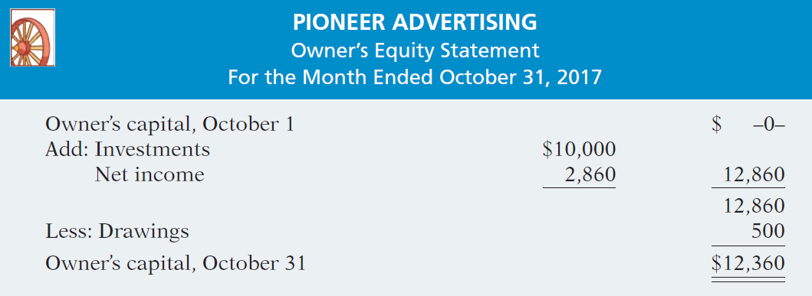

Preparing Statements from a Worksheet
Illustration 4-7
Financial statements from a worksheet
LO 1

Slide 14
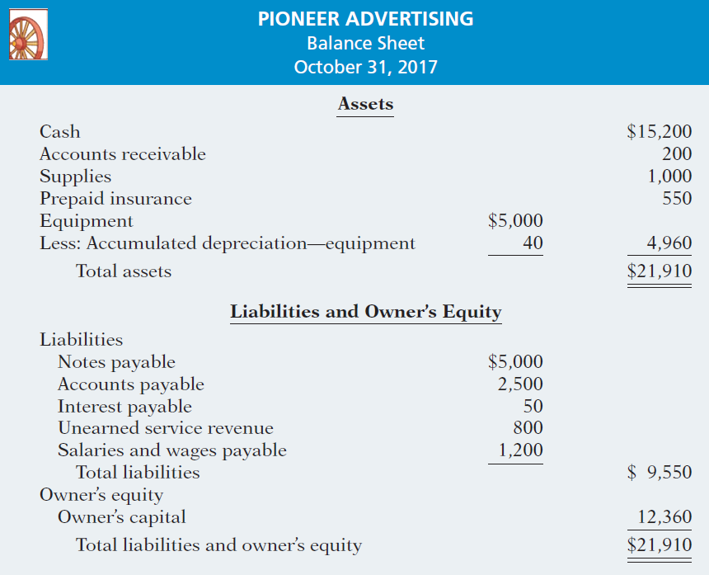
Illustration 4-7
LO 1

Slide 15
Preparing Adjusting Entries from a Worksheet
  Adjusting entries are prepared from the adjustments columns of the worksheet.
  Journalizing and posting of adjusting entries follows the preparation of financial statements when a worksheet is used.
LO 1

Slide 16
DO IT!
1
Worksheet
Susan Elbe is preparing a worksheet. Explain to Susan how she should extend the following adjusted trial balance accounts to the financial statement columns of the worksheet.
Cash
Balance sheet (debit column)
Accumulated Depreciation
Balance Sheet (credit column)
Accounts Payable
Balance Sheet (credit column)
Owner’s Drawings
Balance sheet (debit column)
Service Revenue
Income statement (credit column)
Salaries and Wages Expense
Income statement (debit column)
LO 1

Slide 17
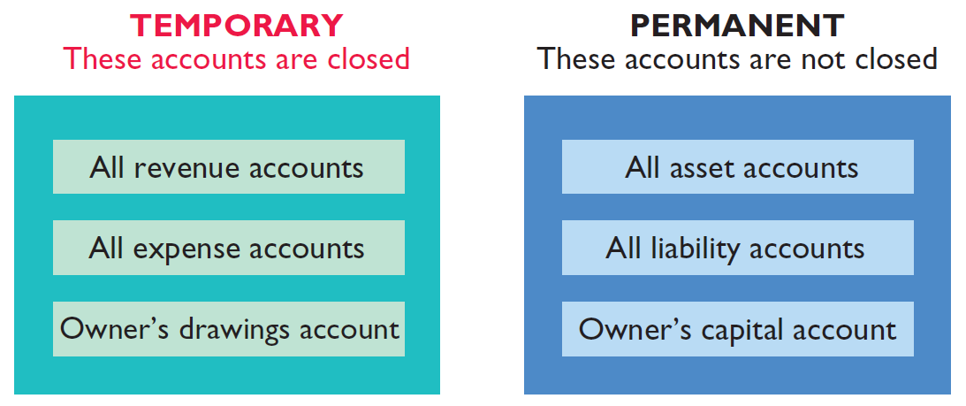
LEARNING
OBJECTIVE
Prepare closing entries and a post-closing trial balance.
2
At the end of the accounting period, the company makes the accounts ready for the next period.
Illustration 4-8
Temporary versus permanent accounts
LO 2

Slide 18
Preparing Closing Entries
Closing entries formally recognize in the ledger the transfer of
  net income (or net loss) and
  owner’s drawings
  to owner’s capital.
Companies generally journalize and post closing entries only at the end of the annual accounting period.
Closing entries produce a zero balance in each temporary account.
LO 2

Slide 19
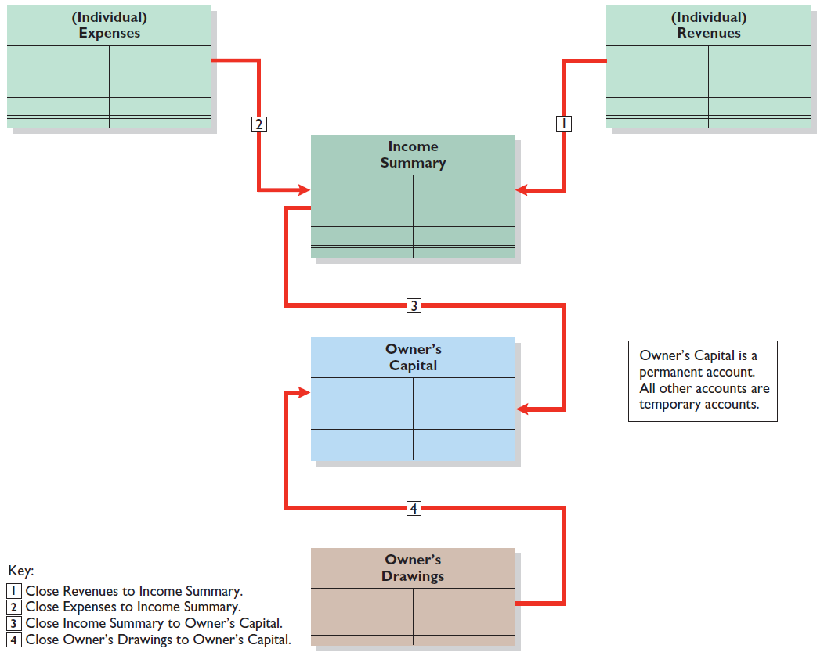
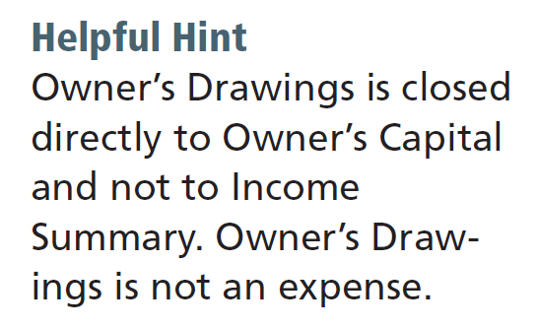
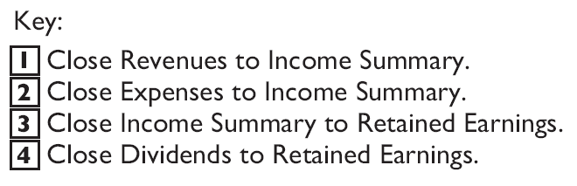
Preparing Closing Entries
Illustration 4-9
Diagram of closing process—proprietorship
Owner’s Capital is a permanent account. All other accounts are temporary accounts.
LO 2

Slide 20
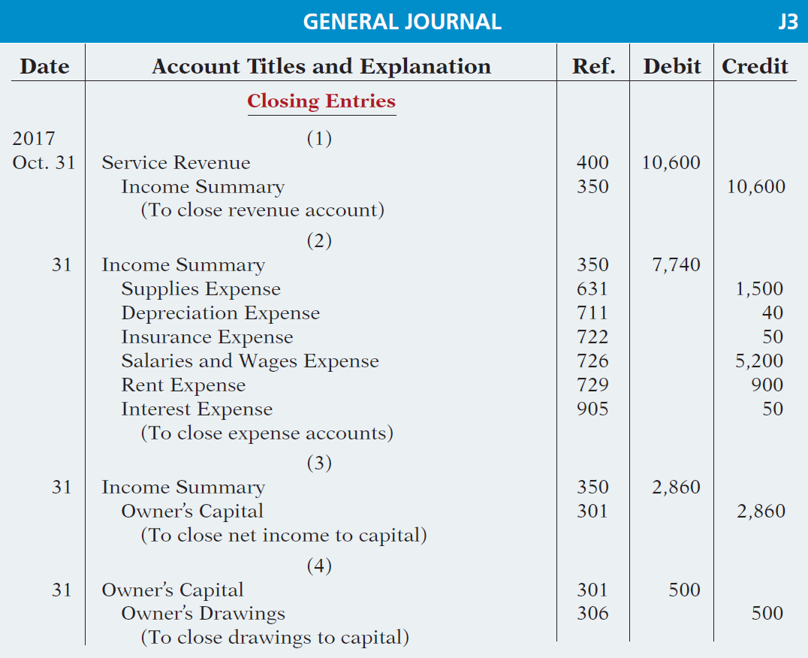
Preparing Closing Entries
CLOSING ENTRIES ILLUSTRATED
Illustration 4-10
Closing entries journalized

Slide 21
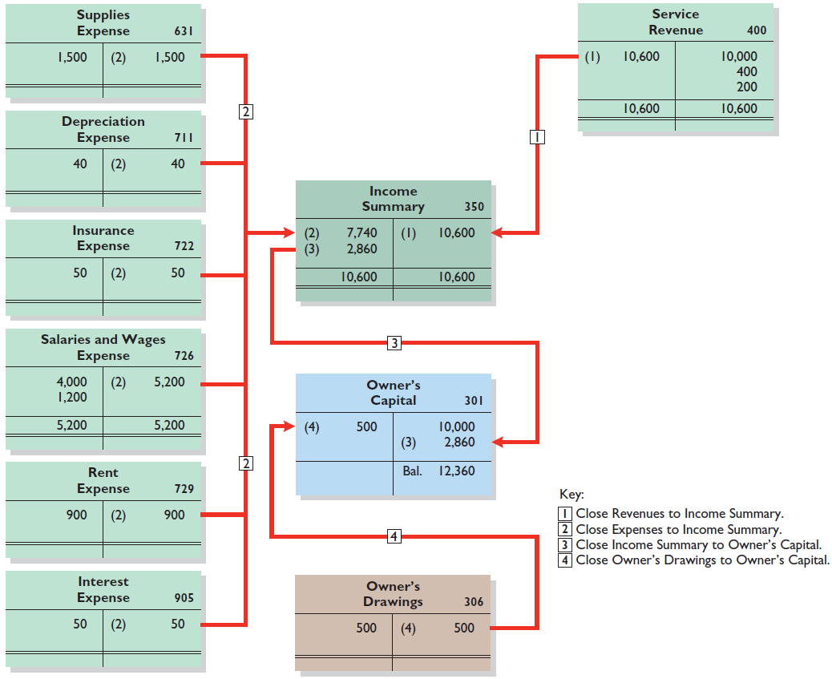
Posting Closing Entries
Illustration 4-11
LO 2

Slide 22
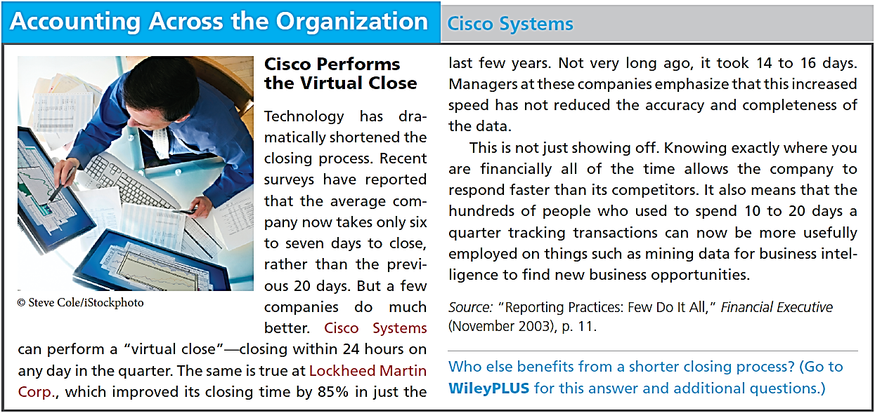
LO 2

Slide 23
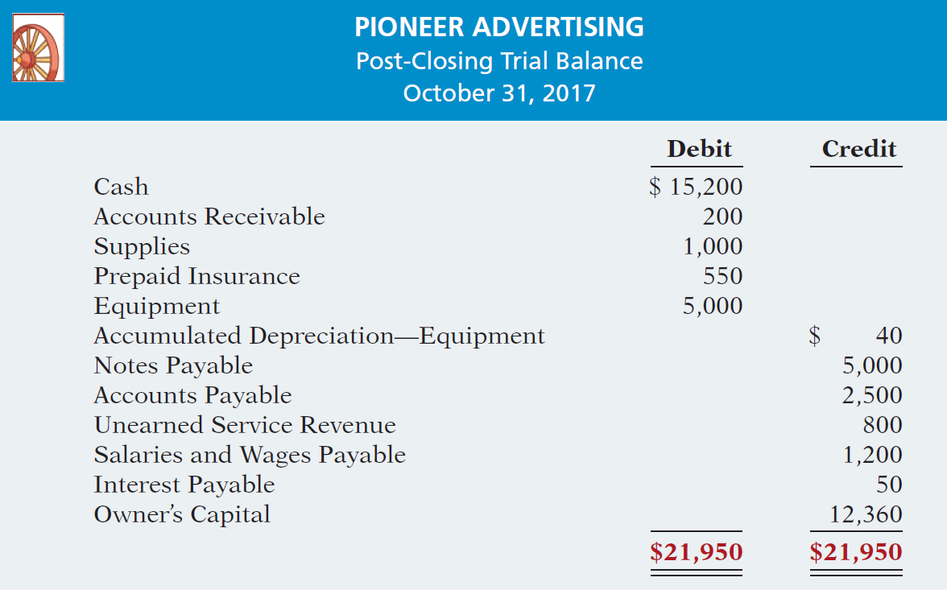
Preparing a Post-Closing Trial Balance
Purpose is to prove the equality of the permanent account balances carried forward into the next accounting period.
Illustration 4-12
Post-closing trial balance
LO 2

Slide 24
DO IT!
2
Closing Entries
The worksheet for Hancock Company shows the following in the financial statement columns:
Owner’s Drawings $15,000
Owner’s Capital $42,000
Net income $18,000
Prepare the closing entries at December 31 that affect owner’s capital.
Income Summary 18,000
Owner’s Capital 18,000
Owner’s Capital 15,000
Owner’s Drawings 15,000
LO 2

Slide 25
LEARNING
OBJECTIVE
Explain the steps in the accounting cycle and how to prepare correcting entries.
3
Illustration 4-15
1. Analyze business transactions
9. Prepare a post-closing trial balance
2. Journalize the transactions
8. Journalize and post closing entries
3. Post to ledger accounts
7. Prepare financial statements
4. Prepare a trial balance
6. Prepare an adjusted trial balance
5. Journalize and post adjusting entries
LO 3

Slide 26
Correcting Entries—An Avoidable Step
  Unnecessary if accounting records are free of errors.
  Made whenever an error is discovered.
  Must be posted before closing entries.
Instead of preparing a correcting entry, it is possible to reverse the incorrect entry and then prepare the correct entry.
LO 3

Slide 27
Correcting Entries—An Avoidable Step
CASE 1: On May 10, Mercato Co. journalized and posted a $50 cash collection on account from a customer as a debit to Cash $50 and a credit to Service Revenue $50. The company discovered the error on May 20, when the customer paid the remaining balance in full.
Incorrect entry
Cash 50
Service Revenue 50
Correct entry
Cash 50
Accounts Receivable 50
Correcting entry
Service Revenue 50
Accounts Receivable 50
LO 3

Slide 28
Correcting Entries—An Avoidable Step
CASE 2: On May 18, Mercato purchased on account equipment costing $450. The transaction was journalized and posted as a debit to Equipment $45 and a credit to Accounts Payable $45. The error was discovered on June 3.
Incorrect entry
Equipment 45
Accounts Payable 45
Correct entry
Equipment 450
Accounts Payable 450
Correcting entry
Equipment 405
Accounts Payable 405
LO 3

Slide 29
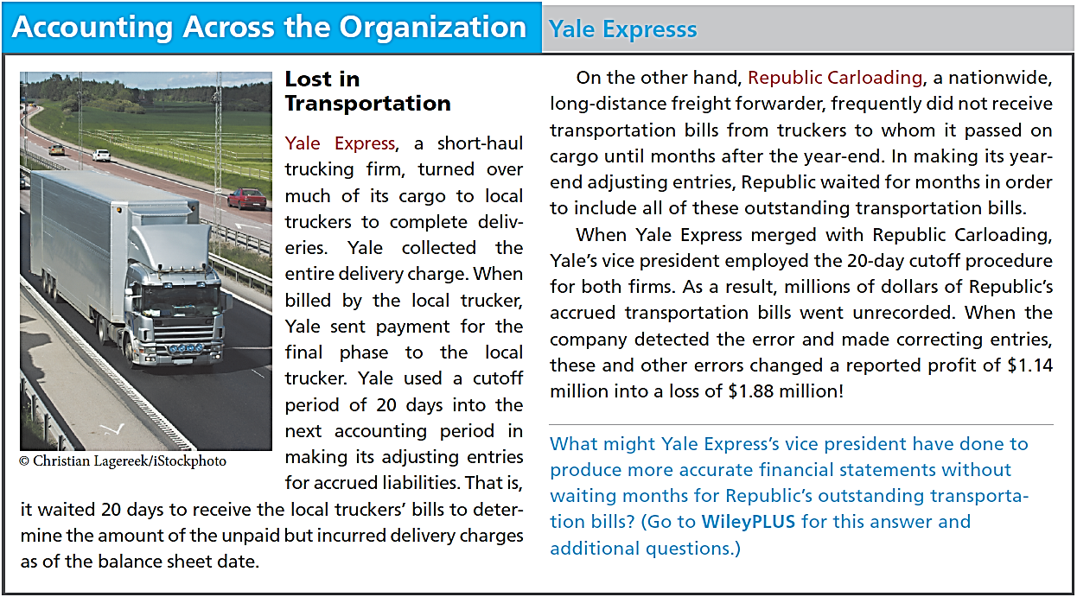
LO 3

Slide 30
DO IT!
3
Correcting Entries
Sanchez Company discovered the following errors made in January 2017 .
A payment of Salaries and Wages Expense of $600 was debited to Supplies and credited to Cash, both for $600.
A collection of $3,000 from a client on account was debited to Cash $200 and credited to Service Revenue $200.
The purchase of supplies on account for $860 was debited to Supplies $680 and credited to Accounts Payable $680.
Correct the errors without reversing the incorrect entry.
LO 3

Slide 31
DO IT!
3
Correcting Entries
Sanchez Company discovered the following errors made in January 2017 .
A payment of Salaries and Wages Expense of $600 was debited to Supplies and credited to Cash, both for $600.
Correct the error without reversing the incorrect entry.
Salaries and Wages Expense 600
Supplies 600
LO 3

Slide 32
DO IT!
3
Correcting Entries
Sanchez Company discovered the following errors made in January 2017 .
A collection of $3,000 from a client on account was debited to Cash $200 and credited to Service Revenue $200.
Correct the error without reversing the incorrect entry.
Service Revenue 200
Cash 2,800
Accounts Receivable 3,000
LO 3

Slide 33
DO IT!
3
Correcting Entries
Sanchez Company discovered the following errors made in January 2017 .
The purchase of supplies on account for $860 was debited to Supplies $680 and credited to Accounts Payable $680.
Correct the error without reversing the incorrect entry.
Supplies ($860 - $680) 180
Accounts Payable 180
LO 3

Slide 34
LEARNING
OBJECTIVE
Identify the sections of a classified balance sheet.
4
  Presents a snapshot at a point in time.
  To improve understanding, companies group similar assets and similar liabilities together.
Standard Classifications
Illustration 4-20
Assets Liabilities and Owner’s Equity
Current assets Current liabilities
Long-term investments Long-term liabilities
Property, plant, and equipment Owner’s (Stockholders’) equity
Intangible assets
LO 4

Slide 35
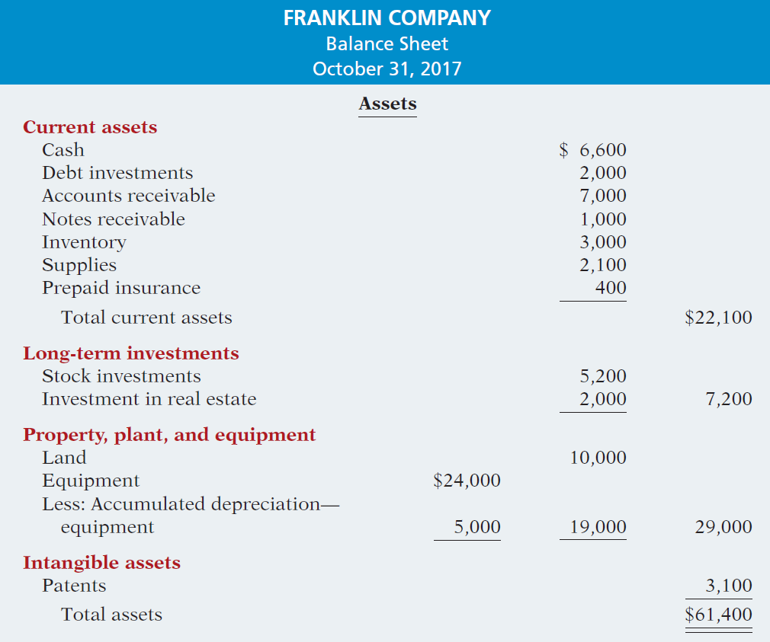
The Classified Balance Sheet
Illustration 4-21
LO 4

Slide 36
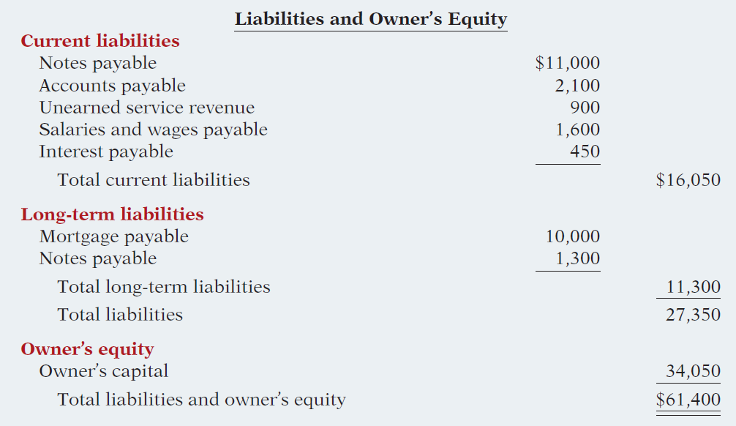
The Classified Balance Sheet
Illustration 4-21
LO 4

Slide 37
Current Assets
  Assets that a company expects to convert to cash or use up within one year or the operating cycle, whichever is longer.
  Operating cycle is the average time that it takes to purchase inventory, sell it on account, and then collect cash from customers.
LO 4

Slide 38
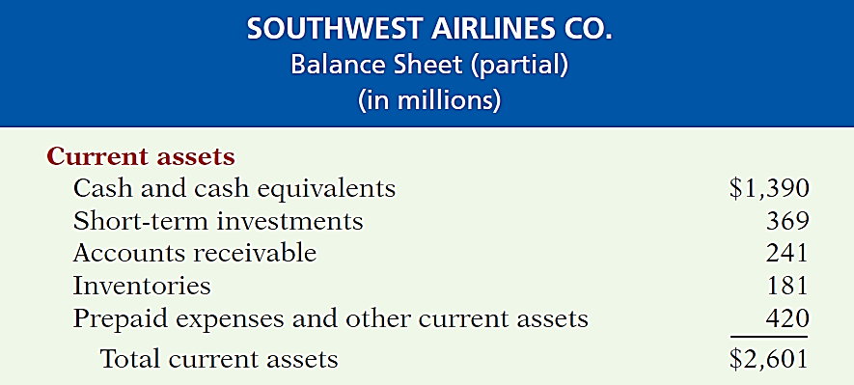

Current Assets
Illustration 4-22
  Usually listed in the order they expect to convert them into cash.
LO 4

Slide 39
Current Assets
Question
The correct order of presentation in a classified balance sheet for the following current assets is:
  accounts receivable, cash, prepaid insurance, inventory.
  cash, inventory, accounts receivable, prepaid insurance.
  cash, accounts receivable, inventory, prepaid insurance.
  inventory, cash, accounts receivable, prepaid insurance.
LO 4

Slide 40
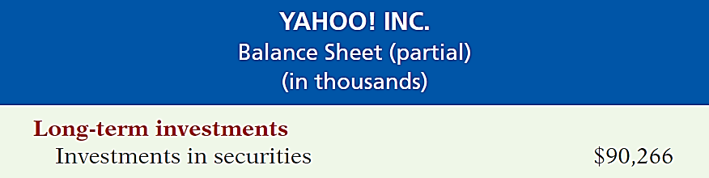
Long-Term Investments
  Investments in stocks and bonds of other companies.
  Investments in long-term assets such as land or buildings that is not currently being used in operating activities.
  Long-term notes receivable.
Illustration 4-23
LO 4

Slide 41
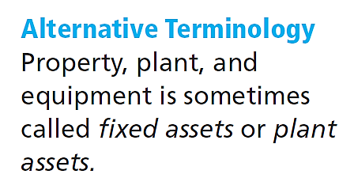
Property, Plant, and Equipment
  Long useful lives.
  Currently used in operations.
  Depreciation - allocating the cost of assets to a number of years.
  Accumulated depreciation - total amount of depreciation expensed thus far in the asset’s life.
LO 4

Slide 42
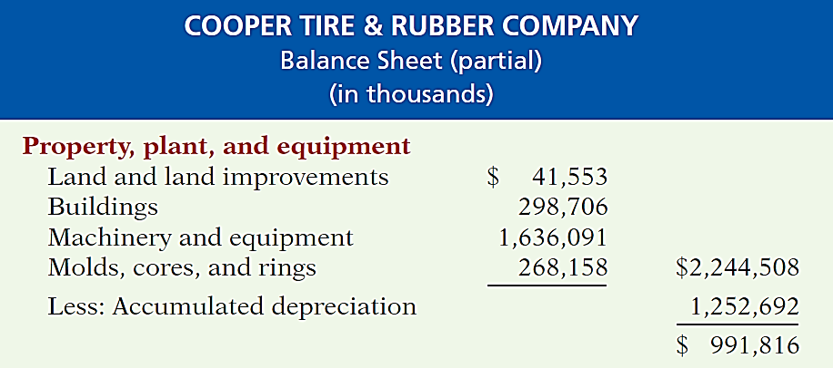

Property, Plant, and Equipment
Illustration 4-24
LO 4

Slide 43
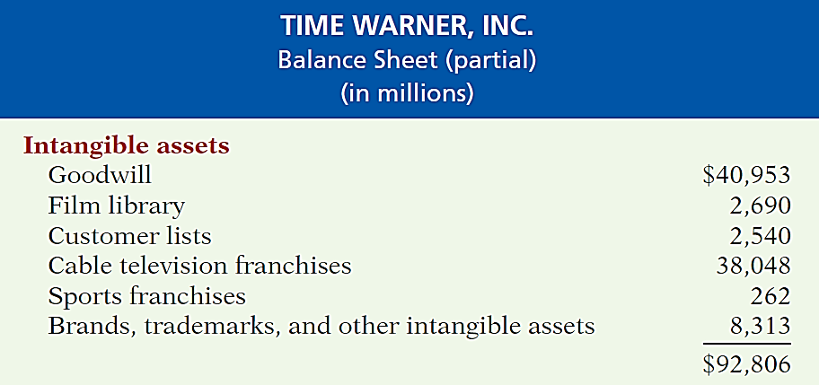
Intangible Assets
  Long-lived assets that do not have physical substance.
Illustration 4-25
LO 4

Slide 44
The Classified Balance Sheet
Question
Patents and copyrights are
  Current assets.
  Intangible assets.
  Long-term investments.
  Property, plant, and equipment.
LO 4

Slide 45
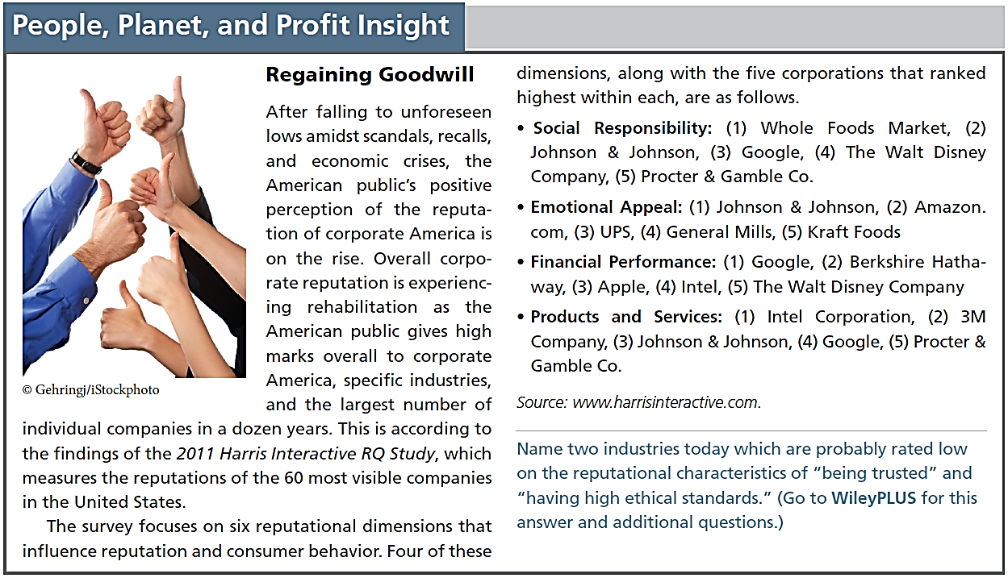
LO 4

Slide 46
Current Liabilities
  Obligations the company is to pay within the coming year or its operating cycle, whichever is longer.
  Usually list notes payable first, followed by accounts payable. Other items follow in order of magnitude.
  Common examples are accounts payable, salaries and wages payable, notes payable, interest payable, income taxes payable current maturities of long-term obligations.
  Liquidity - ability to pay obligations expected to be due within the next year.
LO 4

Slide 47
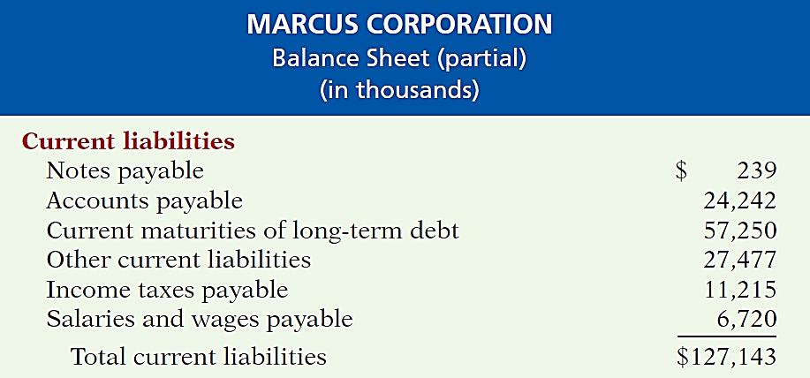
Current Liabilities
Illustration 4-26
LO 4

Slide 48
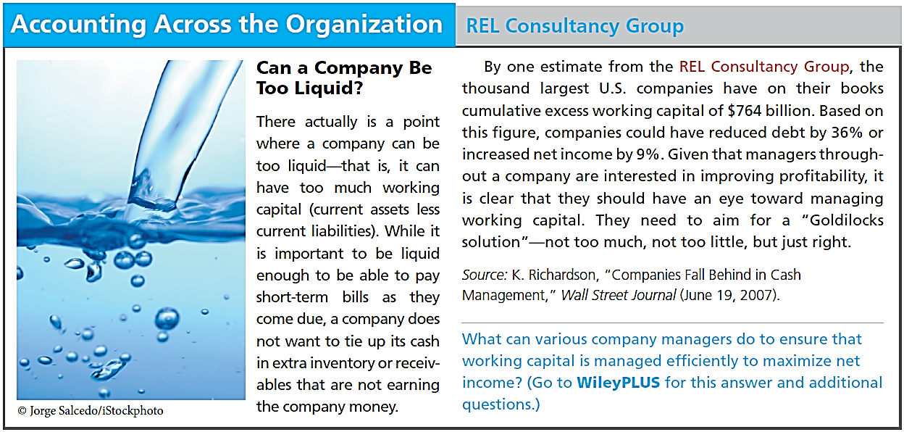
LO 4

Slide 49
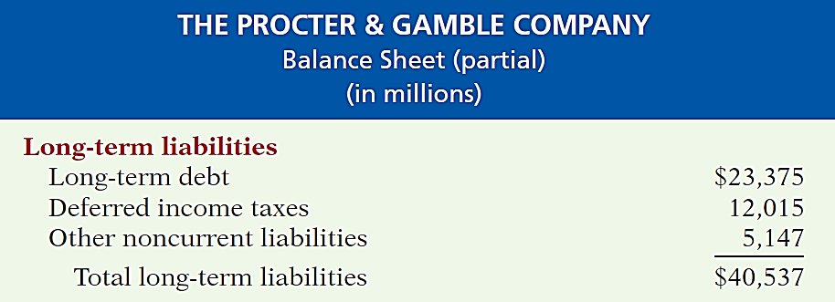
Long-Term Liabilities
  Obligations a company expects to pay after one year.
Illustration 4-27
LO 4

Slide 50
The Classified Balance Sheet
Question
Which of the following is not a long-term liability?
  Bonds payable
  Current maturities of long-term obligations
  Long-term notes payable
  Mortgages payable
LO 4

Slide 51
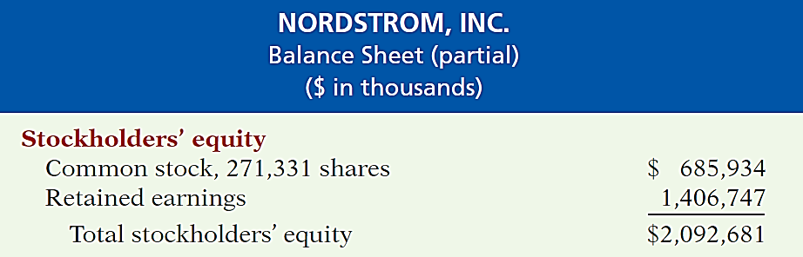
Owner’s Equity
  Proprietorship - one capital account.
  Partnership - capital account for each partner.
  Corporation - Common Stock and Retained Earnings.
Illustration 4-28
LO 4

Slide 52
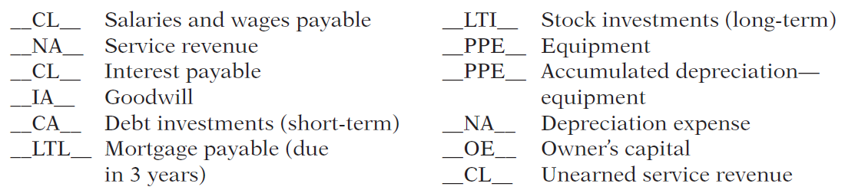
DO IT!
4
Balance Sheet Classifications
The following accounts were taken from the financial statements of Callahan Company.
Match each of the following accounts to its proper balance sheet classification, shown below. If the item would not appear on a balance sheet, use “NA.”
Current assets (CA) Current liabilities (CL)
Long-term investments (LTI) Long-term liabilities (LTL)
Property, plant, and equipment (PPE) Owner’s equity (OE)
Intangible assets (IA)
LO 4

Slide 53
LEARNING
OBJECTIVE
APPENDIX 4A: Prepare reversing entries.
5
Reversing Entries
  It is often helpful to reverse some of the adjusting entries before recording the regular transactions of the next period.
  Companies make a reversing entry at the beginning of the next accounting period.
  Each reversing entry is the exact opposite of the adjusting entry made in the previous period.
  The use of reversing entries does not change the amounts reported in the financial statements.
LO 5

Slide 54
Reversing Entries Example
Illustration: To illustrate the optional use of reversing entries for accrued expenses, we will use the salaries expense transactions for Pioneer Advertising.
  October 26 (initial salary entry): Pioneer pays $4,000 of salaries and wages earned between October 15 and October 26.
  October 31 (adjusting entry): Salaries and wages earned between October 29 and October 31 are $1,200. The company will pay these in the November 9 payroll.
  November 9 (subsequent salary entry): Salaries and wages paid are $4,000. Of this amount, $1,200 applied to accrued salaries and wages payable and $2,800 was earned between November 1 and November 9.
LO 5

Slide 55
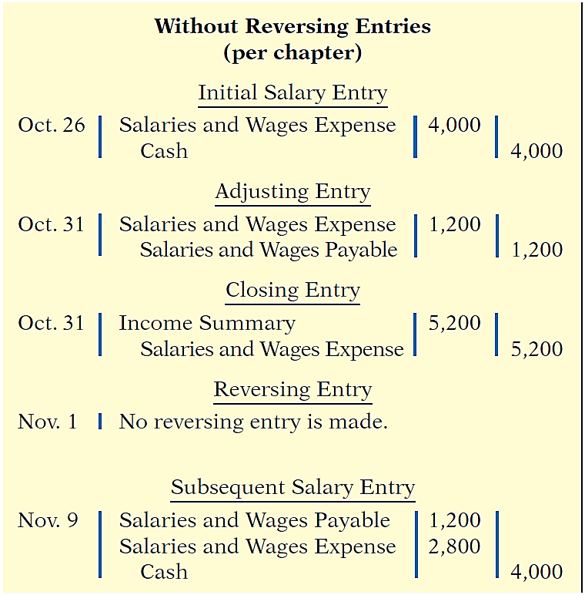
Reversing Entries Example
Illustration 4A-1
With Reversing Entries (per appendix)
Initial Salary Entry
Oct. 26 Same entry
Adjusting Entry
Oct. 31 Same entry
Closing Entry
Oct. 31 Same entry
Reversing Entry
Nov. 1
Salaries and Wages Payable 1,200
Salaries and Wages Expense 1,200
Subsequent Salary Entry
Nov. 9
Salaries and Wages Expense 4,000
Cash 4,000
LO 5

Slide 56
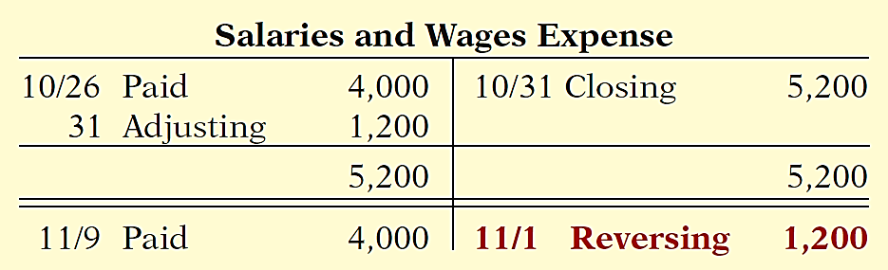
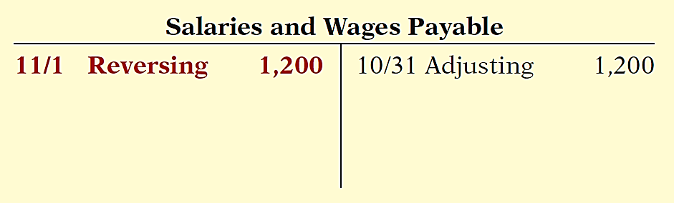
Reversing Entries Example
Illustration 4A-2 Postings with reversing
entries
LO 5

Slide 57

A Look at IFRS
LEARNING
OBJECTIVE
Compare the procedures for the closing process under GAAP and IFRS.
6
Key Points
  Similarities
  The procedures of the closing process are applicable to all companies, whether they are using IFRS or GAAP.
  IFRS generally requires a classified statement of financial position similar to the classified balance sheet under GAAP.
  IFRS follows the same guidelines as this textbook for distinguishing between current and noncurrent assets and liabilities.
LO 6

Slide 58
A Look at IFRS
Key Points
  Differences
  IFRS recommends but does not require the use of the title “statement of financial position” rather than balance sheet.
  The format of statement of financial position information is often presented differently under IFRS.
  Although no specific format is required, many companies that follow IFRS present statement of financial position information in this order:
    Non-current assets
    Current assets
    Equity
  Non-current liabilities
  Current liabilities
LO 6

Slide 59
A Look at IFRS
Key Points
  Differences
  Under IFRS, current assets are usually listed in the reverse order of liquidity. For example, under GAAP cash is listed first, but under IFRS it is listed last.
  Both GAAP and IFRS are increasing the use of fair value to report assets. However, at this point IFRS has adopted it more broadly. As examples, under IFRS, companies can apply fair value to property, plant, and equipment, and in some cases intangible assets.
LO 6

Slide 60
A Look at IFRS
Looking to the Future
The IASB and the FASB are working on a project to converge their standards related to financial statement presentation. A key feature of the proposed framework is that each of the statements will be organized in the same format, to separate an entity’s financing activities from its operating and investing activities and, further, to separate financing activities into transactions with owners and creditors. Thus, the same classifications used in the statement of financial position would also be used in the income statement and the statement of cash flows. The project has three phases. You can follow the joint financial presentation project at the following link: http://www.fasb.org/project/ financial_statement_presentation.shtml .
LO 6

Slide 61
A Look at IFRS
IFRS Self-Test Questions
  Companies that use IFRS:
  may report all their assets on the statement of financial position at fair value.
  may offset assets against liabilities and show net assets and net liabilities on their statements of financial position, rather than the underlying detailed line items.
  may report non-current assets before current assets on the statement of financial position.
  do not have any guidelines as to what should be reported on the statement of financial position.
LO 6

Slide 62
A Look at IFRS
IFRS Self-Test Questions
A company has purchased a tract of land and expects to build a production plant on the land in approximately 5 years. During the 5 years before construction, the land will be idle. Under IFRS, the land should be reported as:
  land expense.
  property, plant, and equipment.
  an intangible asset.
  a long-term investment.
LO 6

Slide 63
A Look at IFRS
IFRS Self-Test Questions
Current assets under IFRS are listed generally:
  by importance.
  in the reverse order of their expected conversion to cash.
  by longevity.
  alphabetically.
LO 6

Slide 64
Copyright
“Copyright © 2015 John Wiley & Sons, Inc. All rights reserved. Reproduction or translation of this work beyond that permitted in Section 117 of the 1976 United States Copyright Act without the express written permission of the copyright owner is unlawful. Request for further information should be addressed to the Permissions Department, John Wiley & Sons, Inc. The purchaser may make back-up copies for his/her own use only and not for distribution or resale. The Publisher assumes no responsibility for errors, omissions, or damages, caused by the use of these programs or from the use of the information contained herein.”

