Slide 1
Basic Television Broadcasting

Slide 2
Introduction
The composite video signal generated by camera and associate circuit and sound signal is processed in control room before transmission.
The two output one form picture signal transmitter and other from sound transmitter are combined.
The combined signal is fed into antenna network for transmission.
Discussion on television studio setup, picture signal transmission and FM, sound signal transmission.

Slide 4
Television Studio
The camera and microphone outputs are fed into control room by coaxial cable.
The control room has several monitors to view pictures.
A large number of such monitors are used to check the content quality of pictures.
Headphones are used to monitor and regulate sound output.
Live studio, VTR and telecine machine rooms are located close to control room.
The telecine machines together with slide scanner are installed next to control room.
All rooms are interconnected by coaxial cables and shielded wires.

Slide 5
Program Control Room (PCR)
All video and audio outputs are routed through a common control room known as PCR.
It is manned by program director, his assistant, a camera control unit engineer, a video mixer expert, a sound engineer and a lighting director.
The video and audio outputs from different sources are terminated on separate panels in PCR.
One panel contains the camera control unit and video mixer.
Another panel contains microphone controls and other equipments.

Slide 6
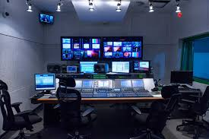

Slide 7
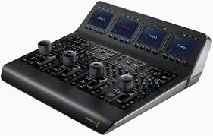
Camera Control Unit (CCU)
The CCU engineers manipulates various controls under directions from the producer.
CCU engineers has the necessary facilities to adjust parameters such as video gain, camera sensitivity, blanking level polarity etc.
For live broadcast, composite
Video signal is received over
Microwave link, demodulated and
Processed by the CCU engineer.

Slide 8
Video Switcher
A video switcher is a multicontact crossbar switch matrix with provision for selecting any one or more out of a large number of inputs and switching them on to outgoing circuit.

Slide 9
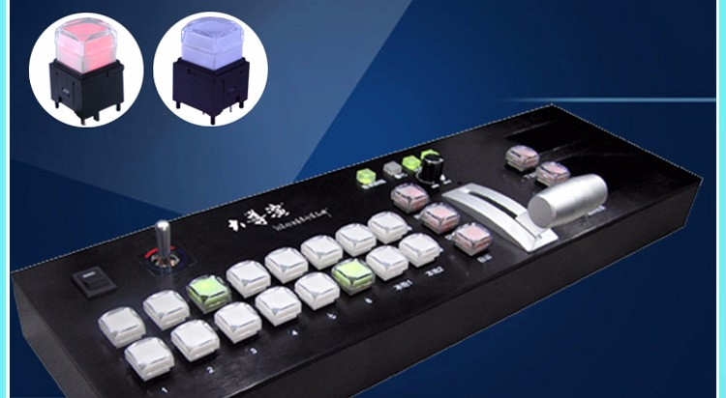
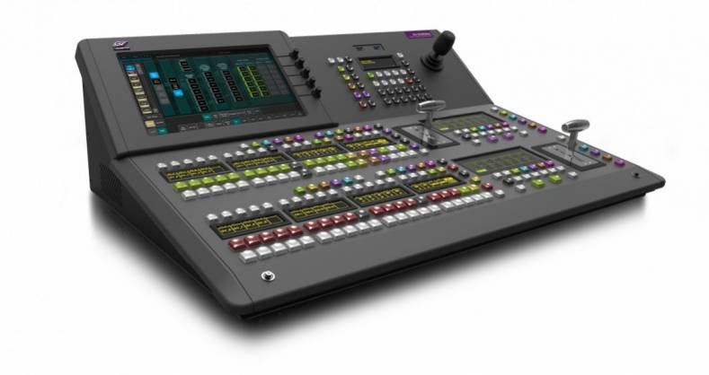
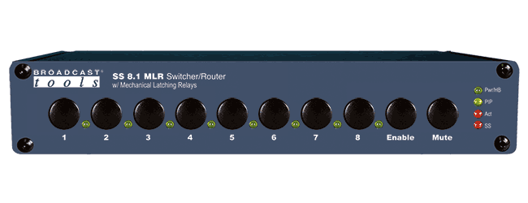
Types of Video Switcher
Types of Video Switcher
  Mechanical pushbutton switcher
  Relay switcher
  Electronic Switcher

Slide 10
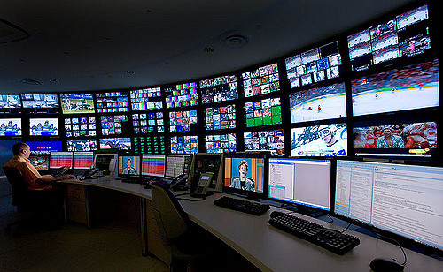
Master Control Room (MCR)
In small broadcasting houses the PCR has a master switcher for routing the composite video signal directly to the transmitter.
In the master control room the composite video signal is raised to about one volt P-P level before feeding it to the cable that connects the control room to the transmitter.

Slide 11
Television Transmitter
A simplified functional block diagram of a television transmitter is shown in figure.
Necessary details of video signal modulation with picture carrier of allotted channel are shown in picture transmitter.
Both the modulator and power amplifier sections of the transmitter employ specially designed VHF triodes for VHF channels and klystrons in transmitters that operate in UHF channels.

Slide 12
Television Transmitter

Slide 13
Television Transmitter
Vestigial Sideband Filter:
  The modulated output is fed to a filter designed to filter out part of the lower sideband frequencies.
Antenna:
  The filter output feeds into a combining network where the output from the FM sound transmitter is added to it.
  A coaxial cable connects the combined output to the antenna system mounted on a high tower situated close to the transmitter.
  The antenna is mounted horizontally for better signal to noise ratio.

Slide 14
Sound Signal Transmission
The outputs of all the microphones are terminated in sockets on the sound panel in the production control room.
The audio signal is accorded enough amplification before feeding it to switchers and mixers for selecting and mixing outputs from different microphones.
The sound engineer in the control room does so in consultation with the programme director.
Frequency modulation, that is capable of providing almost noise free and high fidelity output needs a wider swing in frequency on either side of the carrier.

Slide 15
MERITS OF FREQUENCY MODULATION
Noise Reduction
Transmitter Efficiency
Adjacent Channel Interference
Co-channel Interference

