Slide 1
Introduction to Microbiology Aklima Akter Lecturer Department of Pharmacy Daffodil International University

Slide 2
What is microbiology?
The study of living organisms of microscopic size, which include bacteria, fungi, algae, protozoa, and the infectious agents at the borderline of life that are called viruses.

Slide 3
Subject Areas of Microbiology
Form, structure, reproduction, physiology, metabolism and classification of microorganism
Distribution in nature
Relationship to each other and to other living organisms
Their effects on human beings, plants and other animals
Their abilities to make physical and chemical changes
Reactions to physical and chemical agents

Slide 4
Common characteristics of biological system
Ability to reproduce
Ability to ingest or assimilate food substances and metabolize them for energy and growth.
Ability to excrete waste products
Ability to react with environmental changes

Slide 5
Flora and Fauna on earth
Mammal | 5500
Birds | 10000
Amphibians | 7000
Fishes | 40000
Insects | 1000000
Spider and scorpion | 100000
Plant | 400000

Slide 6
Virus: Living or nonliving?
They are in between i.e. bridge between gap of living and nonliving worlds.
The central dogma of molecular biology encompasses replication of DNA, formation of mRNA by transcription and synthesis of protein from that mRNA. Generally these processes are always occurring in living organism. Though viruses are made up of nucleic acid and proteins they don’t have other cellular machineries which include enzymes and proteins are absent in virus.
But viruses don’t have ribosome and hence they can not synthesize protein from mMRA.

Slide 7
Difference between prokaryotic and eukaryotic cell
Features | Prokaryotic | Eukaryotic
Groups where found as unit of structure | Bacteria | Algae, fungi, protozoa, plants, animals
Size range of organism | 1-2 by 1-4 µm or less | Greater than 5µm in width or diameter
Nuclear membrane | Absent | Present
Nucleolus | Absent | Present

Slide 8
Difference between prokaryotic and eukaryotic cell
Features | Prokaryotic | Eukaryotic
Chromosome | One circular chromosome Chromosome does not contain histones. | More than one chromosome Chromosomes have histones;
Cell division | Binary fission | Mitosis and meosis
Cellularity | Always unicellular | Both uni and multicellular
Reproduction | Always asexual | Sexual and asexual

Slide 9
Difference between prokaryotic and eukaryotic cell
Features | Prokaryotic | Eukaryotic
Ribosomes | Small 70S | Larger 80S
Cytoskeleton | Absent | Present
Pinocytosis | Absent | Present
Gas vacuoles | Can be present | Absent
Mesosome | Present | Absent
Mitochondria | Absent | Present
Chloroplasts | Absent | May be present
Golgi body | Absent | Present

Slide 10
Difference between prokaryotic and eukaryotic cell
Feature | Prokaryotes | Eukaryotes
Cell wall | Peptidoglycan present | Absent
Metabolic mechanisms | Wide variety, particularly that of anaerobic energy yielding reactions; some fix nitrogen gas etc. | Mainly common metabolic pathways
DNA base ratios as GC content | 28 to73% | About 40%

Slide 11
Major groups of organisms
Bacteria
Size: Typical 0.5-1.5 µM by 1.0-3.0 µM; range 0.2 by 100 µM.
Important features:
Prokaryotic
Unicellular, simple internal structure
Grow on artificial laboratory media
Reproduction asexual, characteristically by simple cell division

Slide 12
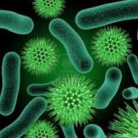
Practical significance:
Some cause diseases
Some perform natural cycling of elements which contributes to soil fertility
Useful in industry for manufacture of valuable compounds
Some spoil foods and some make foods

Slide 13
2. Fungi: Yeasts
Size: 5.0-10.0 µM
Important features:
Eukaryotic
Unicellular, with many distinctive structural features
Cultivated in laboratory much like bacteria
Reproduction by sexual or asexual cell division, budding, or sexual processes

Slide 14
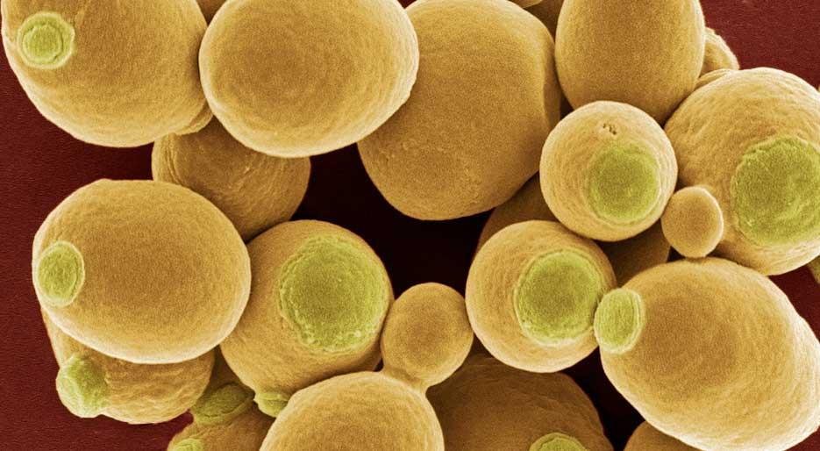
Practical significance:
Production of alcoholic beverages
Used as food supplement
Some cause diseases

Slide 15
3. Fungi: Molds
Size: 2.0-10.0 µM
Important features:
Eukaryotic
Multicellular, with many distinctive structural features
Cultivated in laboratory much like bacteria
Reproduction by asexual and sexual processes

Slide 16
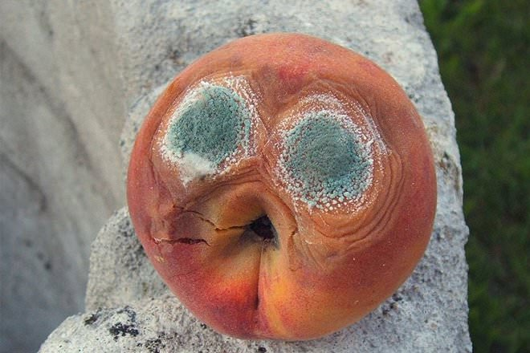
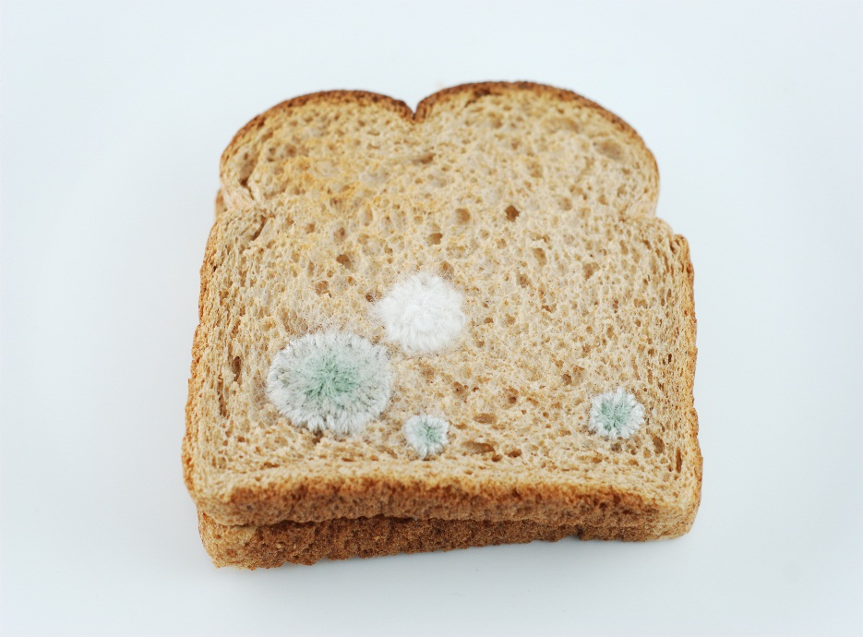
Practical significance:
Responsible for decomposition of many materials
Useful for industrial production of many chemicals e.g. penicillin
Cause diseases of humans, animals and plants

Slide 17
Difference between Yeasts and Molds
Factors | Mold | Yeast
Habitat | Typically found in damp, dark or steam-filled areas. | Very common. Can be found on fruit and berries, in the stomachs of mammals and on skin, among other places.
Reproduction | Reproduce through small spores, which can be either sexual or asexual. | Most reproduce asexually through mitosis. Most common form called “budding.”
Definition | Mold is a fungi that contains multiple identical nuclei. It grows in the form of hyphae of filaments. | A type of fungi that contains only a single cell.

Slide 18
Difference between Yeasts and Molds
Factors | Mold | Yeast
Appearance | Mold has a fuzzy appearance and can be an orange, green, black, brown, pink or purple in color. Can be found in several shapes. | White and thready. Usually oval in shape.
Uses | Some molds are used in food production, for example, Penicillium is used in the production of cheese, Neurospora in the production of oncom, which is made from the by-product of tofu. | Ethanol production, baking, vitamin supplements, study of cell cycle.

Slide 19
Difference between Yeasts and Molds
Factors | Mold | Yeast
Energy Production | Secrete hydrolytic enzymes that degrade biopolymers such as starch, cellulose and lignin into simpler substances that can be absorbed. | Convert carbohydrates to alcohol and carbon dioxide in anaerobic through fermentation. Also obtain carbon from hexose sugars.
Health Hazards | Can cause allergic reactions and respiratory problems | Can cause infection in individuals with compromised immune systems.
Species | 1000s of known species, including penicillium. | 1500 known species.

Slide 20
4. Protozoa
Size: 2.0-200 µM
Important features:
Eukaryotic
Unicellular
Cultivated in laboratory much like bacteria
Some are intracellular parasites
Reproduction by asexual and asexual processes
Practical significance:
Food or aquatic animals
Some cause diseases

Slide 21
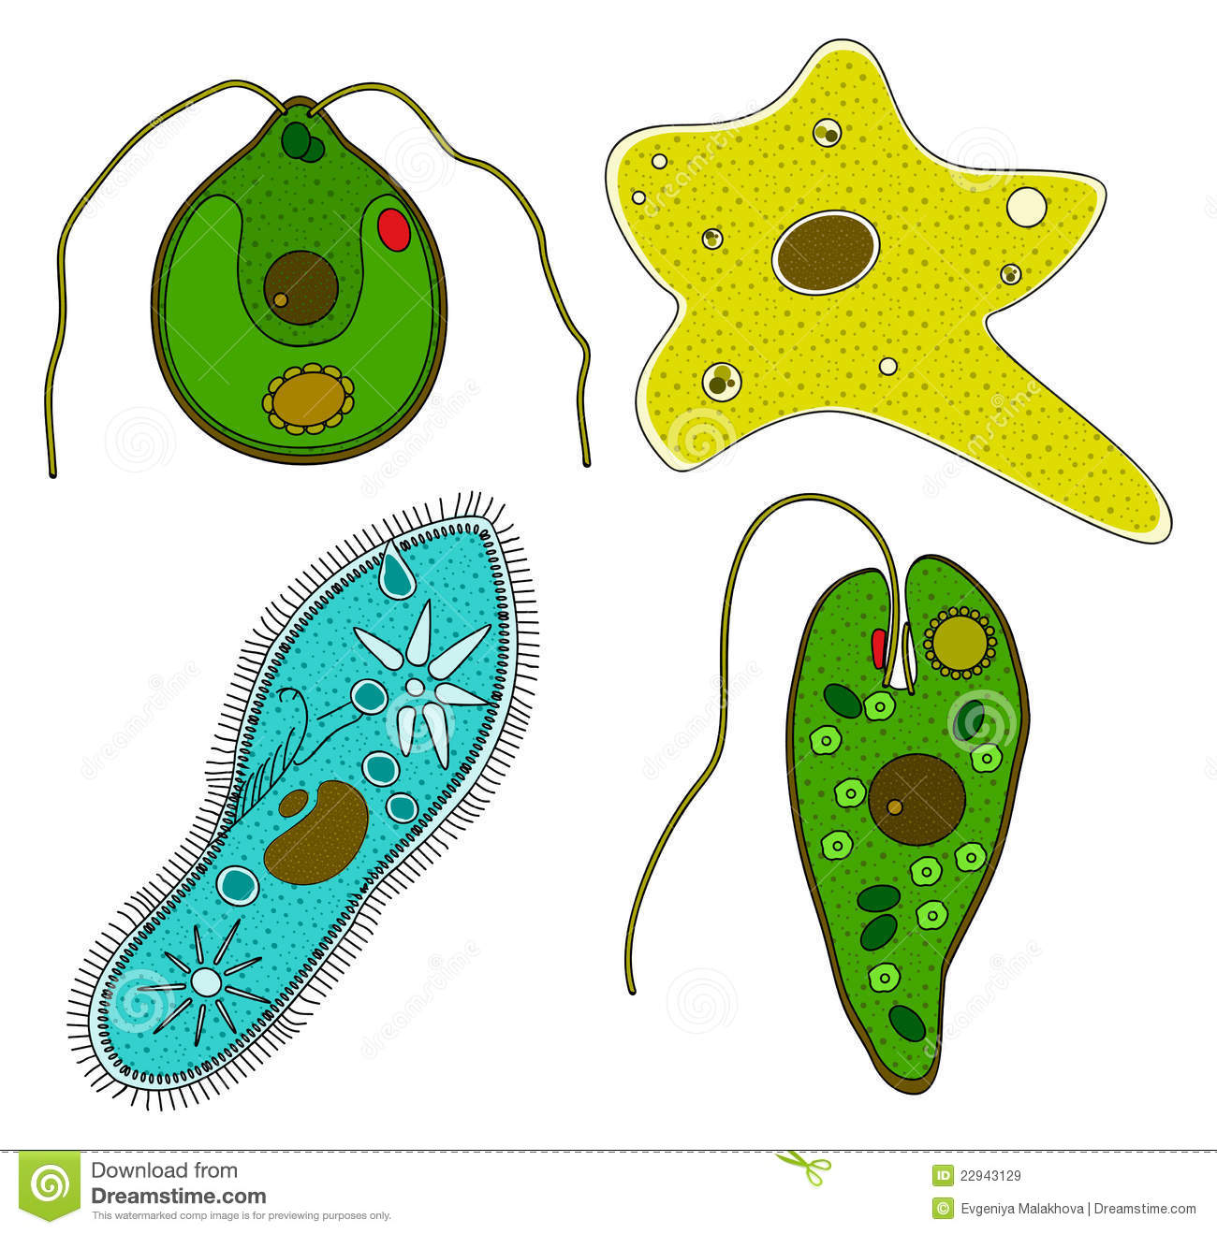

Slide 22
5. Algae
Size: 1.0 µM to many feet
Important features:
Eukaryotic
Multicellular and unicellular
Most occur in aquatic environment
Contain chlorophyll and are photosynthetic
Reproduction by asexual and sexual processes

Slide 23
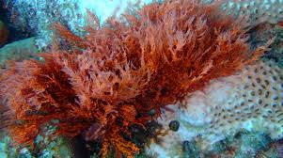
Practical significance:
Important to the production of food in aquatic environment
Some are edible and consumed by human
Used as food supplement and in pharmaceutical products
Source of agar for microbiological media
Some produce toxic products

Slide 24
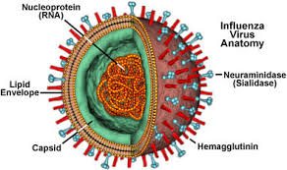
2. Viruses
Size: 0.015-0.2µM
Important features:
Do not grow on artificial media
Require living cells within which they are produced
All are obligate parasites
Electron microscope required to see viruses
Practical significance:
Cause diseases in humans and other animals and plants
Infect microorganisms

Slide 25
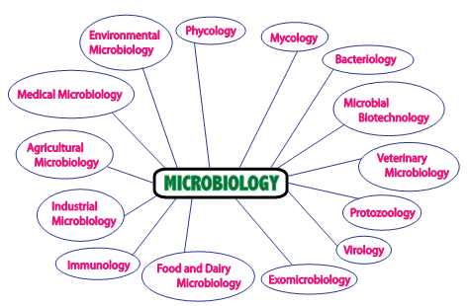
Major fields of applied microbiology

Slide 26
Major fields of applied microbiology
Field | Some applied areas
Medical microbiology | Causative agents of diseases; Diagnostic procedures; diagnostic procedures for identification of causative agents; preventive measures.
Aquatic microbiology | Water purification; microbiological examination; biological degradation of waste; ecology.
Aeromicrobiology | Contamination and spoilage; dissemination of diseases

Slide 27
Food microbiology | Food preservation and preparation; food borne diseases and their prevention
Agricultural microbiology | Soil fertility; plant and animal diseases
Industrial microbiology | Production of medical products such as antibiotics and vaccines; fermented beverages; industrial chemicals; production of proteins and hormones by genetically engineered miroorganisms
Exomicrobiology | Exploration for life in outer space
Geochemical microbiology | Coal, mineral and gas formation; prospecting for deposits of coal, oil, and gas; recovery of minerals from low grade ores

