Slide 1
Nutritional Requirement of Bacteria Carbon
Carbon is one of the most abundant element in living organism (plant, animal or microorganisms) and it is needed for all the organic compounds that make up a living cell
Half of the dry weight of a typical bacterial cell is carbon
Depending upon the source of carbon bacteria can be classified in to two categories:
Chemoheterotrophs get most of their carbon from the source of their energy- organic materials such as proteins, carbohydrates, and lipids
Chemoautotrophs and photoautotrophs derive their carbon from carbon dioxide. They can thrive in very harsh condition.

Slide 2
Oxygen Classification of bacteria based on oxygen requirement
Obligate aerobes: Must require oxygen for growth. Examples of obligatory aerobic bacteria include Mycobacterium tuberculosis.
Obligate anaerobes: Bacteria that are unable to use molecular oxygen for energy-yielding reactions. Examples of obligatory anaerobic bacterial genera include Actinomyces, Clostridium etc.
Facultative anaerobes: Can use oxygen when it is present but are able to continue growth by using fermentation or anaerobic respiration when oxygen is not available. Some examples of facultative anaerobic bacteria are Staphylococcus species, Streptococcus species, Escherichia coli etc.

Slide 3
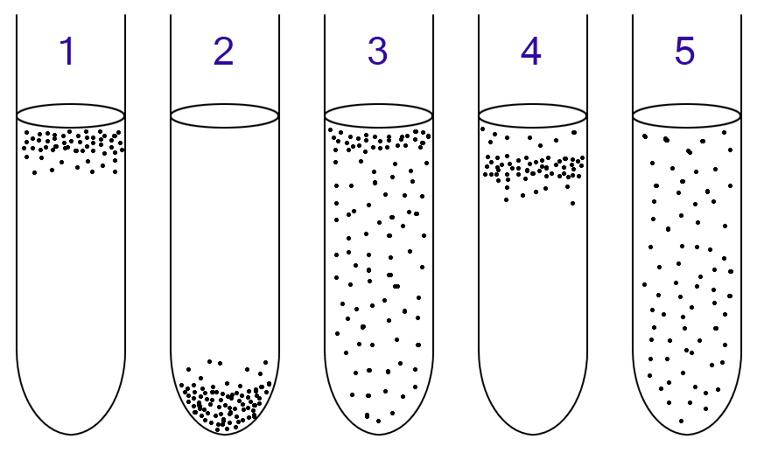
4. Microaerophiles: They require oxygen, however, they grow only in oxygen concentrations lower than those in air. Usually 2-10% oxygen content is better for them. Campylobacter species is the example of microaerophiles.
5. Aerotolerant anaerobes: Can’t use oxygen for growth, but they tolerate it fairly well. Trichinella spiralis (pork worm)

Slide 4
Nitrogen, Sulfur and Phosphorus
Nitrogen: It is necessary to synthesize proteins, nucleic acids etc
Decomposing protein-containing material and reincorporating the amino acids into newly synthesized proteins and other nitrogen-containing compounds
Nitrogen from ammonium ions, which are already in the reduced form and are usually found in organic cellular material
Photosynthesizing cyanobacteria use gaseous nitrogen directly from the atmosphere, a process called nitrogen fixation
Sulfur: It is used to synthesize sulfur-containing amino acids and vitamins such as thiamine and biotin. It is obtained from the sulfate ion, hydrogen sulfide, and the sulfur-containing amino acids.
Phosphorus: It is essential for the synthesis of nucleic acids, ATP, and the phospholipids of cell membranes. A source of phosphorus is the phosphate ion.

Slide 5
Minerals
Potassium, magnesium, and calcium are also elements that microorganisms require, often as cofactors for enzymes
Microbes require very small amounts of other mineral elements, called trace elements, such as iron, copper, molybdenum, and zinc
Organic growth factors
Essential organic compounds an organism is unable to synthesize
Vitamins, amino acids, purines, and pyrimidines

Slide 6
Culture media
Culture medium: A nutrient containing material prepared for the growth of microorganisms in a laboratory is called a culture medium.
Inoculum: Microbe that is introduced into a culture medium to initiate growth is called an inoculum
Culture: The microbes that grow and multiply in or on a culture medium are referred to as a culture
Inoculation: In microbiology inoculation is the process of introducing microorganism into the culture.

Slide 7
Selection criteria
It must contain the right nutrients for the specific microorganism the microbiologist want to grow
It should also contain sufficient moisture, a properly adjusted pH and a suitable level of oxygen
The medium must initially be sterile e.g. it must initially contain no living microorganisms- so that the culture will contain only the microbes we add to the medium
The culture should be in proper physical state: liquid or solid.
Finally, the growing culture should be incubated at the proper temperature humidity and gaseous requirement

Slide 8
Different types of media
Complex media: These are made up of nutrients including extracts from yeasts, meat or plants or digests of proteins from these and other sources. The energy, carbon, nitrogen, and sulfur requirements of the growing microorganisms are provided primarily by protein. Vitamins and other organic growth factors are provided by meat extracts or yeast extracts. If a complex medium is in liquid form, it is called nutrient broth. When agar is added, it is called nutrient agar.
Selective media: These are designed to suppress the growth of unwanted bacteria and encourage the growth of the desired microbes. For example, bismuth sulfite agar is one medium used to isolate the typhoid bacterium, the gram-negative Salmonella typhi from feces. Bismuth sulfite inhibits gram-positive bacteria and most gram-negative intestinal bacteria except S. typhi.

Slide 9
Differential media: These media make it easier to distinguish colonies of the desired organism from other colonies growing on the same plate. Blood agar is a medium that microbiologists often use to identify bacterial species that destroy red blood cells. These species, such as Streptococcus pyogenes causes strep throat, show a clear ring around their colonies where they have lysed the surrounding blood cells.
Chemically defined media: Are those whose exact chemical composition is known. For a chemoheterotroph, the chemically defined medium must contain organic growth factors that serve as a source of carbon and energy. For example, glucose is included in the medium for growing the chemoheterotroph E. coli.
Reducing medium: Helps the growth of obligate anaerobic bacteria.

Slide 10
Enrichment culture: It is also a selective medium which is designed to increase very small numbers of the desired type of organism to detectable levels. The medium for an enrichment culture is usually liquid and provides nutrients and environmental conditions that favor the growth of a particular microbe but not others.
If the soil sample is placed in a liquid enrichment medium in which phenol is the only source of carbon and energy, microbes unable to metabolize phenol will not grow
The culture medium is allowed to incubate for a few days, and then a small amount of it is transferred into another flask of the same medium
After a series of such transfers, the surviving population will consist of bacteria capable of metabolizing phenol

Slide 11
Bacterial growth
Binary Fission: This is the asexual reproduction or cell division in which one bacterium is divided into two daughter cells. The daughter cells are genetically identical to the original cell.
The growth of bacteria (also microalgae, fungus, protozoa etc.) have the following four phases:
Lag phase
Log phase
Stationary phase
Death phase

Slide 12
Lag Phase: During this phase, the number of cells changes very little or not changes at all because the cells do not immediately reproduce in a new medium. This period of little or no cell division is called the lag phase and it can last for 1 hour or several days. During this time, however, the cells are not dormant. The microbial population is undergoing a period of metabolic activity involving the synthesis of RNA, protein, enzymes and other cellular molecules. In this phase the bacterial cell take time for acclimatization in a new medium and for maturation.
Log Phase: This phase is also known as logarithmic phase or exponential phase. In this phase, the cells begin to divide and enter a period of growth. Cellular reproduction is most active during this period, and generation time reaches a constant level. Because the generation time is constant, a logarithmic plot of growth during the log phase is a straight line.

Slide 13
3. Stationary Phase: If exponential growth continues unchecked, myriads of cells could arise. However this doesn't happen due to the death of some old cells, exhaustion of nutrients, accumulation of waste products, and harmful changes in pH. Eventually, the growth rate slows, the number of microbial deaths balances the number of new cells, and the population stabilizes. This period of equilibrium is called the stationary phase.
4. Death Phase: The number of deaths eventually exceeds the number of new cells formed, and the population enters the death phase, or logarithmic decline phase. This could be due to lack of nutrients, a temperature which is too high or low, or the wrong living conditions.

Slide 14
