Slide 1
Bacteriophages
Bacteriophages - viruses that infect bacteria
Bacteriophages are among the most common biological entities on Earth.
The term is commonly used in its shortened form, phage.
some named as members of a “T” series

Slide 2
Bacteriophages
One of the densest natural sources for phages and other viruses is sea water, where up to 9×10⁸ virions per milliliter have been found in microbial mats at the surface, and up to 70% of marine bacteria may be infected by phages.
They have been used for over 60 years as an alternative to antibiotics in the former Soviet Union and Eastern Europe.
They are seen as a possible therapy against multi drug resistant strains of many bacteria.

Slide 3
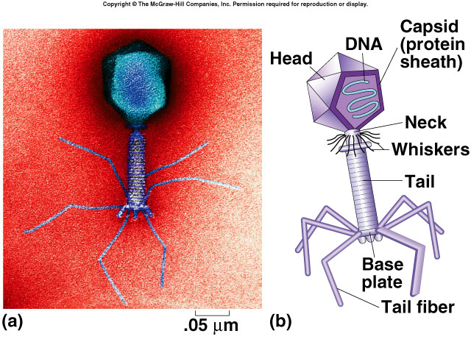
Bacteriophages
Structure
Picture on left is a real SEM image

Slide 4
Bacteriophage infections
Bacteriophages, just like other viruses, must infect a host cell in order to reproduce. The steps that make up the infection process are collectively called the lifecycle of the phage.
Some phages can only reproduce via a lytic lifecycle, in which they burst and kill their host cells. Other phages can alternate between a lytic lifecycle and a lysogenic lifecycle, in which they don't kill the host cell (and are instead copied along with the host DNA each time the cell divides).
Let's take closer look at these two cycles. As an example, we'll use a phage called lambda), which infects E. coli bacteria and can switch between the lytic and lysogenic cycles.

Slide 5
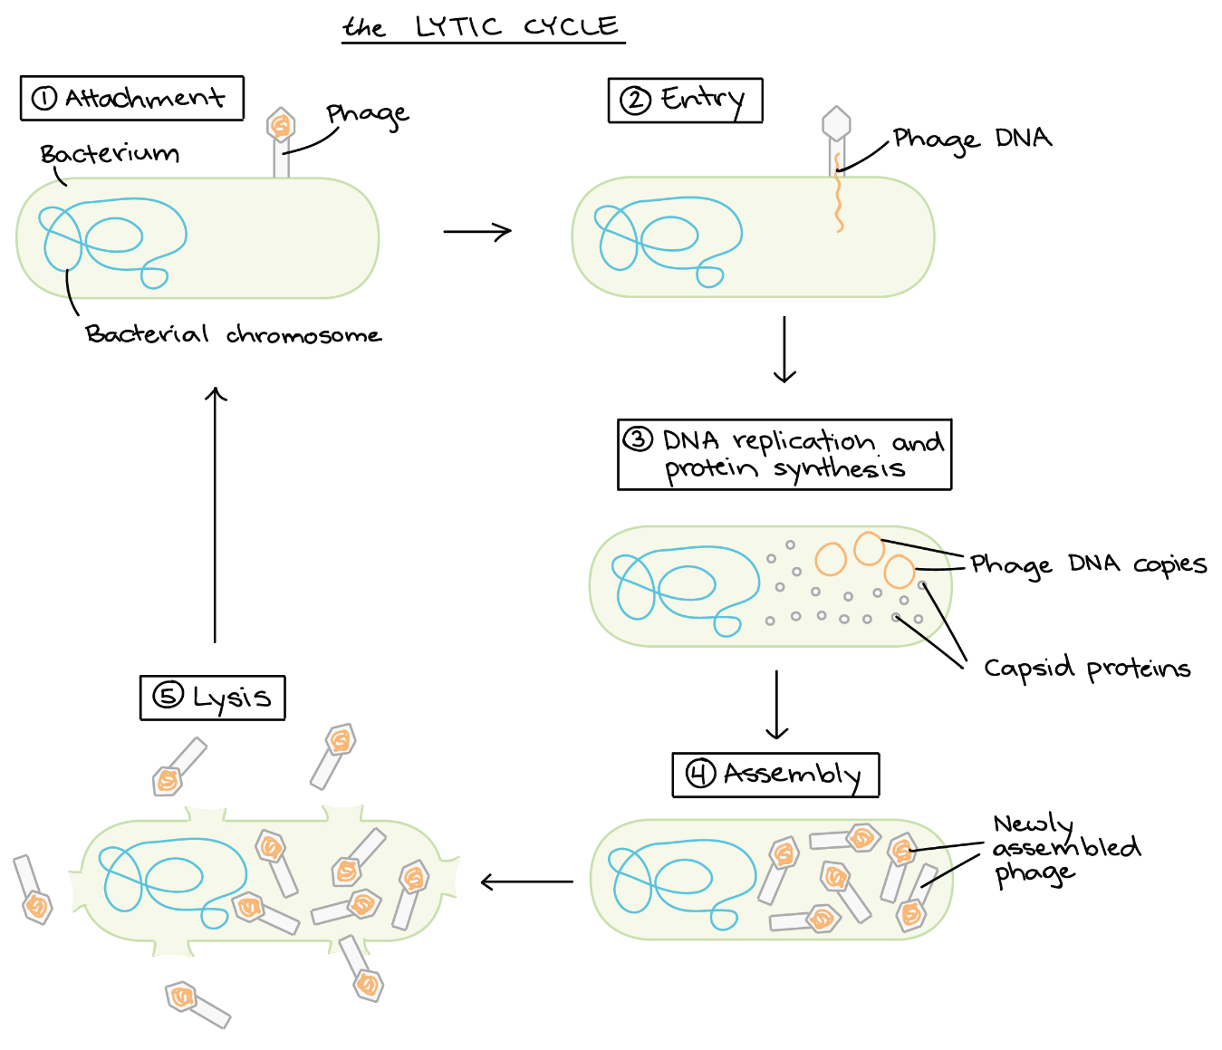
Lytic Cycle
In the lytic cycle, a phage acts like a typical virus: it hijacks its host cell and uses the cell's resources to make lots of new phages, causing the cell to lyse (burst) and die in the process.

Slide 6
Attachment: Proteins in the "tail" of the phage bind to a specific receptor (in this case, a sugar transporter) on the surface of the bacterial cell.
Entry: The phage injects its double-stranded DNA genome into the cytoplasm of the bacterium.
DNA copying and protein synthesis: Phage DNA is copied, and phage genes are expressed to make proteins, such as capsid proteins.
Assembly of new phage: Capsids assemble from the capsid proteins and are stuffed with DNA to make lots of new phage particles.
Lysis: Late in the lytic cycle, the phage expresses genes for proteins that poke holes in the plasma membrane and cell wall. The holes let water flow in, making the cell expand and burst like an overfilled water balloon.
Cell bursting, or lysis, releases hundreds of new phages, which can find and infect other host cells nearby

Slide 7
Lysogenic cycle
Does not immediately kill the cell
integrate their nucleic acid into the genome of the infected host cell (prophage).
prophage - phage genome inserted as part of the linear structure of the DNA chromosome of a bacterium
The integration of a virus into a cellular genome is termed lysogeny.

Slide 8
Lysogenic cycle
The lysogenic cycle allows a phage to reproduce without killing its host. Most phages are either purely lytic (sometimes called virulent phages) or capable of switching between the lytic and lysogenic cycles (sometimes called temperate phages).
However, when it comes to virology, there is an exception to almost every rule, and this is true for phage lifecycles. Filamentous (long, rod-shaped) phages are secreted from the cell in a process that does not lyse or kill the cell (even though the cell is actively producing new phage particles) lifecycle that does not actually involve lysis.
In the lysogenic cycle, the first two steps (attachment and DNA injection) occur just as they do for the lytic cycle. However, once the phage DNA is inside the cell, it is not immediately copied or expressed to make proteins. Instead, it recombines with a particular region of the bacterial chromosome. This causes the phage DNA to be integrated into the chromosome.
Not all phages integrate their DNA into the genome of their host during the lysogenic cycle. Some instead keep their genome in the cell as a separate, circular piece of this is still considered a lysogenic cycle because the phage does not drive production of new virus particles or kill the cell.

Slide 9
Lysogenic cycle
Attachment. Bacteriophage attaches to bacterial cell.
Entry. Bacteriophage injects DNA into bacterial cell.
Integration. Phage DNA recombines with bacterial chromosome and becomes integrated into the chromosome as a prophage.
Cell division. Each time a cell containing a prophage divides, its daughter cells inherit the prophage.

Slide 10
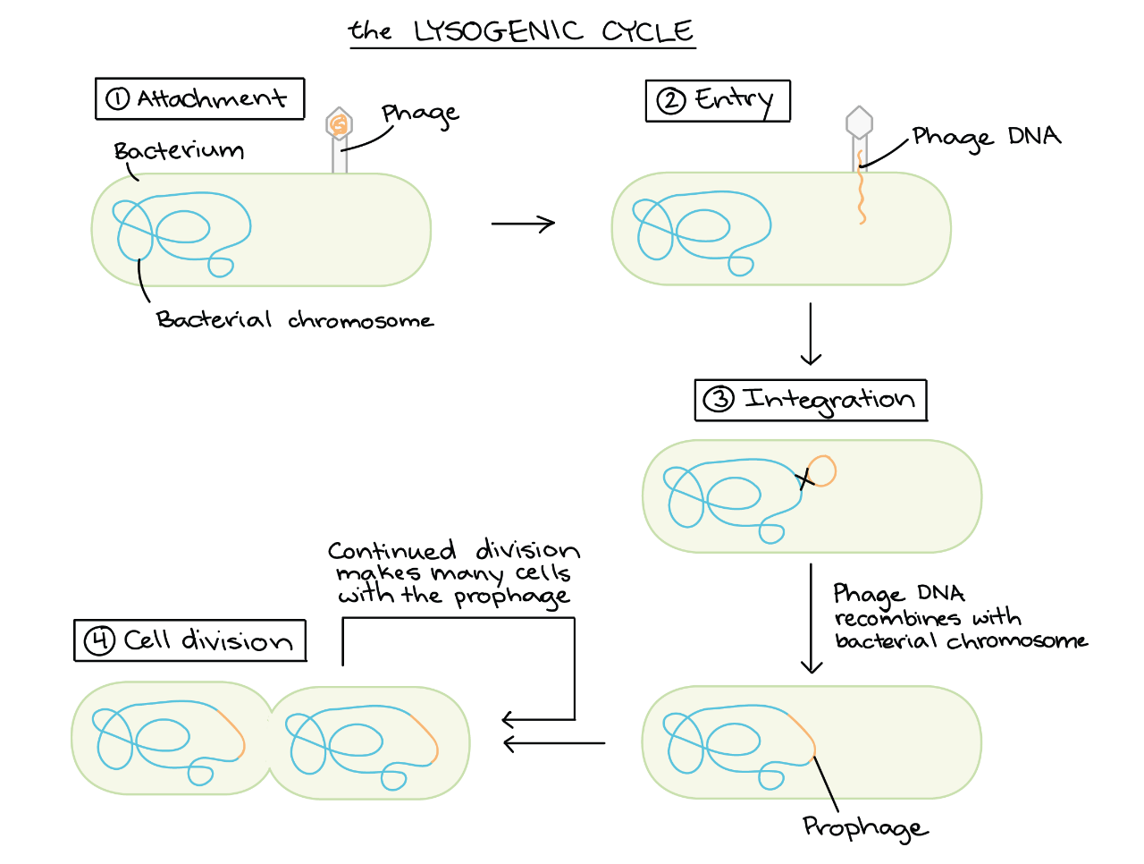
Lysogenic cycle

Slide 11
